Slide 1
Abstraction

Slide 2

Learning Objectives
Definition of Abstraction
Identifying the importance of Abstraction
Levels of Abstraction

Slide 3
What is Abstraction
Abstraction is the process of identifying the most important characteristics of a problem and filtering out the rest of the information.
Abstraction creates a representation of the problem which makes it easier to solve.
It is basically ignoring the minor details to get a look at the bigger picture

Slide 4
Why is Abstraction Important?
Focusing too much on unnecessary details can complicate the process of problem solving.
The motivation behind abstraction is hiding details, to increase focus on important aspects of the problem
When learning how to drive a car, do you need to learn how to accelerate and stop the car or how the internal parts of the car work (like how the coolant flushes into the radiator to maintain car temperature)?

Slide 5
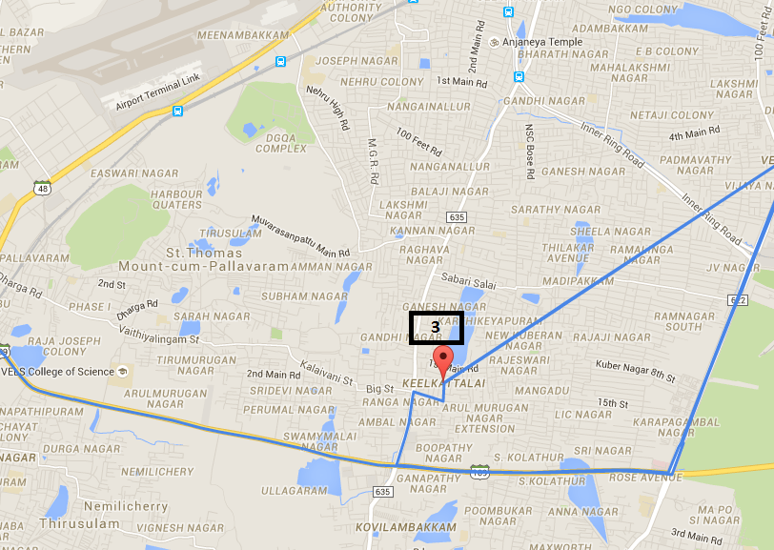
Abstraction Example
An example of abstraction we use in everyday life is maps.
Maps show a simplified version of the world by leaving out unnecessary details (like where every individual tree or bench in a park is).
They only keep the most relevant information that the map reader will need to navigate, such as roads and street names.
Another example is electronic devices and remote or video game controllers.
They hide the complex control mechanism underneath and only show the buttons to work with.
This Photo by Unknown author is licensed under CC BY-SA.

Slide 6

Abstractions in Computer Science
We use the concept of abstraction frequently in computer science such as in programming and software system development.
An example of abstraction in programming is the application of objects and classes that hide complexities and only get input and generate the result.
In software development, an example of abstraction could be web services that can be accessed by APIs without showing the internal process and complexities.
This Photo by Unknown author is licensed under CC BY.

Slide 7

Levels of Abstraction
We use abstraction to develop a new sematic level of the problem that can precisely be understood.
The correct level of abstraction is important to ensure critical information is not filtered out.
The problems should not be vague in the interest of abstraction.

Slide 8

Abstraction Levels' Example
Suppose you want to provide information about where you live to different people:
If you were asked on a government form you would give your exact street address — or else!
If you met someone at school, you might answer: I live in Marietta.
If you were visiting another state? you would say, I live in Georgia.
But what if you were visiting another country? Most likely you would say, I live in the United States.

Slide 9
Abstraction Levels' Example (Cont'd)
Those are all very different answers! Which one is the real answer? All of them of course.
You were using levels of abstraction unconsciously. You responded at the level of detail that would be more helpful and descriptive to the person you were speaking to.
In other words, you were choosing the level of abstraction that best supported the purpose of the conversation.
https://medium.com/@danieljyoo/levels-of-abstraction-a-key-concept-in-systems-design-7fdb33d288af ​

Slide 10

Additional Resources on Abstraction
https://youtu.be/_OVWjMkGsNY
https://youtu.be/jV-7Hy-PF2Q
https://youtu.be/QNCkD_VdJTQ

