Slide 1
CSE1300
Operating Systems
Notes:
Introduce yourself and welcome the students

Slide 2
What is an Operating System (OS)?
An OS is the core software that manages all hardware and software resources in a computer.
It provides a user interface (text-based or graphical) to interact with the computer.
Acts as a bridge between applications and the computer hardware.
Without an OS, using a computer would be very complicated.
OS controls how applications share the CPU, memory, disk, and other hardware components.

Slide 3
USER
APPLICATION
OPERATING SYSTEM
HARDWARE

Slide 4
Functions of an Operating System
Resource Management
CPU Management: Decides when and how long each process can use the CPU.
Memory Management (RAM): Allocates space for programs to run; handles swapping data in and out of memory.
Storage Management (Disk): Organizes files, directories, and controls data access.
Network Management: Handles data transfer between devices over the network.
Security & Permissions: Manages user accounts, password protection, and file access rules.

Slide 5
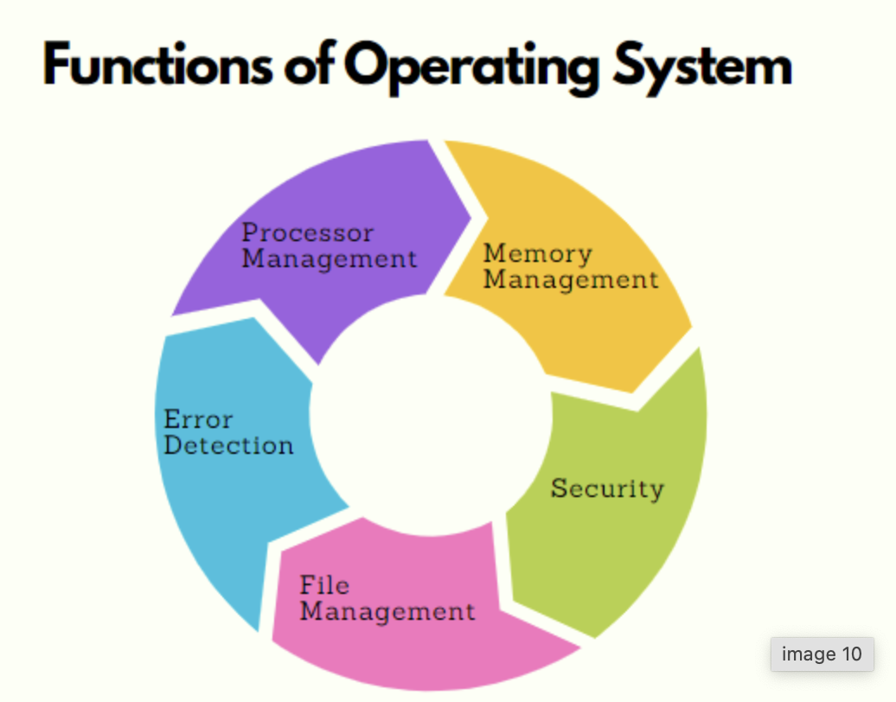
Functions of an Operating System
Allows multiple programs to run effectively without interfering with each other.
For example, your web browser (Chrome, Firefox, Safari, Edge) and PowerPoint (showing this presentation)

Slide 6
Desktop Operating Systems
Microsoft Windows:
- User-friendly, widespread, supports extensive range of software.
- Often pre-installed on many PCs.
Apple macOS:
- Known for sleek design, stability, strong integration with Apple hardware.
- Comes exclusively with Apple devices.
Linux:
- Open-source, free to download and modify.
- Highly flexible and used in servers, personal desktops, embedded systems.
Chrome
- Simple, just uses a web browser to access everything online.

Slide 7
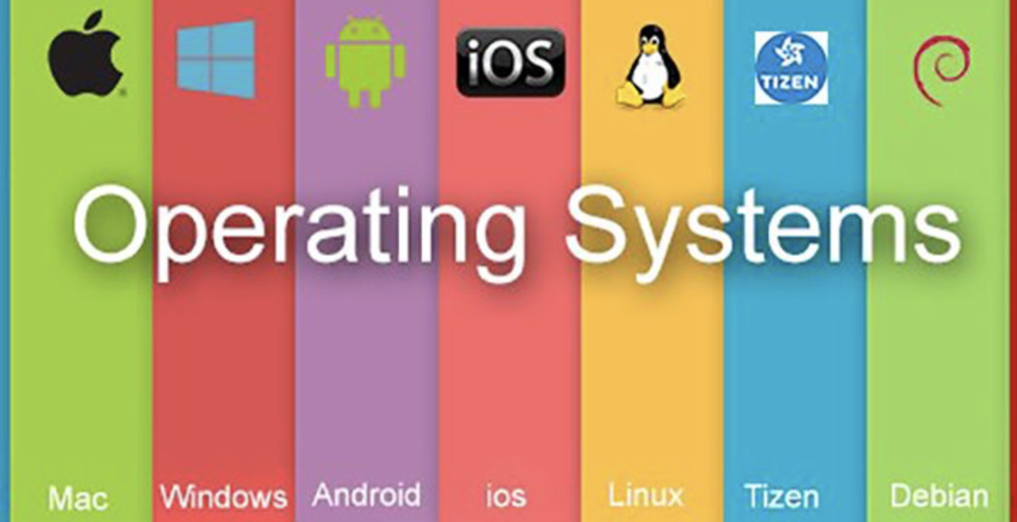
Diverse Operating Systems
The variety in appearance, software compatibility, and user experience for each OS.
Note that while Windows and macOS are proprietary, Linux is community-driven and open-source.

Slide 8
Microsoft Windows OS
Easiest for beginners due to extensive user-friendly features.
Large ecosystem of software (Microsoft Office, gaming, etc.).
Frequent updates (feature updates, security patches).
Common in both home and business environments.
Windows has been around since the mid-1980s and still remains popular.
System updates are very important for security.

Slide 9
Apple macOS
Built exclusively for Apple hardware (MacBook, iMac, Mac Mini).
Known for its robust performance with creative software (graphics, video editing).
Tight integration with Apple services (iCloud, iMessage, etc.).
Stable, consistent interface, but limited to Apple devices.
MacOS is Unix-based at its core, which aids stability and security.
Apple’s controlled hardware environment typically results in fewer driver or compatibility issues.

Slide 10
Linux
Open-Source: Free to use, modify, and distribute.
Distributions (“Distros”): Examples include Ubuntu, Fedora, Debian, and many others. Each distro has its own look and feel but shares the same Linux kernel.
Customization: Highly flexible; can tailor the OS to specific needs.
Community Support: Large online communities offer free help, tutorials, and troubleshooting guides.
Linux’s important role in servers, cloud computing, smartphones (Android is Linux-based), and more.
Modern Linux distros (like Ubuntu) are user-friendly and come with intuitive installers.

Slide 11
How to Install Ubuntu Linux
The next slide has the instructions to install Ubuntu Linux into your computer, you do not have to do it your computer or any of the lab computers. That is just for your understanding on how an OS is installed.
  Please note, if you do this you’ll lose everything on your computer!
  So don’t do it on a machine you use every day.
You can watch any youtube video instead to understand how Ubuntu Linux is installed.

Slide 12
How to Install Ubuntu Linux
Choose Your Distro: Download the ISO file from the Ubuntu website (or another distro site).
Create a Bootable USB: Use tools like Rufus (Windows) or balenaEtcher (macOS/Windows) to copy the ISO to a USB drive.
Boot from USB: Restart your computer and access BIOS/UEFI (often by pressing F2, F10, or DEL). Select the USB drive as the primary boot device.
Installation Process: Select Language, Keyboard Layout
Choose “Install Ubuntu”
Configure disk partitioning (automatic or manual)
Set up username, password, and computer name
Reboot & Enjoy: After installation, remove the USB and reboot into your new Linux system.

Slide 13
Summary
Purpose of an OS: Manages resources, provides an interface, and ensures security.
Examples: Windows, macOS, iOS, Android and Linux
Linux Installation: Straightforward with a bootable USB and guided installer.
Experiment Safely: If you want to try Linux, do so on a spare computer or in a virtual machine (e.g., VirtualBox, VMware).
Stay Updated: Regularly install updates to keep your OS secure and stable.

