Slide 1
Module 2 - Part 2
Data Types and Expressions

Slide 2
Topics
Expressions
Operator precedence
Shorthand operators
Data/Type Conversion

Slide 3
Expressions
An expression is a combination of one or more operators and operands
It has both a data type and a value that results from the expression evaluation
Operands may be:
literals
constants
variables

Slide 4
Arithmetic Operators
Four operators you know, and one new one!
+ addition
- subtraction
* multiplication
/ division
% modulus (say what?)

Slide 5
Integer Division & Modulus
When dividing two integer values:
the quotient is an integer
the remainder is truncated (discarded)
To get the remainder, use the modulus operator with the same operands
25 / 3 = 8 vs. 25 % 3 = 1 (integer division)
3 / 25 = 0 vs. 3 % 25 = 3 (integer division)
25.0 / 5 = 5.0 vs. 10 / 3 = 3.33 (floating point division)

Slide 6
Operator Precedence
Right-to-left operations
- unary plus and unary minus (example, +1 or -1)
- assignment
Left-to-right operations
- multiplication, division and modulus
- addition and subtraction (example 3 + 3)
- string concatenation (“Hello, ” + “world!”)

Slide 7
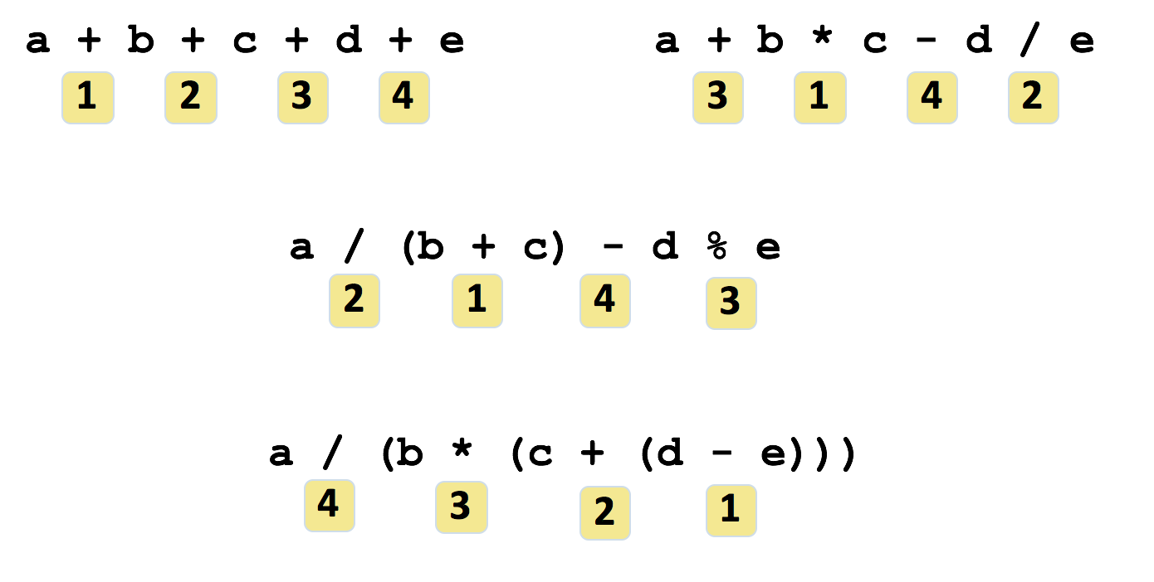
Operator Precedence

Slide 8
Assignment Revisited
Variable = expression;
1) the expression on the right side of the = operator is evaluated Expression has data type and value
2) the result is stored in the variable on the left if the types are compatible (overwriting the original value)
Note: some of you will lose points for putting the expression on the left and variable on the right

Slide 9
Assignment Example
answer = sum / 4 + MAX * lowest;
The result is stored in the variable on the left hand side of the assignment operator.

Slide 10
Shortcut Operators
++ increment by 1
-- decrement by 1
Example:
count++; // count = count + 1
count--; // count = count - 1

Slide 11
Pre vs. Post increment
Post-increment: increment occurs after assignments occur
int x = 7;
int y = x++;
// Prints X is 8 and Y is 7
PRINT ("X is "+x+" and Y is "+y);
Pre-increment: increment occurs before anything else
int x = 7;
int y = ++x;
// Prints X is 8 and Y is 8
PRINT ("X is "+x+" and Y is "+y);

Slide 12
More Shortcut Operators
Operator | Example | Equivalent
+= | a += 3; | a = a + 3;
-= | a -= 10; | a = a - 10;
*= | a *= 4; | a = a * 4;
/= | a /= 7; | a = a / 7;
%= | a %= 10; | a = a % 10;

Slide 13
Assignment Operators
The entire right-hand expression is evaluated first, then the result is combined with the original variable
Therefore:
result /= (total-MIN) % num;
is equivalent to
result = result / ((total-MIN) % num);

Slide 14
Common Error Trap
No spaces allowed between the arithmetic operator and equals sign
Note that the correct sequence is +=, not =+
Example: add 2 to a
a = +2; // PROBABLY WRONG! assigns +2 to a
a += 2; // Probably CORRECT
a = a + 2; // Same as a+= 2

Slide 15
Assigning the Values of Other Variables
Syntax:
dataType variable2 = variable1;
Rules:
variable1 needs to be defined before this statement appears in the source code
the precision of variable1 must be lower than or equal to that of variable2.
called “implicit type cast” when this happens

Slide 16
Two Types of Data Conversion
Widening conversion (promotion)
safe, do not lose data
goes to a “wider” (more bits) data type
may lose precision (long to float)
Narrowing conversion (demotion)
may lose data
may lose precision
should be avoided
compiler error unless specific cast done

Slide 17
Conversion Techniques
Assignment conversion
Example: assign an int to a long
Promotion
Example: divide an int by a double
Casting
Example: assign a double to int

Slide 18
Explicit Type Casting
Syntax:
(dataType)(expression)
Note: parentheses around the expression are optional if the expression consists of 1 variable
Useful for calculating averages:
double result = (double) 25/3;
double result = (double) total / count;

Slide 19
Summary
An expression is a combination of one or more operators and operands.
Expression evaluation follow operator precedent rule (order of operations).
Type conversion can be either widening conversion (promotion) or narrowing conversion (demotion).

