Slide 1
Module 3
Selection Statements

Slide 2
Reminder
We will use generic PRINT and READ statements
PRINT() and PRINTLINE() mean
System.out.print() and System.out.println() for Java
Console.Write() and Console.WriteLine() for C#
cout with and without the endl
READ() means
Scanner s = new Scanner (System.in); s.nextInt() for Java
Console.Read() for C#
cin or getline() for C++

Slide 3
Motivation
In the programs we have written thus far, statements are executed one after the other, in the order in which they appear.
Programs often need more than one path of execution, however. Many algorithms require a program to execute some statements only under certain circumstances. This can be accomplished with decision structures.

Slide 4
Topics
Flow of Control
Boolean definition & Conditional Statements
Relational Operators
Logical Operators
Operator Precedence
if statements
if-else statements
if-else-if statements
switch statements

Slide 5
1. Flow of Control
The order of statement execution is called the flow of control
By default, execution is linear: one statement after another
However, we can:
decide whether or not to execute a particular statement
execute a statement over and over, repetitively
These selection (decision) statements are based on boolean expressions (or conditions) that evaluate to true or false

Slide 6
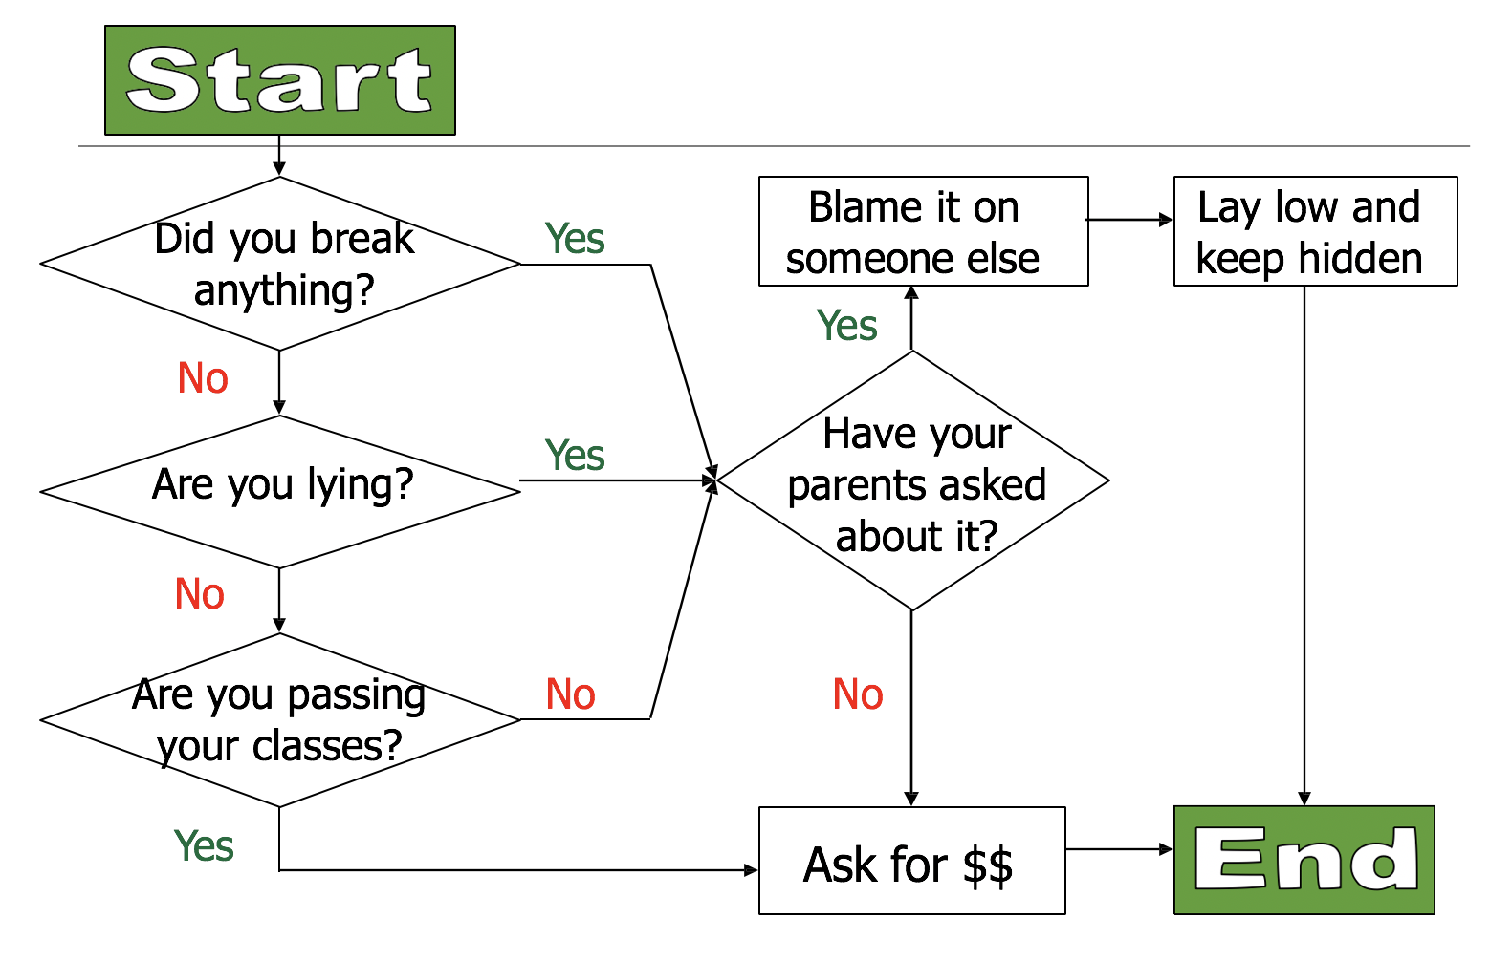
A Flow Diagram

Slide 7
2. The Boolean
A Boolean resolves to either true or false
You can get Boolean values several different ways
Simple
Complex
These Booleans will be used (later) to make decisions

Slide 8
2. Selection Statements
A Selection (conditional) statement allows us to choose which statements will be executed next:
if – block of code executes if a Boolean expression is true.
if-else – will execute one block of code if the Boolean expression is true, or another if it is false.
if-else-if – tests a series of Boolean expressions and execute corresponding block when it finds one that is true.
switch – lets the value of a variable determine where the program will branch to.

Slide 9
3. Relational Operators
Create a true or false using a relational operator:
> greater than
< less than
== equals
.equals( ) method for strings
!= not equal
>= greater than or equal
<= less than or equal
Note the difference between the equality operator (==) and the assignment operator (=)

Slide 10
Relational Operators Example
Literal Example:
5 > 3 // true
6 != 6 // false
true == (4 <=2) // false
‘c’ != ‘b’ // true
Variable Example:
Num1 = 5
Num2 = 7
Result = Num2 > Num1 // Result is true

Slide 11
Relational Operators Example
String equality – must use methods
string myString = "red";
string yourString = "blue";
Java: myString.equals(yourString) // false
C#: myString.Equals(yourString) // false
// 0 if true, otherwise -1 or +1
// depending on which string is lower/higher
C++: myString.compare(yourString)

Slide 12
4. Logical Operators
Boolean expressions can also use the following logical operators:
Logical NOT
Logical AND
Logical OR
They all take Boolean operands and produce Boolean results
Logical NOT is a unary operator (it operates on one operand)
Logical AND and OR are binary operators (each operates on two operands)

Slide 13
Logical Operators (NOT)
The logical NOT operation is also called logical negation or logical complement
If some Boolean condition a is true, then NOT a is false; if a is false, then NOT a is true
Logical expressions can be shown using a truth table

Slide 14
Logical Operators (AND and OR)
The logical AND expression
a AND b
is true if both a and b are true, and false otherwise
The logical OR expression
a OR b
is true if either a or b is true, or both are true, and false otherwise

Slide 15
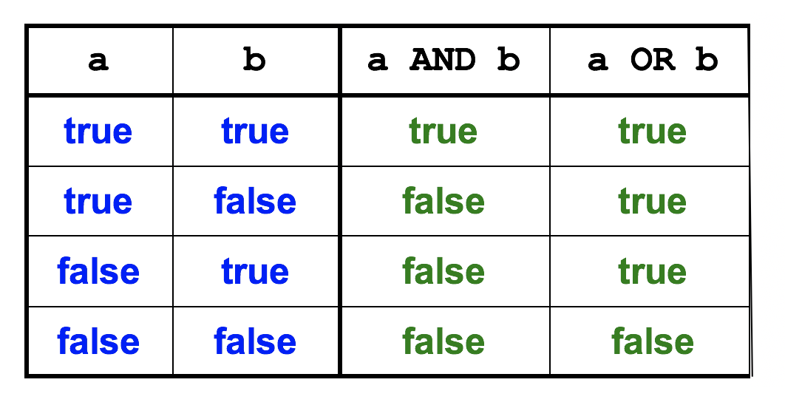
Logical Operators

Slide 16
Logical Operators in Boolean Expressions
Expressions can form complex conditions
IF ((total < (MAX + 5)) AND (NOT found)) THEN
PRINT ("Processing…")
ENDIF
Mathematical operators have higher precedence than the Relational and Logical operators
Relational operators have higher precedence than Logical operators

Slide 17
Boolean Expressions
Specific expressions can be evaluated using truth tables
Given X = ((total < (MAX + 5)) AND (NOT found))
What is the values of X ?

Slide 18
5. Order of Precedence of Arithmetic, Comparison, and Logical Operators
Source: http://www.bouraspage.com/repository/algorithmic-thinking/what-is-the-order-of-precedence-of-arithmetic-comparison-and-logical-operators

Slide 19
Operator Precedence
Applying operator precedence and associativity rule to the expression:
3 + 4 * 4 > 5 * (4 + 3) - 1
Inside parentheses first
Multiplications
Addition
Subtraction
Greater than
The expression resolves to FALSE

Slide 20
Notes on Indentation
In Java, C# and C++
Makes no difference, but crucial for readability and debugging.
Code inside the IF statement is indented and should also be enclosed in curly braces { }.

Slide 21
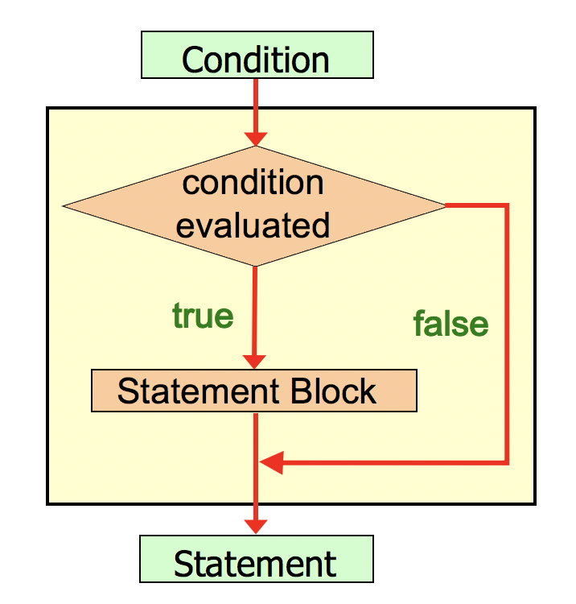
6. Logic of an IF Statement

Slide 22
Now Let’s Do Something!
Using the IF statement, we can decide whether or not to execute some code
Has format:
IF (condition) THEN
// all the code that’s here will only execute
// IF and only IF the condition above is true
ENDIF

Slide 23
Problem Statement
Write a program to convert user input of Celsius temperature to Fahrenheit. Display the converted temperature to the user. Issue a heat warning IF temperature is at least 90 degrees Fahrenheit.
Fahrenheit = 9.0 / 5.0 * Celsius + 32

Slide 24
Pseudocode - IF Statement
BEGIN MAIN
CREATE Fahrenheit = 0, Celsius = 0
PRINT “Enter Celsius temperature: ”
READ user input
Celsius = user input
Fahrenheit = 9.0 / 5.0 * Celsius + 32
PRINT Fahrenheit IF (Fahrenheit >= 90) THEN PRINT “heat warning”
ENDIF
END MAIN
Ps

Slide 25
Example - if Statement
double celsius= 0.0, fahrenheit = 0.0;
PRINT (“What is the Celsius temperature? ");
celsius = READ();
fahrenheit = 9.0 / 5.0 * celsius + 32;
PRINT (“The temperature is " + fahrenheit +
“ degrees Fahrenheit”); if (fahrenheit >= 90) {
PRINT(“It is really hot out there!”);
}

Slide 26
Pseudocode – Logical Operators - OR
BEGIN MAIN CREATE Fahrenheit = 0, Celsius = 0
PRINT (“What is the Celsius temperature? ");
Celsius = READ();
Fahrenheit = 9.0 / 5.0 * Celsius + 32;
PRINT Fahrenheit
IF ((Fahrenheit >= 90) OR (Fahrenheit <= 20)) THEN PRINT “Extreme weather warning!”
END IF END MAIN
Ps

Slide 27
Example – Logical Operators - OR
double fahrenheit = 0.0, celsius = 0.0;
PRINT(“What is the Celsius temperature? ");
celsius = READ();
Fahrenheit = 9.0 / 5.0 * celsius + 32;
PRINTLINE(“The temperature is " + fahrenheit +
“ degrees Fahrenheit”);
if ((fahrenheit >= 90) || (fahrenheit <= 20))
{
PRINTLINE(“Extreme weather warning!”);
}

Slide 28
Expressions that don’t work (in most languages)
BEGIN MAIN CREATE Fahrenheit = 0, Celsius = 0
PRINT (“What is the Celsius temperature? ");
Celsius = READ();
Fahrenheit = 9.0 / 5.0 * Celsius + 32;
PRINT Fahrenheit
// THIS LINE BELOW IF (20 <= Fahrenheit <= 90) THEN //BAD! PRINT “It’s a pleasant day”
END IF END MAIN
// Needs to be broken into two parts
Ps

Slide 29
Pseudocode – Logical Operators - NOT
BEGIN MAIN CREATE Fahrenheit = 0, Celsius = 0
PRINT (“What is the Celsius temperature? ");
Celsius = READ();
Fahrenheit = 9.0 / 5.0 * Celsius + 32;
PRINT Fahrenheit
IF ( NOT (Fahrenheit >= 90) ) THEN PRINT “It’s not hot!”
END IF END MAIN
Ps

Slide 30
Example – Logical Operators - NOT
double fahrenheit = 0.0, celsius = 0.0;
PRINT(“What is the Celsius temperature? ");
celsius = READ();
Fahrenheit = 9.0 / 5.0 * celsius + 32;
PRINT (“The temperature is " + fahrenheit +
“ degrees Fahrenheit”);
if ( !(fahrenheit >= 90) )
{
PRINTLINE(“It’s not hot out there!”);
}

Slide 31
7. Structure of an IF-ELSE Statement
IF has a counterpart – the ELSE statement
Has format:
IF (condition) THEN
statementBlock that executes if condition is true
ELSE
statementBlock that executes if condition is false
ENDIF
IF the condition is true, statementBlock1 is executed; IF the condition is false, statementBlock2 is executed
Notice there is no condition after the ELSE statement.
One or the other will be executed, but not both

Slide 32
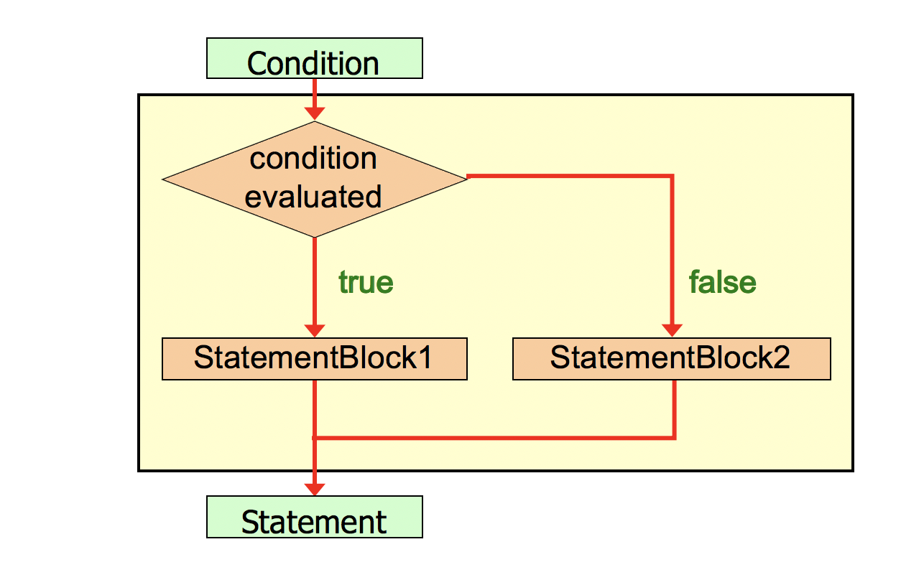
7. Logic of an IF-ELSE statement

Slide 33
Problem Redefined
Original Problem Statement: Write a program to convert user input of Celsius temperature to Fahrenheit. Display the converted temperature to the user. Issue a heat warning IF temperature is at least 90 degrees Fahrenheit. Add: IF the temperature is not that high, output a message to the user.

Slide 34
Pseudocode – IF-ELSE Statement
BEGIN MAIN
CREATE Fahrenheit = 0, Celsius = 0
PRINT “Enter Celsius temperature: ”
READ user input
Celsius = user input
Fahrenheit = 9.0 / 5.0 * Celsius + 32
PRINT Fahrenheit IF (Fahrenheit >= 90) THEN PRINT “heat warning”
ELSE
PRINT “there is no extreme heat”
ENDIF
END MAIN
Ps

Slide 35
Example – if-else (Code Snippet)
double celsius = 0.0, fahrenheit = 0.0;
PRINT("What is the Celsius temperature? ");
celsius = READ();
fahrenheit = 9.0 / 5.0 * celsius + 32;
PRINT("The temperature is " + fahrenheit + " degrees Fahrenheit");
if (fahrenheit >= 90)
{
PRINT("It is really hot out there, be careful!");
}
else {
PRINT(“There is no extreme heat today.”);
}

Slide 36
Pseudocode – Logical Operators - AND
BEGIN MAIN CREATE Fahrenheit = 0
PRINT “Enter Fahrenheit temperature: ”
Fahrenheit = READ
PRINT Fahrenheit
IF ((Fahrenheit >= 50) AND (Fahrenheit <= 80)) THEN
PRINT “It’s a pretty good day!”
ELSE PRINT “It may be better to stay inside.”
END IF END MAIN
Ps

Slide 37
Example – Logical Operators - AND
double fahrenheit = 0.0;
PRINT ("What is the Fahrenheit temperature?”);
READ (fahrenheit);
if ((fahrenheit >= 50) && (fahrenheit <= 80)) {
PRINTLINE ("It’s a pretty good day!");
}
else{
PRINTLINE ("It may be better to stay inside.");
}

Slide 38
8. Structure of an IF-ELSE-IF
Selecting one from many
As soon as one is true, the rest are not considered
Has format:
IF (condition) THEN
//statementBlock that executes if the above boolean is true
ELSE IF (condition) THEN
//statementBlock that executes if the above boolean is true
ELSE IF (condition) THEN
//statementBlock that executes if the above boolean is true
ELSE
//statementBlock that executes if the nothing matched above
ENDIF
Note: only one set of statements will ever execute. Trailing else is optional

Slide 39
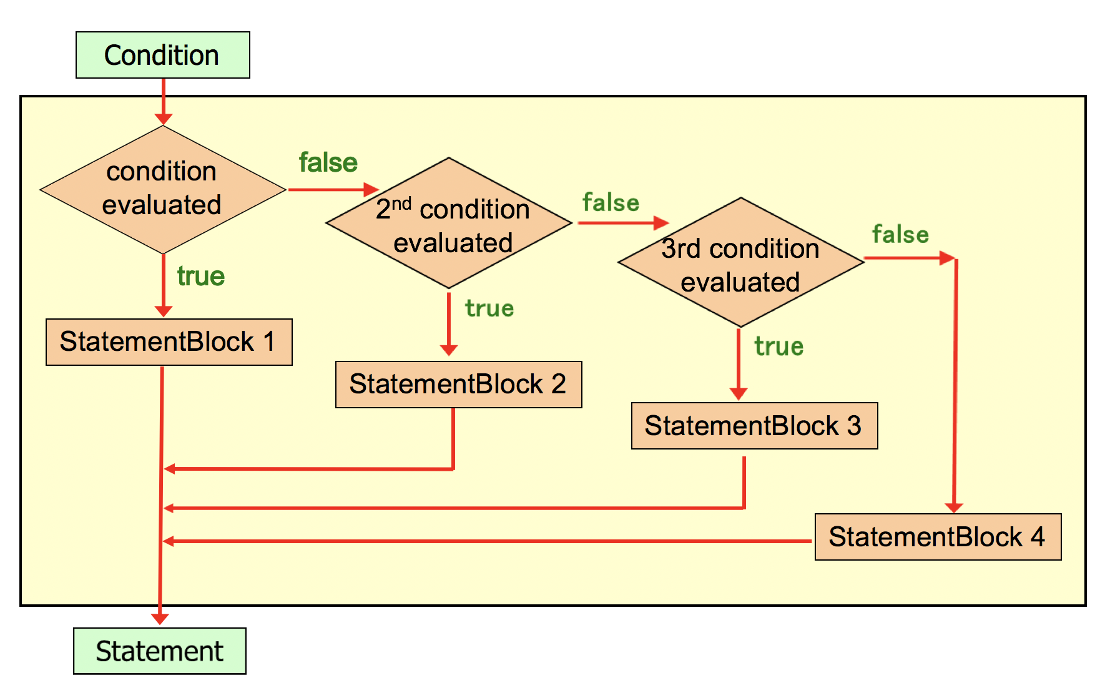
8. Logic of an IF-ELSE-IF

Slide 40
Problem Redefined
Original Problem Statement: Write a program to convert user input of Celsius temperature to Fahrenheit. Display the converted temperature to the user. Issue a heat warning if temperature is at least 90 degrees Fahrenheit. Add: two additional messages to recommend an action based on temperature (in the 70’s or in the 80’s), and a trailing else.

Slide 41
Pseudocode – IF-ELSE-IF
BEGIN MAIN CREATE Fahrenheit = 0, Celsius = 0
PRINT “Enter Celsius temperature: ”
READ user input
Celsius = user input
Fahrenheit = 9.0 / 5.0 * Celsius + 32
PRINT Fahrenheit IF (Fahrenheit >= 90) THEN PRINT “heat warning”
ELSE IF (Fahrenheit >= 80) THEN
PRINT “it is warm, but there is no extreme heat”
ELSE IF (Fahrenheit >= 70) THEN
PRINT “the temperature is pleasant and suggest a picnic”
ELSE PRINT “a suggestion to take a jacket”
END IF END MAIN
Ps

Slide 42
Pseudocode – IF-ELSE-IF – BAD VERSION
BEGIN MAIN CREATE Fahrenheit = 0, Celsius = 0
PRINT “Enter Celsius temperature: ”
READ user input
Celsius = user input
Fahrenheit = 9.0 / 5.0 * Celsius + 32
PRINT Fahrenheit IF (Fahrenheit >= 70) THEN
PRINT “the temperature is pleasant and suggest a picnic”
ELSE IF (Fahrenheit >= 80) THEN
PRINT “it is warm, but there is no extreme heat”
ELSE IF (Fahrenheit >= 90) THEN PRINT “heat warning”
ELSE PRINT “a suggestion to take a jacket”
END IF END MAIN
Ps
Why is this bad?

Slide 43
Example – if-else-if
double celsius = 0.0, fahrenheit = 0.0;
PRINT("What is the Celsius temperature? ");
celsius = READ();
fahrenheit = 9.0 / 5.0 * celsius + 32;
PRINT("The temperature is " + fahrenheit +
"degrees Fahrenheit");
if (fahrenheit >= 90) {
PRINT(“It is really hot!”);
}
else if (fahrenheit >= 80) {
PRINT(“It is very warm!”);
}
else if (fahrenheit >= 70) {
PRINT(“It is very pleasant!”)
}
else {
PRINT(“It is cool today”);
}

Slide 44
9. The switch Statement
The switch statement provides another way to decide which statement to execute next
The switch statement uses a variable and attempts to match the value to one of several possible cases (cases)
Each case contains a value and a list of statements
The flow of control transfers to statement associated with the first case value that matches

Slide 45
9. Structure of a switch
The general syntax of a switch statement is:
SWITCH (variable)
BEGIN
CASE 1:
statementBlock
break // SUPER IMPORTANT BREAKS!
CASE 2:
statementBlock
break // If we don’t include breaks, it goes to next condition
CASE 3:
statementBlock
break
CASE ...
DEFAULT: statementBlock
ENDSWITCH

Slide 46
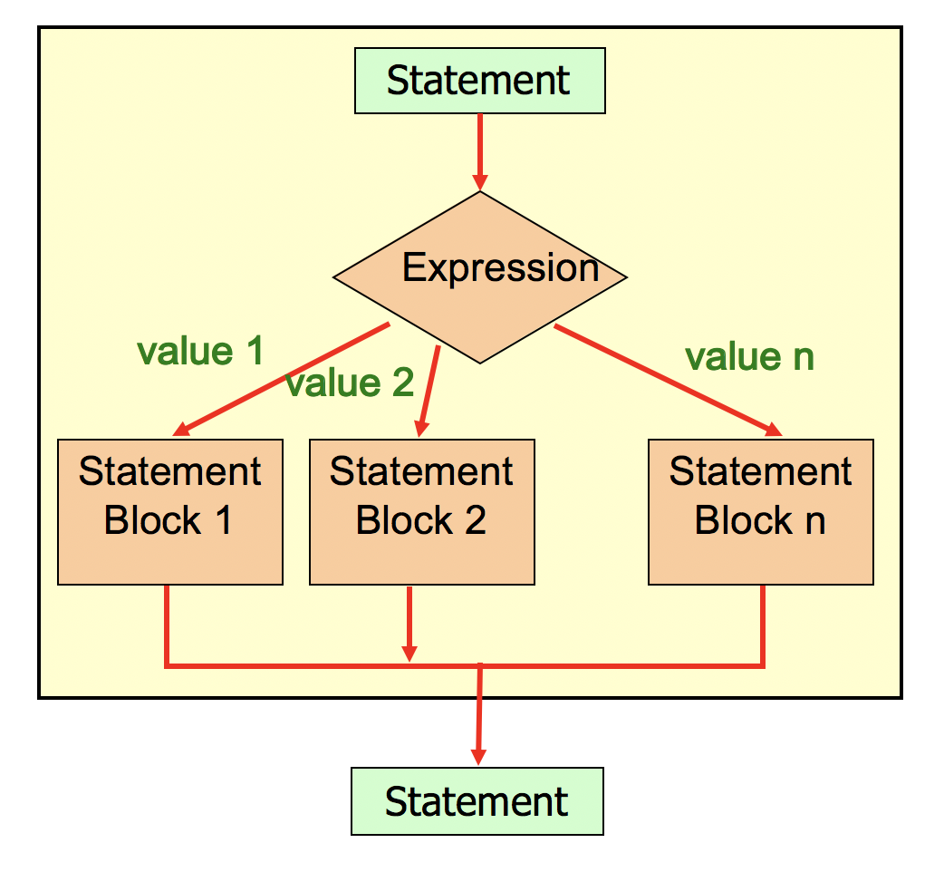
7. Logic of switch statement

Slide 47
break Statement
Often a break statement is used as the last statement in each case's statement list
break statements are required in C#
A break statement causes control to transfer to the end of the switch statement
If a break statement is not used, the flow of control will continue into the next case
Sometimes this may be appropriate, but often not…

Slide 48
Default Case
A switch statement can have an optional default case
The default case has no associated value and simply uses the reserved word default
If the default case is present, control will transfer to the default case if no other case value matches
If there is no default case, and no other value matches, control falls through to the statement after the switch statement

Slide 49
Switch Statement Expression
The variable of a switch statement must be an integer type (byte, short, int, long) or a char type.
It cannot be a boolean value or a floating point value (float or double)
You cannot perform relational checks with a switch statement
In Java and C#, you can also switch on a string

Slide 50
Problem Redefined
Original Problem Statement: Write a program to convert user input of Celsius temperature to Fahrenheit. Display the converted temperature to the user. Add: Using the Fahrenheit temperature and division, determine the conditions outside (i.e., in the 100’s, 90’s, etc.). Use a switch statement to recommend user action based on the result. If it is in the 60’s or below, suggest the user take a jacket.

Slide 51
Pseudocode – switch Statement
// Read user input like before
conditions = compute using Fahrenheit variable / 10
PRINTLINE("It is in the " + conditions + "0's.")
SWITCH (conditions) CASE 10: PRINT “stay inside”, BREAK CASE 9 : PRINT “be careful due to heat”, BREAK CASE 8 : PRINT “it is hot, but not extreme”, BREAK CASE 7 : PRINT “pack a picnic”, BREAK DEFAULT: PRINT “take a jacket”, BREAK
ENDCASE
Ps

Slide 52
switch Example
int conditions = (int)fahrenheit / 10;
PRINTLINE("It is in the " + conditions + "0's.");
switch (conditions)
{
case 10:
PRINT("It’s hot! Stay inside!");
break;
case 9:
PRINT("It is really hot out there!");
break;
case 8:
PRINT("It is warm, but no extreme heat!");
break;
case 7:
PRINT("It is very pleasant today!");
break;
default:
PRINT("Take a jacket!");
break;
}

Slide 53
Summary
Boolean values can be generated several ways
Use the if statement to decide which path to take
Use the else to take the alternate path
The if-else-if statements allow for selecting one from many
Use the switch statement to allow a variable to determine program path

