Slide 1
CSE 1321 Modules 1-6 Review
Notes:
Introduce yourself and welcome the students

Slide 2
Module 1 Algorithms and Abstraction
Algorithms are:
A set of logical steps to accomplish a specific task
A set of direction/instructions
Abstraction is:
LOGICAL GROUPING of concepts or objects
Hide the details (in functions or methods)
We like to think at a high level of abstraction (no details)
Too many details overwhelm us!

Slide 3
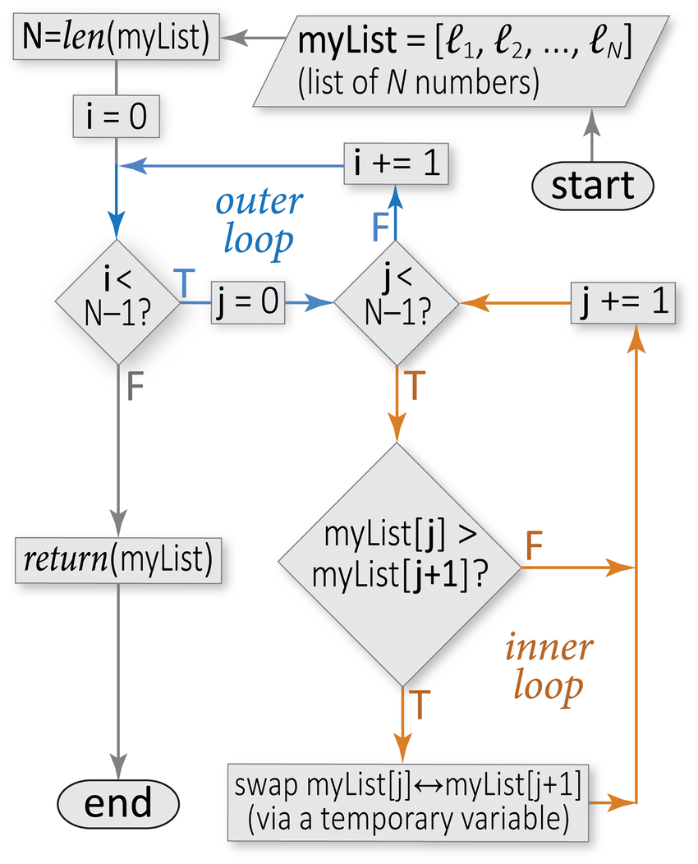
Algorithm in a Flowchart for Sorting
Sample flowchart for a sorting algorithm. This flowchart illustrates the conditional constructs, loops, and other elements of control flow that comprise an algorithm for sorting, from smallest to largest, an arbitrary list of numbers (the algorithm is known as “bubble sort”). In this type of diagram, arrows symbolize the flow of logic (control flow), rounded rectangles mark the start and end points, slanted parallelograms indicate I/O (e.g., a user-provided list), rectangles indicate specific subroutines or procedures (blocks of statements), and diamonds denote conditional constructs (branch points). Note that this sorting algorithm involves a pair of nested loops over the list size (blue and orange), meaning that the calculation cost will go as the square of the input size (here, an N-element list); this cost can be halved by adjusting the inner loop conditional to be “”, as the largest i elements will have already reached their final positions
Image and Text from https://www.researchgate.net/figure/Sample-flowchart-for-a-sorting-algorithm-This-flowchart-illustrates-the-conditional_fig7_303337342

Slide 4
Pseudocode Skeleton
Ps
BEGIN MAIN
END MAIN
Note: every time you BEGIN something, you must END it!
Write them as pairs!

Slide 5
C# Skeleton
using System;
class MainClass
{
public static void Main (string[] args)
{
}
}
Note: The opening “{“ means BEGIN
and the closing “}” means END

Slide 6
Java Skeleton
class MainClass
{
public static void main (String[] args) {
}
}
Note: Capitalization matters!

Slide 7
C++ Skeleton
#include <iostream>
int main ()
{
return 0;
}

Slide 8
Pseudocode Variables & Input
Ps
BEGIN MAIN
CREATE inputNum
PRINT(“Please enter an Integer: “)
inputNum = READ from user input
END MAIN

Slide 9
C# Variables & Input
using System;
class main
{
public static void Main(String[] args)
{
Console.Write("Please enter an integer: ");
int inputNum = Convert.ToInt16(Console.ReadLine());
}
}

Slide 10
Java Variables & Input
import java.util.Scanner;
public class Main
{
public static void main(String[] args)
{
Scanner input = new Scanner(System.in);
System.out.print("Please enter an integer: ");
int inputNum = input.nextInt();
}
}

Slide 11
C++ Variables & Input
#include <iostream>
#include <string>
using namespace std;
int main ()
{
int inputNum = 0;
cout << "Please enter an integer:";
cin >> inputNum;
return 0;
}

Slide 12
Escape Sequences
Printing and escape sequence prints a special character in an output string.
Common escape sequences:
\b backspace. (e.g “B\bsecz\bret” prints what?)
\t tab
\n newline
\r carriage return
\” double quote
\’ single quote
\\ backslash

Slide 13
Data Types
8 simple data types:
4 subsets of integers (int, long, short, byte)
2 subsets of floating point numbers (float and double)
Character
Boolean
Complex Data Types:
String
Classes
Arrays
Objects

Slide 14
CONSTANTS and Literals
CONSTANTS are values that cannot change while the program is running.
E.g.: MAX_WEIGHT = 600
ELEVATOR_LIMIT = 10 * MAX_WEIGHT
Literals are the values that are entered into the code:
E.g. : ELEVATOR_LIMIT = 6000

Slide 15
Order of Precedence
<>: also means not equal to

Slide 16
Shortcut Operators
++ increment by 1 (must be x++ or x ++, not x + +)
-- decrement by 1 (must be y-- or y --, not y - -)
+= Add value on the right of the symbol to the variable on the left and store the result in the variable on the left.
-= Subtract value on the right of the symbol from the variable on the left and store the result in the variable on the left.
*= Multiply the variable on the left by the value on the right of the symbol and store the result in the variable
/= Divide the variable on the left by the value on the right of the symbol and store the result in the variable
%= Divide the variable on the left by the value on the right and store the resulting remainder in the variable.

Slide 17
Relational and Logical Operators
Used to create a true or false expression: Relational:
> greater than
< less than
== equals (note the double equals)
!= not equal (can also be <>)
>= greater than or equal
<= less than or equal
Logical:
Logical NOT (only works on one operand)
Logical AND (requires two operands)
Logical OR (requires two operands)

Slide 18
IF Statements
Ps
Builds on the Pseudocode from Slide 8
BEGIN MAIN
CREATE inputNum
PRINT(“Please enter an Integer: “)
inputNum = READ from user input
IF (inputNum % 2 == 0)
PRINTLINE(“That number is even.”)
END IF
END MAIN

Slide 19
IF-ELSE Statements
Ps
Builds on the Pseudocode from Slide 18
BEGIN MAIN
CREATE inputNum
PRINT(“Please enter an Integer: “)
inputNum = READ from user input
IF (inputNum % 2 == 0)
PRINTLINE(“That number is even.”)
ELSE
PRINTLINE(“That number is odd.”)
END IF
END MAIN

Slide 20
IF-ELSE IF-ELSE Statements
Ps
Builds on the Pseudocode from Slide 19
BEGIN MAIN
CREATE inputNum
PRINT(“Please enter an Integer: “)
inputNum = READ from user input
IF (inputNum == 0)
PRINTLINE(“That number is zero.”)
ELSE IF (inputNum % 2 != 0)
PRINTLINE(“That number is odd.”)
ELSE
PRINTLINE(“That number is even.”)
END IF
END MAIN

Slide 21
SWITCH/CASE Statements
Different approach to the same problem (determining if a number is even or odd)
BEGIN MAIN
CREATE inputNum
PRINT(“Please enter an Integer: “)
inputNum = READ from user input
SWITCH(inputNum % 2)
CASE 0: PRINTLINE(“That number is even.”)
BREAK
CASE 1: PRINTLINE(“That number is odd.”)
BREAK
CASE default: (“You did not enter a number!”)
BREAK
END SWITCH
END MAIN
Ps

Slide 22
In-Class Exercise
Write a IF…ELSE…IF or SWITCH/CASE solution to the problem below:
You have been tasked with writing the code to program an elevator for a skyscraper that is being built in Downtown Atlanta.
Due to a new elevator design, there are no individual floor buttons, passengers simply press buttons to enter their desired floor (like inputting a PIN).
In addition, there is no 13th floor and the top floor is 100.
1 | 2 | 3
4 | 5 | 6
7 | 8 | 9
CLOSE | 0 | OPEN

Slide 23
In-Class Exercise Solution
BEGIN MAIN
CREATE inputFloor
PRINT(“Please enter a floor using keypad: “)
inputFloor = READ from user input
SWITCH(inputFloor)
CASE 1: PRINTLINE(“Moving to 1st floor.”)
BREAK
CASE 2: PRINTLINE(“Moving to 2nd floor.”)
BREAK //skipped floors 3-98 leaving CASE 13 out
CASE 99: PRINTLINE (“Moving to 99th floor.”)
BREAK
CASE 100: PRINTLINE(“Moving to 100th floor.”)
BREAK
DEFAULT: PRINTLINE(“Staying put, that floor does not exist”)
BREAK
END SWITCH
END MAIN

Slide 24
WHILE Loops – Repetition and Sentinel
Ps
Builds on the Pseudocode from Slide 20
BEGIN MAIN
CREATE inputNum = 1
WHILE (inputNum >= 0)
PRINT(“Please enter an Integer: “)
inputNum = READ from user input
IF (inputNum == 0)
PRINTLINE(“That number is zero.”)
ELSE IF (inputNum % 2 != 0)
PRINTLINE(“That number is odd.”)
ELSE
PRINTLINE(“That number is even.”)
END IF
END WHILE
END MAIN

Slide 25
DO…WHILE Loops - Repetition and Sentinel
Ps
Builds on the Pseudocode from Slide 20
BEGIN MAIN
CREATE inputNum = -1
DO
PRINT(“Please enter an Integer: “)
inputNum = READ from user input
IF (inputNum == 0)
PRINTLINE(“That number is zero.”)
ELSE IF (inputNum % 2 != 0)
PRINTLINE(“That number is odd.”)
ELSE
PRINTLINE(“That number is even.”)
END IF
WHILE (inputNum >= 0)
END DO WHILE
END MAIN

Slide 26
FOR Loops - Repetition
Ps
Builds on the Pseudocode from Slide 20
BEGIN MAIN
CREATE inputNum
PRINT(“Please enter an Integer: “)
inputNum = READ from user input
FOR i is 0 to inputNum by 1
BEGIN FOR
IF (i == 0)
PRINTLINE(i + “ is zero.”)
ELSE IF (inputNum % 2 != 0)
PRINTLINE(i + “ is odd.”)
ELSE
PRINTLINE(i + “ is even.”)
END IF
END FOR
END MAIN

Slide 27
In-Class Exercise
Write a WHILE or DO…WHILE solution to the problem below:
You have been asked to update the elevator code to keep track of which floor the elevator is going to by incorporating a display which shows the next floor to be visited (only one floor can be entered at a time), the variable to display the next stop is called NextStop.
Remember, there is no 13th floor and the top floor is 100.
Next Stop:
1 | 2 | 3
4 | 5 | 6
7 | 8 | 9
CLOSE | 0 | OPEN

Slide 28
In-Class Exercise Solution
BEGIN MAIN
CREATE NextStop = 0
DO
PRINT(“Please enter a floor using keypad ‘0 to shut elevator down’: “)
NextStop = READ from user input
SWITCH(NextStop)
CASE 1: PRINTLINE(“Moving to 1st floor.”)
NextStop = 1
BREAK //skipped floors 2-99 (13th is covered by default)
CASE 100: PRINTLINE(“Moving to 100th floor.”)
NextStop = 100
BREAK
DEFAULT : PRINTLINE(“Staying put, that floor does not exist!”)
BREAK
END SWITCH
WHILE (NextStop > 0)
END MAIN

Slide 29
Modules 5 & 6 - 1D Arrays
Complex Data Type that:
Holds several values of the same type
Allows instant access by specifying an index number using brackets [ ] (remember to start at 0)
Is linear
Is static

Slide 30
1D Arrays - Creation
Ps
BEGIN MAIN
CREATE INTEGER Stops[5]
END MAIN

Slide 31
1D Arrays - Iteration
Ps
FOR each i in Stops from 0 to 4 by 1
PRINTLINE(“Next Stop is: “ + Stops[i])
END FOR

Slide 32
1D Arrays – In-class Exercise
You have been asked to help a small movie theater create a program to track the ticket prices for the 100 seats in the theater for an upcoming blockbuster movie.
Declare a 1D array that can hold 100 prices.
Fill the first 20 values with $10
Fill the second 20 values with $20
Fill the third 20 values with $30
Fill the fourth 20 values with $40
Fill the last 20 values with $50

Slide 33
1D Arrays – In-class Exercise
BEGIN MAIN
CREATE INTEGER Seats[100]
FOR s is 0 to (length/size of Seats - 1) by 1
IF (s < 20)
Seats[s] = 10
ELSE IF (s < 40)
Seats[s] = 20
ELSE IF (s < 60)
Seats[s] = 30
ELSE IF (s < 80)
Seats[s] = 40
ELSE
Seats[s] = 50
END FOR
END MAIN

Slide 34
In-class Exercise – Searching 1D
For a special movie premiere event the theater held an auction and stored the bids in their seating array (1D array). They would like you to search through the array and find the highest bid so they know what it was.
Hint: Use a linear search since the data is not sorted.

Slide 35
In-class Exercise – Linear Search
BEGIN MAIN
CREATE maxBid
maxBid = Seats[0]
FOR each b in Seats from 1 to (Seats.length -1) by 1
IF (Seats[b] > maxBid)
maxBid = Seats[b]
END IF
END FOR
PRINTLINE(“Max bid was: “ + maxBid)
END MAIN

Slide 36
Binary Search - Pseudocode
Ps
METHOD BinarySearch (parameters: array G, target)
BEGIN
low = 0, mid = 0, high = the number of elements in G
WHILE (true)
mid = (low + high) / 2
IF (target == G[mid])
RETURN true
ELSE IF (target < G[mid])
high = mid
ELSE
low = mid
ENDIF
ENDIF
IF (mid+1 >= high)
RETURN false
ENDIF
ENDWHILE
END BinarySearch

Slide 37
Bubble Sort - Pseudocode
Ps
FOR each I from 0 to Length of A - 1
FOR each J from I+1 to Length of A – I – 1
IF (A[J] > A[J+1])
temp = A[J]
A[J] = A[J+1]
A[J+1] = temp
END IF
END FOR
END FOR
//Bubble sort compares adjacent elements and moves the larger value to the right.

Slide 38
Selection Sort - Pseudocode
Ps
FOR each I from 0 to n
minPos = I
FOR each J from I + 1 to n
IF (B[j] < B[minPos])
minPos = J
ENDIF
ENDFOR
IF (I != minPos AND minPos < n)
temp = B[minPos]
B[minPos] = B[I]
B[I] = temp
ENDIF
ENDFOR
//Selection sort scans the array to find the smallest element and swaps it with the first element, then continues with the next position and so on. This creates a Sorted sub-array and an Unsorted sub-array, as each element is placed the Sorted sub-array grows, and the Unsorted sub-array shrinks.

Slide 39
Insertion Sort - Pseudocode
Ps
FOR each index from 2 to n
key = A[index]
position = index
// Shift larger values to the right
WHILE (position > 0 AND key < A[position-1])
A[position] = A[position - 1]
position = position -1
ENDWHILE
list [position] = key
ENDFOR
//Insertion sort works by inserting the next value to sort (it starts with the 2nd element) into its place. This creates a Sorted set (left side of array) and an Unsorted set, as each element is placed the Sorted set grows, and the Unsorted set shrinks.

Slide 40
Module 5 - 2D Arrays
Ps
Complex Data Type that:
Holds several values of the same type
Allows instant access by specifying a index number using brackets [][] or [ , ](remember to start at 0)
Is linear
Is static

Slide 41
2D Arrays - Creation
Ps
BEGIN MAIN
CREATE INTEGER Stops[5][5]
END MAIN
//Willy Wonka elevator that can go 8 directions

Slide 42
2D Arrays - Iteration
Ps
Use nested loops to iterate through a 2D array
FOR each r in ROW from 0 to 4 by 1
FOR each c in COLUMNS from 0 to 4 by 1
PRINTLINE(“Next Stop is: “ + Stops[r][c])
END FOR
END FOR

Slide 43
2D Arrays – In-class Exercise
You have been asked to help a small movie theater revise the program to track the ticket prices for the 100 seats in the theater for an upcoming blockbuster movie.
Declare a 2D array that can hold 100 prices.
Fill the rows one and two with $10
Fill rows three and four with $20
Fill rows five and six with $30
Fill row seven and eight with $40
Fill the rows nine and ten with $50

Slide 44
2D Arrays – In-class Exercise
BEGIN MAIN
CREATE INTEGERS Seats[10][10]
FOR R in ROWS from 0 to (length of ROWS - 1) by 1
FOR C in COLS from 0 to (length of COLS - 1) by 1
IF (R == 0 OR 1)
Seats[R][C] = 10
ELSE IF (R == 2 OR 3)
Seats[R][C] = 20
ELSE IF (R == 4 OR 5)
Seats[R][C] = 30
ELSE IF (R == 6 OR 7)
Seats[R][C] = 40
ELSE
Seats[R][C] = 50
END FOR
END FOR
END MAIN

Slide 45
In-class Exercise – Searching 2D
The theater has asked you to write a program that allows a user to select a seat from the seating array (2D array). They would like it to search through the array by price to find the first available seat at that price point.
Hint: Use a linear search since it is a 2D array.

Slide 46
In-class Exercise – Searching 2D
BEGIN METHOD findSeat(CREATE price)
FOR each row in Seats from 0 to 9 by 1
FOR each col in Seats from 0 to 9 by 1
IF (Seats[row][col] == price)
RETURN ”The seat at “ + [row] + “,” + [col] + “is available for $” + price
END IF
END FOR
END FOR
END METHOD

Slide 47
In-class Exercise – Searching 2D
BEGIN MAIN
CREATE price
PRINT (“Please enter price for seat: “)
READ price
PRINTLINE(findSeat(price))
END MAIN

Slide 48
End of Review
Questions?

