Slide 1
CSE 1321
Module 3 – Part 2
Loops and Repetition

Slide 2
Topics
  Motivation
  while Loop Statement
  for Loop Statement
  Infinite Loops
  Nested Loops
  Using break and continue

Slide 3
Motivation
You want to print a string (e.g., "Welcome to CSE 1321!") a thousand times. You could copy/paste the following:
print("Welcome to CSE 1321!")
There has to be a better way! How do we solve this problem?
USING LOOPS

Slide 4
Loop Statements
Loops are repetition statements that allow us to execute a statement (or block of statements) multiple times
They are controlled by Boolean expressions
We will study two types of loop statements:
  the while loop
  the for loop
  We must choose the right type for the situation at hand

Slide 5
Loop Statements
The while loop runs undetermined (unknown) number of iterations
The for loop, on the other hand, runs a pre-determined (known) number of iterations (sometimes called a counting loop)

Slide 6
General criteria for loops
Have some initial condition
    Starting a counter
    Beginning in a certain state
Must have a test to continue
Must make progress towards finishing

Slide 7
while Loop Statement
A while loop (statement) has the following syntax:
while (condition):
statement block //loop body
If the condition is true, the statement block is executed
Then the condition is evaluated again, and executes the statement until the condition becomes false
If the condition is false initially, the statement (loop body) is never executed
Therefore, the body of a while loop will execute zero or more times

Slide 8
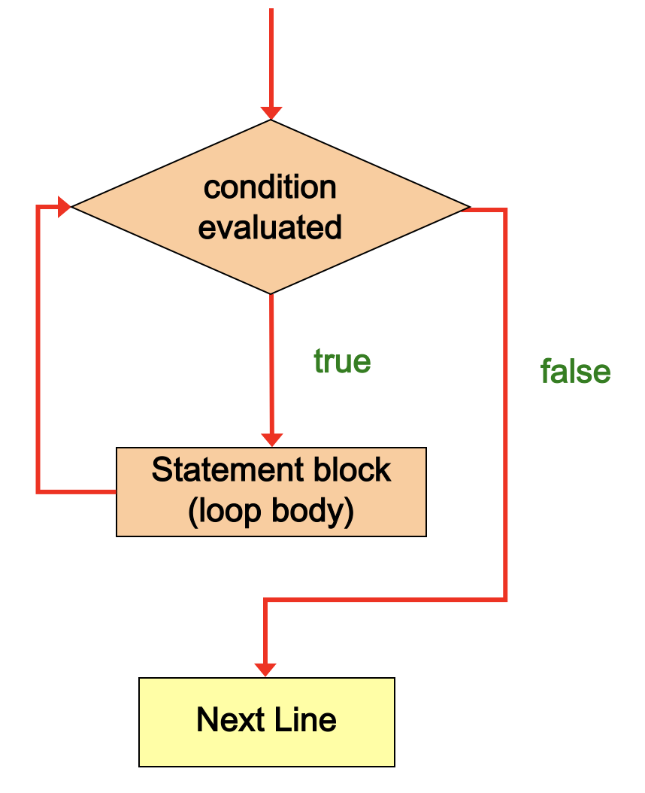
while Loop Logic
Note: If the initial evaluation of the condition is false, the loop body executes zero times. Therefore, the while loop executes zero or more times

Slide 9

Example: Writing 1,000 Sentences
(using a while loop)
  counter = 0
  while counter < 1000:
  print (str(counter) + “ I will not…”)
counter
0

Slide 10
Example: Writing 1,000 Sentences
(using a while loop)
  counter = 0
  while counter < 1000:
  print (str(counter) + “ I will not…”)
counter
0

Slide 11
Example: Writing 1,000 Sentences
(using a while loop)
  counter = 0
  while counter < 1000:
  print (str(counter) + “ I will not…”)
  Output: 0 I will not eat at Taco Bell again
counter
0

Slide 12
Example: Writing 1,000 Sentences
(using a while loop)
  counter = 0
  while counter < 1000:
  print (str(counter) + “ I will not…”)
counter
0

Slide 13
Example: Writing 1,000 Sentences
(using a while loop)
  counter = 0
  while counter < 1000:
  print (str(counter) + “ I will not…”)
counter
0

Slide 14
Example: Writing 1,000 Sentences
(using a while loop)
  counter = 0
  while counter < 1000:
  print (str(counter) + “ I will not…”)
  Output: 0 I will not eat at Taco Bell again
counter
0

Slide 15
Example: Writing 1,000 Sentences
(using a while loop)
  counter = 0
  while counter < 1000:
  print (str(counter) + “ I will not…”)
counter
0

Slide 16
Example: Writing 1,000 Sentences
(using a while loop)
  counter = 0
  while counter < 1000:
  print (str(counter) + “ I will not…”)
counter
0

Slide 17
Example: Writing 1,000 Sentences
(using a while loop)
  counter = 0
  while counter < 1000):
  print (str(counter) + “ I will not…”)
  Output: 0 I will not eat at Taco Bell again
counter
0

Slide 18
Infinite Loops
This loop isn’t making a lot of progress!
Loops that repeat forever are called infinite loops
Apparently “lock up”
Output:
  0 I will not eat at Taco Bell again
  0 I will not eat at Taco Bell again
  0 I will not eat at Taco Bell again
  0 I will not eat at Taco Bell again
  .
  .
  .

Slide 19
Problem Solved
  counter = 0
  while counter < 1000:
  print (str(counter) + “ I will not…”)
  counter += 1
counter
0

Slide 20
Problem Solved
  counter = 0
  while counter < 1000:
  print (str(counter) + “ I will not…”)
  counter += 1
counter
0

Slide 21
Problem Solved
  counter = 0
  while counter < 1000:
  print (str(counter) + “ I will not…”)
  counter += 1
  Output: 0 I will not eat at Taco Bell again
counter
0

Slide 22
Problem Solved
  counter = 0
  while counter < 1000:
  print (str(counter) + “ I will not…”)
  counter += 1
counter
1
  # Remember, counter += 1; is the same as
  # counter = counter + 1

Slide 23
Problem Solved
  counter = 0
  while counter < 1000:
  print (str(counter) + “ I will not…”)
  counter += 1
counter
1

Slide 24
Problem Solved
  counter = 0
  while counter < 1000:
  print (str(counter) + “ I will not…”)
  counter += 1
  Output: 1 I will not eat at Taco Bell again
counter
1

Slide 25
Problem Solved
  counter = 0
  while counter < 1000:
  print (str(counter) + “ I will not…”)
  counter += 1
counter
2

Slide 26
Problem Solved
  counter = 0
  while counter < 1000:
  print (str(counter) + “ I will not…”)
  counter += 1
counter
2

Slide 27
Problem Solved
  counter = 0
  while counter < 1000:
  print (str(counter) + “ I will not…”)
  counter += 1
  Output: 2 I will not eat at Taco Bell again
counter
2

Slide 28
Problem Solved
  counter = 0
  while counter < 1000:
  print (str(counter) + “ I will not…”)
  counter += 1
counter
3

Slide 29
How does it end?
  counter = 0
  while counter < 1000:
  print (str(counter) + “ I will not…”)
  counter += 1
counter
999

Slide 30
Problem Solved
  counter = 0
  while counter < 1000:
  print (str(counter) + “ I will not…”)
  counter += 1
  Output: 999 I will not eat at Taco Bell again
counter
999

Slide 31
Problem Solved
  counter = 0
  while counter < 1000:
  print (str(counter) + “ I will not…”)
  counter += 1
counter
1000

Slide 32
Problem Solved
  counter = 0
  while counter < 1000:
  print (str(counter) + “ I will not…”)
  counter += 1
  # So we never print out
  # 1000 I will not eat at Taco Bell again
counter
1000

Slide 33
How does it end?
  counter = 0
  while counter <= 1000:
  print (str(counter) + “ I will not…”)
  counter += 1
now True
counter
1000

Slide 34
Sentinel Values
Question: How can the user control a while loop?
A sentinel value is a special input value that represents the end of inputs from the user
The sentinel value should be included in the prompt so that the user knows how to stop the loop. For example,
PRINTLINE(“Enter a grade (type 9999 to quit):”)
A sentinel value gives the user control over the loop

Slide 35
Input Validation
A while loop can be used for input validation, making a program more robust
Ensure correct input values before processing
Can issue error messages for invalid data

Slide 36
In-class Problem: Input Validation
Problem Statement: Write a program in which you allow your user to guess a secret number between 1 and 10. For this example, set your secret number to a literal for easy testing. When you are done, think about how you can modify the program to allow the user to continue to guess until they get it right. Also, think about how you could use conditionals to give them valuable feedback to reach the answer!

Slide 37
Input Validation Example
if __name__ == “__main__”:
secretNum = 5
userGuess = int(input("Enter a number between 1 and 10: "))
while 1 < userGuess < 10:
userGuess = input("Not between 1 and 10. Try again!")
if userGuess == secretNum:
print(str(userGuess) + " is the secret number!")
else:
print(str(userGuess) + " isn't the secret number!")

Slide 38
for Loop
  In Python, for loops iterate through items in a sequence
  Common sequences include lists (more on those later), strings, or a range of numbers

Slide 39
for Loop syntax
  for element in iterable:
  pass # code
  e.g.:
  name = “Alice”
  for letter in name:
  print(letter + “-”, end=“”)
  #A-l-i-c-e-

Slide 40
for Loop in action
  name = “Alice”
  for letter in name:
  print(letter + “-” , end=“”)
Memory
name = “Alice”
Output:

Slide 41
for Loop in action
  name = “Alice”
  for letter in name:
  print(letter + “-” , end=“”)
Memory
name = “Alice”
letter = “A”
Output:

Slide 42
for Loop in action
  name = “Alice”
  for letter in name:
  print(letter + “-” , end=“”)
Memory
name = “Alice”
letter = “A”
Output:
A-

Slide 43
for Loop in action
  name = “Alice”
  for letter in name:
  print(letter + “-” , end=“”)
Memory
name = “Alice”
letter = “l”
Output:
A-

Slide 44
for Loop in action
  name = “Alice”
  for letter in name:
  print(letter + “-” , end=“”)
Memory
name = “Alice”
letter = “l”
Output:
A-l-

Slide 45
for Loop in action
  name = “Alice”
  for letter in name:
  print(letter + “-” , end=“”)
Memory
name = “Alice”
letter = “i”
Output:
A-l-

Slide 46
for Loop in action
  name = “Alice”
  for letter in name:
  print(letter + “-” , end=“”)
Memory
name = “Alice”
letter = “i”
Output:
A-l-i-

Slide 47
for Loop in action
  name = “Alice”
  for letter in name:
  print(letter + “-” , end=“”)
Memory
name = “Alice”
letter = “c”
Output:
A-l-i-

Slide 48
for Loop in action
  name = “Alice”
  for letter in name:
  print(letter + “-” , end=“”)
Memory
name = “Alice”
letter = “c”
Output:
A-l-i-c-

Slide 49
for Loop in action
  name = “Alice”
  for letter in name:
  print(letter + “-” , end=“”)
Memory
name = “Alice”
letter = “e”
Output:
A-l-i-c-

Slide 50
for Loop in action
  name = “Alice”
  for letter in name:
  print(letter + “-” , end=“”)
Memory
name = “Alice”
letter = “e”
Output:
A-l-i-c-e-

Slide 51
for Loop in action
  name = “Alice”
  for letter in name:
  print(letter + “-” , end=“”)
Memory
name = “Alice”
Output:
A-l-i-c-e-

Slide 52
for Loop syntax
  We can also iterate through a range() of numbers
  With a single input, range() iterates from 0 up to (input – 1)
  With 2 inputs, range() iterates from the left number to (right number – 1)
  With 3 inputs, range() iterates from the left number to (middle number – 1) skipping (right number). The right number is usually called the “step”

Slide 53
for Loop syntax
  for num in range(10):
  print(num)
  # prints the following
  # 0
  # 1
  # 2
  # 3
  # 4
  # 5
  # 6
  # 7
  # 8
  # 9

Slide 54
for Loop syntax
  for num in range(5, 10):
  print(num)
  # prints the following
  # 5
  # 6
  # 7
  # 8
  # 9

Slide 55
for Loop syntax
  for num in range(0, 10, 2):
  print(num)
  # with a step of 2, prints the following
  # 0
  # 2
  # 4
  # 6
  # 8

Slide 56
In-class Problem:
Problem Statement: Write a program in which you enable your user to enter a number for which they want to see the multiplication table.

Slide 57
for Loop Example
if __name__ == “__main__”:
choice = int(input("Enter a number to see the table: "))
for multiplier in range(11):
print(str(multiplier) + " * " + str(choice) + " = " + str(multiplier * choice))

Slide 58
5. Infinite Loops
The body of a loop must eventually make the condition false
If not, it is called an infinite loop, which will execute until the user interrupts the program
This is a common logical error – so double check!

Slide 59
Example
An example of an infinite loop:
count = 1
while (count <= 25):
print(count)
count -= 1 #Error
This loop will continue executing until interrupted or until an underflow error occurs

Slide 60
Be Careful!
Always check that the condition can eventually become False so the loop can terminate
Not so much of a problem in iterative loops
Definitively a problem in while loops!

Slide 61
6. Nested Loops
Similar to nested Selection statements, loops can contain other loop statements
For each iteration of the outer loop, the inner loop iterates completely

Slide 62
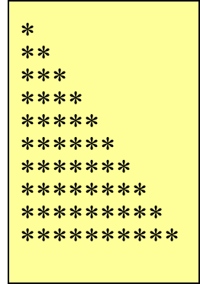
Nested for Loop Example
Problem Statement: Write a program that uses nested FOR loops to print 10 rows of stars, as shown in the picture to the right.

Slide 63
Python – Nested for Loop Example
# key insight: the outer loop is in charge of printing rows
# the inner loop is in charge of printing columns
If __name__ == “__main__”:
for row in range(10):
for column in range(row):
print("*", end="")
print() # once a row is done, we must skip to the next one

Slide 64
Nested Loops Iterations
How many times will the string "I am here" be printed?
if __name__ == “__main__”:
count1 = 1
while count1 <= 10:
count2 = 1
while count2 <= 5:
print("I am here!“, end=“”)
count2 += 1
print()
count1 += 1

Slide 65
7. Using break and continue
We can additionally control the flow of how loops work with keywords break and continue
  break stops the loop
  continue “skips” the current iteration

Slide 66
Example of break
sum = 0
number = 0
while (number < 20):
number = number + 1
sum = sum + number
if (sum >= 100): // stop if sum is over 100
break
print("The number is “ + str(number))
print("The sum is “ + str(sum))

Slide 67
Example of continue
sum = 0
number = 0
while (number < 10) :
number = number + 1
if (number == 5 or number == 6) :
continue; // do not add 5 and 6 to sum
sum = sum + number
print("The number is “ + str(number))
print("The sum is “ + str(sum))

Slide 68
In-class Problem
Write code for a calculator program that enables the user to select an operation (Add, Subtract, Multiply, Divide, or Quit) and then enter a series of numbers where that operation is applied. The program should continue asking for numbers until the user enters a 0, at which point it asks for another operation.

Slide 69
In-class Problem #2
Problem Statement: Write a program that asks the user to input a number. The program should contain a while loop that runs if the user inputs any value other than 0. The loop body should accumulate the sum of all numbers that the user inputs. During each iteration, output the sum of the numbers input so far. When the user inputs a 0, the loop stops. After the loop has stopped, output the total of all numbers input and the average; if the loop never ran, indicate this to the user.

