Slide 1
Module 4 – Part 2
Surfaces

Slide 2
Topics
Surfaces
  What is a surface
  Creating Surfaces
  Blitting
  Updating the Screen

Slide 3
Surfaces – Creating a Surface
Surfaces are objects used to represent images
They have a fixed resolution and pixel format, determined at creation
By default, Surfaces are black
To create a Surface, use the following constructor:
  surf = pygame.Surface((width, height))
Notice the constructor above only takes one parameter: a single tuple with two integers

Slide 4
Surfaces – Creating a Surface
As mentioned, Surfaces are black by default.
Surfaces can have images on them, but we’ll start simple: let’s paint our Surface all red.
surf.fill(color=(255,0,0))
The fill() method above covers the surface in a single color completely
We pick the color by entering its RGB value (Red, Green, Blue)
These values vary from 0 to 255
  Red = 255, 0, 0
  Green = 0, 255, 0
  Blue = 0, 0, 255
  We can get any other color by combining the colors above

Slide 5
Surfaces - Display
Pygame features a special Surface: the Display
If the Display isn’t initialized, we won’t have a window to see inside the game
Only things that are drawn to the Display are shown on screen
The code below initializes the Display with a resolution of 1280x720, and stores its surface to the “screen” variable:
screen = pygame.display.set_mode((1280, 720))

Slide 6

Surfaces - Testing
Let’s put together what we have so far and try to run it:
import pygame
pygame.init()
screen = pygame.display.set_mode((500,500))
surf = pygame.Surface((200, 200))
surf.fill((255,0,0))
running = True
while running:
for event in pygame.event.get():
if event.type == pygame.QUIT:
running = False

Slide 7
Surfaces - Blitting
We saw a black screen, but no sign of our red Surface called “surf”.
This is because we haven’t drawn surf to the Display.
To draw a Surface onto another Surface, we have to use the blit() method.
“Blitting” is an old technical term (Bit Block Transfer)
It essentially means transferring the bits from a source to a destination.
In our case, we are moving the pixels from the source Surface to the destination Surface

Slide 8
Surfaces - Blitting
The general method is as follows:
target_surface.blit(Surface, (x, y))
target_surface: were we want to draw to
Surface: where the information is coming from
(x, y): where on the target should the source be drawn
Since we are trying to draw our red square onto the screen:
  screen.blit(surf, (0,0))

Slide 9
Surfaces – Blit testing
import pygame
pygame.init()
screen = pygame.display.set_mode((500,500))
surf = pygame.Surface((200, 200))
surf.fill((255,0,0))
screen.blit(surf, (0,0))
running = True
while running:
for event in pygame.event.get():
if event.type == pygame.QUIT:
running = False

Slide 10
Surfaces – Updating the screen
Still nothing. Why?
The Display’s Surface has been updated, but the computer hasn’t been told to update what’s on the screen with the updated Surface.
There are two methods to update the screen:
  pygame.display.flip(): updates the whole screen
  pygame.display.update(): updates parts of the screen
  For now, we will primarily be using flip()

Slide 11
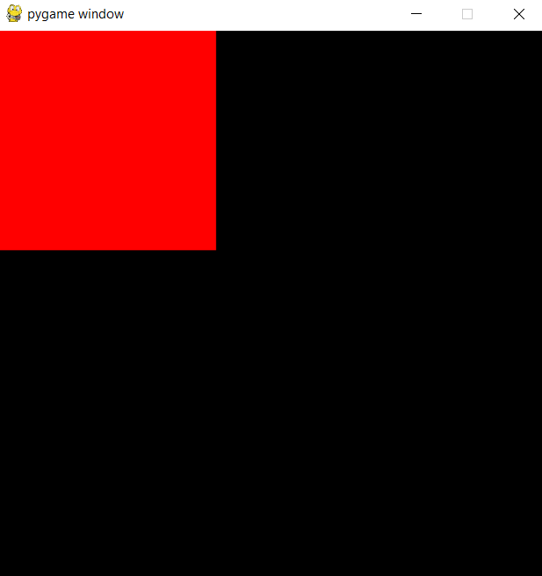
Surfaces – Updating the screen
import pygame
pygame.init()
screen = pygame.display.set_mode((500,500))
surf = pygame.Surface((200, 200))
surf.fill((255,0,0))
screen.blit(surf, (0,0))
pygame.display.flip()
running = True
while running:
for event in pygame.event.get():
if event.type == pygame.QUIT:
running = False

Slide 12
Surfaces – Success!
Our square is finally visible!
We can change where the square is being drawn by changing the coordinates in blit()
Making the first number larger will move the square to the right, while making it smaller will move it to the left
Making the second number larger will move the square down, while making it smaller will make it move up

Slide 13
Surfaces – Graphic Coordinates
Why is the coordinate (0,0) drawing the square at the top left of the screen?
By convention, in computer graphics, our origin is at the top left, with the X-axis growing to the right and the Y-axis growing downwards.
y-axis grows
x-axis grows
Origin (0,0)
Origin (0,0)
y-axis grows
x-axis grows
Computer Graphics
Cartesian Plane

Slide 14
Surfaces – Adding more surfaces
Our program can have as many surfaces as we want
Let’s add a green and a blue one:
surf2 = pygame.Surface((200, 200))
surf2.fill((0,255,0))
surf3 = pygame.Surface((200, 200))
surf3.fill((0,0,255))
screen.blit(surf2, (0,0))
screen.blit(surf3, (0,0))
pygame.display.flip()

Slide 15
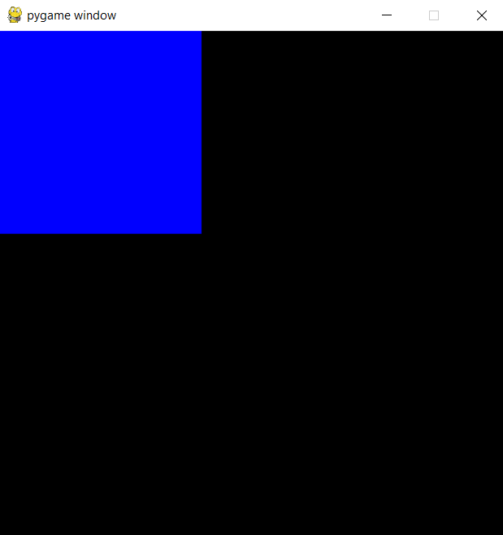
Surfaces – Blit testing
import pygame
pygame.init()
screen = pygame.display.set_mode((500,500))
surf = pygame.Surface((200, 200))
surf.fill((255,0,0))
surf2 = pygame.Surface((200, 200))
surf2.fill((0,255,0))
surf3 = pygame.Surface((200, 200))
surf3.fill((0,0,255))
screen.blit(surf, (0,0))
screen.blit(surf2, (0,0))
screen.blit(surf3, (0,0))
pygame.display.flip()
running = True
while running:
for event in pygame.event.get():
if event.type == pygame.QUIT:
running = False

Slide 16
Surfaces – Adding more surfaces
We only see the blue square, but not the other two squares.
That is because the following happened:
  The computer drew the red square at the top left
  The computer drew the green square at the top left
  The computer drew the blue square at the top left
  The computer updated the screen
  Since the blue square was the last one to be drawn, and all squares are the same size, one got drawn on top of the other!

Slide 17
Surfaces – Adding more surfaces
The order that you blit things matter!
The last thing blitted will be what stays
If we changed the blitting order, we’d get a different colored square
Let’s change the sizes of our squares so we can see them all

Slide 18
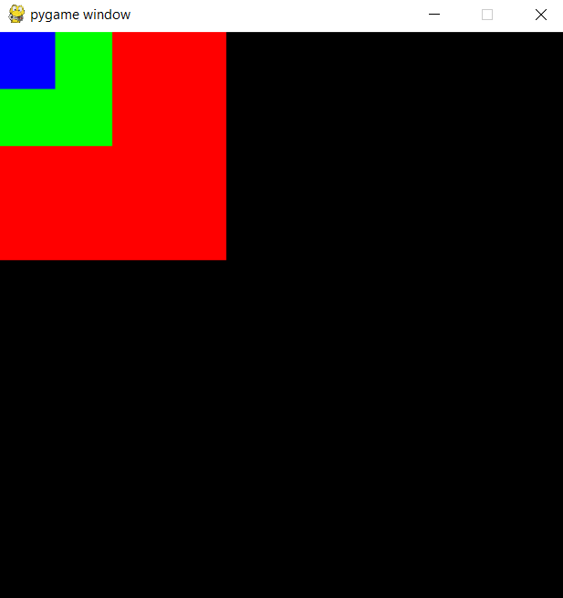
Surfaces – Blit testing
import pygame
pygame.init()
screen = pygame.display.set_mode((500,500))
surf = pygame.Surface((200, 200))
surf.fill((255,0,0))
surf2 = pygame.Surface((100, 100))
surf2.fill((0,255,0))
surf3 = pygame.Surface((50, 50))
surf3.fill((0,0,255))
screen.blit(surf, (0,0))
screen.blit(surf2, (0,0))
screen.blit(surf3, (0,0))
pygame.display.flip()
running = True
while running:
for event in pygame.event.get():
if event.type == pygame.QUIT:
running = False

Slide 19
Surfaces – Adding more surfaces
We can now see all squares
Make no mistake: We can only see all of them because we drew them in the right order.
If we had drawn the red square last, it would have covered all the other squares
Let’s move where we draw the squares, so we can see them fully.

Slide 20
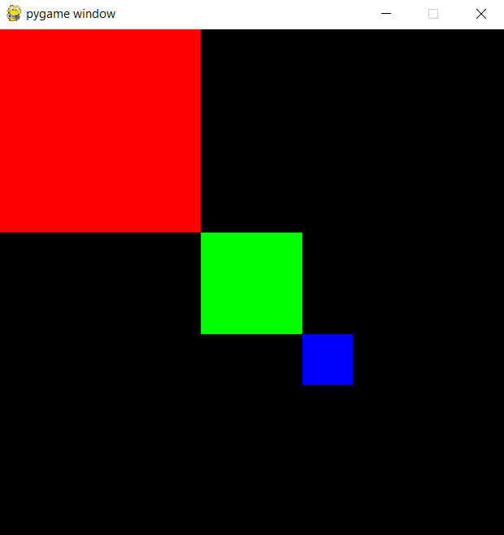
Surfaces – Blit testing
import pygame
pygame.init()
screen = pygame.display.set_mode((500,500))
surf = pygame.Surface((200, 200))
surf.fill((255,0,0))
surf2 = pygame.Surface((100, 100))
surf2.fill((0,255,0))
surf3 = pygame.Surface((50, 50))
surf3.fill((0,0,255))
screen.blit(surf, (0,0))
screen.blit(surf2, (200,200))
screen.blit(surf3, (300,300))
pygame.display.flip()
running = True
while running:
for event in pygame.event.get():
if event.type == pygame.QUIT:
running = False

Slide 21
Surfaces – Adding Surfaces onto other Surfaces
The Display isn’t the only Surface that can be blitted on: Any Surface can be blitted on.
Notice that we are using the coordinates of the target Surface!
Thus, if we write:
surf.blit(surf2, (0,0))
The (0,0) above means “draw surf2 on surf at the coordinates (0,0) of surf”!
It does not mean “draw surf2 on surf at the coordinates (0,0) of the Display”!

Slide 22
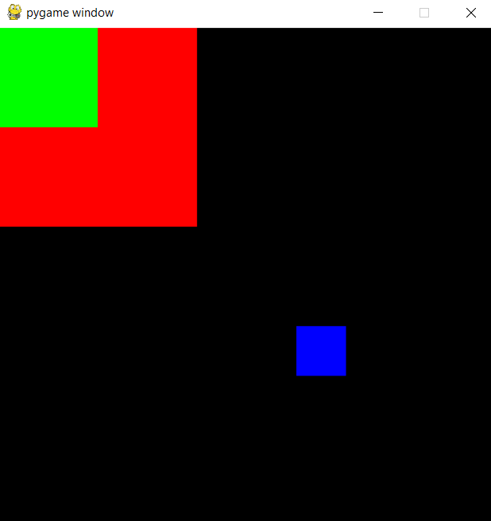
Surfaces – Blit testing
import pygame
pygame.init()
screen = pygame.display.set_mode((500,500))
surf = pygame.Surface((200, 200))
surf.fill((255,0,0))
surf2 = pygame.Surface((100, 100))
surf2.fill((0,255,0))
surf3 = pygame.Surface((50, 50))
surf3.fill((0,0,255))
surf.blit(surf2, (0, 0))
screen.blit(surf, (0,0))
screen.blit(surf3, (300,300))
pygame.display.flip()
running = True
while running:
for event in pygame.event.get():
if event.type == pygame.QUIT:
running = False

Slide 23
Surfaces – Final Remark
Always be mindful of the order you are blitting things!
In the previous slide, if we had blitted the red square onto the Display before we blitted the green square onto the red square, we would have a red square on our screen, but no green square
  The version of the red square we drew to the Display was the one without the green on it
Always blit things from back to front!

Slide 24
Steps to draw to the Display
Initialize the Display and save its Surface
  Only do this once!
Create all the other Surfaces you need
Change the color of these Surfaces
Blit those Surfaces onto the Display’s Surface
  Be mindful of the blitting order!
Flip the Display to updated it

Slide 25
Summary
Surfaces are objects which store image information
To create a Surface, you need its width and height
You can change a Surface’s color
Blitting a Surface onto another draws that Surface on top of the other Surface
The Display is a special Surface
Everything drawn to the Display shows on your screen
The Display must be updated

