Slide 1
Module 4 – Part 4
Collision

Slide 2
Topics
Collision
  What are collisions
  Checking point collision
  Checking Rect collision
  Checking multiple-Rect collision
  Checking line collision

Slide 3
Reminder
Rects are objects used to store spatial information
Specifically, a Rect is a rectangular area
It has x and y coordinates, as well as a width and height
Rects are helpful because all of its fields are automatically updated if we edit one of its fields
To create a Rect, use the following constructor:
  rect = pygame.Rect(x, y, width, height)
Remember: In computer graphics, the origin of anything is at the top left!

Slide 4
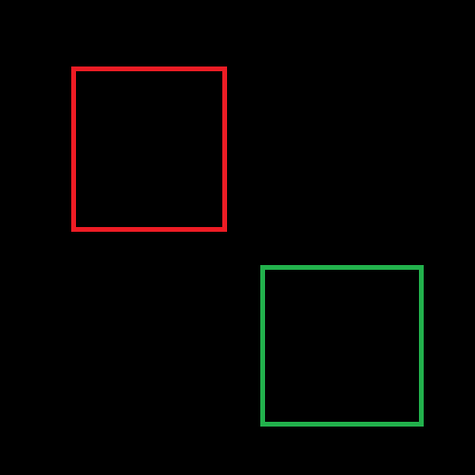
Collisions
Under some circumstances, you may want to check if part of the area of one Rect is inside the area of another Rect
  Check if the area of two Rects intersect
  This is a collision!
collision
Rects are touching
no collision
Rects are not touching

Slide 5
Collision methods
Rects already have baked-in methods to check for collision:
collidepoint(x,y) -> bool
colliderect(Rect) -> bool
collidelist(list) -> index
collidelistall(list) -> list
clipline(x1,y1,x2,y2) -> ((cx1,xy1),(cx2,cy2))

Slide 6
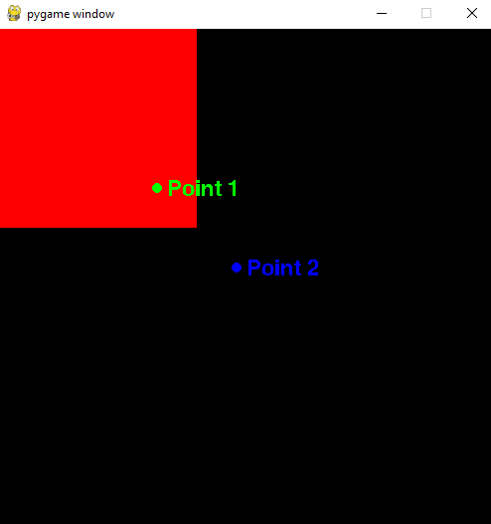
collidepoint()
Takes in two parameters, representing the x and y coordinates of the point
  Can instead take a tuple with the coordinates inside it
Returns True if the point is inside the Rect. False, otherwise.
point1 = (40, 40)
point2 = (60,60)
rect = pygame.Rect(0,0,50,50)
print(rect.collidepoint(point1)) #True
print(rect.collidepoint(point2)) #False

Slide 7
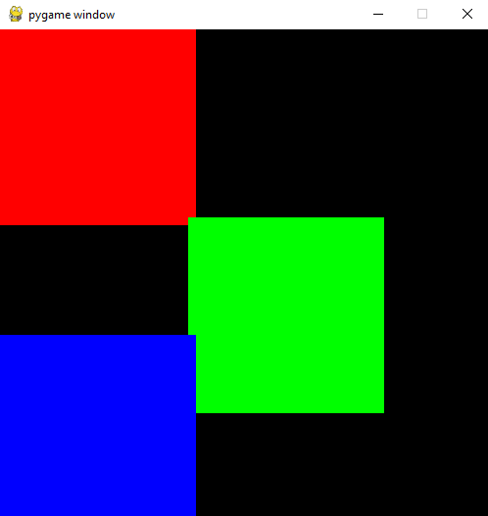
colliderect()
Takes in a Rect as a parameter
Returns True if two Rects intersect. Otherwise, returns False
red = pygame.Rect(0,0,50,50)
green = pygame.Rect(48,48,50,50)
blue = pygame.Rect(0,78,50,50)
print(red.colliderect(green)) #True
print(red.colliderect(blue)) #False
print(green.colliderect(blue)) #True

Slide 8
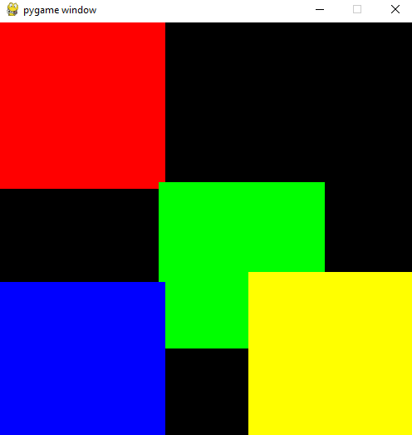
collidelist()
Takes in a list of Rects
Returns the index of the first Rect on the list which collides with the calling Rect
  Returns -1 if there is no collision
red = pygame.Rect(0,0,50,50)
green = pygame.Rect(48,48,50,50)
blue = pygame.Rect(0,78,50,50)
yellow = pygame.Rect(75,75,50,50)
list1 = [green, blue]
list2 = [red, blue]
list3 = [red, green, blue]
print(red.collidelist(list1)) # 0
print(yellow.collidelist(list3)) # 1
print(yellow.collidelist(list2)) # -1

Slide 9
collidelistall()
Takes in a list of Rects
Returns a list containing the indexes of all Rects which collide with the calling Rect
  List will be empty if there’s no collision
red = pygame.Rect(0,0,50,50)
green = pygame.Rect(48,48,50,50)
blue = pygame.Rect(0,78,50,50)
yellow = pygame.Rect(75,75,50,50)
list1 = [green, blue]
list2 = [red, blue]
list3 = [red, green, blue]
list4 = [red, blue, yellow]
print(red.collidelistall(list1) # [0]
print(yellow.collidelistall(list3) # [1]
print(yellow.collidelistall(list2) # []
print(green.collidelistall(list4) # [0,1,2]

Slide 10
clipline()
Takes 4 coordinates
  These coordinates are the x and y coordinates of one end of the line and the x and y coordinates of the other end of the line
  rect.clipline(start_x, start_y, end_x, end_y)
Returns 2 tuples, containing the coordinates of a line that is cropped to be inside the Rect
((cropped_start_x,cropped_start_y), (cropped_end_x,cropped_end_y))
  Return value will be an empty tuple if no cropping exists

Slide 11
clipline() - example code
screen = pg.display.set_mode((500,500))
rect1 = pg.Rect(0,0,200,200)
rect1.center = 250,250
surf1 = pg.Surface(rect1.size)
surf1.fill((255,0,0))
line1 = ((50, 500),(350,0))
line2 = rect1.clipline(line1)
screen.blit(surf1, rect1.topleft)
pg.draw.line(screen, (255,255,255), line1[0], line1[1], width=3)
pg.draw.line(screen, (0,0,255), line2[0], line2[1], width=4)
pg.display.flip()

Slide 12
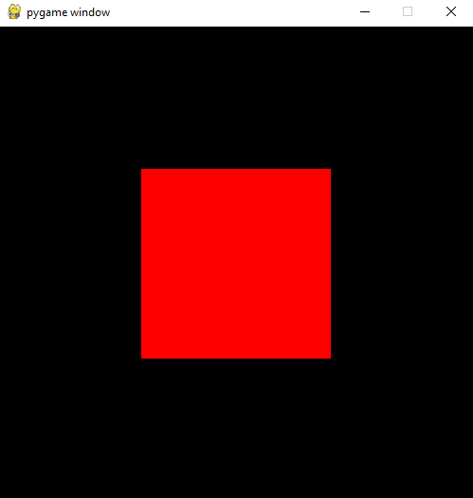
clipline() - explanation
In the previous slide, we created a Surface based on the Display that is 500x500.
We then created a Rect that is 200x200, and set its center to the center of the Display
We’ve blitted a red Surface on the Display
Here’s what we have so far:

Slide 13
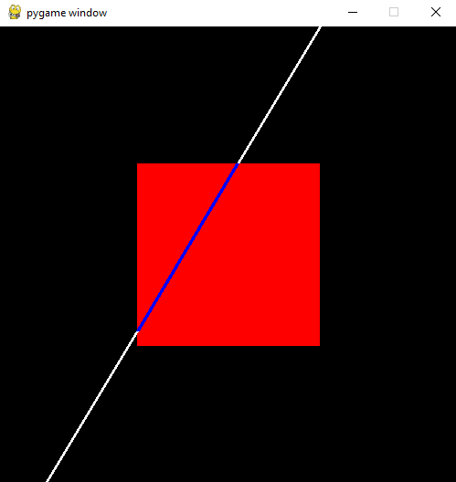
clipline() - explanation
Using the Draw module, we drew a white line from points (50,500) at the bottom left to (350,0) at the center-ish right.
pg.draw.line(screen, (255,255,255), line1[0], line1[1], width=3)
We then used clipline() to create a new line, based on the white line, which would only contain the parts of the white line that are inside the Rect. We then drew that new line, colored blue, to the Display.
line2 = rect1.clipline(line1)# returns ((150, 333), (259, 150))
pg.draw.line(screen, (0,0,255), line2[0], line2[1], width=4)

Slide 14
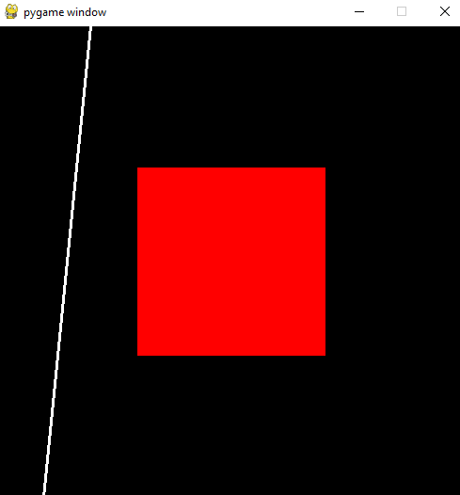
clipline() - explanation
What if the line does not intersect with the Rect?
line1 = ((50, 500),(100,0))
pg.draw.line(screen, (255,255,255), line1[0], line1[1], width=3)
Then the output of clipline() will be an empty tuple
line2 = rect1.clipline(line1)# returns ()
pg.draw.line(screen, (0,0,255), line2[0], line2[1], width=4)

Slide 15
Summary
Rects have several helpful methods to determine collision
collidepoint() to check if a point is inside a Rect
colliderect() to check if two Rects collide
collidelist() to find out the first Rect in a list that collides with a Rect
  Returns -1 if no collision
collidelistall() to find out all the Rects in a list that collide with a Rect
  List will be empty if no collision
clipline() to get a new line that’s completely inside a Rect
  Line will be an empty tuple if there’s no collision

