Slide 1
Module 4 – Part 6
Multimedia

Slide 2
Topics
Draw module
Image module
Transform module
Font module
Mixer module
Music module

Slide 3
Overview
Pygame is capable of more than just drawing rectangles.
You can draw circles, lines, or shapes of any format.
You can use images from your computer
You can play music
You can play several different sounds at the same time

Slide 4
Draw module - Overview
The Draw module contains several useful functions for drawing shapes onto Surfaces
You do not create Draw objects. Instead, you simply use the functions available in the modules.
Different functions have different parameters and draw different things to the target Surface

Slide 5
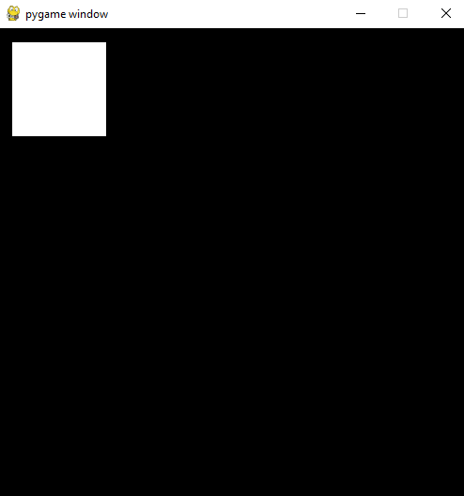
Draw module - rect
Takes in a target Surface, a color, and a Rect
Returns a Rect that includes all of the altered pixels
pygame.draw.rect(target_surface, color, Rect) -> Rect
pg.draw.rect(screen, (255,255,255), pygame.Rect(15, 15, 100, 100))

Slide 6
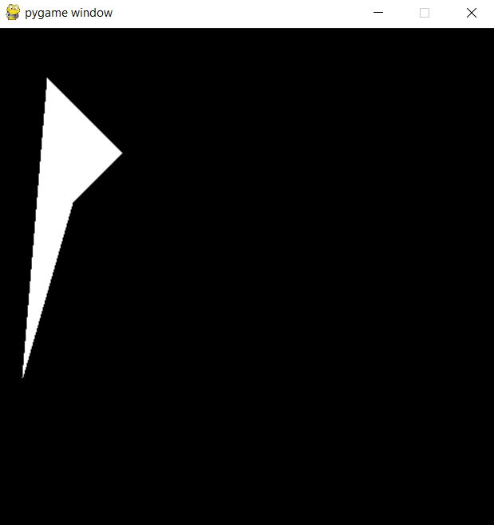
Draw module - polygon
Takes in a target Surface, a color, and a list of points
Returns a Rect that includes all of the polygon
pygame.draw.polygon(target_surface, color, points) -> Rect
pg.draw.polygon(screen, (255,255,255), ((50,50),(125,125),(75,175),(25,350)))

Slide 7
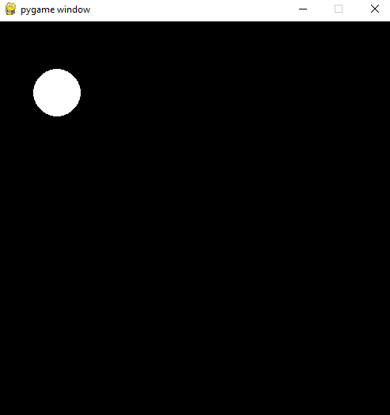
Draw module - Circle
Takes in a target Surface, a color, the coordinates of the center, and the radius
Returns a Rect that includes the Circle
pygame.draw.circle(target_surface, color, center, radius) -> Rect
pg.draw.circle(screen, (255,255,255),(75, 90), 30)

Slide 8
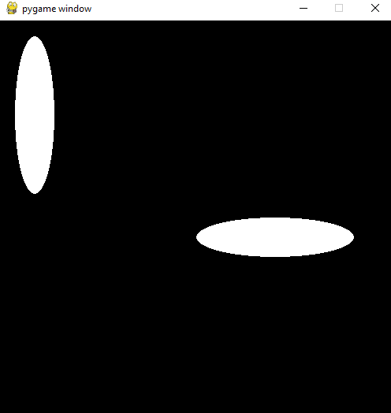
Draw module - Ellipse
Takes in a target Surface, a color, and a Rect
Returns a Rect that includes the Ellipse
pygame.draw.ellipse(target_surface, color, Rect) -> Rect
pg.draw.ellipse(screen, (255,255,255),Rect(20, 20, 50, 200))
pg.draw.ellipse(screen, (255,255,255),Rect(250, 250, 200, 50))

Slide 9
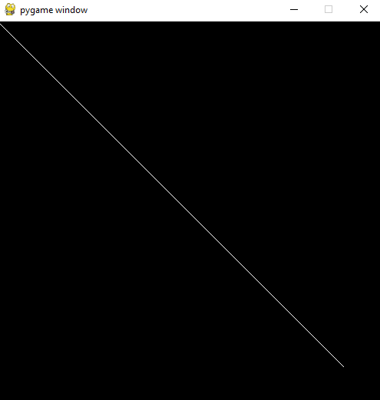
Draw module - Line
Takes in a target Surface, a color, and two pairs of coordinates
The pairs of coordinates represent the starting point of the line and the ending point of the line
Returns a Rect that includes the line
pygame.draw.line(target_surface, color, start_pos, end_pos) -> Rect
pg.draw.line(screen, (255,255,255),(0,0), (450,450))

Slide 10
Image Module - Overview
Pygame allows loading images from file.
You do not create Image objects. Rather, you use functions in the Image module to load the images, and these functions will give you a Surface
Supported image types for loading: BMP, GIF (non-animated), JPEG, LBM, PCX, PNG, PNM, SVG, TGA (uncompressed), TIFF, WEBP, XPM
It is recommended to always convert the image using convert() or convert_alpha()

Slide 11
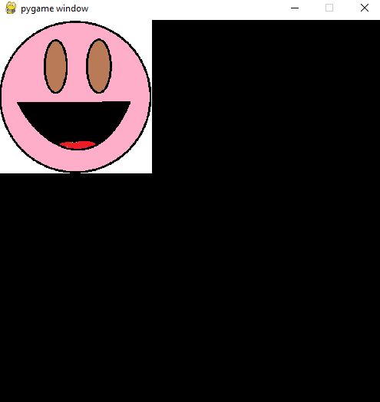
Image Module - Load
Takes in the file name
Returns a Surface with the image in it
Use convert_alpha() if the image has transparency
Use convert() otherwise
pygame.image.load(filename).convert()
-> Surface
pygame.image.load(filename).convert_alpha() -> Surface
face = pg.image.load("happy-face.png").convert()
screen.blit(face, (0,0))

Slide 12
Transform Module - Overview
Pygame has a module for making edits to an image, like rotating it or scaling it.
Most of these transformations are destructive
  What that means is that information is lost when transforming an image.
You should always keep the original image in a separate Surface, and save the transformations into a new Surface

Slide 13
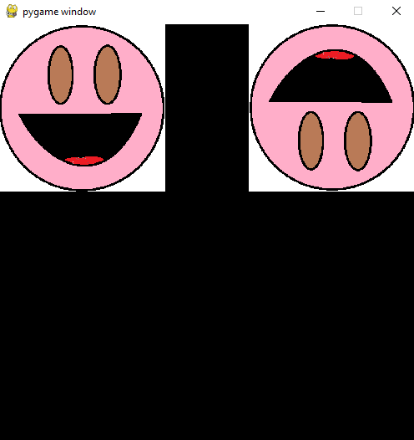
Transform Module - Flip
Takes in a Surface, a Boolean indicating if the X-axis should be flipped, and a Boolean for the Y-axis
Returns a Surface with the image flipped
flip() is non-destructive
pygame.transform.flip(surface, flip_x, flip_y)
-> Surface
original_face = pg.image.load("happy-face.png").convert()
face1 = pg.transform.flip(original_face, False, True)
screen.blit(original_face, (0,0))
screen.blit(face1, (300,0))

Slide 14
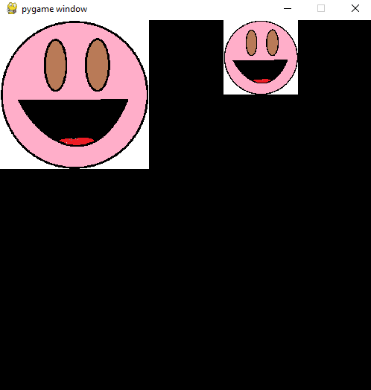
Transform Module - Scale
Takes in a Surface, and a pair of values for the new size
Returns a Surface with the image scaled
scale() is destructive
pygame.transform.scale(surface, size)
-> Surface
original_face = pg.image.load("happy-face.png").convert()
face1 = pg.transform.scale(original_face, (100,100))
face2 = pg.transform.scale(original_face, (200,200))
screen.blit(face2, (0,0))
screen.blit(face1, (300,0))

Slide 15
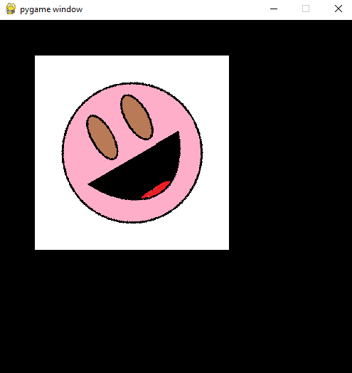
Transform Module - Rotate
Takes in a Surface, and an angle
Angle represents how much the image is rotated, in degrees
Positive values rotate counterclockwise
Target Surface is automatically padded to hold the new image
Returns a Surface with the image rotated
rotate() is destructive
pygame.transform.rotate(surface, angle)
-> Surface
original_face = pg.image.load("happy-face.png").convert()
face1 = pg.transform.rotate(original_face, 30)
screen.blit(face1, (50,50))

Slide 16
Font Module - Overview
Pygame allows writing things to the Display.
First, you create a Font object using the Font constructor.
The Font constructor takes in the name of the file containing the font and the font size:
  If passed a value of None, the default font will be used
myfont = pygame.font.Font(None, 64)
myfont2 = pygame.font.Font(“fontfile.ttf”, 32)
Unless you want to change the size, the font type, or you want to write multiple things in different parts of the screen, you only need to create one font object

Slide 17
Font Module - Render
Once a Font object has been created, you can then call its render() method.
render() takes in a string containing the text you wish to write, a Boolean for the antialias option, and a color.
  Antialias smoothes out the edges of your letters
render() returns a Surface with the words written on it.
You can then blit this Surface onto the Display as normal.

Slide 18
Font Module – Useful methods
The methods below, while useful, are fake
They create fake versions of the effect you are trying to apply
For best results, if you want your letters to be bold, you should load a bold version of your font.
set_underline(bool)
set_bold(bool)
set_strikethrough(bool)
set_italic(bool)

Slide 19
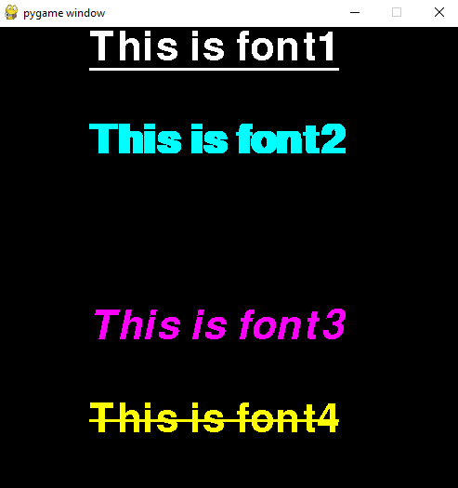
Font Module – Examples
font1 = pg.font.Font(None, 64)
font2 = pg.font.Font(None, 64)
font3 = pg.font.Font(None, 64)
font4 = pg.font.Font(None, 64)
font1.set_underline(True)
font2.set_bold(True)
font3.set_italic(True)
font4.set_strikethrough(True)
surf1 = font1.render("This is font1", False, (255,255,255))
surf2 = font2.render("This is font2", True, (0, 255, 255))
surf3 = font3.render("This is font3", False, (255, 0, 255))
surf4 = font4.render("This is font4", False, (255, 255, 0))
screen.blit(surf1, (100,0))
screen.blit(surf2, (100, 100))
screen.blit(surf3, (100, 300))
screen.blit(surf4, (100, 400))
pygame.display.flip()

Slide 20
Mixer – Creating Sounds
Pygame allows playing sounds
First, you create a Sound object using the Sound constructor from the mixer module.
The Sound constructor takes in the name of the file containing the sound:
sound = pygame.mixer.Sound(“filename.mp3”)
Once you have your Sound object, you can call the play() method to play it
sound.play()

Slide 21
Mixer – play() parameters
play() can also take a few parameters:
play(loops=0, maxtime=0, fade_ms=0)
loops: how many times the sound should be repeated
  0 means the sound will be played once
  1 means the sound will be played once, and then repeated once
  Etc
maxtime: forcibly stops the sound after a certain number of milliseconds
fade_ms: The sound will start playing at a volume of 0 and then grow louder for that number of miliseconds.

Slide 22
Mixer – Useful methods
stop(): stops the sound’s playback
set_volume(volume): sets the sound’s volume using a float between 0 and 1
get_volume(): returns the volume level as a float between 0 and 1
fade_out(time): lowers the sounds volume to 0 throughout the specified time, in milliseconds

Slide 23
Music - Overview
The mixer module has a special submodule specifically for playing music.
Unlike Sound, you do not get a Music object when loading a music file.
Instead, all the music functionality is interacted through straight through the music module
You can only ever have one music loaded or playing.

Slide 24
Music – General functions
Load a music file for playback (does not start the music)
pygame.mixer.music.load(“filename.mp3")
Starts playing the music. Works much like Sound.play()
pygame.mixer.music.play(loops)
Resets the music from the beginning
pygame.mixer.music.rewind()
Stops the current music
pygame.mixer.music.stop()
Pause and unpause the music
pygame.mixer.music.pause()
pygame.mixer.music.unpause()

Slide 25
Music – Helpful functions
Lowers the music’s volume throughout the specified time
pygame.mixer.music.fadeout(time)
Sets the volume of the music
Beware: As of Pygame 2.5.2, set_volume() sets the volume of the entire application, not just the music.
pygame.mixer.music.set_volume(volume)
Checks if music is currently playing
pygame.mixer.music.get_busy()

Slide 26
Summary
The Draw module can be used to draw different shapes onto Surfaces
The Image module can load images from disk, or save images to disk
The Transform module allows for the (usually destructive) alteration of images, such as rotation or scaling.
The Mixer module allows for playing sounds
The Music module allows for music to be played

