Slide 1
Module 5
Object-Oriented Programming and class Design

Slide 2
Motivation
Object-Oriented Programming (OOP) is based on the concept of classes, from which objects are created.
In essence, classes work as a blueprint for creating something, while objects created from that class are the actual thing.

Slide 3
Classes
Using classes, we’re actually creating new data types!
A class represents the concept of things in the real world, like Dogs.
Classes follow a template, and have:
a name
variables (often called “attributes” or “fields”)
functions (which are now called “methods”, “behaviors” or “member functions”)

Slide 4
The Smallest Class
class Dog:
pass

Slide 5
Oh no! What have we done?
We’ve:
created a new (complex) data type!
created the “concept” of a Dog
We don’t have any Dogs yet, just the concept

Slide 6
Objects
An object:
is an entity in the real world that can be distinctly identified
might represent a particular dog, employee, student, etc.
has a unique identity, state, and behavior.

Slide 7
Object Identity, State and Behavior
An object has a unique identity as it represents one entity.
The object state consists of a set of data fields (instance variables or properties) with their current values.
The object behavior is defined by a set of methods
Example: Class Student that describes individual students, such that each student has a unique ID, has his/her own state (information), and all students share same behavior (methods).

Slide 8
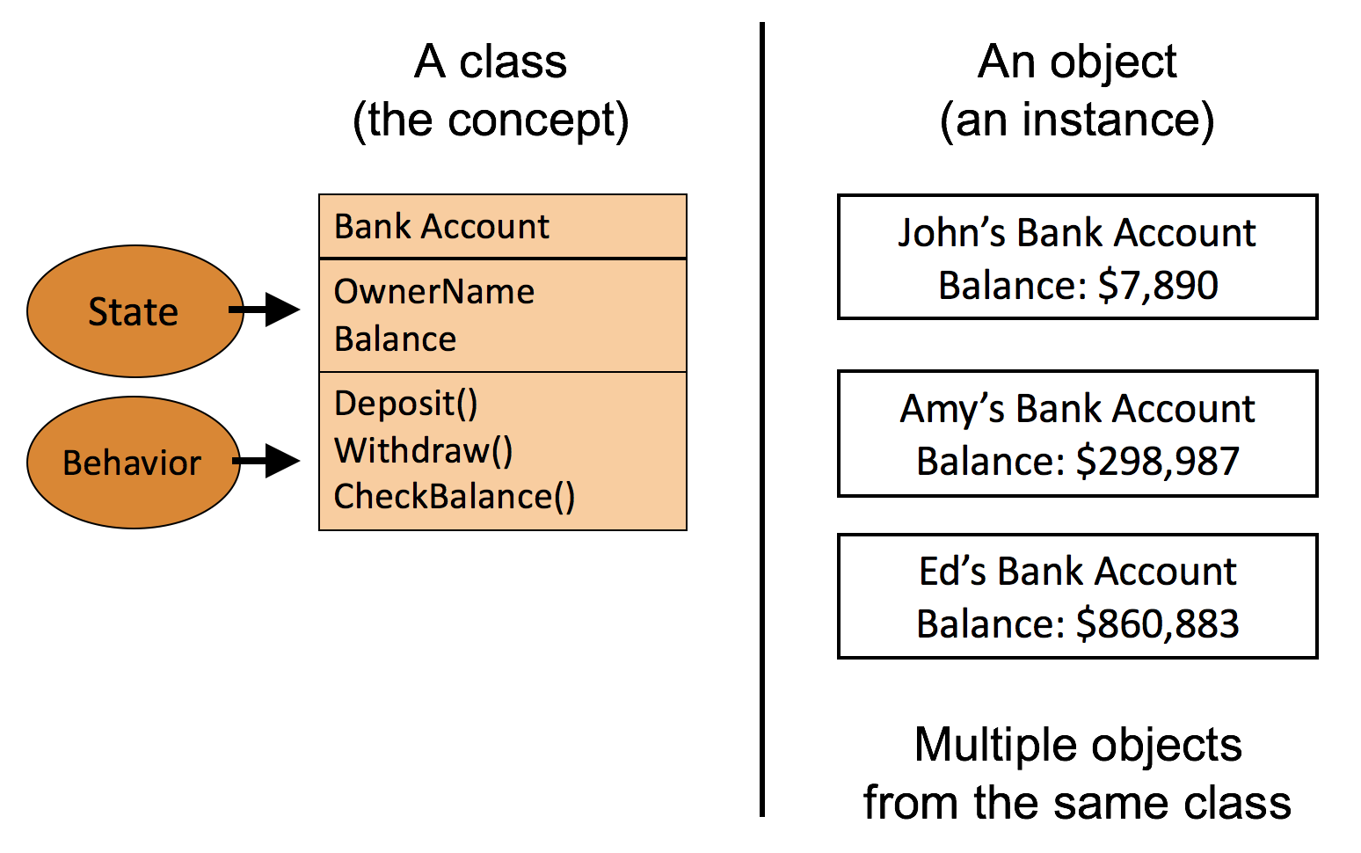
Example: Class Bank Account

Slide 9
A “real life” example
Let’s make a Dog!
Attributes (characteristics)
rabid or not rabid (boolean)
weight (a number)
name (string)
Behaviors
growl
eat

Slide 10
Step 1: The Skeleton
class Dog:
pass

Slide 11
Step 2: Add attributes
class Dog:
# States of a Dog
rabid = False
weight = 0.0
name = “”

Slide 12
Step 3: Adding behaviors
class Dog:
# States of a Dog
rabid = False
weight = 0.0
name = “”
# Behaviors of a Dog
def eat(self, food):
weight += food
print(self.name + “ now weighs “ + str(weight))
def growl(self):
print(self.name + “ says grr”)

Slide 13
Self keyword
You may have noticed that the methods inside the class always have at least one parameter, the “self” parameter.
This parameter is necessary for accessing the fields inside the object
You will not pass any arguments when a class method only has the self parameter.

Slide 14
Creating Dogs
# empty code file
Memory

Slide 15
Creating Dogs
d1 = Dog()
Memory
d1
rabid = False
weight = 0.0
name = “”

Slide 16
Creating Dogs
d1 = Dog()
d1.name = “Alice”
Memory
d1
rabid = False
weight = 0.0
name = “Alice”

Slide 17
Creating Dogs
d1 = Dog()
d1.name = “Alice”
d1.rabid = True
Memory
d1
rabid = True
weight = 0.0
name = “Alice”

Slide 18
Creating Dogs
d1 = Dog()
d1.name = “Alice”
d1.rabid = True
d1.weight = 50.0
Memory
d1
rabid = True
weight = 50.0
name = “Alice”

Slide 19
Creating Dogs
d1 = Dog()
d1.name = “Alice”
d1.rabid = True
d1.weight = 50.0
d2 = Dog()
Memory
d1
d2
rabid = True
rabid = False
weight = 50.0
weight = 0.0
name = “Alice”
name = “”

Slide 20
Creating Dogs
d1 = Dog()
d1.name = “Alice”
d1.rabid = True
d1.weight = 50.0
d2 = Dog()
d2.name = “Bob”
Memory
d1
d2
rabid = True
rabid = False
weight = 50.0
weight = 0.0
name = “Alice”
name = “Bob”

Slide 21
Creating Dogs
d1 = Dog()
d1.name = “Alice”
d1.rabid = True
d1.weight = 50.0
d2 = Dog()
d2.name = “Bob”
d2.weight = 30.0
Memory
d1
d2
rabid = True
rabid = False
weight = 50.0
weight = 30.0
name = “Alice”
name = “Bob”

Slide 22
We’ve created 2 dogs!
Notice that they start with the same fields, and the same values in those fields.
However, we edited the individual objects to hold data that was particular to that object
Thus, accessing the fields from each object will give us different data:
print(d1.name) # prints “Alice”
print(d2.name) # prints “Bob”

Slide 23
The “.” operator
“Dot” operator used to
Get to an instance’s attributes
Get to an instance’s methods
Basically, get inside the instance
Format:
<instance>.<attribute or method>

Slide 24
Using the “.” operator
d1 = Dog()
d1.name = “Alice”
d1.rabid = True
d1.weight = 50.0
d2 = Dog()
d2.name = “Bob”
d2.weight = 30.0
d1.eat(2) # Alice weighs 52 lbs
d2.growl() # Bob says GRRRR
d1.eat(4) # Alice weighs 56 lbs
d2.eat(-1) # Bob weighs 29 lbs

Slide 25
The Constructor
This is a special method
Used to give initial values to ALL attributes
Is activated when someone creates an instance of the class (i.e.: creates an object)
In most languages, the name of this method MUST be the same name as the class
In Python, the name of this method must be “__init__”

Slide 26
The Constructor
Dog without a constructor:
class Dog:
rabid = False
weight = 0.0
name = “”
Dog with a constructor:
class Dog:
def __init__(self):
self.rabid = False
self.weight = 0.0
self.name = “”

Slide 27
The Constructor
Seems like extra work. Why initialize the fields inside the constructor instead of directly in the class body?
Allows initializing the class fields in the constructor parameters
Prevents unintended behavior when using mutable fields
class Dog:
def __init__(self, weight, rabid = False, name = “”):
self.rabid = rabid
self.weight = weight
self.name = name

Slide 28
The Constructor – Initializing fields
class Dog:
def __init__(self, weight, rabid = False, name = “”):
self.rabid = rabid
self.weight = weight
self.name = name
# Dogs now need at least 1 argument before they can be
# created: the weight
d1 = Dog(45, name = “Charlie”)
d1
rabid = False
weight = 45
name = “Charlie”

Slide 29
Designing the Constructor
Constructors will vary, depending on design
Ask questions:
Are all Dogs born with the same rabid state? (yes – they are all born non-rabid)
Are all Dogs born with the same weight? (no – they are born with different weights)
Are all Dogs born with the same name? (no – they all have different names)
If ever “no”, then you need information passed in as parameters.

Slide 30
The Constructor – Class vs Instance fields
Before we start talking about mutable fields, let’s talk about the difference between class and instance fields
Without the constructor, the Dog class looked like this:
class Dog:
rabid = False
weight = 0.0
name = “”

Slide 31
The Constructor – Class vs Instance fields
Even before we create our first Dog object, we already have one: The class itself.
This allows us to change the default values of newly created objects
d1 = Dog() # False, 0.0, “”
Dog.rabid = True # Changed rabid for future Dogs
Dog.weight = 200 # Changed weight for future Dogs
d2 = Dog() # True, 200, “”

Slide 32
The Constructor – Class vs Instance fields
When accessing a field using the class name, we say that field belongs to the class
When accessing a field of a specific object, we say that field belongs to that instance (or object)
In practice, what’s actually happening is that a class field is shared across all newly created objects until an assignment is done
After the first assignment operation, the object will have its own copy of the field

Slide 33
The Constructor – What is actually happening
class Dog:
rabid = False
weight = 0.0
name = “”
Memory
Dog
rabid = False
weight = 0.0
name = “”

Slide 34
The Constructor – What is actually happening
class Dog:
rabid = False
weight = 0.0
name = “”
d1 = Dog()
Memory
Dog
d1
rabid = False
d1 has no fields. Its fields come from Dog
weight = 0.0
name = “”

Slide 35
The Constructor – What is actually happening
class Dog:
rabid = False
weight = 0.0
name = “”
d1 = Dog()
# d1 now has its own
# copy of rabid
d1.rabid = True
Memory
Dog
d1
rabid = False
rabid = True
weight = 0.0
name = “”

Slide 36
The Constructor – What is actually happening
Memory
class Dog:
rabid = False
weight = 0.0
name = “”
d1 = Dog()
d1.rabid = True
print(d1.weight) # prints 0.0
print(d1.rabid) # prints True
Dog
d1
rabid = False
rabid = True
weight = 0.0
name = “”

Slide 37
The Constructor – What is actually happening
Memory
class Dog:
rabid = False
weight = 0.0
name = “”
d1 = Dog()
d1.rabid = True
print(d1.weight)
print(d1.rabid)
d2 = Dog()
Dog
d1
rabid = False
rabid = True
weight = 0.0
name = “”
d2

Slide 38
The Constructor – What is actually happening
Memory
class Dog:
rabid = False
weight = 0.0
name = “”
d1 = Dog()
d1.rabid = True
print(d1.weight)
print(d1.rabid)
d2 = Dog()
print(d2.rabid) # prints False
Dog
d1
rabid = False
rabid = True
weight = 0.0
name = “”
d2

Slide 39
The Constructor – What is actually happening
Memory
class Dog:
rabid = False
weight = 0.0
name = “”
d1 = Dog()
d1.rabid = True
print(d1.weight)
print(d1.rabid)
d2 = Dog()
print(d2.rabid) # prints False
Dog.rabid = None
Dog
d1
rabid = None
rabid = True
weight = 0.0
name = “”
d2

Slide 40
The Constructor – What is actually happening
Memory
class Dog:
rabid = False
weight = 0.0
name = “”
d1 = Dog()
d1.rabid = True
print(d1.weight)
print(d1.rabid)
d2 = Dog()
print(d2.rabid) # prints False
Dog.rabid = None
print(d2.rabid) # prints None
print(d1.rabid) # still prints True
Dog
d1
rabid = None
rabid = True
weight = 0.0
name = “”
d2

Slide 41
The Constructor – Class vs Instance fields
To reiterate: when an object doesn’t have a field, it will reach up to the Class fields.
You can force an object to have its own fields by:
Doing an assignment operation on the object’s field
d1.name = “Alice”
Initializing the field in the constructor
def __init__(self):
self.name = “Alice”

Slide 42
The Constructor – Mutable fields
Normally, it makes no difference if an object has its own copy of the field or if it is using the classes’ field
This is because the object will have its own copy once an assignment operation is done
But this is a big problem for mutable fields (like lists)

Slide 43
The Constructor – Mutable fields
class Student:
name = “”
class Classroom:
list_of_students = [] # the danger
s1 = Student()
s1.name = “Alice”
s2 = Student()
s2.name = “Bob”
# all normal so far

Slide 44
The Constructor – Mutable fields
class Student:
name = “”
class Classroom:
list_of_students = [] # the danger
s1 = Student()
s1.name = “Alice”
s2 = Student()
s2.name = “Bob”
c1 = Classroom() # created a classroom
c2 = Classroom() # created another classroom

Slide 45
The Constructor – Mutable fields
class Student:
name = “”
class Classroom:
list_of_students = [] # the danger
s1 = Student()
s1.name = “Alice”
s2 = Student()
s2.name = “Bob”
c1 = Classroom() # created a classroom
c2 = Classroom() # created another classroom
c1.list_of_students.append(s1) # added Alice to class 1
c2.list_of_students.append(s2) # added Bob to class 2

Slide 46
The Constructor – Mutable fields
class Student:
name = “”
class Classroom:
list_of_students = [] # the danger
s1 = Student()
s1.name = “Alice”
s2 = Student()
s2.name = “Bob”
c1 = Classroom() # created a classroom
c2 = Classroom() # created another classroom
c1.list_of_students.append(s1) # added Alice to class 1
c2.list_of_students.append(s2) # added Bob to class 2
print(c1) # prints [‘Alice’, ‘Bob’] THIS IS A PROBLEM
print(c2) # prints [‘Alice’, ‘Bob’] BOTH CLASSROOMS ARE SHARING THE SAME STUDENTS

Slide 47
The Constructor – Mutable fields
What happened?
Adding Alice to Classroom 1 added her to Classroom 2 and adding Bob to Classroom2 added him to Classroom 1
Why?
Because the list_of_students field belongs to the class.
Given that c1 and c2 don’t have their individual copies, they are sharing the one from the class
We never assigned a list_of_students field to c1 or c2, we appended information to it

Slide 48
The Constructor – Mutable fields (solving the problem)
class Student:
name = “”
class Classroom:
list_of_students = [] # the danger
s1 = Student()
s1.name = “Alice”
s2 = Student()
s2.name = “Bob”
c1 = Classroom() # created a classroom
c1.list_of_students = [] # c1 now has its own copy of list_of_students
c2 = Classroom() # created another classroom
c2.list_of_students = [] # c2 now has its own copy of list_of_students
c1.list_of_students.append(s1) # added Alice to class 1
c2.list_of_students.append(s2) # added Bob to class 2
print(c1) # prints [‘Alice’] Problem solved
print(c2) # prints [ ‘Bob’] Problem solved

Slide 49
The Constructor – Mutable fields (solving the problem)
class Student:
name = “”
class Classroom:
def __init__(self):
self.list_of_students = [] # list created inside the constructor is now individual to every object
s1 = Student()
s1.name = “Alice”
s2 = Student()
s2.name = “Bob”
c1 = Classroom() # created a classroom
c2 = Classroom() # created another classroom
c1.list_of_students.append(s1) # added Alice to class 1
c2.list_of_students.append(s2) # added Bob to class 2
print(c1) # prints [‘Alice’] Problem solved
print(c2) # prints [ ‘Bob’] Problem solved

Slide 50
Summary
A class:
has attributes (which are just variables)
has a constructor which is used to initialize attributes
has other methods (like eat and growl)
is a blueprint (template) for creating objects
creates a new data type
An object:
is an instance of a class
has a state (variables) that is independent from others
trying to access a variable that the object doesn’t have prompts the object to reach to the class for that variable
mutable fields at the class level need to be handled with care

