Slide 1
Module 7
Exception and
Exception Handling

Slide 2
Overview
What are exceptions and why are they needed?
New keywords and their structure
  try
  except
  finally
  raise
How to raise exceptions inside methods
Reading the stack trace
Types of exceptions

Slide 3
Exception Handling
An exception is an indication of a potential problem that occurs during a program’s execution.
  We can resolve these issues without crashing
  We can develop more fault-tolerant programs.
  Build more secure systems
Prior to exceptions being created:
  Every function returned a value (even print!)
  Had to check that value to see if it ran correctly

Slide 4
Hey, what could go wrong?
if __name__ == "__main__":
num1 = int(input("Enter num1: "))
num2 = int(input("Enter num2: "))
result = num1 / num2
print(f"Result: {result}")

Slide 5
Hey, what could go wrong?
if __name__ == "__main__":
num1 = int(input("Enter num1: "))
num2 = int(input("Enter num2: "))
result = num1 / num2 # what if num2 is 0?
print(f"Result: {result}")

Slide 6
Hey, what could go wrong?
if __name__ == "__main__":
names = ['Alice', 'Bob', 'Charlie', 'David', 'Edward']
option = int(input('Show which name? '))
print(names[option])

Slide 7
Hey, what could go wrong?
if __name__ == "__main__":
names = ['Alice', 'Bob', 'Charlie', 'David', 'Edward']
option = int(input('Show which name? '))
print(names[option]) # what if the user enters 60?

Slide 8
What happened?
Do we always have a problem? NO.
Do we have the potential for a problem? YES
  Example 1: potential to divide by zero
  Example 2: potential to access memory outside the bounds of the array
  Both examples: Entering a non-number
What could happen?
  Example 1: a ZeroDivisionError could be raised
  Example 2: an IndexError could be raised
  Both examples: a ValueError could be raised

Slide 9
The main idea
We are going to try to do some code
If something messes up, it creates an exception that we can handle.
The finally block runs whether an exception was raised or not
try :
# Some potentially problematic code
except:
# Handle the problem, but DON'T CRASH
finally:
# Optional. This runs whether an
# exception was raised or not

Slide 10
The Flow of Exception Handling
When a “problem” occurs in a try block:
  An exception is raised
  Program control immediately transfers to the first except block matching the type of the raised exception.
  After the exception is handled, program control resumes after the last except block.

Slide 11
The Flow of Exception Handling
When a problem DOES NOT occur in a try block:
  An exception is NOT raised
  The except block(s) do NOT execute at all
  Execution continues through the “try” block, then continues after the except/finally block

Slide 12
Rules on the except block
Must have one or more excepts immediately after the try block
Yes, you can have more than one except block
You can have the except keyword by itself or you can specify the type of exception you are trying to handle
You can specify several different exception types in a single except block, using a tuple
You can give an alias to the exception being handled to print its error message
Only one except block executes – the first matching one
Usually have the generic Exception as the last block

Slide 13
except Block
except ZeroDivisionError:
# handles division by 0
print(“Cannot divide by zero: ”)
except (TypeError, ValueError):
# handles both TypeError and ValueError
print(“Value or Type error!”)
except Exception as error:
# handles any type of exception
print(“An unknown error has occurred”)
print(error)

Slide 14
except Block
What happens if a function raises an exception it cannot handle?
The function will stop executing immediately (unless a finally block is present). The exception will then be re-raised in the function that called the current function

Slide 15
except Block
def readsNames(index, names):
print(names[int(index)])
print("Reads names is done executing")
def handlesIndexErrors(index, number):
try:
readsNames(index, number)
except IndexError as error:
print("handlesIndexErrors() can handle invalid indexes")
print(error)
finally:
print("handlesIndexErrors() is done executing")
if __name__ == "__main__":
names = ['Alice', 'Bob', 'Charlie', 'David', 'Edward']
try:
index = input("Enter a index: ")
handlesIndexErrors(index, names)
except ValueError as error:
print("This try block handles non-numeric inputs")
print(error)
finally:
print("Program is done")

Slide 16
finally Block
This is the “cleanup” block
Example: Operating systems typically prevent more than one program from manipulating a file.
Therefore, the program should close the file
(i.e., release the resource) whether an exception was raised or not
The finally block is guaranteed to execute regardless of whether an exception occurs.

Slide 17
finally Block
If an exception occurs during execution of the try clause, the exception may be handled by an except clause. If the exception is not handled by an except clause, the exception is re-raised after the finally clause has been executed.
An exception could occur during execution of an except clause. Again, the exception is re-raised after the finally clause has been executed.
If the finally clause executes a break, continue or return statement, exceptions are not re-raised.
If the try statement reaches a break, continue or return statement, the finally clause will execute just prior to the break, continue or return statement’s execution.
If a finally clause includes a return statement, the returned value will be the one from the finally clause’s return statement, not the value from the try clause’s return statement.
If an exception occurs in the finally, the finally block is immediately interrupted

Slide 18
finally Block
In the function below, even though the exception raised is never handled, it is quietly ignored as the FINALLY block has a CONTINUE keyword. The same would have happened if it instead had a BREAK or CONTINUE
def function():
names = ['Alice', 'Bob', 'Charlie', 'David', 'Edward']
for name in names:
try:
if "i" in name:
raise Exception(f"{name} has 'i' in it")
print(name)
except RuntimeError as error:
print(error)
finally:
print("Finally executing")
print("=====")
continue

Slide 19
finally Block
In the function below, the exception is re-raised once the FINALLY block is done executing. Flow control will be yielded back to whatever function called function(). If no other functions called function(), the program will crash.
def function():
names = ['Alice', 'Bob', 'Charlie', 'David', 'Edward']
for name in names:
try:
if "i" in name:
raise Exception(f"{name} has 'i' in it")
print(name)
except RuntimeError as error:
print(error)
finally:
print("Finally executing")
print("=====")

Slide 20
Full try/except/finally Syntax
try:
# code that might generate an exception
except ExceptionTypeOne:
# code to handle an ExceptionTypeOne exception
except ExceptionTypeTwo:
# code to handle an ExceptionTypeTwo exception
except Exception:
# code to handle anything that got past the previous except block
finally:
# code to execute whether or not an exception occurs

Slide 21
Best practice
Do not place try blocks around every statement that might raise an exception.
It’s better to place one try block around a significant portion of code and follow this try block with except blocks that handle each possible exception.
Separate try blocks should be used when it is important to distinguish between multiple statements that can raise the same exception type.
Always be as specific as possible with the type of exception you are handling

Slide 22
Raising Exceptions
You can raise any kind of exception you want at any time you want:
  raise
  raise Exception
  raise Exception(“An error has occurred”)

Slide 23
Raising an exception and handling it
def doesStuff():
raise Exception("I've raised an exception!")
if __name__ == "__main__":
try:
doesStuff()
print("This line never executes")
except Exception as error:
print(error)
finally:
print("Prints no matter what")

Slide 24
Raising an exception and NOT handling it
def doesStuff():
raise RuntimeError("I've raised an exception!")
if __name__ == "__main__":
try:
doesStuff()
print("This line never executes")
except ValueError as error:
print(“This block will not execute”)
finally:
print("Prints no matter what")

Slide 25
Raising an exception and handling it
def raisesExceptions(number):
if number % 2 == 0:
raise ValueError("That's an even number!")
else:
raise RuntimeError("That's an odd number!")
def handlesOdds(number):
try:
raisesExceptions(number)
except RuntimeError as error:
print("handlesOdds() can handle odd numbers")
print(error)
finally:
print("handlesOdd() is done executing")
if __name__ == "__main__":
try:
number = int(input("Enter a number: "))
handlesOdds(number)
except ValueError as error:
print("This try block can handle even numbers")
print(error)
finally:
print("Program is done")

Slide 26
Reading the call stack
When your program crashes, an error message is displayed.
This error message is very useful as it states the exact place where your code failed, what functions were being executed at the time, and what exception was raised
def doesSomethingElse():
raise Exception("Error!")
def doesSomething():
doesSomethingElse()
if __name__ == "__main__":
doesSomething()
Traceback (most recent call last):
File “ExceptionTesting.py", line 8, in <module>
doesSomething()
File " ExceptionTesting.py", line 5, in doesSomething
doesSomethingElse()
File " ExceptionTesting.py ", line 2, in doesSomethingElse
raise Exception("Error!")
Exception: Error!

Slide 27
Reading the call stack
What functions were executing when the error occurred (latest function at the bottom)
What line(s) generated the error
Traceback (most recent call last):
File “ExceptionTesting.py", line 8, in <module>
doesSomething()
File " ExceptionTesting.py", line 5, in doesSomething
doesSomethingElse()
File " ExceptionTesting.py ", line 2, in doesSomethingElse
raise Exception("Error!")
Exception: Error!
Type of error
Error message

Slide 28
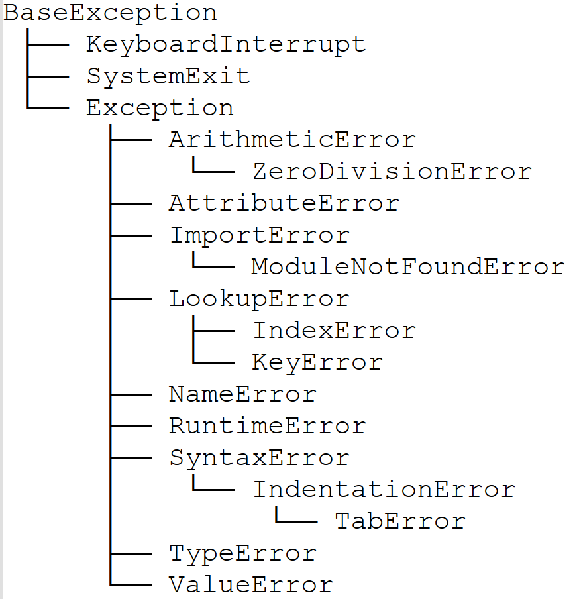
Exception types
There are several different types of exceptions
You should always try to handle the most specific type for your particular case
You should always raise the most specific type for your particular case
It is possible to create your own Exceptions
Find all built-in types here:
https://docs.python.org/3/library/exceptions.html#exception-hierarchy

Slide 29
Summary
Using exceptions helps with building robust, secure code
Uses keywords try, except and finally
You can raise exceptions in methods
If a program crashes due to an unhandled exception, the printed call stack helps us determine what the program was doing when it crashed
There are several different built-in exception types
You should always raise/handle the most specific type possible

