Slide 1
Module 7 – Part 3
Flow Control

Slide 2
if-elif-else
IF statements work the same in both languages, with only syntactical differences
Python
  IF‘s condition doesn’t need to be enclosed in parenthesis
  The IF’s body is denoted by the presence of tabs
  Same applies to ELIFs
Java
  IF’s condition must be enclosed in parenthesis
  The IF’s body must be enclosed in curly braces
  ELIFs are called “ELSE IF”
  Rules that apply to IFs also apply to ELSE-IFs

Slide 3
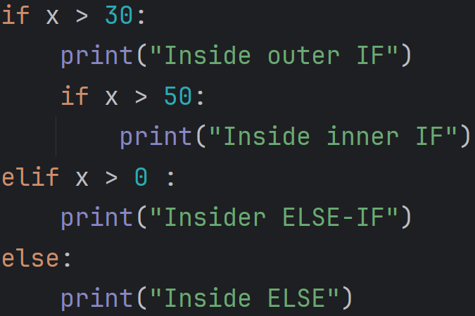
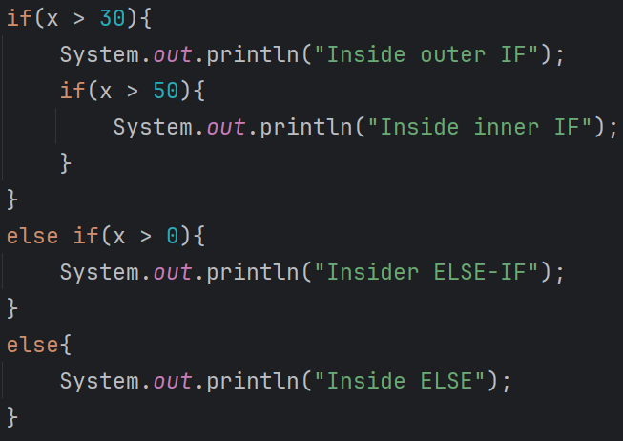
if-elif-else

Slide 4
Match vs Switch
Match statement
  Case datatypes can be of any type
  Cases can check for other conditions
  “break”, as a keyword, is not allowed
  Default case is called “_”
Switch statement
  All case datatypes must match the switch’s data type
  Cases cannot check for other conditions
  Cases without a “break;” in them will fall through to the next case
  Default case is called “default”

Slide 5
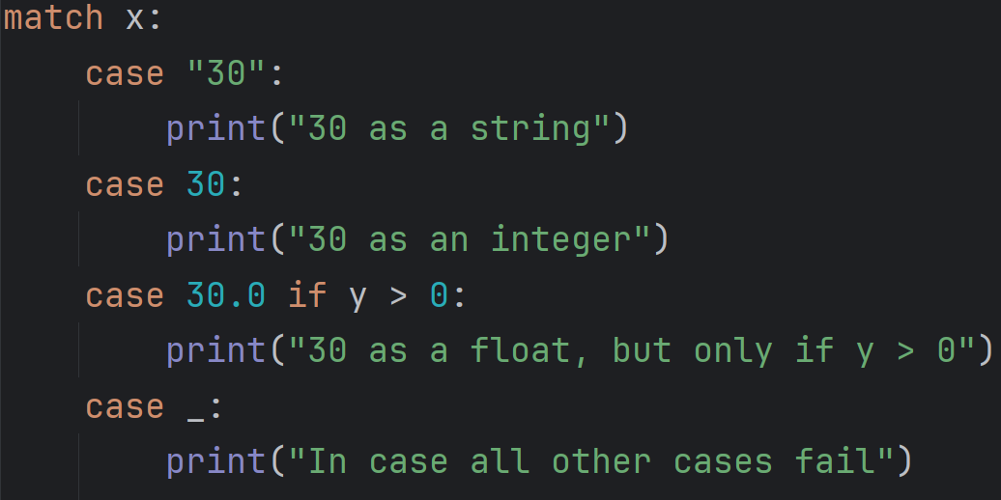
Match

Slide 6
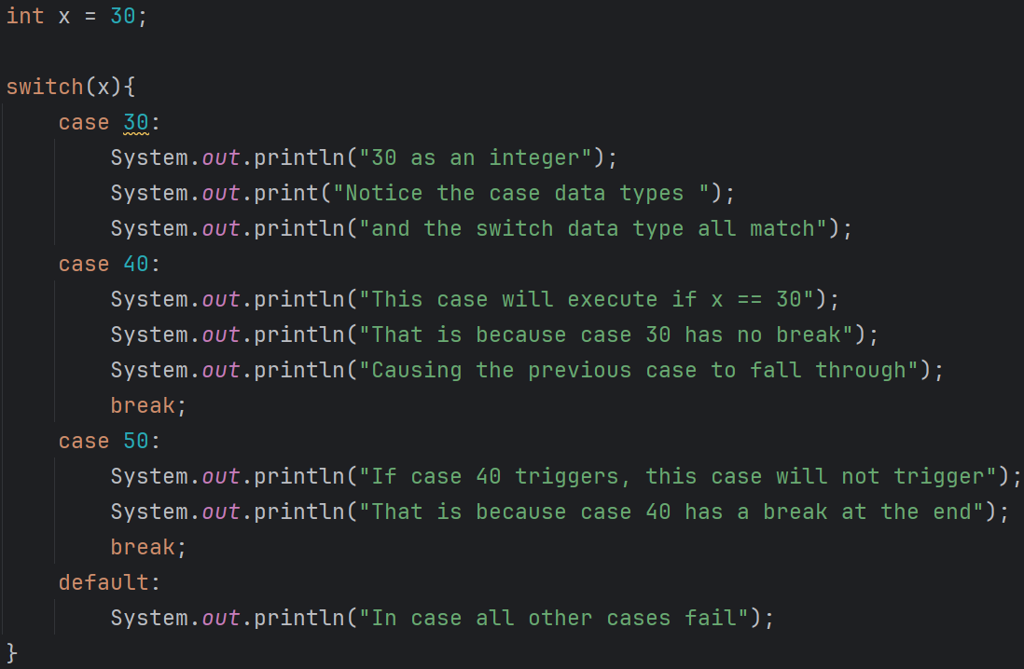
Switch

Slide 7
while loops
WHILE loops work the same in both languages, with only syntactical differences
Python
  WHILE‘s condition doesn’t need to be enclosed in parenthesis
  The WHILE’s body is denoted by the presence of tabs
Java
  WHILE’s condition must be enclosed in parenthesis
  The WHILE’s body must be enclosed in curly braces

Slide 8
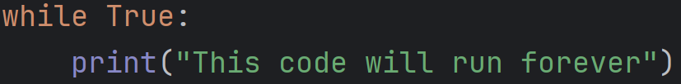
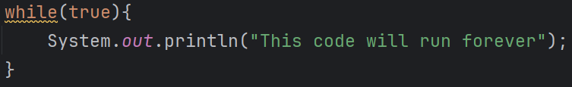
while loops

Slide 9
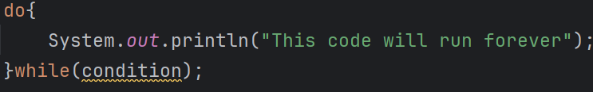
do-while loops
Python
  Do not exist in Python
Java
  WHILE loops and DO-WHILE loops differ on when their condition is checked
  WHILE loops check their condition before starting an iteration
  DO-WHILE loops check their condition after finishing an iteration
  This means that DO-WHILE loops will always execute at least once, while WHILE loops may not execute at all

Slide 10
for loops
Java has two different FOR loops: The regular FOR loop and the ENHANCED FOR loop
What we know in Python as a FOR loop is the equivalent of an ENHANCED FOR loop in Java.
These loops are better suited to traverse a collection of elements
Syntax is largely the same, with a few key difference
  You must declare the element’s type
  The iterable must be holding only the type declared above
  Instead of “in”, use “:”
  Strings are not iterable in Java

Slide 11
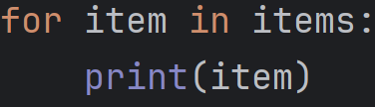
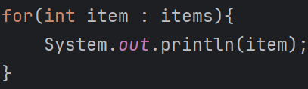
for loops

Slide 12
for loops
Java’s basic type of FOR loop has the following syntax
for(initializer; condition; increment){
//body
}
These loops, sometimes called countable loops, are best for determining at a glance how many times the loop will run
Initializer: Initializes the value of any sentinel variables being used
  Sentinel is the technical name of the variable being used to determine if the loop should run for another iteration
Condition: Determines if the loop will run another iteration
Increment: Updates the sentinel at the end of every iteration
Roughly equivalent to using for “x in range(y):”

Slide 13
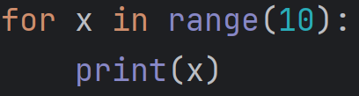
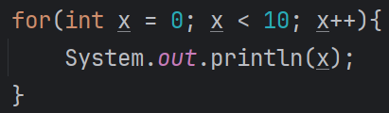
for loops

Slide 14
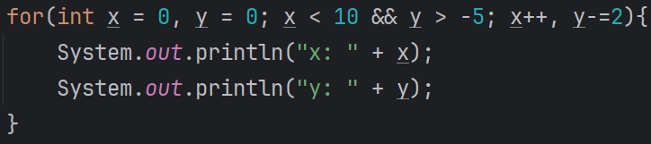
for loops
You are not limited to a single sentinel initialization, a simple Boolean condition, or a simple increment
The loop below will initialize x at 0 and y at 0
It will continue running as long as x is less than 10 OR y is greater than -5
After every iteration, x is incremented by 1 while y is decremented by 2

Slide 15
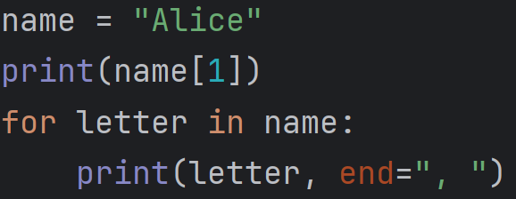
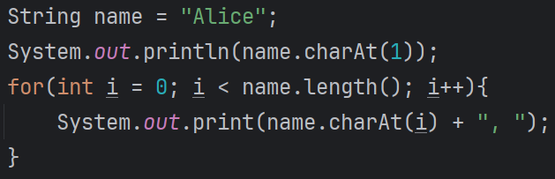
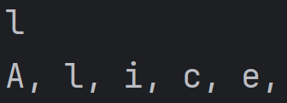
Traversing a string
As mentioned, you cannot iterate through a string in Java
If you need to retrieve a particular character in a string, use the charAt() method

Slide 16
Methods
Methods behave the same at a fundamental level, but have major differences between them
Python
  Defined using the “def” keyword
  Parameters can have default values
  Can return any data type
  Lack of “return” keyword makes the method return “None”
Java
  Must be public, and must declare what datatype they return
    Methods inside the Driver class must always be static
  Parameters must declare their type and cannot have default values
  Must always return the datatype in the method’s header
  Have a special type, “void”, which allows the method to return nothing
  Can be overloaded

Slide 17
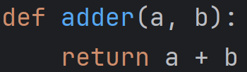
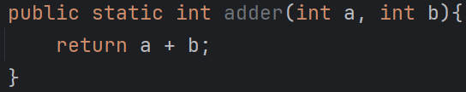
Methods

Slide 18
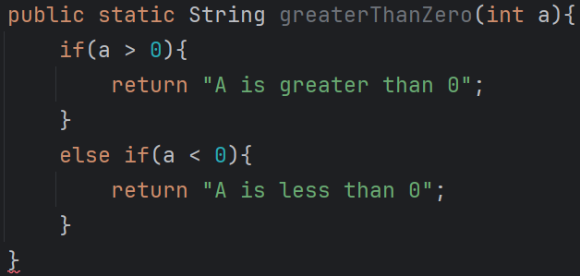
Methods
The method below doesn’t always return a string and, as such, is considered to have a syntax error.

Slide 19
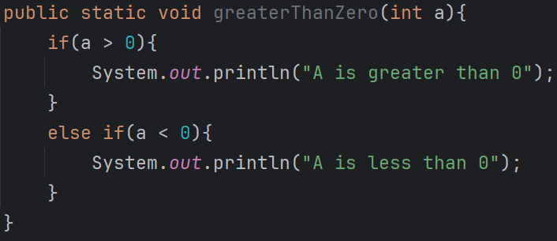
Methods
The method below is of type void and, therefore, cannot return any values.

Slide 20
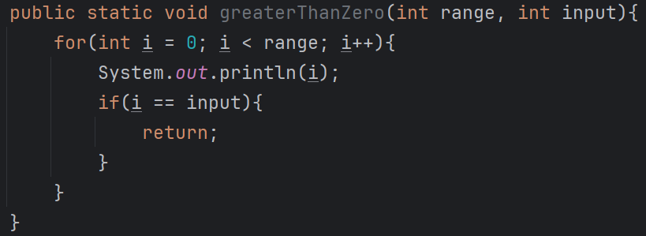
Methods
Void methods can have the return keyword, so long as it isn’t returning any value.
In this case, the return keyword is being used to signal that the method is done executing

Slide 21
Methods – Difference in Parameters
We don’t always have all the information we need before calling a method. Or maybe we do, but we want to use some default value
Python and Java handle this situation differently
Python
  Method parameters can have default values
  If you want to use a default value, simply pass no argument for that parameter
Java
  Method parameters cannot have default values
  Methods can instead be overloaded
  In an overload, you declare several methods with the same name, as long as they have a different list of parameters

Slide 22
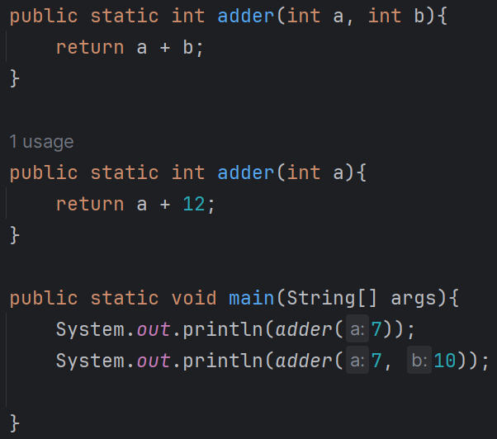
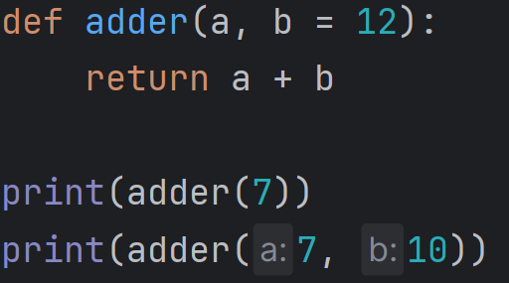

Methods – Difference in Parameters

Slide 23
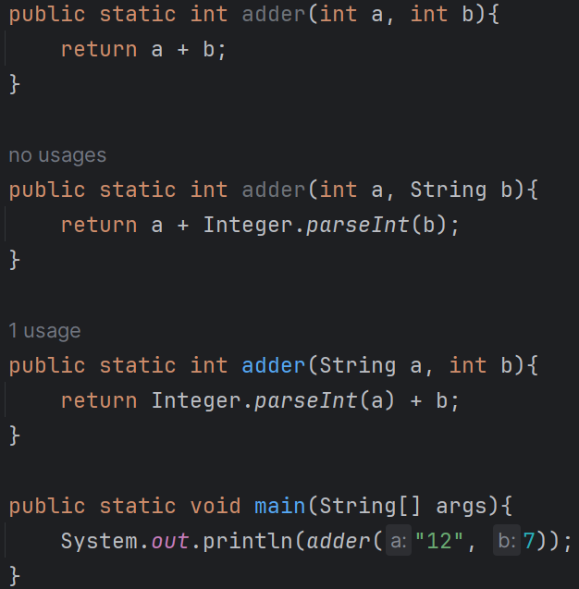
Methods – Difference in Parameters
When using an overload, the computer knows which overload you are trying to use by the types of the arguments you pass
Hence why the argument list between overloads must be different
Changing a method’s return type does not constitute an overload

