Slide 1
Module 7 – Part 5
Classes and Objects

Slide 2
Overview
Python and Java both feature classes and objects in much the same way, with only syntax differences between them
Python:
  Fields declared in the body of a class belong to the class
    These fields are shared among all objects of that class until an assignment is done
  Constructor is called __init__()
  The keyword to specify the object itself is “self”
  An object can have fields added or removed after the program starts
Java
  Fields declared inside the body of a class belong to individual objects
    Only static fields belong to the class itself
  Constructor must have the same name as the class
  The keyword to specify the object itself is “this”
  All object fields are set in stone once the program starts

Slide 3
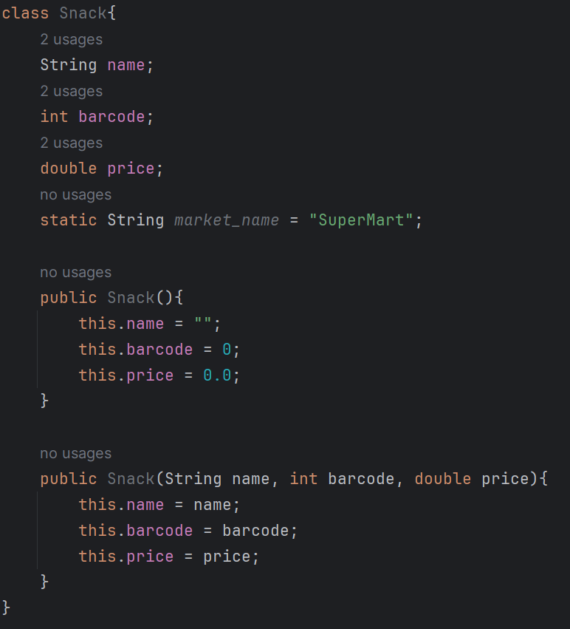
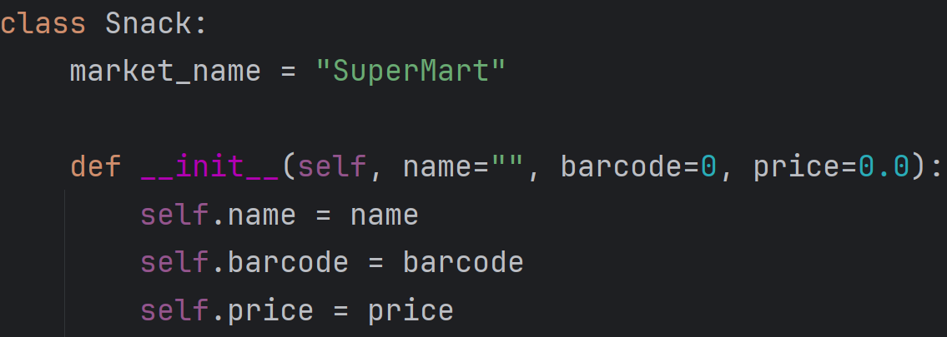
Declaring classes
  Notice we use constructor overloading to achieve in Java what we can do in Python using default parameters
  Notice also that Java constructors (and methods) do not have an obligatory “self” parameter

Slide 4
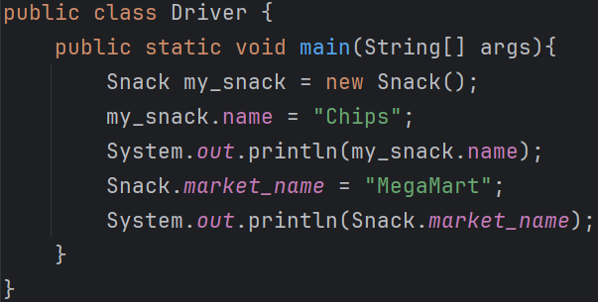
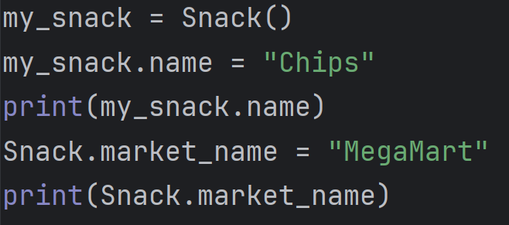
Creating and using objects
  The syntax for creating objects, accessing their fields, and accessing the fields of the underlying class differ, but the concepts are the same

Slide 5
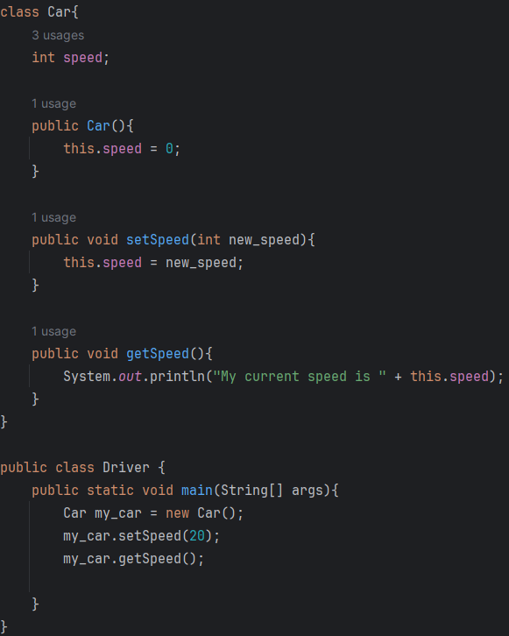
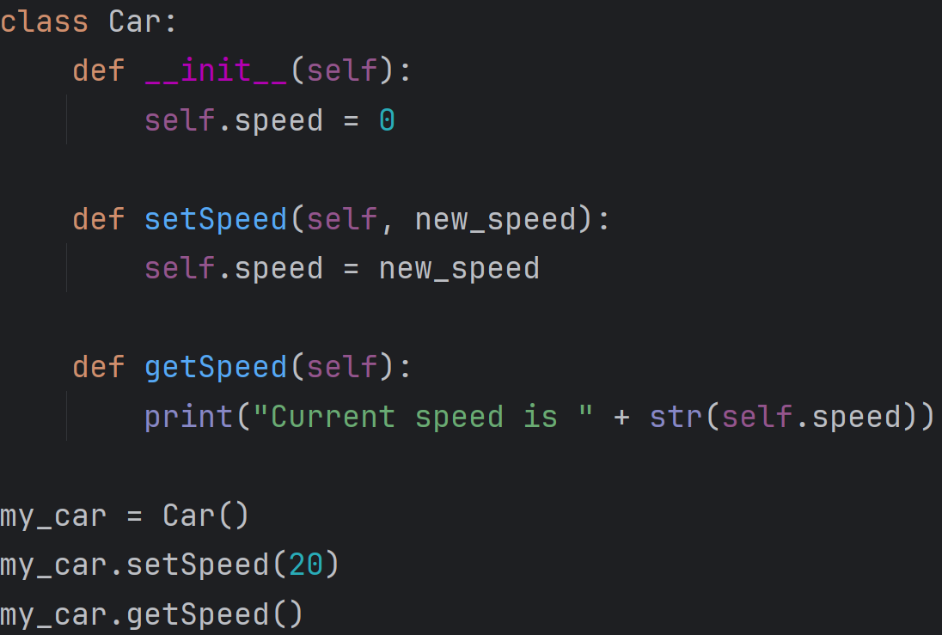
Using objects methods
  We can use object methods very much the same way in both languages
  Notice that methods that aren’t inside of our Driver class must be non-static

Slide 6
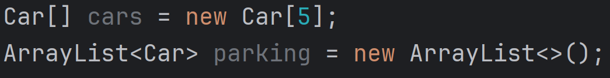
Classes are data types
  Don’t forget that, when you write a class, you are creating a new data type
  As such, you can create collections of that data type
  In the examples below, after we’ve created a Car class, we can freely create arrays or ArrayLists of Cars.

