Slide 1
Arrays
1D & 2D Arrays

Slide 2
Defining a 1D array
CREATE array nums [size]
Ps

Slide 3
C++ - Define a 1D Array
<type><name>[size];
For example:
int size = 10
int grid[size]

Slide 4
Defining a 2D array
CREATE array nums [numRows][numColumns]
Ps

Slide 5
C++ - Define a 2D Array
<type><name>[<row_size>][<column_size>];
For example:
int grid[10][20];

Slide 6
Working with 2D arrays
Usually involves nested loops, as shown below. Problem Statement: Create an array of 4 rows and 5 columns. Populate the array with the numbers 1-20.
--------------------------------------------------------------------- Create array grid[4][5] count = 1
FOR each element in a row
FOR each element in a column grid[row][col] = count
count = count + 1
END INNER FOR END FOR

Slide 7
int count = 1;
int grid[4][5];
//getting the rows in the array
for (int row = 0; row < 4; row++)
{
//populate the values in the array (row) we're currently on from the outer loop
for (int column = 0; column < 5; column++)
{
grid[row][column] = count;
count++;
}
}
//for each array in the grid (represented by rows)
for (int row = 0; row < 4; row++)
{
for (int column = 0; column < 5; column++) {
//for each element in the array (row) we're currently on
cout << grid[row][column] << ",";
if(grid[row][column] % 5 == 0) { cout << endl; }
}
}

Slide 8
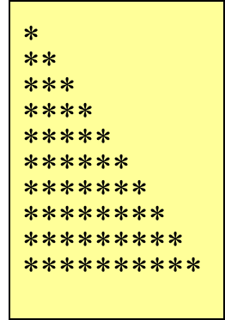
Pseudocode – Nested for Loop Example
BEGIN MAIN CREATE maxRows = 10, row, star
FOR (row = 1, row < maxRows, row = row + 1)
FOR (star = 1, star <= row, star = star + 1)
PRINT “*”
ENDinnerFOR
PRINTLINE () ENDouterFOR
END MAIN
Ps

Slide 9
Nested for Loop Example
int maxRows = 10;
for (int row = 1; row <= maxRows; row++) { for (int star = 1; star <= row; star++) { cout << "*"; }
cout << endl; }

