Slide 1
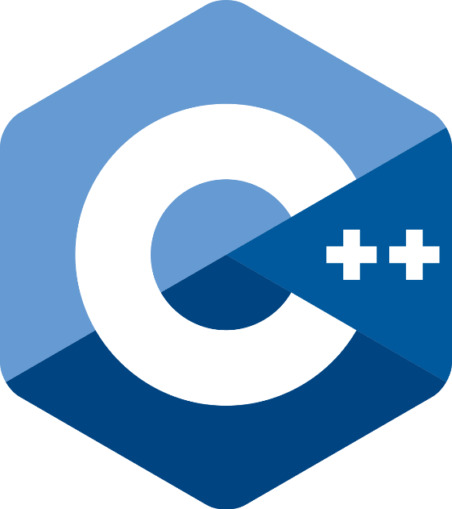
Methods
Ps
Methods and Data Passing

Slide 2
Why have functions?
CREATE average, userNum1, userNum2
PRINT (“Please enter the 2 numbers”)
READ userNum1
READ userNum2
average = (userNum1 + userNum2) / 2
// a lot of other code
READ userNum1
READ userNum2
average = (userNum1 + userNum2) / 2
// more code here, then
READ userNum1
READ userNum2
average = (userNum1 + userNum2) / 2

Slide 3
Header/Body Example
// Header is top line
int Sum(int num1, int num2)
{ // Begin the body
int sum = 0;
for(int i = num1; i <= num2; i++)
{
sum += i;
}
return sum;
} // End the body

Slide 4
Example
double average (int x, int y) {
return ( (x+y) / 2.0);
}
int main()
{
int num1, num2, num3;
double result1, result2;
num1 = 5; num2 = 7; num3 = 4;
result1 = average (num1, num2); // 6
result2 = average (num3, num1); // 4.5
cout<< "Average1 is: "<<result1<< endl;
cout<< "Average2 is: "<<result2;
}
Memory
num1
num2
num3
5
7
4
result1
result2
6
4.5

Slide 5
Another Quick Example (function falls asleep; main awake)
int main ()
{
int num1, num2, num3;
num1 = 5; num2 = 7; num3 = 4;
printNum (num1); //passing data
}
Output
5
Memory
num1
num2
num3
5
7
4
void printNum (int myNum) {
cout<<"Your number is "<<myNum;
}

Slide 6
Psuedocode - A Bad Solution (where is the repeated code?)
Ps
sum = 0
FOR (i = 1 i <= 10 i = i+1)
sum = sum + i ENDFOR
PRINT("Sum from 1 to 10 is “, sum)
sum = 0
FOR (int i = 20 i <= 30 i = i+1)
sum = sum + i ENDFOR
PRINT("Sum from 20 to 30 is “, sum)
sum = 0
for (int i = 35 i <= 45 i = i+1)
sum = sum + i ENDFOR
PRINT("Sum from 35 to 45 is “, sum)

Slide 7
METHOD MAIN BEGIN CREATE result = SUM(arguments: 1,10) PRINT("Sum from 1 to 10 is:”, result) result = SUM(arguments: 20,30) PRINT("Sum from 20 to 30 is:”, result) result = SUM(arguments: 35,45) PRINT("Sum from 35 to 45 is:”, result) END MAIN METHOD SUM(parameters: num1, num2) BEGIN CREATE sum = 0 FOR (i = num1, i <= num2, i = i+1 ) sum = sum + i ENDFOR RETURN sum END SUM
Ps

Slide 8
C++ Example – Method Sum
int Sum(int num1, int num2)
{
int sum = 0;
for(int i = num1; i <= num2; i++)
{
sum += i;
}
return sum;
}
int main()
{
int result = Sum(1, 10);
cout<<"Sum from 1 to 10 is " << result<<endl;
result = Sum(20, 30);
cout<<"Sum from 20 to 30 is " << result<<endl;
result = Sum(35, 45);
cout<<"Sum from 35 to 45 is " << result<<endl;
}

Slide 9
Psuedocode - Method Max
Ps
METHOD MAIN BEGIN CREATE i = 5 CREATE j = 2 CREATE k = max(i, j)
PRINT("The maximum of ", i , " and ” , j ," is ", k) END MAIN
METHOD MAX(parameters: num1, num2) BEGIN CREATE result if (num1 > num2) result = num1 else result = num2 RETURN result END MAX

Slide 10
C++ – Method Max
int main() {
int i = 16, j = 2;
int k = max(i, j);
cout<<"The maximum of "<<i<<" and "<<j<<" is "<< k;
}
int max(int num1, int num2)
{
int result;
if (num1 > num2)
{
result = num1;}
else{
result = num2;
}
return result; }

Slide 11
#include <iostream>
#include<string>
using namespace std;
int math(int x, int y) {
return x+y;
}
int math (int x) {
return x*x;
}
double math(double x, double y) {
return x*y;
}
string math (){
return "Why does this work?";
}
int main() {
cout<<math(7.5, 9.5)<<endl; // Prints 71.25
cout<<math(4)<<endl; // Prints 16
cout<<math()<<endl; // Prints ”Why does this work?”
}

