Slide 1
Module 1
Part 3:
Using complex data types in Java
Arrays
ArrayList
Strings

Slide 2
Complex types
We’ve seen that Java has 8 primitive types:
4 types of decimal numbers (byte, short, int, long)
2 types of floating point numbers (float, double)
char
boolean
Everything else is a complex type.
Complex types are generally built on primitive types
They are Objects

Slide 3
String
In Java, a string is considered a complex type.
It is effectively a list of characters.
In Java, the data type is String with a capital S
String color=”Blue”;
Strings are used all the time.

Slide 4
String Object
Strings are actually stored in objects.
As a refresher, an object can contain:
Data attributes
Methods (functions)
You can access an attribute, or call a method in an object using a . operator.
For example:
String myColor=”Blue”;
int sizeOfColor=myColor.length()
length() is a method in the string object

Slide 5
Java String Manipulation
String example=”Test,1,2”;
example.toUpperCase() → “TEST,1,2”
example.toLowerCase() → “test,1,2”
example.trim() //Removes spaces at front and end
example.equals(String) → Compare strings
example.equalsIgnoreCase(String) → case insensitive compare.

Slide 6
Accessing specific characters in a string
String example=”Test,1,2”;
example.length() → 8 //There are 8 characters
example.charAt(0) -> ‘T’ //The first character.
example.charAt(example.length()-1) -> ‘2’ //Last character
example.substring(2,5) → “st,”
Note in Java it’s start position, end position, it doesn’t include the end position.
example.split(“,”) //returns an array of strings [“Test”,”1”,”2”]
example.toCharArray() //Produces an array of chars

Slide 7
Collections
In Python you had lists []’s, tuples ()’s and sets {}’s
In Java you have:
Array[]
Arrays are fixed in size. You declare the size when you create them.
They can only hold one type at a time.
ArrayList
They grow and shrink as you need them to.
They likewise can only hold a single type at a time, you declare it when you create them.
We’ll see more later in the semester.

Slide 8
ArrayList
Python | Java
name=("alice","bob","eve") for person in name: print(person) | import java.util.ArrayList; ArrayList<String> names = new ArrayList<String>(); names.add("alice"); names.add("bob"); names.add("eve"); for(String person : names) { System.out.println(person); }

Slide 9
ArrayList
Linear data structure which can hold data of the same type
As items are added it’s grows to the necessary size
As items are removed it can shrink to the correct size
Like arrays, they are indexed from position 0
Much like a list in Python

Slide 10
Creating an ArrayList in Java
import java.util.ArrayList;
ArrayList<String> myStr = new ArrayList<String>();
ArrayList<Integer> myNum = new ArrayList<Integer>();
Notes:
You specify the type you will store in the ArrayList in <>’s
ArrayList can only hold items of a single type.
ArrayLists must be of OBJECTS. If you want an arraylist of primitive types you must use the object wrapper (int -> Integer, double -> Double etc).

Slide 11
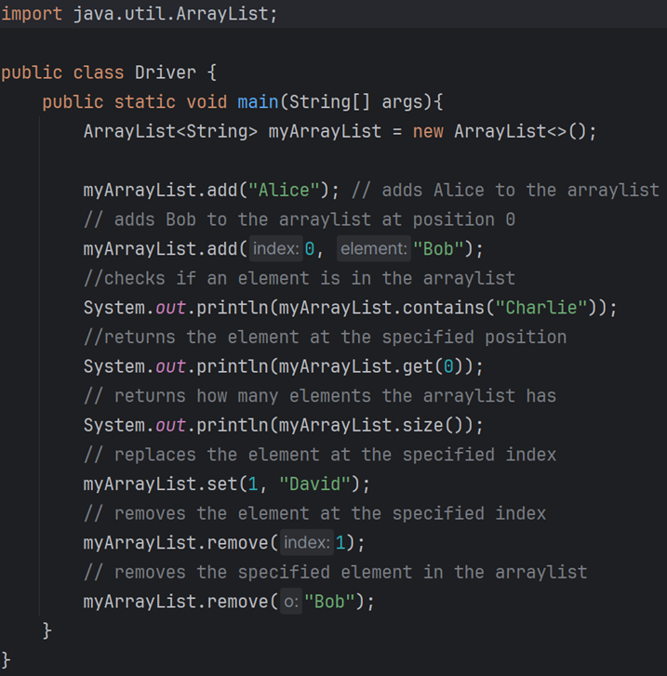
ArrayLists Methods
Has methods such as:.
.add()
.remove(index to remove)
.remove(object to remove)
.size() //returns how many items in the ArrayList
.get() //returns object at index
.clear() //clears the ArrayList
.contains() //Searches if an item is in the list
.isEmpty() //returns true/false
.set(index, new) //replaces the item at position index
Start of with capacity of 10, grows as it’s needed.

Slide 12
Example
import java.util.*;
class Main {
public static void main(String[] args) {
ArrayList<Integer> myList = new ArrayList<Integer>();
for (int i = 0; i < 5; i++) {
myList.add(i);
}
for (int x : myList) {
System.out.println(x);
}
}
}

Slide 13
Arrays
Arrays are very similar to ArrayLists, but are more limited.
Cannot be sliced
Can only hold a single data type
Cannot change size once created.
Think of them as a liner collection of one data type
What is the benefit of Arrays?
They are guaranteed to occupy the amount of space you allocated when you created them.
More on this later.
They can be multidimensional.

Slide 14
Array Of Integers
int[] myIntArray = new int[10];
This creates an array which can hold 10 integers.
Specifically in memory this will allocated 10*32bits
Note there are two parts
Declaration of array of ints called myIntArray.
Creation of the space to hold 10 ints.
Can't use until memory is allocated with new.
In java the [] can be after myIntArray or after the type (int).

Slide 15
Reading and writing to arrays.
Getting information from an array:
variable = name[position]; // reads value at position in name
Storing information in an array:
name[position] = value; // stores value at position in name
Note arrays are indexed from 0
This is probably one of the most common mistakes when using arrays
If you create an array of size 10, it has cells 0-9, NOT 1-10.

Slide 16
Class Example
Make an Array of size 10 which holds ints.
Using a loop, keep prompting the user to enter a number.
Store each number in the next cell of an array.
If the user enters -1, or the array is full, stop asking.
Print out the smallest of the numbers that were entered (excluding the -1).

Slide 17
import java.util.Scanner;
public class Main {
public static void main(String[] args) {
Scanner myScan=new Scanner(System.in);
int[] numbers=new int[10];
int position=0;
do {
System.out.println("Enter a number, enter -1 to stop");
int nextNumber=myScan.nextInt();
if(nextNumber!=-1) {
numbers[position]=nextNumber;
position++;
}
else {
break;
}
}while(position<numbers.length);
int smallest=numbers[0];
for(int i=1;i<position;i++) {
if(numbers[i]<smallest) {
smallest=numbers[i];
}
}
System.out.println("Smallest is: "+smallest);
}
}

Slide 18
Running the code
Imagine a user runs the code from the previous example. The user enters:
Enter a number, enter -1 to stop
17
Enter a number, enter -1 to stop
5
Enter a number, enter -1 to stop
22
Enter a number, enter -1 to stop
1
Enter a number, enter -1 to stop
-1
Smallest is: 1

Slide 19
Picturing numbers
Numbers starts off with all 0’s in it, because Java initializes all int’s to 0 automatically.
This was done with this line of code:
int[] numbers=new int[10];
0
1
2
3
4
5
6
7
8
9
0
0
0
0
0
0
0
0
0
0
Position

Slide 20
Picturing numbers
do {
System.out.println("Enter a number, enter -1 to stop");
int nextNumber=myScan.nextInt();
if(nextNumber!=-1) {
numbers[position]=nextNumber;
position++;
}
else {
break;
}
}while(position<numbers.length);
Enter a number, enter -1 to stop
17
0
1
2
3
4
5
6
7
8
9
17
0
0
0
0
0
0
0
0
0
Position

Slide 21
Picturing numbers
do {
System.out.println("Enter a number, enter -1 to stop");
int nextNumber=myScan.nextInt();
if(nextNumber!=-1) {
numbers[position]=nextNumber;
position++;
}
else {
break;
}
}while(position<numbers.length);
Enter a number, enter -1 to stop
5
0
1
2
3
4
5
6
7
8
9
17
5
0
0
0
0
0
0
0
0
Position

Slide 22
Picturing numbers
do {
System.out.println("Enter a number, enter -1 to stop");
int nextNumber=myScan.nextInt();
if(nextNumber!=-1) {
numbers[position]=nextNumber;
position++;
}
else {
break;
}
}while(position<numbers.length);
Enter a number, enter -1 to stop
22
0
1
2
3
4
5
6
7
8
9
17
5
22
0
0
0
0
0
0
0
Position

Slide 23
Picturing numbers
do {
System.out.println("Enter a number, enter -1 to stop");
int nextNumber=myScan.nextInt();
if(nextNumber!=-1) {
numbers[position]=nextNumber;
position++;
}
else {
break;
}
}while(position<numbers.length);
Enter a number, enter -1 to stop
1
0
1
2
3
4
5
6
7
8
9
17
5
22
1
0
0
0
0
0
0
Position

Slide 24
Picturing numbers
do {
System.out.println("Enter a number, enter -1 to stop");
int nextNumber=myScan.nextInt();
if(nextNumber!=-1) {
numbers[position]=nextNumber;
position++;
}
else {
break;
}
}while(position<numbers.length);
Enter a number, enter -1 to stop
-1
0
1
2
3
4
5
6
7
8
9
17
5
22
1
0
0
0
0
0
0
Position

Slide 25
Picturing numbers
int smallest=numbers[0];
for(int i=1;i<position;i++) {
if(numbers[i]<smallest) {
smallest=numbers[i];
}
}
System.out.println("Smallest is: "+smallest);
smallest = 17
i=1
If(5<17) {
smallest = 5
}
0
1
2
3
4
5
6
7
8
9
17
5
22
1
0
0
0
0
0
0
i
Position

Slide 26
Picturing numbers
int smallest=numbers[0];
for(int i=1;i<position;i++) {
if(numbers[i]<smallest) {
smallest=numbers[i];
}
}
System.out.println("Smallest is: "+smallest);
smallest = 5
i=2
If(22<5) {
//It’s not!
0
1
2
3
4
5
6
7
8
9
17
5
22
1
0
0
0
0
0
0
i
Position

Slide 27
Picturing numbers
int smallest=numbers[0];
for(int i=1;i<position;i++) {
if(numbers[i]<smallest) {
smallest=numbers[i];
}
}
System.out.println("Smallest is: "+smallest);
smallest = 5
i=3
If(1<5) {
smallest = 1
}
0
1
2
3
4
5
6
7
8
9
17
5
22
1
0
0
0
0
0
0
i
Position

Slide 28
Picturing numbers
int smallest=numbers[0];
for(int i=1;i<position;i++) {
if(numbers[i]<smallest) {
smallest=numbers[i];
}
}
System.out.println("Smallest is: "+smallest);
smallest = 1
i=4
for( ; 4<4; )
//4 is not less than 4, so the loop stops
0
1
2
3
4
5
6
7
8
9
17
5
22
1
0
0
0
0
0
0
i
Position

Slide 29
Array of Strings
String[] names = new String[3];
names[0]="Alice";
names[1]="Bob";
names[2]="Eve";
for(String person : names) {
System.out.println(person);
}

Slide 30
Alternative syntax to create and initialize Arrays
double[] grades = new double[] {92.8,78.4,44.6};
double sum=0;
for(int i=0;i<grades.length;i++) {
sum+=grades[i];
}
double average=sum/grades.length;
System.out.println("Average: "+average);

Slide 31
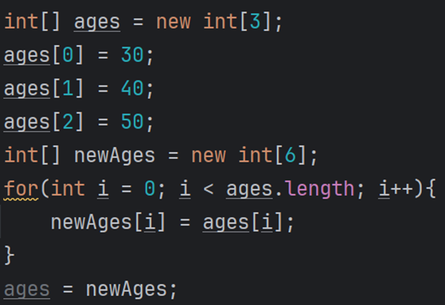
Resizing Arrays
What if you create an array but realize later on that you need a bigger array?
You’ll have to create a new array with the new size, and then copy over the contents of the old array.
We can determine the size of an array by using .length

Slide 32
Searching Arrays
If you want to check if a particular element is inside an array, you’ll need to do it manually.
There is no “in” keyword for a “if element in array:” statement.

Slide 33
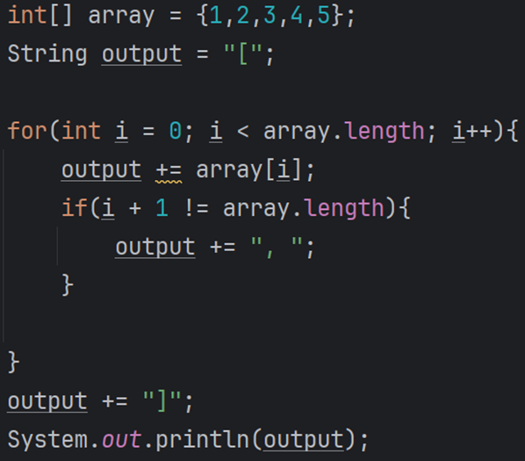
Printing Arrays
Printing an array simply prints out its memory representation
If you want to print the contents of an array, you’ll have to do it manually

Slide 34
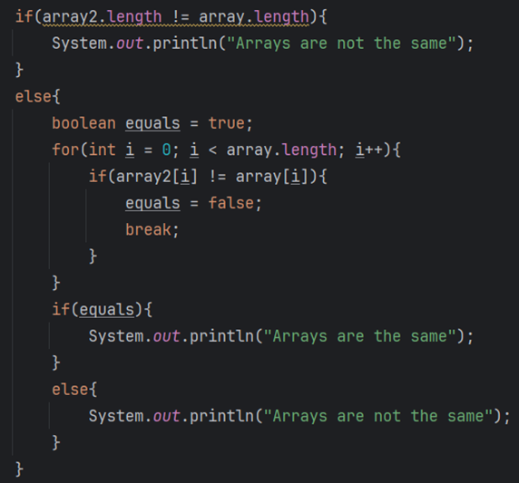
Comparing Arrays
If you want to compare if two arrays have the same contents, much like with strings, using == will not work.
You’ll have to compare the arrays manually

Slide 35
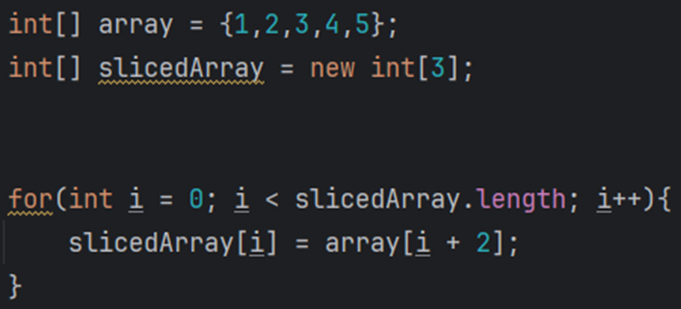
Slicing Arrays
If you want to slice an array, you’ll do it manually
The examples below are equivalent

Slide 36
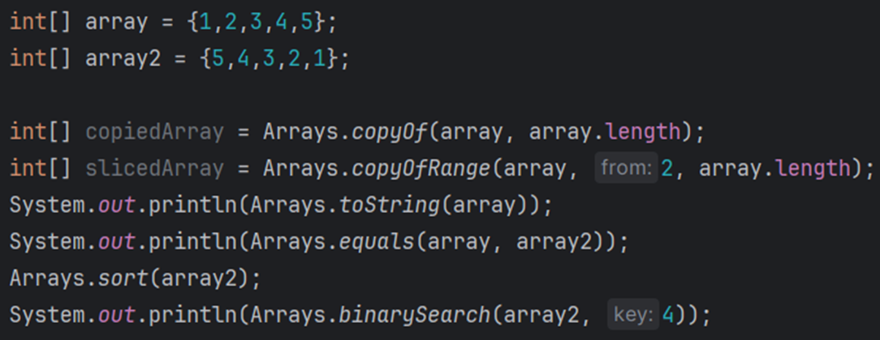
Array Class
Java arrays are objects, so you can use some of the built in object methods:

Slide 37
Arrays of Objects
Trophy[] troph;
//Each cell of the array can hold a Trophy (object)
System.out.println(“How many trophies?”);
int trophie_count=myScan.nextInt();
troph = new Trophy[trophie_count];

Slide 38
Multi-Dimensional Array of Integers
int[][] myIntArray = new int[10][10];
This produces a 2D array with 100 cells.
You can think of it as an array of arrays.
The first number represents the row
The second number represents the column
You access the last cell as:
myIntArray[9][9];
You can have 3D, 4D arrays...

Slide 39
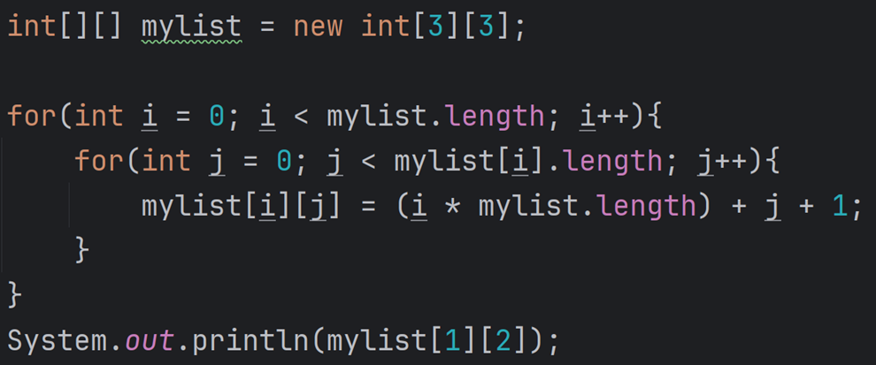
Working with multidimensional arrays
This creates a 3x3 array
Notice you’ll have 2 loops to iterate across the structure, one for rows, one for columns.

