Slide 1
Module 2 - Part 1
Parameters, Pass By Value, Pass by Reference, Overloading Methods,
and Garbage Collection

Slide 2
Overview
See different ways to pass parameters
By reference
By value
By 'out'
See how 'garbage' is created
Demonstrate the ref keyword in C#

Slide 3
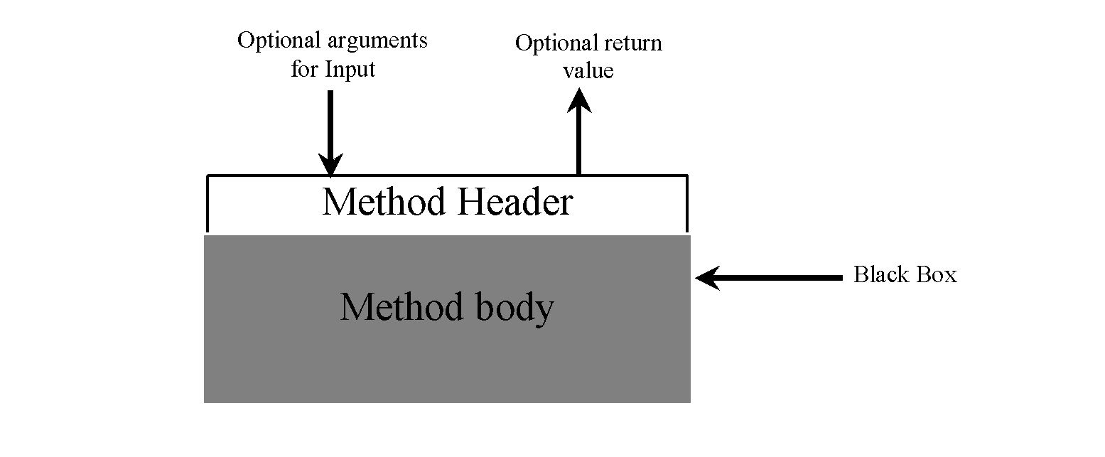
Review: What is a Method?
Think of a method as a black box that contains the detailed implementation for a specific task.
The method may use inputs (parameters)
It may return an output with a specific type.

Slide 4
Method Structure
Return Type
Method Name
Formal Parameters
Modifiers
Method Header
public static int addTwoNums (int x, int y) { return x + y; }
Method Body

Slide 5
Calling the Method
Return Type
Method Name
Formal Parameters
Modifiers
Method Header
public static int addTwoNums (int x, int y) { return x + y; }
Method Body
Actual parameters (called ”arguments”)
int result = addTwoNums (5, 2);

Slide 6
What is the output of this code?
static void B (int x) { // Built-in type argument passing
x += 9;
PRINT (x); //Prints 51, because x was 42, then 9 was added.
}
public static void M/main (S/string[] args) {
int a = 42;
PRINT (a); // Prints 42
B (a); // Prints 51 because is call-by-value;
PRINT (a); // Prints 42
}

Slide 7
Very Important:
In that last example we called method B and passed it an argument of: a
a is an integer
Method B has a formal parameter x which is given a COPY of the value of a
Thus changes to x have no effect on a, as x was given a COPY of the value.
This is true for all primitive types (int, long, float, double and even String)

Slide 8
What about Complex Data Types?
With classes/objects, we still pass by value
HOWEVER, we are copying the reference to the object
We’ll start with code, then look at what’s going on

Slide 9
class Dog { public int weight; }
static void B(Dog x) {
x.weight += 9;
PRINT(x.weight);
}
public static void M/main(S/string[] args) {
Dog myDog = new Dog();
myDog.weight = 10;
PRINT(myDog.weight);
B(myDog);
PRINT(myDog.weight);
}
myDog
weight = 0;

Slide 10
class Dog { public int weight; }
static void B(Dog x) {
x.weight += 9;
PRINT(x.weight);
}
public static void M/main(S/string[] args) {
Dog myDog = new Dog();
myDog.weight = 10;
PRINT(myDog.weight);
B(myDog);
PRINT(myDog.weight);
}
myDog
weight = 10;

Slide 11
class Dog { public int weight; }
static void B(Dog x) {
x.weight += 9;
PRINT(x.weight);
}
public static void M/main(S/string[] args) {
Dog myDog = new Dog();
myDog.weight = 10;
PRINT(myDog.weight);
B(myDog);
PRINT(myDog.weight);
}
// PRINTS 10 to the screen
myDog
weight = 10;

Slide 12
class Dog { public int weight; }
static void B(Dog x) {
x.weight += 9;
PRINT(x.weight);
}
public static void M/main(S/string[] args) {
Dog myDog = new Dog();
myDog.weight = 10;
PRINT(myDog.weight);
B(myDog);
PRINT(myDog.weight);
}
// MAGIC HAPPENS! x is a copy of myDog...
// That is, x points to the same thing
// myDog points to
x
myDog
weight = 10;

Slide 13
IMPORTANT
Watch what happens to the weight variable

Slide 14
class Dog { public int weight; }
static void B(Dog x) {
x.weight += 9; // Look at weight before…
PRINT(x.weight);
}
public static void M/main(S/string[] args) {
Dog myDog = new Dog();
myDog.weight = 10;
PRINT(myDog.weight);
B(myDog);
PRINT(myDog.weight);
}
x
myDog
weight = 10;

Slide 15
class Dog { public int weight; }
static void B(Dog x) {
x.weight += 9; // Look at weight after!
PRINT(x.weight);
}
public static void M/main(S/string[] args) {
Dog myDog = new Dog();
myDog.weight = 10;
PRINT(myDog.weight);
B(myDog);
PRINT(myDog.weight);
}
x
myDog
weight = 19;

Slide 16
class Dog { public int weight; }
static void B(Dog x) {
x.weight += 9;
PRINT(x.weight); // print out 19
}
public static void M/main(S/string[] args) {
Dog myDog = new Dog();
myDog.weight = 10;
PRINT(myDog.weight);
B(myDog);
PRINT(myDog.weight);
}
x
myDog
weight = 19;

Slide 17
class Dog { public int weight; }
static void B(Dog x) {
x.weight += 9;
PRINT(x.weight);
}
public static void M/main(S/string[] args) {
Dog myDog = new Dog();
myDog.weight = 10;
PRINT(myDog.weight);
B(myDog);
PRINT(myDog.weight); // print out 19
}
x
myDog
weight = 19;

Slide 18
IMPORTANT
myDog’s weight has changed!
WHY?
Because we passed an OBJECT to the method, not a primitive type.

Slide 19
Summary
Anytime you pass a primitive type (e.g. int, long, float, char, String) to a method, a copy of the value is made.
Any changes made to the parameter is local to the method.
Anytime you pass an object a copy of the reference to the object is passed.
Any changes made to the object persist after the call to the method.
This is true in both Java and C# by default.
However, C# has some additional capabilities.

Slide 20
How else can a method change a value?
Sometimes you need to write a method which changes an attribute. How can you do this if you are always passing primitive types as values?
You have two choices:
Wrap the primitive type in an object. Pass the object to the method, now changes will be persistent.
Pass the value to the method, and have the method return the altered value. e.g.:
int change_x (int x) {
x++;
return (x);
}
//In Main:
int a=change_x(a);

Slide 21
C# specific options...
Keyword ref: Passes a reference to the actual variable. Use this when you want to pass a value in and have any change to that value be persistent when the method is complete
Keyword out: Use this when you want the method to initialize a value and place it for later use in the actual variable (persists when the method is complete)

Slide 22
C# ref example
static void B (ref int x)
{
x += 9;
Console.WriteLine (x);
}
public static void Main (string[] args) {
int a = 42;
Console.WriteLine (a); // Prints 42
B (ref a); // Prints 51 BUT! a has changed!
Console.WriteLine (a); // Prints 51
}

Slide 23
C# out keyword
Remember, this is used to initialize a variable
Why even have it? We have ref, right?
Honestly, out isn’t used often, but:
Marks the “intent” of what you’re doing
Could prevent bad data from coming in

Slide 24
C# out example
static void B (out int x)
{
x = 9;
Console.WriteLine (x);
}
public static void Main (string[] args) {
int a; // We can't print this yet - not initialized
B (out a); // Initializes a and prints 9
Console.WriteLine (a); // Prints 9
}

Slide 25
Garbage...
How it’s made, How it’s handled.

Slide 26
Let’s look at this example:
class Number {
int x=7;
public Number(int x) {
this.x=x;
}
}
class Main {
public static void main(String[] args) {
Number a = new Number(5);
a = new Number(8);
}
}
What happened in Main?
First we defined an attribute called a, which was of type Number
On the next line we create a new Number object on top of a
What happened to the Number object that contained 5?
It’s gone!....Sorta

Slide 27
Let’s look at this example:
class Number {
int x;
public Number(int x) {
this.x=x;
}
}
class Main {
public static void main(String[] args) {
Number a = new Number(5);
a = new Number(8);
}
}
a
Number
x=5

Slide 28
Let’s look at this example:
class Number {
int x;
public Number(int x) {
this.x=x;
}
}
class Main {
public static void main(String[] args) {
Number a = new Number(5);
a = new Number(8);
}
}
a
Number
Number
x=5
x=8

Slide 29
Let’s look at this example:
This number object is no long referenced by any variable
It is considered garbage
Soon the garbage collector will come along and remove it.
a
Number
Number
x=5
x=8

Slide 30
What is a garbage collector?
A task that runs in the background.
Any object that you create that is no longer in use, is cleaned up by the garbage collector
There is no guarantee of when it will be cleaned up
If the garbage collector is too aggressive it could hinder performance of your program, so it tends to run when your program is waiting on something like user input.

Slide 31
Overloading Methods
Using the same method name for multiple methods
The signature of each overloaded method must be unique
The signature includes the number, type, and order of the parameters
The compiler determines which version of the method is being invoked by analyzing the parameters
The return type of the method is not part of the signature

Slide 32
Overloading Methods
float tryMe (int x){
return x + .375;
}
float tryMe (int x, float y){
return x*y;
}
// Which tryMe is called?
result = tryMe (25, 4.32f);

Slide 33
Overloading Operators
C#, not only can methods be overloaded, even operators (e.g. +, -, *, /, ==, ++, etc) can be overloaded.
Use operator overloading when it makes an application clearer than accomplishing the same operations with explicit method calls.
Java does not allow operator overloading, equivalent is to define addDogs() methods

Slide 34
Rules for Operator Overloading
Keyword operator, followed by an operator symbol, indicates that a method overloads the specified operator.
Methods that overload binary operators must take two arguments—the first argument is the left operand, and the second argument is the right operand.
Overloaded operator methods must be public and static.

Slide 35
public class Dog {
public string name;
public int weight;
public Dog(string name, int weight) {
this.name = name; this.weight = weight;
}
public static Dog operator+ (Dog d1, Dog d2) {// Overload the + operator
Dog mergedDog = new Dog("ComboDog", 0);
mergedDog.name = d1.name+":"+d2.name;
mergedDog.weight = d1.weight+d2.weight;
return mergedDog;
}
}
class MainClass {
public static void Main(String[] args) {
Dog myDog = new Dog("CSE", 8);
Dog yourDog = new Dog ("1322", 9);
Dog uberDog = myDog + yourDog; // Add two dogs together!
Console.WriteLine (uberDog.name + " weighs " + uberDog.weight);
}
} // OUTPUT is CSE:1322 weighs 17

