Slide 1
Module 3
Part 1
Inheritance

Slide 2
UML - Unified Modeling Language
Often you’ll need to discuss design of classes with coworkers. Being able to visualize your classes in a consistent way is very helpful.
UML allows you to draw the important details of a class for discussion.
Most IDEs have built in way to draw a UML diagram from your code. Typically teams have an up to date UML on their wall near their work area, so they can quickly reference Methods/Attributes for classes.
Each class is drawn as a rectangle, with the class name at the top, followed by all the attributes, then all the methods.
Constructors are often not mentioned.

Slide 3
UML permissions
Attributes and methods that are public will have a + on front of them.
Attributes and methods that are private will have a - on front of them.
Protected attributes we’ll discuss later are represented by a #

Slide 4
An Example – Mammal Class
What do all mammals have?
Temperature
Weight
Intelligence level
Fur color
What do all mammals do?
Eat( )
Drink( )
Move( )
GiveBirth( )
So far, no inheritance
Mammal
+ temp
+ weight
+ iQ
+ furColor
+ Eat( )
+ Drink( )
+ Move( )
+ GiveBirth( )
This is called a UML Diagram

Slide 5
Inheritance Introduction
‹#›
Inheritance allows a new class to “absorb” an existing class’s members.
All non-private attributes and methods of the parent are now available to the child.
Inheritance saves time by reusing proven and debugged high-quality software.
Best shown through an example
Notes:
‹#›

Slide 6
The Dog Class
What we could do is just copy/paste the code and rename to Dog
Do the same thing for:
Cat
Elephant
Boar
Cow
No copy/pasting! BAD! USE INHERITANCE when classes are similar
Mammal Dog
+ temp
+ weight
+ iQ
+ furColor
+ Eat( )
+ Drink( )
+ Move( )
+ GiveBirth( )

Slide 7
Inheritance
Mammal
+ temp
+ weight
+ iQ
+ furColor
+ Eat( )
+ Drink( )
+ Move( )
+ GiveBirth( )
Dog
Cat
Cow
Note: arrows point up to class they inherit from

Slide 8
Inheritance
Trick questions:
how many attributes does Dog have?
how many methods does Dog have?

Slide 9
Inheritance
Trick questions:
how many attributes does Dog have?
how many methods does Dog have?
Dog, Cat, and Cow have 4 attributes and 4 methods, even though you can’t see them
No need to redeclare those attributes
It’s because of inheritance!

Slide 10
Customizing your Dog
Your Dog is basically no different than a Mammal
At this point, you can:
Add additional attributes
Add additional methods
You can also override (redefine) inherited methods
Don’t confuse overriding with overloading (which is having two methods with the same name)

Slide 11
Terminology
‹#›
The is-a relationship represents inheritance.
a Dog is a Mammal
a Cow is a Mammal
Mammal is called a super class, parent class, or a base class (all mean the same thing)
Dog/Cow/Cat would be a derived class, a sub class, or child class
Notes:
‹#›

Slide 12
Inheritance example
import java.util.*;
class Mammal {
public float weight;
public int iQ;
}
class Dog extends Mammal {
// There are 2 attributes here that you
// can't see because of inheritance!
}
class Main {
public static void main (String[] args) {
Dog d = new Dog();
}
}

Slide 13
Inheritance Fundamentals
The hierarchy can be extended:
A Labrador is-a Dog
A Labrador is-a Mammal
A Mammal has-a string (furColor)
Mammal
Dog
Labrador

Slide 14
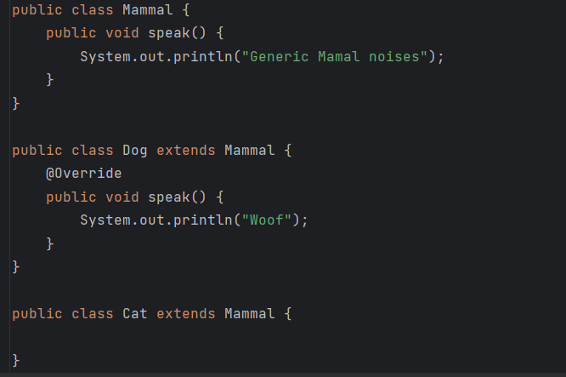
Example of overriding a method
If you inherit a method from your parent, but you need to do things slightly differently, you’ll override the method.

Slide 15
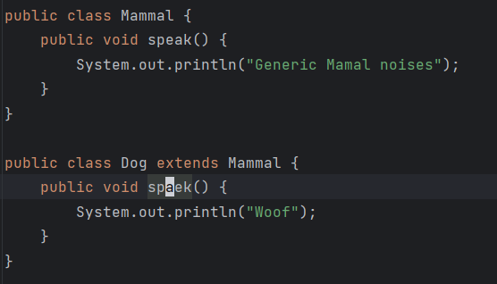
@Override keyword
In java the @Override keyword is technically optional
You should always include it when you are doing an override.
If you put it in, Java can check that you are successfully overriding a method that you inherited.
Without it, Java will let you silently fail to override a method.
This is not a successful override…

Slide 16
Object is the mother of all classes
All classes inherit from Object
If you don’t specify, a class directly inherits from Object
This will be “invisible” code
Object defines basic things like toString( )
This is why you “override” toString( )
Redefine it to print something meaningful
When overriding, method signature must match
Default: print memory address of object

Slide 17
Example of “Invisible Code”
// This class...
class Mammal {
public float weight;
public int iQ;
}
// ...is exactly the same thing as this one
class Mammal extends Object {
public float weight;
public int iQ;
}

Slide 18
Example of Overriding ToString()
class Mammal extends Object {
public float weight;
public int iQ;
public Mammal () {
weight = 7; iQ = 45;
}
}
class Dog extends Mammal {
@Override
public String toString() {
String s = "Weight is " + weight;
s+= " and IQ is " + iQ + "\n";
return s;
}
}
class Main {
public static void main(String[] args) {
Dog d = new Dog();
System.out.println(d); // Weight is 7 and IQ is 45
}
} // @Override tells the compiler to check the override

Slide 19
Methods of Object
Method | Description
clone​() | Creates and returns a copy of this object.
equals​(Object obj) | Indicates whether some other object is "equal to" this one.
getClass​() | Returns the runtime class of this Object.
hashCode​() | Returns a hash code value for the object.
notify​() | Wakes up a single thread that is waiting on this object's monitor.
notifyAll​() | Wakes up all threads that are waiting on this object's monitor.
toString​() | Returns a string representation of the object.
wait​() | Causes the current thread to wait until another thread invokes the notify() method or the notifyAll() method for this object.
wait​(long timeout) | Causes the current thread to wait until either another thread invokes the notify() method or the notifyAll() method for this object, or a specified amount of time has elapsed.
wait​(long timeout, int nanos) | Causes the current thread to wait until another thread invokes the notify() method or the notifyAll() method for this object, or some other thread interrupts the current thread, or a certain amount of real time has elapsed.
Notes:
‹#›

Slide 20
Multiple Inheritance not allowed
Werewolf w = new Werewolf( );
w.run(); // which run method is called?
Man
- weight
+ run( )
Wolf
- num puppies
+ run( )
Werewolf
- weight
- num puppies
+ run( )

Slide 21
Note about interfaces
Keep this example in mind. We’ll revisit it when talking about interfaces later.
Man
- weight
+ run( )
Wolf
- num puppies
+ run( )
Werewolf
- weight
- num puppies
+ run( )

Slide 22
super keywords
super is how we reference things in the parent class
In the child classes, you may see code like:
super.myMethod( ) – call the parent class’s myMethod()
Only needed if the child has overridden a method in the parent, and you want to call the original parents version. (Rare!)
Best shown through examples

Slide 23
Example: Referencing Parent Classes
class Mammal extends Object {
public void makeNoise() {
System.out.println ("AHOOWOOW");
}
}
class Dog extends Mammal {
@Override
public void makeNoise() {
super.makeNoise();
System.out.println("Woof!");
}
}
class Main {
public static void main(String[] args) {
Dog d = new Dog();
d.makeNoise(); // Prints AHOOWOOW then Woof!
}
}

Slide 24
Calling a parents constructor
All constructors in children classes automatically call their parents constructor.
If you don’t use the word super in a child’s constructor, it’ll automatically call the parents default (ie, no parameters) constructor.
This happens whether you like it or not!!!
This is more “invisible code”
If you wish to call a different constructor, you simply add the word super() passing the appropriate parameters.
Best shown through examples

Slide 25
Implicit code is highlighted in yellow
class Mammal extends Object {
public Mammal () {
System.out.println ("Mammal constructor");
}
}
class Dog extends Mammal {
public Dog() {
super();
System.out.println("Dog constructor");
}
}
class Main {
public static void main(String[] args) {
// Wow! Output is:
// Mammal constructor
// Dog constructor
Dog d = new Dog();
}
}

Slide 26
This code calls the overloaded constructor in Student
public class Student {
String name;
public Student() {
name="unknown";
}
public Student(String newName) {
name=newName;
}
}
public class KSUStudent extends Student{
public KSUStudent() {
super("Unknown KSU Student");
}
}

Slide 27
Access Modifiers
There are four levels of visibility (for this course)
Here are loose/sloppy definitions:
public – is visible everywhere in the code
private – is visible only within the class
protected – is visible only within the class or child classes
default – varies by language
In general, visible to class in the same package/namespace
Note: You do not specify ‘default’ in your code when labeling attributes/methods in a class.
Note: default is a keyword used in switch statements

Slide 28
Access Modifiers in Inheritance
Access Location | Access Modifiers
 | public | protected | default | private
Same Class | Yes | Yes | Yes | Yes
Sub-Class of the Same Package | Yes | Yes | Yes | NO
Another Class of the Same Package | Yes | Yes | Yes | NO
Sub-Class of Another Package | Yes | Yes | NO | NO
Sub-Class/ Class of Another Package | Yes | No | NO | NO
Figure: Base Class Member’s Visibility Modes
Notes:
‹#›

Slide 29
Access Modifiers
‹#›
Most things are public by default in Java
This is desirable for methods, but undesirable for attributes
private members are not inherited and are not directly accessible by child-class methods and properties.
Must access a parent’s private variables by methods of that parent class
Notes:
‹#›

Slide 30
Example: private variables
class Mammal {
private int bodyTemp; // only Mammal can see this
public int getTemp() {return bodyTemp;} // Accessor
protected void changeTemp(int newTemp) { // Modifier
bodyTemp = newTemp;
}
}
class Dog extends Mammal {
// Dog doesn't have access to bodyTemp, so use Mammal's accessor
public void changeTemp(int newTemp) {
super.changeTemp(newTemp);
}
}
class Main {
public static void main (String[] args) {
Dog d = new Dog();
d.changeTemp(99); // Correct way
System.out.println(d.getTemp()); // 99
d.bodyTemp = 95; // Doesn't compile
}
}

Slide 31
Odds and Ends
‹#›
Declaring instance variables as private and providing getters/setters helps enforce good design
A change in a parent class propagates down to child classes – good for maintenance/design
Constructors are not inherited. Why not?
Class Object’s default (empty) constructor does nothing, but will always be called.
Notes:
‹#›

Slide 32
Summary
Inheritance
One class “absorbs” members from another class
Doesn’t absorb constructors or private members
You can only inherit from one class
You can access parent methods/variables using super
Access modifiers change what’s inherited and what is visible

