Slide 1
Module 7
Threads

Slide 2
Idea of parallelism
Most modern CPUs have more than one core.
Most programs you’ve written up to today have been single thread, meaning they can only use one core at a time.
Parallelism is about writing your code such that it can take advantage of those cores, and do more things at once.
This topic is big and complex, and in this course we are going to just scratch the surface, but we’ll mention many of the issues as we go.

Slide 3
Messaging Application
Imagine you’re writing a text messaging app. What would the code look like?
friendsMesg = readFromNetwork();
PRINT (friendsMesg);
myMesg = READ();
sendOverNetwork(myMesg);
friendsMesg = readFromNetwork();
PRINT (friendsMesg);
myMesg = READ();
sendOverNetwork(myMesg);
Why does this not work?

Slide 4
Messaging App Problem
Problem: What if friend sends two messages?
We need to have independent reading and writing
So, we split the program into two parts:
A thread to read messages from the network and post them
A thread to read the keyboard and write it to the network

Slide 5
Multithreading
Multithreading - running many threads concurrently within a single program/process.
“main” always has a thread, but can create additional threads
Take advantage of multiple processors/cores if available

Slide 6
How to create a thread
In Java, there are two ways:
Create a class that extends the Thread class
Implement the Runnable interface (much better)
Either way, your class needs to have a run( ) method

Slide 7
Example: A Day at the Races
class Dog implements Runnable {
static int dogCounter = 0;
int ID;
Dog() {
ID = ++dogCounter;
}
public void run() {
for (int i = 0; i < 1000; i++) {
System.out.println ("Dog:"+ID+"\tat:"+i);
}
}
}

Slide 8
Example: A Day at the Races
class Main {
public static void main(String[] args) {
Dog d1 = new Dog();
Dog d2 = new Dog();
Thread t1 = new Thread(d1);
Thread t2 = new Thread(d2);
t1.start(); // calls run
t2.start(); // calls run
}
}

Slide 9
Core is switching
between threads

Slide 10
Important note
The order in which the threads execute is not predictable.
It depends on how many cores are available to process.
Your program is not the only process running on your machine. The operating system (Windows, Mac, Linux, IOS, Android etc) determines which thread gets access to the CPU. Your code gets no vote in this.
Each time you run the program, you may get different output.
This is why the output doesn’t show Dog:1, Dog:2, Dog:1, Dog:2

Slide 11
Example: Racing 100 Dogs
class Main {
public static void main(String[] args) {
Dog[] dogs = new Dog[100];
Thread[] threads = new Thread[100];
for (int i = 0; i < 100; i++) {
dogs[i] = new Dog();
threads[i] = new Thread(dogs[i]);
}
for (int i = 0; i < 100; i++) {
threads[i].start();
}
}
}

Slide 12
Switching between Dogs

Slide 13
Thread Life Cycle
Newborn State
Runnable State
Running State
Blocked State
Dead State
Newborn
New Thread
Stop
Start
Active Thread
Dead
Stop
Runnable
Running
Killed Thread
yield
Stop
resume notify
sleep, wait
suspend
Blocked
Idle Thread
(Not Runnable)
Figure: A thread’s Life Cycle

Slide 14
Multi-threaded Program
Fig: Block diagram of a Multi-threaded Program
Main Method
Module
(Main Thread)
start
start
start
Thread A
Thread B
Thread C
switching
switching

Slide 15
What is an operating system?
An operating system (e.g. Windows, Mac, iOS, Android, Linux etc) has many duties:
You mostly think of the window manager, how windows/apps are opened, closed, how you switch between them.
A bigger job is to manage your computer's resources:
Memory management
CPU process/thread management
Network management (wifi, wired connection)
Peripheral management (sound, external monitors, mice, keyboards, bluetooth, nfc etc)

Slide 16
Memory management
It’s important that your java program cannot access the memory that Chrome/Safari is using, because they may contain secret information (credit cards, personal information, bank, medical, school records).
In general each process/application must have a “sandbox” of its own memory. No other process is permitted to access that memory.
Each process must request more memory from the operating system’s kernel if it needs it.
Generally this is granted, but if there is no more memory it can be denied.
Each time you do int[] myArray=new int[500], java has to go to your os and request 500 * 32bits of ram.

Slide 17
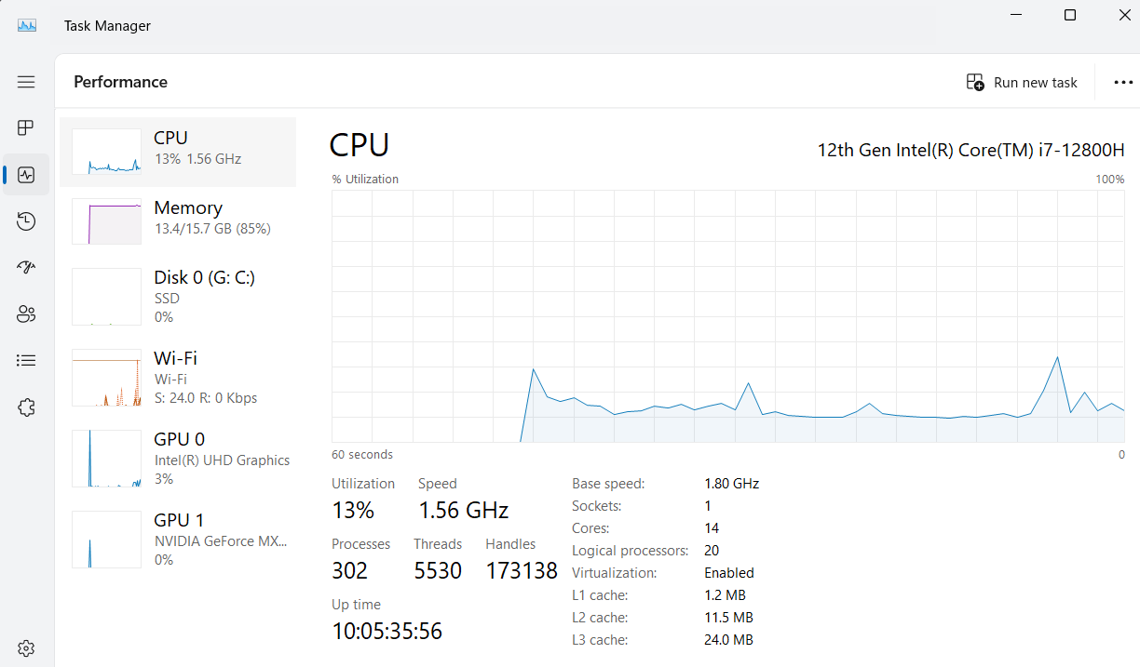
Process/Thread management
Every computing device you own (phone, computer, tablet etc) can have multiple things going on at once.
My computer is currently showing slides, and running intellij, as well as hundreds of other processes.
I have a single CPU with 14 cores.
Your operating system, decides which process gets to run on which core at what time, and for how long.
This is a tremendously complex piece of code called the scheduler in the kernel.

Slide 18
How are threads actually executed?
Your OS has a list of threads which are ready to run.
It also has a list of cores which are available.
It will decide which thread is sent to which core.
If you have a single CPU with 1 core, but a long list of threads ready to run, it’ll rotate each thread onto the processor in some order, attempting to give them about equal time.
If you have a single CPU with 14 cores, and you have 5000 threads, it’ll do the same thing, but it’s doing it to 14 cores simultaneously.
There are many reasons a thread may be taken off a core:
It’s blocked waiting on something, access to memory, files, network sockets, or other devices are common examples of blocking.
It’s been on there too long, other threads are waiting
Something with a higher priority has come along.

Slide 19
Processing orders in a large ecommerce site
Most companies who deal in large numbers of customers (e.g. Ecommerce, Social Media, streaming services) have to deal with spiky load.
For example, social media may have large periods of the day when very little happens, then suddenly something happens and there is LOTS of engagement.
New year is one of the peaks on social media, because everyone posts “Happy new year” all at once.
When building out a service, these peaks are very hard to scale for, because you have to have a LOT of resources available when the peak happens, but not so much the rest of the time.

Slide 20
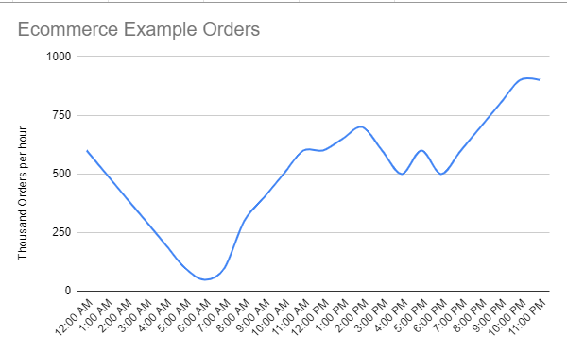
Ecommerce Orders
In general people order when they are awake. Depending on the products you sell, early morning, late evening may be your busy times.
It would be easier to write code to process a steady number of orders every hour, but the real world may look more like this:
Realize if you have international customers, their order graph will be shifted by time zones.

Slide 21
Smoothing out the peaks
A common way to smooth out the peaks is to use a queue.
Think about placing an order at an online ecommerce site.
You don’t immediately get the order when you place it.
Actually they don’t even start looking at it immediately. The order is places into a queue for processing.
The first step may be to charge your credit card for the order.
Banks can only process so many cards at once, so the ecommerce site lets items sit in the queue until there is room to process them at the bank.
Once they have charged you, it goes into another queue which will hold it until someone is available to pack it in the warehouse.
Again, there are only so many resources available to pack in the warehouse, so it waits until they have someone available.
Finally it waits until someone can ship it.
Without these queues, orders would get lost all the time.
Let’s take a look at some code:

Slide 22
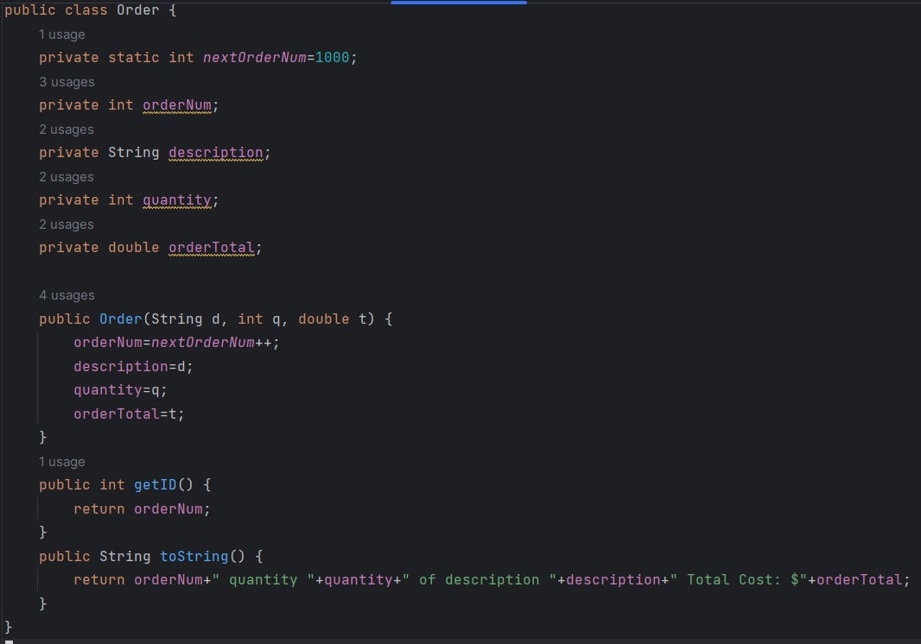
An example Order object

Slide 23
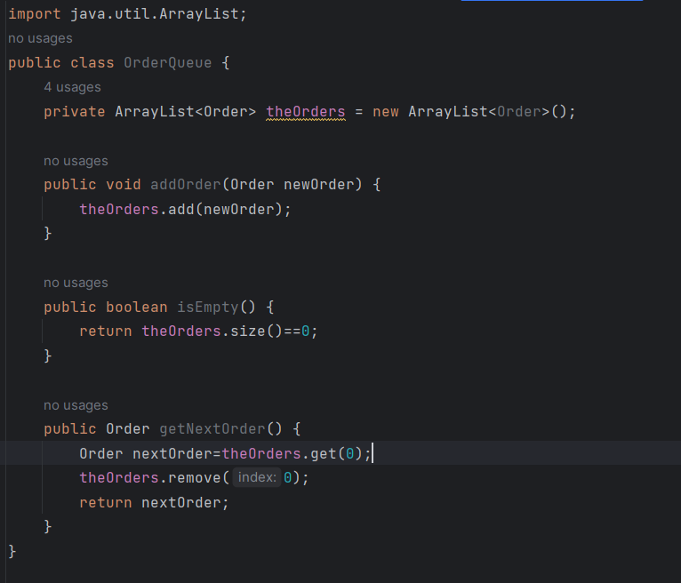
OrderQueue Object (Used to store orders)

Slide 24
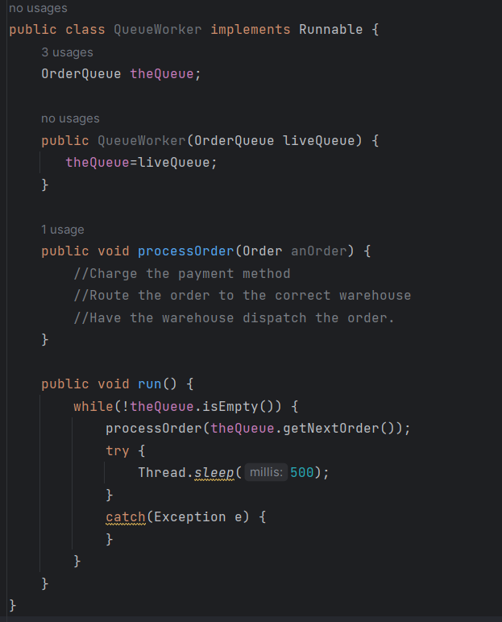
A Queue Worker example.
The job of the queue worker is to find orders which have not been processed, and process them.
This queue runner will see if there is a waiting order, if there is process it, then sleep for half a second.
Note it exits when the queue is empty.

Slide 25
Notes
In this example, you could instantiate as many queue workers as you want.
Overnight from 3am-6am, maybe there are 50 queue workers running, perhaps at peak, you have 50,000 queue workers running.
Notice they are all sleep after processing an order, this is a common tactic which makes it so a given thread isn’t going crazy on the queue when there is nothing to process. You’d adjust this down if you wanted more items processed faster.
It’s a tradeoff between how fast orders are processed, and how much peak work you’ll do.

Slide 26
Threadsafe
Note this previous example is not thread safe.
This means there could be circumstances where orders get lost, or are duplicated.
Let’s talk about why and how to fix it
What would happen if there is 1 order in the list.
At the same moment 2 different worker threads wake up and ask is the list empty. Both are told no, because there is one in the list.
Now, both of them will attempt to getNextOrder().
They will both be given the order to work on, and both threads will then delete the order from the queue.
The user gets charged twice, and gets 2 TVs…er…not great.
How to fix this?
You must use a thread safe data structure. ArrayLists are NOT thread safe.

Slide 27
Thread safe data structures
Java has thread safe versions of each data structure.
They are used slightly differently.
synchronizedList works the same as an ArrayList but is thread safe.
This is achieved by each modification being atomic
Atomic means that once you start a task, it must be finished before anyone else can interact with the list.

Slide 28
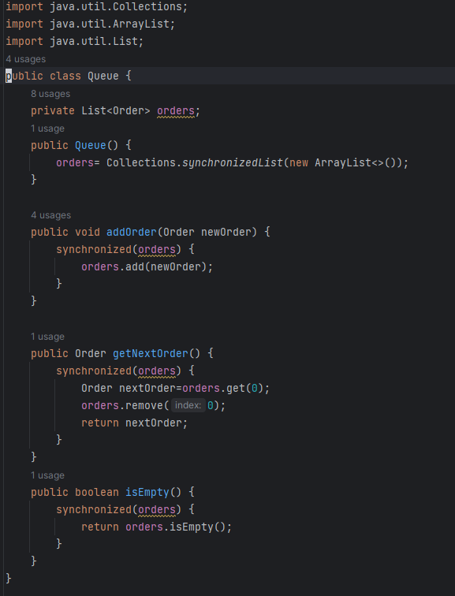
Collections.synchronizedList
To make a thread safe ArrayList, you’ll create a class which wraps around ArrayList
Each time you access the List in this class, you’ll wrap it in the synchronized() keyword.
This prevents any other thread for working on (ie. changing) the arraylist until the first thread is done.

Slide 29
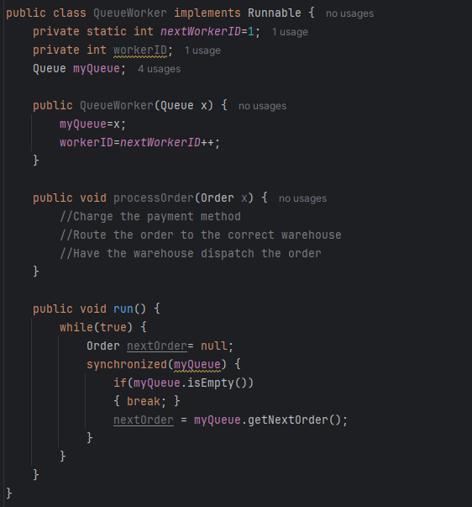
Updating the QueueWorker

Slide 30
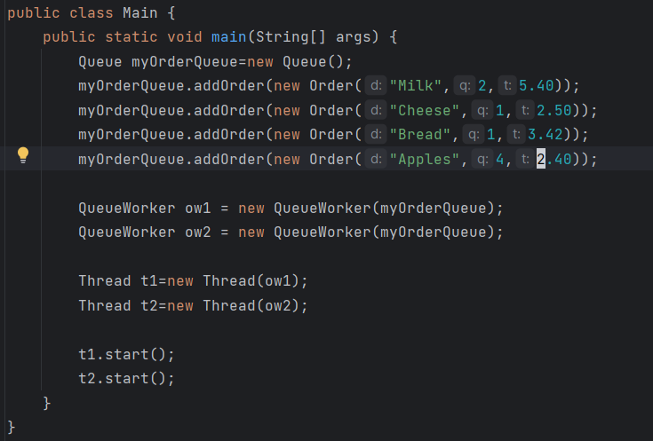
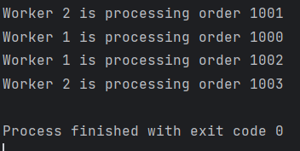
Example Driver
More likely the adding of orders would be another set of threads.
Output:

Slide 31
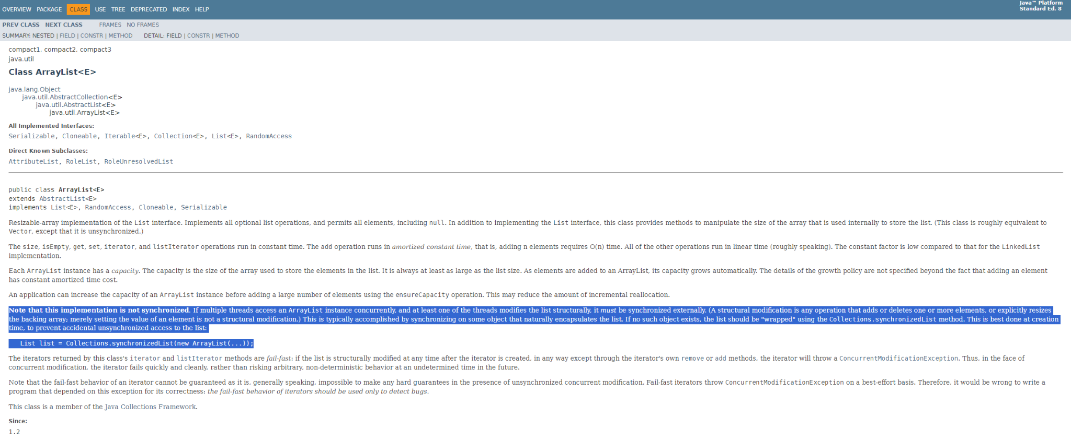
Thread Safety
When working with threads, you always have to ask yourself what happens if two or more threads interact with a pieces of data at the same time.
Look at the documentation for Java to see if a structure is thread safe…here is the page for ArrayLists on oracle's site:
Some structures are inherently thread safe: vector, stack, SynchronizedSet, SynchronizedList, SynchronizedMap

Slide 32
join()
Sometimes when you have a block of work to do, you divide it up among multiple threads.
Each thread does 1/n of the work
When you do this, you’ll need to know that a thread is done with it’s work.
You can wait for a thread to complete with the keyword join().

Slide 33
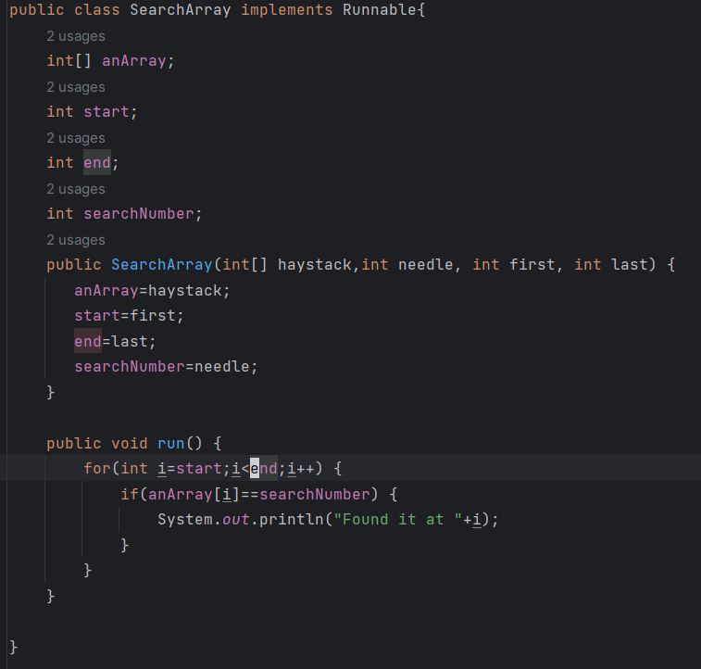
join() example
Imagine a class which searches an array for an item and prints out the index it finds it.

Slide 34
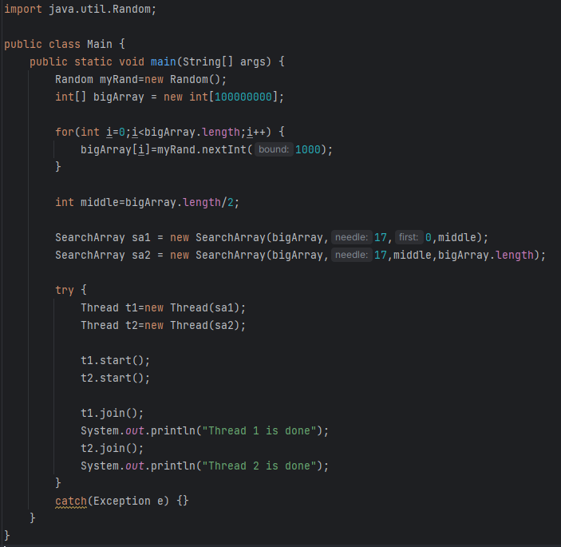
join() driver.
This creates a big array of random number.
Creates 2 threads to search each ½ of the big array.
Waits for each to finish, and reports when they do.

Slide 35
join() usage
This is a pretty trivial example.
A more realistic example:
It’s possible to access information from the internet in your code.
The internet is not instant. You can hit wifi, or network delays, or the server you are requesting information from may be down.
This is typically done in a thread, you’ll ask the thread to go get the information.
You can request many different pieces of information at the same moment, as each one completes (ie, as join() succeeds) you’ll process that bit.
This allows you to work on the first pieces of information that come back first.

Slide 36
Thread Control Methods
Method Signature | Description
String getName() | Retrieves the name of running thread in the current context in String format
void start() | This method will start a new thread of execution by calling run() method of Thread/runnable object.
void run() | This method is the entry point of the thread. Execution of thread starts from this method.
void sleep(int sleeptime) | This method suspend the thread for mentioned time duration in argument (sleeptime in ms)
void yield() | By invoking this method the current thread pause its execution temporarily and allow other threads to execute.
void join() | This method used to queue up a thread in execution. Once called on thread, current thread will wait till calling thread completes its execution
boolean isAlive() | This method will check if thread is alive or dead
Source: https://www.w3resource.com/java-tutorial/java-threadclass-methods-and-threadstates.php

Slide 37
Race Conditions
Classic problem:
You want to buy a plane ticket on Delta
You want to reserve a specific seat
Somebody else wants the same seat!
Algorithm:
bool isAvailable = ReadSeat( )
IF (isAvailable) THEN
// Make it unavailable/invisible to others
WriteSeat( )
END IF
This is called a critical area and MUST be completed in its entirety (i.e. it can’t be switched out)

Slide 38
Dealing with Race Conditions
To prevent race conditions, each thread must complete its critical code section before another thread enters either the same critical code section or another related critical code section that manipulates the same shared variables or resources.
The synchronize keyword helps with this problem, but as mentioned before, also prevents us from truly parallelizing the code.
These are real world tradeoffs you’ll have to navigate.

Slide 39
Synchronized methods
Methods can be marked synchronized:
In this case, this method can only be executed by one Thread at a time.
Note, this greatly reduces your ability to parallelize workloads.

Slide 40
Deadlock
Imagine that you have 2 threads:
Thread 1 takes control of datastructure1, and now needs datastructure2 to continue.
Thread 2 takes control of datastructure2, and now needs datastructure1 to continue
If the two threads are started at the same moment, we’ll reach deadlock.
Neither thread can finish, and they will both wait indefinitely for the other.
This is the simplest example of deadlock, it can be a circle of 15 separate threads which each need the next threads thing…in that case, it’s very hard to even know you hit deadlock.
This is beyond the scope of this class, but something to be aware is a major problem with parallelism.

Slide 41
More Terminology – Processes vs. Threads
A Process:
This is a complete program
Has something called a Process Control Block (PCB)
Must have one or more paths of execution called threads
A Thread:
Exists within a process
Is a separate path of execution within a program
Is “lightweight” – meaning “fast”
There’s always at least one thread in a process (because of main)

Slide 42
MultiThread vs MultiProcess
In this class we’ve explained multithreading.
There are other ways to achieve multiprocessing.
In java there is something called ForkJoin pools, which is another way to do things.
We are not going to cover it in this course, nor will we ask you questions about it.

