Slide 1
Module 7 - Part 3
Java Fork Join Pools

Slide 2
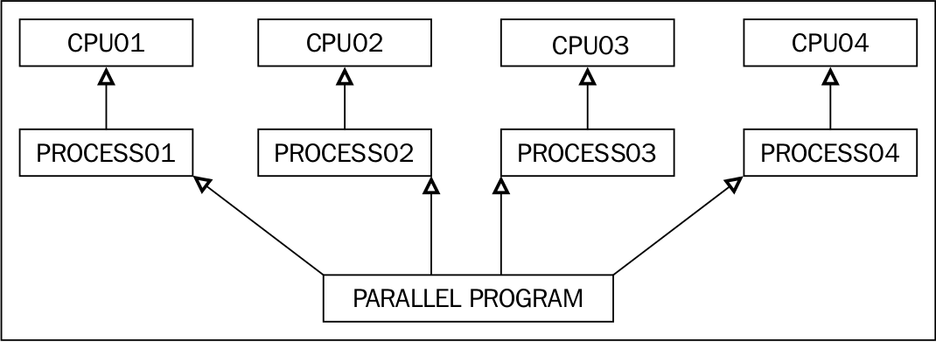
Parallel Programming with Java ForkJoinPool
Parallel programming is a process of running multiple tasks on multiple processors.

Slide 3
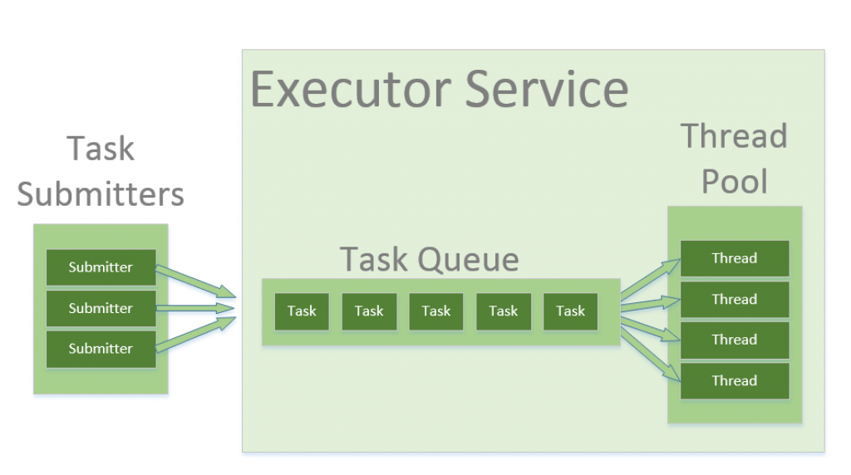
How it works
1) Thread Pool in Java Since Java Version 1.0
A thread pool is a collection of worker threads that efficiently execute asynchronous callbacks on behalf of the application.
Used to reduce the number of application threads;
Provides management of the worker threads.
2) ExecutorService in Java Since Java Version 1.5
Is an asynchronous execution mechanism that is capable of executing tasks in the background. It is a thread pool implementation.

Slide 4
How it works Part 2
3) ForkJoinPool in Java Since Java Version 1.7
The ForkJoinPool is similar to the Java ExecutorService but with one difference that it easily split the working task into smaller tasks which are then submitted to the ForkJoinPool; and finally joins the results (if any).

Slide 5
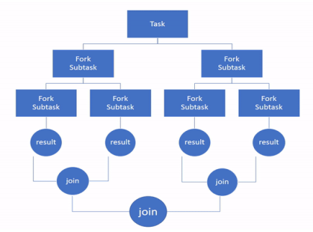

Slide 6
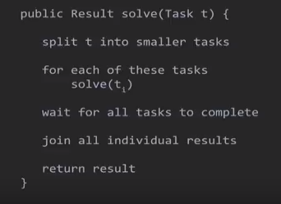
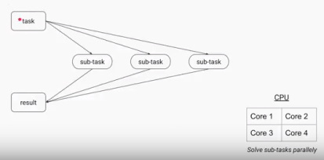
Uses Divide & Conquer Fashion:

Slide 8
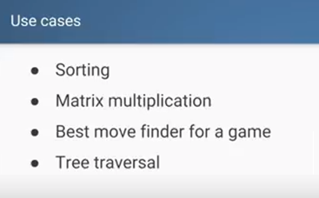
Use Cases

Slide 9
Framework

Slide 10
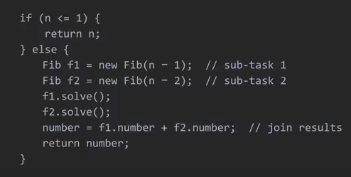
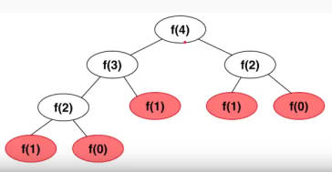
Fibonacci(n) Calculation:

Slide 11
Steps in Implementing
1) Creating a ForkJoinPool Object
ForkJoinPool fjpool = new ForkJoinPool();
2) Submitting Tasks to the ForkJoinPool Object
fjpool.invoke(task)
RecursiveAction: A task which does not return any value. It just does some work, e.g. writing data to disk, and then exits.
RecursiveTask: A task that returns a result. It may split its work up into smaller tasks, and merge the result of these smaller tasks into a collective result.

Slide 12
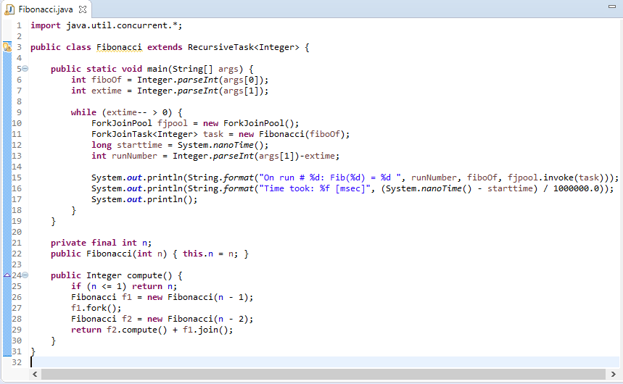
A Sample Java Program with the ForkJoinPool Utilization

Slide 13
