Slide 1
Module 8 - Part 2
Doubly Linked Lists

Slide 2
Challenge
Write a recursive method that adds 10 to the data in each node of a linked list.

Slide 3
Challenge Solution
Write a recursive method that adds 10 to the data in each node of a linked list.
void AddTen(Node n)
{
if (n != null)
{
n.Data += 10;
AddTen(n.Next);
}
}

Slide 4
Doubly Linked List
Each node has two links: one forward (as before) and one backward.
The Node class now has an additional instance variable:
previous, the previous Node.
Thus, we can traverse a doubly linked list either forward or backwards.
Every time we insert or delete, both links must be updated.

Slide 5
Doubly Linked Node
A doubly linked node looks like this
The right arrow represents next.
The left arrow represents previous.

Slide 6
Inserting in a Doubly Linked List
There are three cases:
insert at the beginning.
insert in the middle.
insert at the end.
Updating the links will differ in the three cases above.
Furthermore, when a node is inserted at the beginning, head needs to be updated.

Slide 7
Inserting in the Middle
In order to insert a node before a node named current, the following steps need to be performed:
Instantiate a new node.
Set two forward links: new node to current, node before current to new node.
Set two backward links: current to new node, new node to node before current.
Update the number of items.
Updating the links will differ in the three cases above.

Slide 8
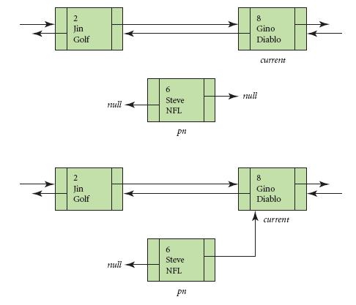
Inserting into a Doubly Linked List
1. Instantiate the
new node
2. Set next in new
node to current.

Slide 9
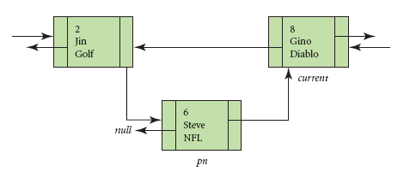
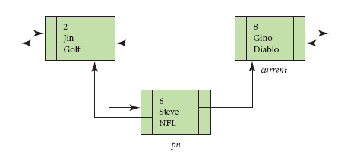
Inserting into a Doubly Linked List
3. Set next in node
before current to the
new node.
4. Set previous in the
new node to the node
before current.

Slide 10
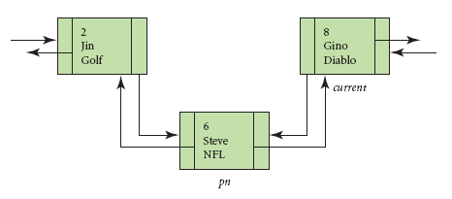
Inserting into a Doubly Linked List
5. Set previous in
current to the new
node.

Slide 11
Deleting from a Doubly Linked List
There are four cases:
delete at the beginning.
delete in the middle.
delete at the end.
cannot delete.
Updating the links will differ in the first three cases above.
Furthermore, when a node is deleted at the beginning, head needs to be updated.

Slide 12
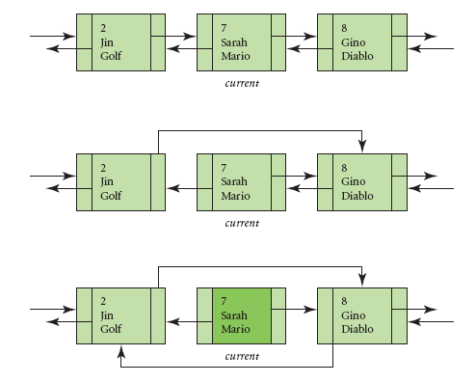
Deleting in the Middle of a Doubly Linked List
We will delete the
Player with id 7
Set next in the node
before current to the node
after current.
2. Set previous in the node
after current to the node
before current.

Slide 13
C# doubly linked list Nodes
The nodes of the linked list are called LinkedListNodes and are also generic.
LinkedListNode<string> myNode = LL1.First;
First and Last are properties of the LinkedList class that allow direct access to the first and last nodes respectively.

Slide 14
C# doubly linked list
The linked list class in C# is a generic and doubly linked which means that we have direct access to the front and the end of the linked list.
LinkedList<string> LL1 = new LinkedList<string>();
LL1.AddFirst("a");
LL1.AddLast("c");

Slide 15
Traversing by Nodes
public static void PrintList (LinkedList<string> L)
{
LinkedListNode<string> myNode = L.First;
while (myNode != null) {
Console.Write(myNode.Value + " ");
myNode = myNode.Next;
}
Console.WriteLine();
}

Slide 16
Java Doubly linked list
LinkedList<String> LL = new LinkedList<String>(); System.out.println(LL); LL.addFirst("bill"); System.out.println("display1 "+ LL);
LL.addFirst("tom"); System.out.println("display2 "+ LL);
LL.addLast("joe"); System.out.println("display3 "+ LL); LL.addFirst("art"); System.out.println("display4 "+ LL);
LL.removeFirst(); System.out.println("display5 "+ LL); PrintList(LL); System.out.println("display6 "+ LL);

Slide 17
Printing the hard way
public static void PrintList (LinkedList<String> L) { LinkedList<String> temp=new LinkedList<String>(); for(String s : L) temp.addLast(s); while (temp.size()>0) { String myData = temp.removeFirst(); System.out.println(myData + " "); } System.out.println(); }

