Slide 1
Module 8
Part 2
Stacks and Queues

Slide 2
Stacks
Implement a first-in-last-out behavior also known as a last-in-first-out behavior.
Push() to add an element
Pop() to remove an element
Peek() returns the top element without removing it from the stack

Slide 3
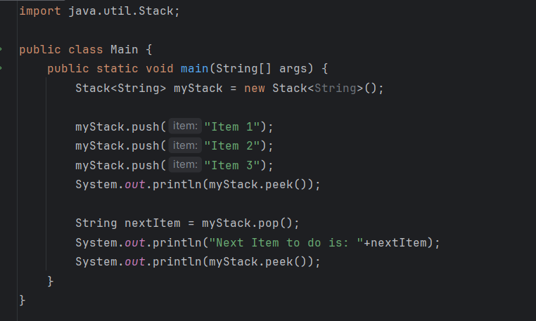
Built in Java Stack

Slide 4
Notice the order of the output
Although Item 3 was the last item added to the stack, it’s what we see at the “top” when we peek().
When we pop from the stack we get the last item added, which was Item 3.
Now the “top” item on the stack is Item 2.

Slide 5
Stack in a linked list?
You could implement a stack in a linked list:
Push in at the front
Pop from the front
Or you could:
Push in at the back
Pop out of the back.
Which of these is easier?
What if you have a head and a tail link?

Slide 6
Stack in an array or ArrayList?
You could implement a stack using an array.
Push into the first empty cell.
Pop from the last occupied cell.
You could implement a stack using an array.
Push into cell 0 (after you move everything down)
Pop out of cell 0 (and then move everything back up one)
One of these is easier than the other, also more efficient.

Slide 7
Big O of each
Is it more efficient to implement a stack in an array or a linked list?
Does it matter which side you push/pop from in each case?

Slide 8
Queues
Implement a first-in-first-out behavior
Enqueue() to add an element
Dequeue() to remove an element
Add and remove from the opposite sides of the internal data structure

Slide 9
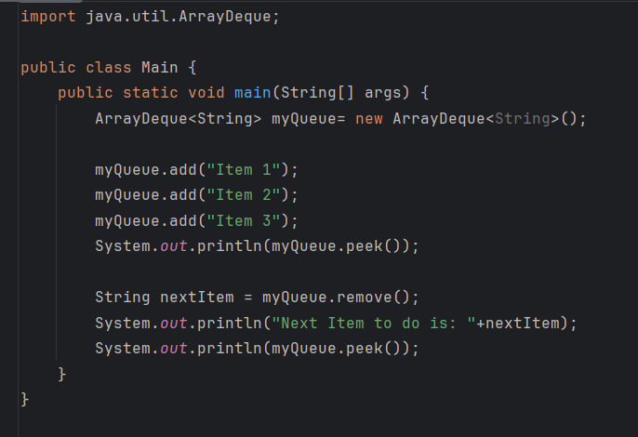
Using the built in Queue in Java
Queue is an interface in Java, as such there are many implementations, including ArrayDequeue, and Priority Queue

Slide 10
Standard Queues
Much like the line for checking out in a grocery store, the first person who gets into the queue, is the first person processed.
The last person who gets in the queue is the last person processed.

Slide 11
Queues
Can be implemented with Linked Lists.
Enqueue at front of list
Dequeue at end of list
Can be implemented with Arrays
Enqueue at back of array
Dequeue at front of array (and move everyone up)
If only there were a way to keep track of front and back of the queue?

Slide 12
Priority Queues
In the real world, sometimes things are not processed in the order they are received.
Think of a hospital ER. People are triaged as they come in and the most critical patients are seen before less critical.
This is an example of a priority queue. The priority is used to decide what is processed next.
Java has a class PriorityQueue that implements this type of queue.
It also has add(), peek() and remove() methods.

Slide 13
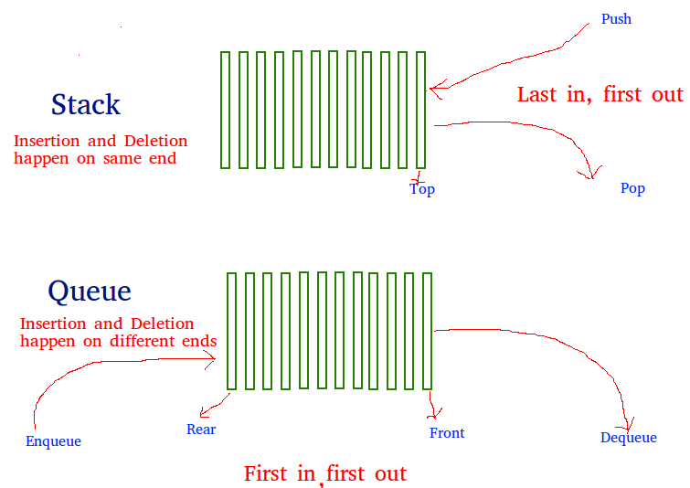
Stack vs Queue

