Slide 1
Module 8 - Part 3
Stacks and Queues

Slide 2
Stacks
Implement a first-in-last-out behavior also known as a last-in-first-out behavior.
Push() to add an element
Pop() to remove an element
Peek() returns the top element without removing it from the stack

Slide 3
Stack in a linked list?
You could implement a stack in a linked list:
Push in at the front
Pop from the front
You could also implement it in a linked list:
Push in at the back
Pop out of the back.
Which of these is easier?
What if you have a head and a tail link?

Slide 4
Stack in an array or ArrayList/List?
You could implement a stack using an array.
Push into the first empty cell.
Pop from the last occupied cell.
You could implement a stack using an array.
Push into cell 0 (after you move everything down)
Pop out of cell 0 (and then move everything back up one)
One of these is easier than the other, also more efficient.

Slide 5
Big O of each
Is it more efficient to implement a stack in an array or a linked list?
Does it matter which side you push/pop from in each case?

Slide 6
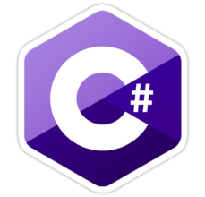
C# A Stack as a List
public class MyStack {
private List<object> list;
public MyStack() {
list = new List<object>();
}
public void push(object o) {
list.Add(o);
}
public object pop()
{
int pos = list.Count - 1;
object temp = list[pos];
list.RemoveAt(pos);
return temp;
}
}

Slide 7
Methods in Stack class
Object push(Object element) : Pushes an element on the top of the stack.
Object pop() : Removes and returns the top element of the stack. An ‘EmptyStackException’ exception is thrown if we call pop() when the invoking stack is empty.
Object peek() : Returns the element on the top of the stack, but does not remove it.
boolean empty() : It returns true if nothing is on the top of the stack. Else, returns false.
int search(Object element) : It determines whether an object exists in the stack. If the element is found, it returns the position of the element from the top of the stack. Else, it returns -1.

Slide 8
Queues
Implement a first-in-first-out behavior
Enqueue() to add an element
Dequeue() to remove an element
Add and remove from the opposite sides of the internal data structure

Slide 9
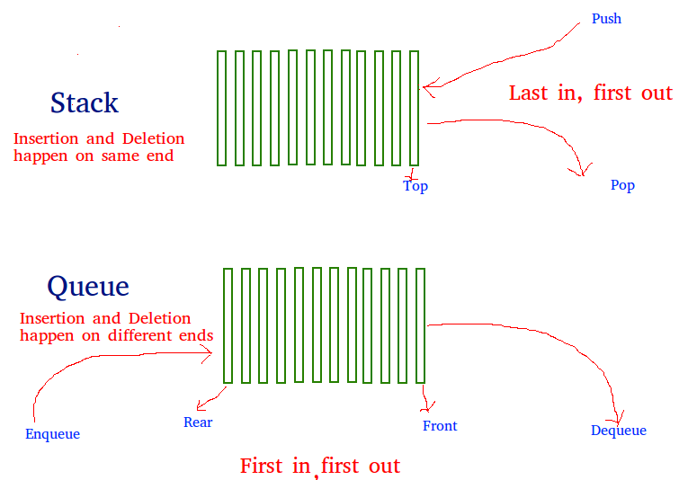
Stack vs Queue

Slide 10
Queues
Can be implemented with Linked Lists.
Enqueue at front of list
Dequeue at end of list
Can be implemented with Arrays
Enqueue at back of array
Dequeue at front of array (and move everyone up)
If only there were a way to keep track of front and back of the queue?

Slide 11
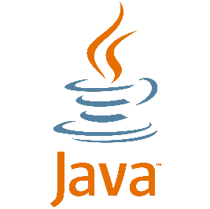
Java a Queue as an array
public class ArrayQueue { private int DEFAULT_SIZE = 5; private Object[] elements; private int numElements; private int front, back; public ArrayQueueC() { elements= new Object[ DEFAULT_SIZE]; numElements=0;
front=0; back=0; }
public void enqueue(Object item) { numElements++; elements[back]=item; back++; if(back%DEFAULT_SIZE==0 && numElements>0) back=0; if(isFull()) increaseSize(); } . . .
}

