Slide 1
Module 9
GUI, Event driven programing, and Graphics

Slide 2
What is a GUI?
So far everything we have done in Java/C# has been on the command line.
Most modern programs use a Graphical User Interface.
Text is laid out in a pleasing way
Users can interact with the application in ways other that just typing answers. Clicking on items on the screen, seeing graphical output.
Things can be drawn in 2D or even 3D.
You’ll still be writing Java/C#, but you’ll be interacting differently than you have in the past.
Most GUI programing happens in response to a user interaction. i.e. the user clicks a button, now what do you want it to do?

Slide 3
Why use GUIs?
If well designed, should be natural for people to understand how to use it without extensive training.
This includes logically arranging the data, only showing what’s necessary at any given time to not overwhelm, hiding rarely used elements in advanced screens, or sub menus.
UI design is a whole discipline.
There are trends which come and go as people learn what works better.
Currently clean minimal designs are favored over complex busy designs.
Larger easy to read fonts are favored over pages of text.
More animations and storytelling are favored.

Slide 4
Frontend vs backend coding
Most applications we’ve written so far have been simple programs that do a single task.
Larger applications are often divided and coded in two separate sections
Backend
Typically interacts with data sources (e.g. databases, files, internet APIs), implements all the logic.
Frontend
Sometimes a web application, or mobile app, or desktop application or all three.
Middleware
Often the interface between the backend, and the various front ends may be a set of APIs which allow new front ends to be developed in different formats.

Slide 5
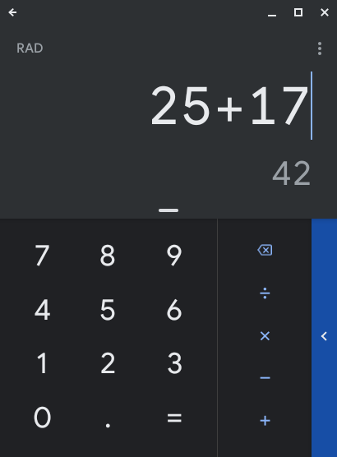
Common Parts of a GUI
The GUI will run in a window.
The window has a background color, size etc
The information in the window is typically laid out in a logical fashion.
Commonly windows are laid out as a grid or table, a tree or as cards. Sometimes all are used.
Users interact with the GUI through:
Menus, Buttons, selection lists, radio buttons (select only one), checkboxes (select many), date pickers, file choosers, labels (text strings), knobs, sliders, links, progress bars, etc.
If the GUI is graphical, you’ll be drawing items on a canvas and possibly moving them.

Slide 6
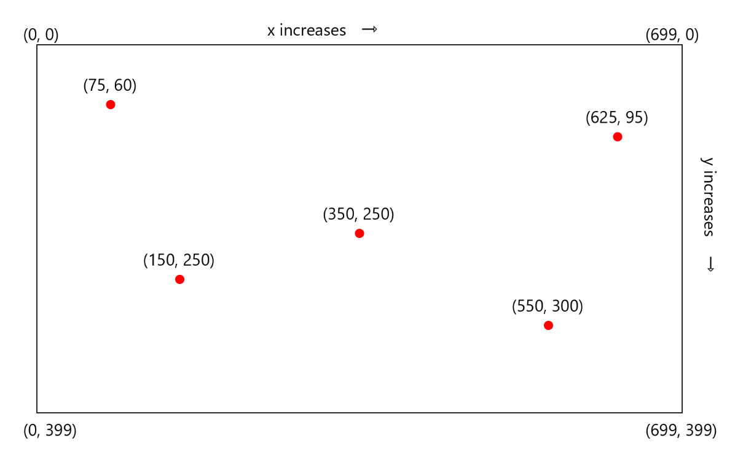
Positioning items in a GUI (Layout)
Items are positioned with an XY coordinate.
(0,0) is the top left corner
Thus a line drawn from 75,60 to 350,250 would be a diagonal line

Slide 7
Review of Hexadecimal
Colors will be specified as 3 hexadecimal values, so let’s review Hexadecimal.
Hex is a number system based on 16 digits 0-9, A, B, C, D, E and F.
Any decimal number 9 or below is the same in Hex.
Decimal 10 = A,
Decimal 11= B ...
Decimal 15 = F
Decimal 16 = 10
Decimal 17 = 11 ...
Decimal 26 = 1A
Decimal 31 = 1F
Decimal 32 = 20 ...
Decimal 255 = FF

Slide 8
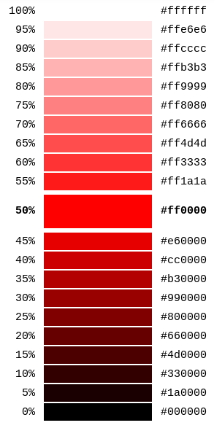
Colors
Any color can be represented by 3 (hex) values of Red, Green and Blue.
Red = FF 00 00
Green = 00 FF 00
Blue = 00 00 FF
Yellow = FF FF 00
Purple = FF 00 FF
White = FF FF FF
Black = 00 00 00
Every shade and color can be achieved by altering the 3 values.

Slide 9
GUI Libraries - Java
Java
You’ll be learning JavaFX.
You’ll need to install the JavaFX library into Intellij
Download if needed the v13 Zulu Build of OpenJDK
https://www.azul.com/downloads/zulu-community/
Unzip and save it somewhere that you remember.
Open Intellij, on the left choose “JavaFX”
At the top where it says “Project SDKs” choose 13 Java Version 13.04 if available, if not click “Add JDK” and browse to where you saved your Zulu 13 OpenJDK from the step above.
Hit “Next”, name your project and hit “Finish”.
If everything is well, you should be able to run the default program and see a Hello World window appear.
On a MAC you may additional need to set the JavaFX Library.
https://www.jetbrains.com/help/idea/javafx.html#add-javafx-lib

Slide 10
GUI Libraries - C#
C#
We’ll be using the Windows Forms app in Visual Studio.
Open Visual Studio.
Choose “New Project”,
Click on “Windows Forms Application”
Give it a name.
Now if you run the project, you should see your hello world window.

Slide 11
Understanding how to lay things out
The hello world window that popped up is referred to as a stage.
Any window is a stage, you can have multiple windows.
A stage can only have one Scene visible at any given time. Also each scene can only be applied to a single Stage at any moment. You can however define multiple scenes.
Scenes typically have a layout:
e.g. GridPane, TilePane, TabPane, ScrollPane, Hbox, Vbox Group
Layouts have objects in them.
e.g. Labels, Canvas, Tables, TextAreas etc.

Slide 12
We are going to begin by drawing some basic shapes
Java:
You main method will call Application.launch(args)
Next create a new class which extends the object Application
You’ll override public void start(Stage primaryStage)
The variable of type Stage that you take in will be your primary window.
Next you’ll define a layout (e.g. group)
Add a canvas to the group
Draw on the canvas
Add the group to the scene.
Set the stage to the scene
Ask the stage to show.

Slide 13
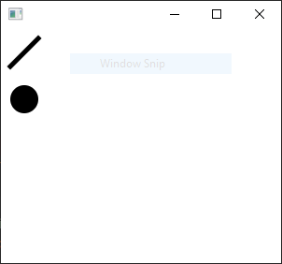
Java Code
public class Main extends Application { @Override public void start(Stage primaryStage) throws Exception{ Group root = new Group(); Canvas canvas1=new Canvas(300,250); GraphicsContext gc= canvas1.getGraphicsContext2D(); gc.fillOval(10,60,30,30); gc.setLineWidth(5); gc.strokeLine(40,10,10,40); root.getChildren().add(canvas1); Scene scene1=new Scene(root); primaryStage.setScene(scene1); primaryStage.show(); } public static void main(String[] args) { launch(args); } }
import javafx.application.Application; import javafx.scene.Group; import javafx.scene.Scene; import javafx.scene.canvas.Canvas; import javafx.scene.canvas.GraphicsContext; import javafx.stage.Stage;

Slide 14
C# code is simpler
In C# you’ll override the OnPaint Method. At the end of the override you’ll call your parents OnPaint() method passing it a PaintEventArgs argument. This triggers the paint event.
Create a Graphics object
Create a pen to draw the line.
Create a solidbrush to make the filled in circle.
Using the graphics object call DrawLine passing the pen and starting x,y, ending x,y
Using the graphics object call FillEllipse passing the solidbrush, and

Slide 15
Draw some basic shapes C#
protected override void OnPaint(PaintEventArgs e) { Graphics g = e.Graphics; Pen pen = new Pen(Brushes.Black); SolidBrush fillbrush = new SolidBrush(Color.Black); g.DrawLine(pen, 40, 10, 10, 40); g.FillEllipse(fillbrush, 10, 60, 30, 30); base.OnPaint(e); }

Slide 16
What else can we do?
Java
fillPolygon
fillRect
fillRoundRect
fillArc
fillText
strokeLine
strokeRect
strokeRoundRect
strokeOval
strokeArc
strokePolygon
strokePolyline
strokeText
drawImage
C#
FillPolygon
FillRectangle
FillClosedCurve
FillPie
FillPath
DrawArc
DrawClosedCurve
DrawCurve
DrawEllipse
DrawImage
DrawPath
DrawPie
DrawPolygon
DrawRectangle
DrawString
ScaleTransform

Slide 17
Forms for user interaction
A very common user interaction is to present the user a form to fill out.
Examples:
Every time you log into an application you have a username, password field and a submit button. Perhaps a “I forgot my password” link.
Calculators have lots of buttons, you see text at the top
Most signup pages will have lots of text fields where you’ll enter your name, email, phone etc.
When a button is pressed in a form, an event will be fired. You’ll need to write code to deal with the event.
e.g. if it’s a login page, you’d check if they entered a valid username/password.

Slide 18
Building a form in Java with code
Your main class will extend Application, your main method will call launch as before.
Begin by creating a GridPane which lays items out in a grid. The size of the grid is determined when you add things to it.
It’s numbered starting at 0,0 where the first digit is column and the second is row
Add the grid to a new scene
Specify the size of the scene.
Now add items to the grid.
e.g. The words “UserName: “ is a label, so you’d create a new label, and add it to column 0 row 0 of the grid.
A box for the user to enter their username is a TextField, make a new one and add it to column 1 row 0.
Make a new label “Password: “, add it to column 0 row 1.
Make a new PasswordField() and add it to column 1 row 1.
Make a new submit Button() and add it to column 0 row 2, but allow it to span 2 columns and 0 rows.

Slide 19
Java Code
public class Main extends Application {
@Override
public void start(Stage primaryStage) {
GridPane mygrid=new GridPane();
mygrid.setAlignment(Pos.CENTER);
mygrid.setVgap(10);
Scene myscene=new Scene(mygrid,500,500);
Label user_label = new Label("UserName:");
TextField userTA = new TextField();
Label passwd_label = new Label("Password:");
PasswordField passwdTA = new PasswordField();
Button submit_button = new Button("Submit");
//Event handler will go here.
mygrid.add(user_label,0,0);
mygrid.add(userTA,1,0);
mygrid.add(passwd_label,0,1);
mygrid.add(passwdTA ,1,1);
mygrid.add(submit_button,1,2,2,1);
primaryStage.setScene(myscene);
primaryStage.show();
}

Slide 20
Building with SceneBuilder (Intellij)
Sometimes called Model-View-Controller
You can also build the same page by dragging and dropping.
In intellij, click on “sample.fxml”, and look to the bottom to find “SceneBuilder”
On the left you can see “Containers” in there look for “GridPane”, drag it to the window on the right.
Under Controls you’ll find Label, PasswordField, TextField, and Button drag them over.
Click on the first label, look to the right in the “Properties” panel, update the “Text” field to say “Username: “. Repeat for the second label set the text to “Password: “
Click on the button, set it’s text to “Login”.

Slide 21
Adding the event handler - Java
The following code will happen if the submit button is pressed. It’ll simply tell you the username entered. This code will go where the comment was in the last slide
final Text actiontarget = new Text();
mygrid.add(actiontarget, 1, 6);
submit_button.setOnAction(new EventHandler<ActionEvent>() {
@Override
public void handle(ActionEvent e) {
//actiontarget.setFill(Color.red);
actiontarget.setText(userTA.getText()+" attempted to sign in");
}
});

Slide 22
Building in Visual Studio C#
You’ll begin by dragging a panel from the toolbox on the left onto Form1
Next drag 2 Labels, 2 TextBoxes, and a Button
Click on the first Label, on the right choose “Properties” and fill change it’s “Text” to “Username: “
Click on the second Label, and change it’s Text to “Password: “
Click on the first TextBox, change it’s name to “username”
Click on the second TextBox, and change it’s PasswordChar to *, and it’s name to password
Click on Submit and change it’s Text to “Submit”
Finally drag a 3rd Label below the submit button. Change it’s text to an empty string, and it’s name to response

Slide 23
Adding the event handler C#
Click on Form1.cs at the top of your window.
You’ll see it’ll have automatically created button1_Click
Add the following code:
string result = username.Text + " attempted to login";
response.Text = result;

Slide 24
Building an interactive app
Next we are going to build a trivial interactive app.
This will be a basic tic tac toe game.
We need to draw 4 lines that intersect
We’ll do that with the basic draw lines commands in each language
Then we’ll setup an event handler for when the user clicks the mouse in the window
Wherever the user clicks we’ll place an X or an O.
We’ll keep track of which one we just placed, and then switch to the next for the next click.
We aren’t going to worry about lining up the X and O or figuring out who won etc.

Slide 25
In C# draw the lines
In Form1.Design.cs add these lines:
string turn = "X";
protected override void OnPaint(PaintEventArgs e)
{
base.OnPaint(e);
Graphics g = e.Graphics;
Pen myPen = new Pen(Brushes.Black);
SolidBrush myBrush = new SolidBrush(Color.Black);
g.DrawLine(myPen, 10, 100, 290, 100);
g.DrawLine(myPen, 10, 200, 290, 200);
g.DrawLine(myPen, 100, 10, 100, 290);
g.DrawLine(myPen, 200, 10, 200, 290);
}
In InitializeComponent() add:
this.MouseDown += new System.Windows.Forms.MouseEventHandler(this.Form1_MouseDown);

Slide 26
Add event handler
Into Form1.cs add (get to it by double clicking on the form):
private void Form1_MouseDown(object sender, MouseEventArgs e)
{
using (Graphics graphics = CreateGraphics())
{
graphics.DrawString(turn, DefaultFont, new SolidBrush(Color.Blue), e.X, e.Y);
if (turn == "X")
{
turn = "O";
}
else
{
turn = "X";
}
}
}

Slide 27
In Java draw the lines
Edit your application.java file, add to the start() method:
Group root = new Group();
Canvas myCanvas = new Canvas(300,300);
GraphicsContext gc = myCanvas.getGraphicsContext2D();
gc.strokeLine(10,100,290,100);
gc.strokeLine(10,200,290,200);
gc.strokeLine(100,10,100,290);
gc.strokeLine(200,10,200,290);
root.getChildren().add(myCanvas);
stage.setTitle("TicTacToe");
Scene scene1 = new Scene(root);
stage.setScene(scene1);
stage.show();

Slide 28
Create the event handler
Add the following code below the drawn lines:
double x, y;
root.setOnMouseClicked(new EventHandler<MouseEvent>() {
String turn="X";
@Override
public void handle(MouseEvent event) {
double x=event.getSceneX();
double y=event.getSceneY();
gc.setFont(new Font("Times New Roman", 40));
gc.strokeText(turn,x,y);
if(turn=="X") {
turn="O";
}
else {
turn="X";
}
}
});

