Slide 1
Module 9
Part 2
GUI, Event driven programing, and Graphics in C#

Slide 2
Intro to GUIs
Finally this semester we are going to look at building GUIs in C#.
Why are we doing it in C# not Java?
C# provides a much better interface for building GUIs than Java.
If you are interested in GUIs in Java, check out JavaFX in IntelliJ
Again this is a huge topic which we are only going to scratch the surface of.

Slide 3
Event driven programming
Most things you have written so far in Java or C# were executed in a linear fashion. It starts at the top of main, and works its way through the code.
Event driven is different. You’ll write lots of event handlers they don’t get executed until a user causes them by pressing a button, typing text, or clicking somewhere on the screen.
Then you’ll design a GUI, and connect each GUI element to the appropriate event handlers.

Slide 4
Why use GUIs?
If well designed, should be natural for people to understand how to use it without extensive training.
This includes logically arranging the data, only showing what’s necessary at any given time to not overwhelm, hiding rarely used elements in advanced screens, or sub menus.
UI design is a whole discipline.
There are trends which come and go as people learn what works better.
Currently clean minimal designs are favored over complex busy designs.
Larger easy to read fonts are favored over pages of text.
More animations and storytelling are favored.

Slide 5
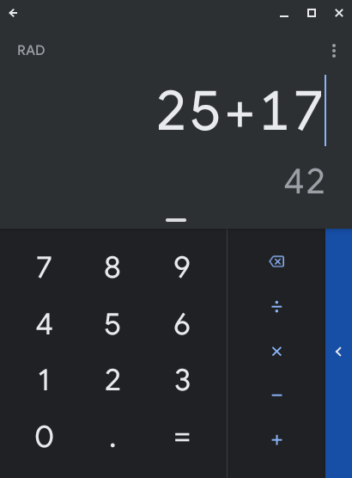
Common Parts of a GUI
The GUI will run in a window.
The window has a background color, size etc
The information in the window is typically laid out in a logical fashion.
Commonly windows are laid out as a grid or table, a tree or as cards. Sometimes all are used.
Users interact with the GUI through:
Menus, Buttons, selection lists, radio buttons (select only one), checkboxes (select many), date pickers, file choosers, labels (text strings), knobs, sliders, links, progress bars, etc.
If the GUI is graphical, you’ll be drawing items on a canvas and possibly moving them.

Slide 6
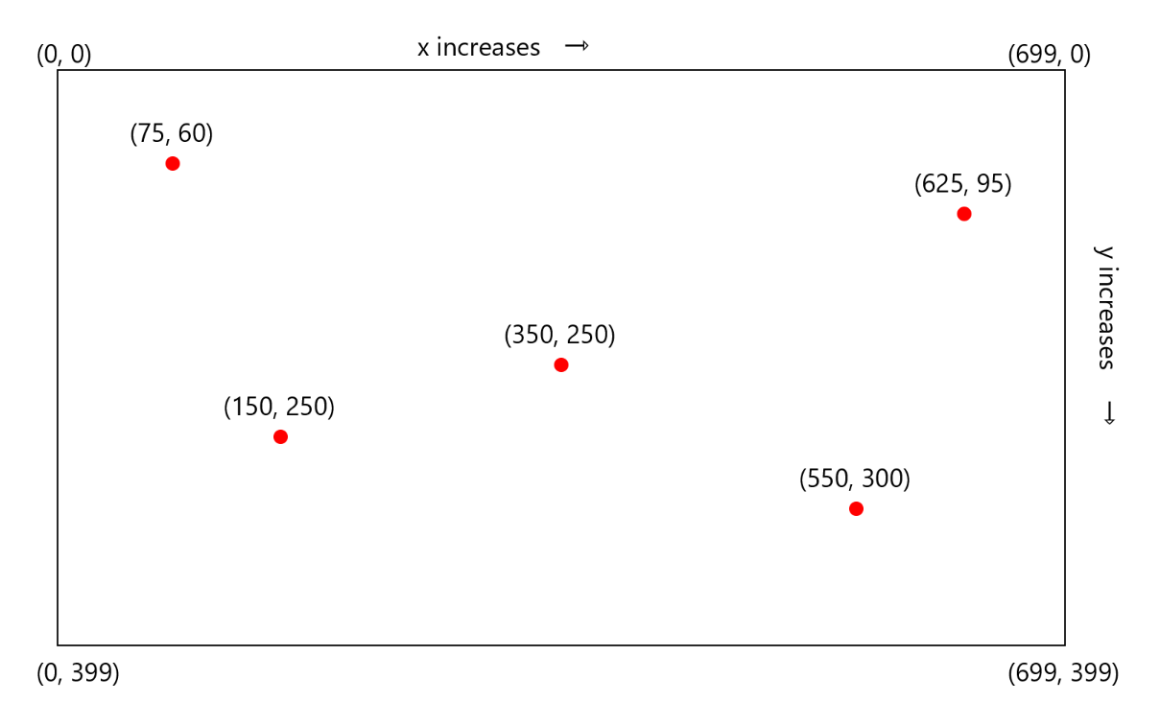
Positioning items in a GUI (Layout)
Items are positioned with an XY coordinate.
(0,0) is the top left corner
Thus a line drawn from 75,60 to 350,250 would be a diagonal line

Slide 7
Absolute vs Relative positioning
While you could lay out an interface by positioning every item at specific locations, that layout won’t scale well on different size screens.
Think about your phone, you can look at it in portrait mode, or in landscape mode. The dimensions of the screen are very different in those 2 configurations.
Thus if you absolutely placed everything, some things would be off screen.
Instead we’ll typically use relative positioning. That way things can “reflow” when the screen size changes.

Slide 8
Review of Hexadecimal
Colors will be specified as 3 hexadecimal values, so let’s review Hexadecimal.
Hex is a number system based on 16 digits 0-9, A, B, C, D, E and F.
Any decimal number 9 or below is the same in Hex.
Decimal 10 = A,
Decimal 11= B ...
Decimal 15 = F
Decimal 16 = 10
Decimal 17 = 11 ...
Decimal 26 = 1A
Decimal 31 = 1F
Decimal 32 = 20 ...
Decimal 255 = FF

Slide 9
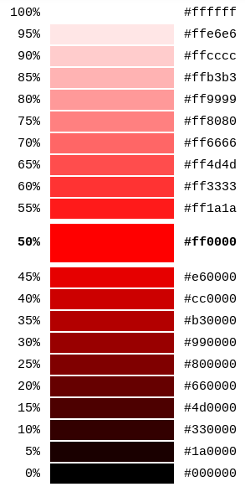
Colors
Any color can be represented by 3 (hex) values of Red, Green and Blue.
Red = FF 00 00
Green = 00 FF 00
Blue = 00 00 FF
Yellow = FF FF 00
Purple = FF 00 FF
White = FF FF FF
Black = 00 00 00
Every shade and color can be achieved by altering the 3 values.

Slide 10
GUI Libraries
We’ll be using the Windows Forms app in Visual Studio
Open Visual Studio.
Choose “New Project”,
Click on “Windows Forms Application”
Give it a name.
Now if you run the project, you should see your hello world window.

Slide 11
Building a login form
You’ll begin by dragging a panel from the toolbox on the left onto Form1
Next drag 2 Labels, 2 TextBoxes, and a Button
Click on the first Label, on the right choose “Properties” and change its “Text” to “Username: “
Click on the second Label, and change its Text to “Password: “
Click on the first TextBox, change its Design-name to “username”
Click on the second TextBox, and change its PasswordChar to *, and its Design-name to password
Click on Submit and change it’s Text to “Submit”
Finally drag a 3rd Label below the submit button. Change it’s text to an empty string, and it’s name to response

Slide 12
Adding the event handler
Click on Form1.cs at the top of your window.
You’ll see it’ll have automatically created button1_Click
Add the following code:
string result = username.Text + " attempted to login";
response.Text = result;

Slide 13
Adding a second form
In the “Search Solution Explorer” window right click on the name of your project and choose “Add” - “Form (Windows Form)”.
Design the second form.
In your event handler for the submit button you can switch to the second form with:
Form2 f2 = new Form2();
f2.Show();
this.Hide();

Slide 14
Instead of opening a new window
You can replace a part of the previous window, for example the Panel you added.
Form2 f2 = new Form2() { TopLevel = false, TopMost = true };
panel1.Controls.Add(f2);
f2.Show();
You’d now have to hide the other things which are in the panel
More likely you’d create a new panel with the new content, and switch them on the same form.

Slide 15
Doing some basic drawing
In a new project you’ll override the OnPaint Method. At the end of the override you’ll call your parents OnPaint() method passing it a PaintEventArgs argument. This triggers the paint event.
Create a Graphics object
Create a pen to draw the line.
Create a solidbrush to make the filled in circle.
Using the graphics object call DrawLine passing the pen and starting x,y, ending x,y
Using the graphics object call FillEllipse passing the solidbrush, and

Slide 16
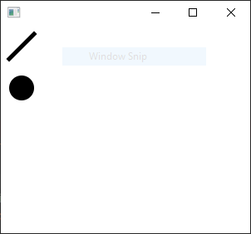
Draw some basic shapes C#
protected override void OnPaint(PaintEventArgs e) { Graphics g = e.Graphics; Pen pen = new Pen(Brushes.Black); SolidBrush fillbrush = new SolidBrush(Color.Black); g.DrawLine(pen, 40, 10, 10, 40); g.FillEllipse(fillbrush, 10, 60, 30, 30); base.OnPaint(e); }

Slide 17
What else can we do?
Java
fillPolygon
fillRect
fillRoundRect
fillArc
fillText
strokeLine
strokeRect
strokeRoundRect
strokeOval
strokeArc
strokePolygon
strokePolyline
strokeText
drawImage
C#
FillPolygon
FillRectangle
FillClosedCurve
FillPie
FillPath
DrawArc
DrawClosedCurve
DrawCurve
DrawEllipse
DrawImage
DrawPath
DrawPie
DrawPolygon
DrawRectangle
DrawString
ScaleTransform

Slide 18
Building an interactive app
Next we are going to build a trivial interactive app.
This will be a basic tic tac toe game.
We need to draw 4 lines that intersect
We’ll do that with the basic draw lines commands in each language
Then we’ll setup an event handler for when the user clicks the mouse in the window
Wherever the user clicks we’ll place an X or an O.
We’ll keep track of which one we just placed, and then switch to the next for the next click.
We aren’t going to worry about lining up the X and O or figuring out who won etc.

Slide 19
In C# draw the lines
In Form1.Design.cs add these lines:
string turn = "X";
protected override void OnPaint(PaintEventArgs e)
{
base.OnPaint(e);
Graphics g = e.Graphics;
Pen myPen = new Pen(Brushes.Black);
SolidBrush myBrush = new SolidBrush(Color.Black);
g.DrawLine(myPen, 10, 100, 290, 100);
g.DrawLine(myPen, 10, 200, 290, 200);
g.DrawLine(myPen, 100, 10, 100, 290);
g.DrawLine(myPen, 200, 10, 200, 290);
}
In InitializeComponent() add:
this.MouseDown += new System.Windows.Forms.MouseEventHandler(this.Form1_MouseDown);

Slide 20
Add event handler
Into Form1.cs add (get to it by double clicking on the form):
private void Form1_MouseDown(object sender, MouseEventArgs e)
{
using (Graphics graphics = CreateGraphics())
{
graphics.DrawString(turn, DefaultFont, new SolidBrush(Color.Blue), e.X, e.Y);
if (turn == "X")
{
turn = "O";
}
else
{
turn = "X";
}
}
}

Slide 21
Frontend vs backend coding
Most applications we’ve written so far have been simple programs that do a single task.
Larger applications are often divided and coded in two separate sections
Backend
Typically interacts with data sources (e.g. databases, files, internet APIs), implements all the logic.
Frontend
Sometimes a web application, or mobile app, or desktop application or all three.
Middleware
Often the interface between the backend, and the various front ends may be a set of APIs which allow new front ends to be developed in different formats.

