Slide 1
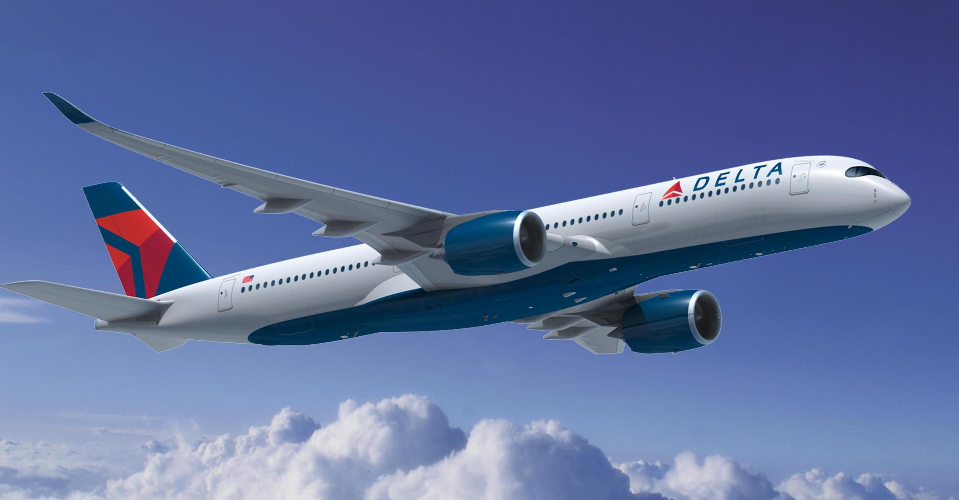
“Running a reliable, customer-focused airline producing strong profits
and cash flows sustainable through the business cycle”
Delta strategy: JPM Aviation, Transportation, and Industrials Conference (March 15, 2017)
Delta Airlines, Inc. (NYSE: DAL)
Kennesaw State University

Slide 2
◘ ◘ ◘ ◘ ◘ ◘
Investment Summary
Recommendation: HOLD Delta Airlines, Inc. (NYSE: DAL)
Delta Airlines Prices and Valuation Targets
Market Data
Closing Price¹ | $50.89
52-Week High² | $51.78
52-Week Low² | $44.53
2015 EPS | $4.61
2016 EPS | $5.78
Average Volume² | 9.5 M
Shares Outstanding | 736.4 M
Market Cap¹ | $37.5 B
Dividend Yield | 1.6%
P/E TTM | 8.61
PEG | 0.77
EV/Revenue | 1.0x
EV/EBITDA | 4.8x
Investment Summary
Low-cost and foreign carriers add capacity and seize market share
Declining fares and higher wages offset industry gains from lower fuel prices
Balance sheet “de-risking” and operating margin improvements
As of January 12, 2017
52-Week period ended January, 12, 2017
Sources: Bloomberg

Slide 3




◘ ◘ ◘ ◘ ◘ ◘
Business Description: Delta Airlines, Inc.
Delta Primary Operating Segments as a Percentage of 2016 Revenue
85%
10%
3%
2%
Ancillary Businesses
and Refinery²
Passenger Revenue
Airport Services¹
Cargo
Routes and Hubs
Ownership Summary
10
Domestic
Hubs
3
International
Hubs
57
Countries
320
Destinations
Type | Percentage
Institutions | 82.71%
Retail | 17.03%
Insiders | 0.26%
Delta Airlines represents 6.6% of the total market size for air passenger transportation
1. Loyalty Programs, Administrative Fees, club, and on-board sales, Baggage Fees
2. Aircraft maintenance and staffing services, vacation wholesale, and refinery sales (MPIC LLC and Monroe Energy LLC
Sources: Bloomberg, DAL 10-K (2016)

Slide 4



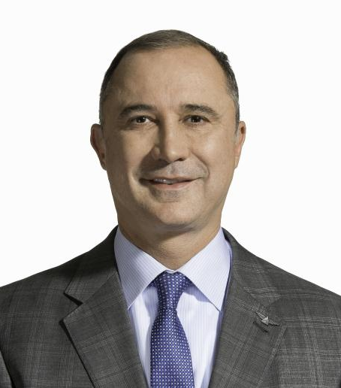
◘ ◘ ◘ ◘ ◘ ◘
Business Description: Corporate Governance
Executive Management
“We rate Delta's stewardship of capital as Standard, noting that it is one of the better stewards of capital across the U.S. airlines we cover.”
– Morningstar Investment Research Center
Edward Bastian
CEO
Gil West
SEVP &COO
Paul Jacobson
EVP & CFO
Glen Hauenstein
President
Committees and Members
Targets for Capital Allocation
Audit
14
Total Directors
10
Independent Directors
Return 70% of FCF to owners in the form of dividends and buybacks
Invest 50% of operating cash flow to fleet
Pay down debt to $4 billion by 2020 while funding pension plan at $1.2 billion per year
Corporate Governance
Finance
Personnel & Compensation
Safety and Security
Majority of Board of Directors and each Committee are Independent
Sources: Bloomberg, Morningstar Investment Research Center, JPM Aviation, Transportation, and Industrials Conference (March 15, 2017)

Slide 5
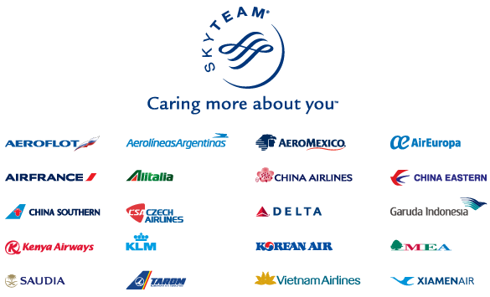

◘ ◘ ◘ ◘ ◘ ◘
Business Description: Corporate Strategy
Innovative Technology Improves Efficiency
International Partnerships
Maintenance-Related Cancellations
Missed-Bag Ratio
-97.6%
Saving Cash to Fund Pension
Cash Management Earns DAL Investment Grade
Rating Agency | Current Rating | Outlook
Standard & Poor’s | BB+ | Stable
Moody’s | Baa3 | Positive
Fitch | BBB- | Positive
Delta’s strategy includes superior cash management, investments in efficiency, and strategic alliances
Sources: Delta Airlines Annual Filings, Delta Investor Day Presentation (December 2016), Bloomberg DAL BICO

Slide 6
◘ ◘ ◘ ◘ ◘ ◘
Business Description: Airplane Assets
Airplane Assets
Average Aircraft Age (Years)
Delta versus Competitors Average Aircraft Age (Years)
Flight Equipment as of December 31, 2016
Current Fleet |  |  |  |  | Commitments
Owned | Capital Leases | Operating Leases | Total | Average Age | Purchase | Lease | Options
639 | 66 | 127 | 832 | 17.0 | 245 | 4 | 50
Delta’s fleet modernization will increase efficiency
Sources: Bloomberg, Factset, Delta Airlines 10-K (2016)

Slide 7
◘ ◘ ◘ ◘ ◘ ◘
Industry Overview: Porter’s Five Forces
Herfindahl Index, Four Firm Concentration Ratio
Existing Rivalries
Equity | Revenue | Market Share | Herfindahl
AAL | $40,990 | 25.6% | 656.4
DAL | $40,506 | 25.3% | 641.1
UAL | $37,864 | 23.7% | 560.3
LUV | $19,820 | 12.4% | 153.5
Total | $139,180 | 87.0% | 2011.3
Threat of Substitutes
Bargaining Power of Buyers
1
2
3
4
5
Network Carriers Introduce ‘Basic Economy’
Bargaining Power of Suppliers
Threat of New Entrants
DAL
Feb 2015
UAL, AAL
Feb 2017
1: Insignificant Threat 4: Significant Threat
2: Low Threat 5: High Threat
3: Moderate Threat
2015
2016
2017
Airline industry has no ‘economic moat’ to ensure strong profitability
Sources: US Department of Transportation 3rd Quarter 2016 Air Fare Data

Slide 8

◘ ◘ ◘ ◘ ◘ ◘
Industry Overview: Global Competition
Respective revenue figures as of 2016 Fiscal Year, $USD Million
Lufthansa: $33,454
Air France-KLM: $26,843
IAG (LEVEL**): $23,875
Norwegian Air**: $3,120
WOW Air (private) --
American $40,180
Delta $39,639
United $36,556
- - - - - - - - - - - - - - - - -
Alaska* $5,316
Allegiant** $1,363
JetBlue* $6,632
Southwest* $20,425
Spirit** $2,322
China Southern $16,346
Emirates: $22,005
Ethiad¹: $9,020
Qatar: $9,600
* Delta Airlines’ domestic competition
** Low Cost Carrier
Strong domestic and international competition limits Delta’s pricing power
1. Most recent Ethiad results for FY2015
Sources: Bloomberg, Morningstar

Slide 9
◘ ◘ ◘ ◘ ◘ ◘
Industry Overview: Capacity and Traffic
Load Factor Analysis
Load Factor Plateaus in Recent Years
Delta Load Factor versus Peers (2016)
Operating margin gains from load factor increases have topped off
Sources: Delta Airlines, American Airlines, and United Continental Annual Filings; FactSet

Slide 10
◘ ◘ ◘ ◘ ◘ ◘
Industry Overview: Profitability
Q3 Average Fares in Constant 2016 USD
North American Airlines Pilot Labor Agreements
Airline | Current Pay Rates p/Block Hr | 2016 Wage Increase | Contract Effective/ Signed | Contract up for Renewal
Effective Agreements
American | $232 | 23% | 2015 | 2020
United | $254 | 18% | 2016 | 2020
Southwest | $237 | 15% | 2016 | 2020
Delta | $255 | 18% | 2016 | 2020
Under Negotiation
Alaska | $192 | --- | 2013 | 2018
Virgin America | $178 | --- | --- | ---
Spirit | $147 | --- | 2010 | 2015
JetBlue | $205 | --- | --- | ---
Unhedged Fuel Costs
Crude Oil, Brent Futures
USD/barrel
2017 2018 2019 2020 2021 2022 2023 2024
Rising labor costs and declining fares have consumed gains from a low fuel price environment
Pay Rates are for a captain with 7 years of service flying a Boeing 737-8 or Airbus A320
Sources: FactSet, Bloomberg, Bureau of Economic Analysis

Slide 11
◘ ◘ ◘ ◘ ◘ ◘
Financial Analysis: Revenue
2016 PRASM (DAL vs Network, P2Ps, and LCCs)^{1,2}
Revenue Growth
Measured in US ¢
DAL PRASM, Op. Expense, and Yield per PM
Breakdown of Geographic Revenue
Measured in US ¢
55%
57%
59%
62%
64%
LCC pricing and market expansion will pressure Delta’s PRASM
1. Network carriers: DAL, UAL, AAL; Point-to-Point Carriers: ALK, JBLU, LUV; Low-Cost Carriers: SAVE, ALGT
2. DAL excluded from average calculation of Network Carriers’ PRASM
Sources: Bloomberg, DAL Raymond James Institutional Investors Conference 3/6/17

Slide 12
◘ ◘ ◘ ◘ ◘ ◘
Financial Analysis: Profitability
DAL Revenue and NOI ($B)
Comparable Companies Analysis (2016)
DAL EBIT Margin (%)
‘12 | ‘13 | ’14 | ’15 | ‘16 | ’17E | ’18E | ’19E | ’20E
7.0 | 8.4 | 11.8 | 19.3 | 17.5 | 18.0 | 18.2 | 18.4 | 18.5
Delta’s margins are under pressure as the pace of revenue improvement lags cost increases
Network: DAL, UAL, AAL; P2P: ALK, JBLU, LUV; LCC: SAVE, ALGT
Sources: Bloomberg, JPM Aviation, Transportation, and Industrials Conference (March 2017)

Slide 13
◘ ◘ ◘ ◘ ◘ ◘
Financial Analysis: Debt
DAL Short-Term and Long-Term Debt ($B)
Summary of Long-Term Debt (2016, $B)
11.8% Avg
YoY Decline
Comparable Companies Debt to Equity (2016, %)
Network |  | Point-to-Point |  | Low-Cost
DAL | 59.7 | JBLU | 34.5 | ALGT | 135.2
AAL | 643.2 | LUV | 47.7 | SAVE | 70.39
UAL | 135.2 | ALK | 101.1
Average¹ | 389.2 |  | 61.1 |  | 102.8
Variable rate debt with caps 6.76% to 9.75%
Increase of 100 bps in average interest rates:
fair value of fixed LT debt by $120 M
interest expense on variable LT by $37 M
Increased balance sheet strength through de-risking has boosted Delta’s credit rating
1. DAL excluded from average calculation of Network Carriers’ Debt to Equity Ratio
Sources: Bloomberg, Delta 10-K (2016)

Slide 14
◘ ◘ ◘ ◘ ◘ ◘
Financial Analysis: Shareholder Return
DuPont Analyses
Delta Airlines vs. Comparable Companies Avg. DuPont ROE
Equity | 3-Step
American Airlines | 70.7%
Allegiant Air | 46.4%
United Continental | 26.1%
Alaska Airlines | 27.8%
Delta Airlines | 32.8%
Southwest Airlines | 26.6%
Spirit Airlines | 18.9%
JetBlue | 18.9%
Average¹ | 33.6%
Median¹ | 26.6%
Current share buyback authorization of $5 billion ends in 2017
1. Delta Airlines excluded from average and median calculations
Sources: Bloomberg

Slide 15
◘ ◘ ◘ ◘ ◘ ◘
Valuation: Methods
Discounted Cash Flow Analysis
P/E Multiple Analysis
Moderate WACC Scenario
BULL Case
BASE Case
BEAR Case
BULL Case
BASE Case
BEAR Case
Three-Stage Dividend Discount Model
High WACC Scenario
BULL Case
BASE Case
BEAR Case
BULL Case
BASE Case
BEAR Case

Slide 16
◘ ◘ ◘ ◘ ◘ ◘
Valuation: DCF Assumptions
DCF Assumptions: Weighted Average Cost of Capital
Corporate BBB Effective Yield (%)
 | Pre- Recession | Bankruptcy to 2007 IPO | Post- Recession
Mean | 5.86 | 5.96 | 4.17
Median | 5.84 | 5.92 | 4.00
Selected Cost of Debt |  |  | 6.0%
WACC Calculation
Debt Weight | 17.60%
Equity Weight | 82.40%
Taxes | 36.00%
WACC | 7.28%
CAPM
Risk Free Rate (10-Yr US Treasury) | 2.36%
Expected Market Return | 7.41%
Comp Beta¹ | 1.25
Unlevered Beta | 0.98
Relevered Beta | 1.11
Selected Cost of Equity | 8.00%
Comp set includes AAL, ALK, ALGT, JBLU, LUV, SAVE, UAL
Recent industry WACC estimates:
6.34% Damadoran, NYU 2017
6.80% IATA International Air Transport Agency, 2016
6.70% KPMG Cost of Capital Study, 2015
8.00% Washington State Dept. of Revenue, 2015
Sources: Delta Airlines 10-K (2016), Bloomberg, BofA Merrill Lynch BBB Corporate Effective Yield, IATA

Slide 17
◘ ◘ ◘ ◘ ◘ ◘
Valuation: DCF Output
DCF Output: Base Case Scenario
Monte Carlo Validates DCF Results
Mean | $54.90
Std. Dev. | $14.45
Mean + 1 SD | $69.35
Mean - 1 SD | $40.46
Base-Case DCF Target Price: $60.61

Slide 18
◘ ◘ ◘ ◘ ◘ ◘
Valuation: P/E Multiple Method
Price to Earnings (P/E) Multiple Valuation
Annual P/E
 | S&P500 | DAL
2016 | 20.9 | 9.4
2015 | 19.0 | 14.3
2014 | 18.6 | 4.3
2013 | 18.6 | 11.4
2012 | 15.0 | 10.0
Average | 18.4 | 9.9
Std. Dev. | 2.1
DAL to S&P500 |  | 0.53
Forecast
 | S&P500 | DAL Est. P/E
2017 Baseline | 19.5 | 10.4
(+1 Std Dev) | 21.6 | 11.6
(-1 Std Dev) | 17.4 | 9.31
Price Targets
 | EPS Forecast | 2017 DAL Px
2017 Baseline | 5.12 | $53.49
(+1 Std Dev) |  | $59.33
(-1 Std Dev) |  | $47.66
Base-Case P/E Target Price: $53.49
Sources: FactSet

Slide 19
◘ ◘ ◘ ◘ ◘ ◘
Valuation: Dividend Discount Method
Three-Stage Dividend Discount Model
Year | Annual Div. | Growth | Average Shares | Div. Per Share | PV @ 8.0% | FCF Payout
2013 | $100
2014 | $251 | 151% | 836.67 | $0.30
2015 | $359 | 43% | 797.78 | $0.45
2016 | $509 | 42% | 754.07 | $0.68
High Growth Stage
2017 | $615 | 21% | 759.26 | $0.81 | $0.75 | 18%
2018E | $712 | 20% | 732.69 | $0.97 | $0.83 | 20%
2019E | $825 | 20% | 707.04 | $1.17 | $0.93 | 22%
2020E | $915 | 15% | 682.29 | $1.34 | $0.99 | 24%
2021E | $1,016 | 15% | 658.41 | $1.54 | $1.05 | 26%
Transition Stage
6 Years |  |  |  | $15.43 | $10.50
Long Run
Long Run |  | 5% |  | $53.09 | $36.13
Base-Case DDM Target Price: $51.18

Slide 20
◘ ◘ ◘ ◘ ◘ ◘
Valuation: Outputs
Sensitivity Analysis
DCF WACC (7.3%)
P/E Multiple
Bear Case: $54.28
Base Case: $60.61
Bull Case: $67.53
Bear Case: $47.66
Base Case: $53.49
Bull Case: $59.33
DCF WACC (8.0%)
Three-Stage DDM
Bear Case: $46.88
Base Case: $52.28
Bull Case: $58.15
Bear Case: $42.40
Base Case: $51.17
Bull Case: $66.06
Target Price: $53.00

Slide 21
◘ ◘ ◘ ◘ ◘ ◘
Investment Risks
H
Rise in Interest Rates
Broad Market Level
Low Cost Carriers
Likelihood
Fuel Costs
Technological Issues
L
Labor Costs
H
Impact
Pension Obligations
Foreign Exchange Rates
Global
Terrorism
Regulatory
General Recession
L

Slide 22
◘ ◘ ◘ ◘ ◘ ◘
Conclusion
Older fleet translates to lower capital costs
Top performance metrics among peers
SkyTeam and other international alliances
Low interest rate and favorable energy environment
Price transparency and low switching costs
Declining air fares and pricing pressures
High exposure to international risk
Competing in highly saturated market
Threat of LCCs
HOLD
Closing Price¹: $50.89
Target Price: $53.00
Potential Upside: ~4%
1. Price as of January 12, 2017

Slide 23
Q
A
&
◘ ◘ ◘ ◘ ◘ ◘
Conclusion
Andrew • Eli • Erica • JP • Patrick

