Slide 1
Writing Alt Text for Complex Images
Spring 2022

Slide 2

Jason Rodenbeck
Assistant Director, Academic Web Accessibility
Digital Learning Innovations (DLI)
jrodenb1@kennesaw.edu
https://dli.kennesaw.edu
https://accessibility.kennesaw.edu
DLI@kennesaw.edu

Slide 3
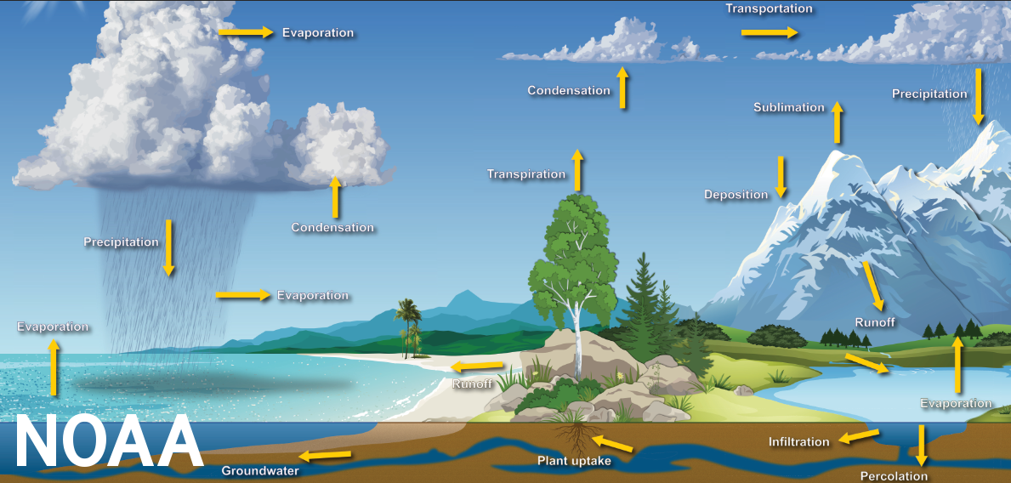
Images are important!
We use images because they help illustrate ideas that are difficult to describe—they simplify our message even as they add to it!
However, to make the image accessible to people who cannot see the image, we frequently have to go ahead and describe what we were trying to avoid describing!
This creates tension!
ALT-TEXT: Complex NOAA infographic showing water cycle including water in various forms across various terrains--infographic demonstrates the difficulty of writing alternative text for very complex images.

Slide 4
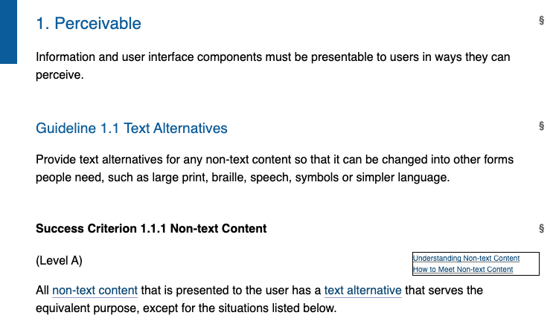
Online Accessibility Standards
Web Content Accessibility Guidelines (WCAG 2.1)
  WCAG 2.1: 1.1.1 Non-text Content
  All non-text content that is presented to the user has a text alternative that serves the equivalent purpose (with rare exceptions)
Alt text describes screen shot and contains all the text in the screenshot.

Slide 5
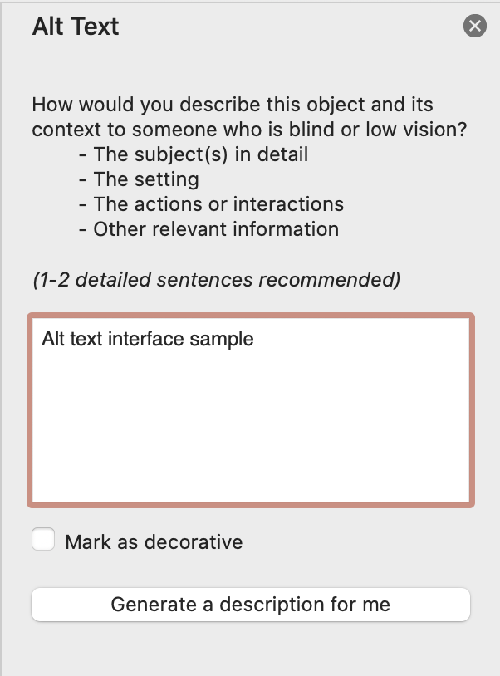
Alt-Text IS:
A text substitute which
  Is read by screen readers,
  Is presented if the image fails to load
  Is indexed by search engines
Alt text: Microsoft PowerPoint alt text interface sample.

Slide 6

Alt-Text GOAL:
If your content contains images which carry meaningful information students are intended to receive through that image...
...the goal of alternative text is to ensure equitable access to that meaningful information for students who cannot perceive the image.
Alt text: 3D target with arrow splitting another arrow in the bullseye. Image animates when presented.

Slide 7
Alt-Text CAN:
Be presented in two ways:
  Tagged in the code of the document (using built-in tools in Word, etc.)
  OR, when too long or too complex, can be described somewhere else on the document / page (two options)
Important: if you have described the image in the text of the document, you may not need extensive alt-text!

Slide 8
The Basic Rules for What to Write
Don’t say “Image of!”
  Unless it’s an image of a painting, portrait, etc.
Consider the content and the function
  What is it my students need to learn from this image?
  Has the image been described in the text already?
  Does ALL of the content of the image need to be described or is there a specific thing that students are supposed to get from the image that is paramount?
  Are there other ways to represent the meaning of the image that are simpler?
OR What NOT to!

Slide 9
Strategies from W3C Images Concepts
Review:
  Informative images
    Examples 2 and 3
  Decorative images
    Page design
  Functional images
    None—just note what they are
  Images of text
    None—just note what they are and note that text content must be communicated
Complex images
  Approaches 1 and 2

Slide 10
Resources
DLI Academic Web Accessibility Alt Text Resources (doc and video)
Web Aim’s Alt Text Techniques page
W3C’s Images Concepts page
Writing Alt Text for Maps (Presentation is for PDFs but will apply to many formats)

Slide 11
Thank You
Questions?

