Slide 1
Blackbaud Financial Edge (FE) Expense Management Training
Tuesday
August 29, 2023

Slide 2
What We’ll Cover
Blackbaud FE NXT Access
How to Submit Payment Requests
Required Documentation
Financial Aid Documentation
Rejected Payment Requests
Working with my invoice requests
Error Messages
Meals using foundation funds
Foundation Resource Page
Foundation Communication
Accounting Period Closed
Monthly Statements Available
Foundation Updates

Slide 3
Division of University Advancement (DUA)
Generating and stewarding the resources necessary to Advance the mission and fuel the vision of Kennesaw State University.
4 Offices within DUA:
Advancement Services
Alumni & Constituent Engagement (ACE)
Development
KSU Foundation, Inc.

Slide 4
Advancement Services
Database Administration & Management
Gift Processing
Prospect Development
Prospect Research
Reporting & Analytics
Advancement Technology Coordination

Slide 5
Alumni & Constituent Engagement
Alumni & Student Engagement
Signature Events & Programs
Board & Volunteer Management
Alumni Social Media & Newsletters
Intentional Relationships & Partnerships
Drive campaigns for Annual Giving ($1-$24,999) from internal and external supporters

Slide 6
Development
Identify, cultivate and solicit major gifts ($50,000+) from individual donors
Secure corporate and foundation gifts for KSU
Secure Planned Gifts
Steward strategically donors for future cultivation

Slide 7
KSU Foundation, Inc.
Financial Reporting for Advancement and Foundation
Budgets
Safeguard Donor Funds
Capital Markets & Bond Compliance
Real Estate
Investments

Slide 8
Blackbaud FE NXT Access
Fill out Add_Change Form with department’s signature approval and email to me
Approval Rule(s)
Project ID(s)
Once access is set up, new user will receive Blackbaud email to complete registration
New user will also receive email from me containing:
Expense Management Submission or Approval Job Aid
Submitter or Approver Notification Set up Job Aid
KSU Foundation Guidelines
New Vendor Job Aid (submitters only)
W-9 Form (submitters only)

Slide 10
College Unit
01 - Coles College of Business
02 - Bagwell College of Education
03 - Norman J. Radow College of Humanities & Social Sciences
04 - Community and Professional Education
05 - College of Science & Math
06 - College of the Arts
07 - Graduate College
09 -Wellstar College of Health & Human Services
10 - Global Affairs
12 - Enterprise / Institutes
13 - KSU Foundation
14 - Operations / Administration
15 - President's Office
16 - Student Affairs
17 - University Development
19 - General Scholarships
20 - Athletics
22 - KSU Housing
22 - KSU Housing
23 - KSU Journey Honors College
24 - College of Architecture & Construction Mgmt
25 - College of Engineering & Engineering Technology
26 - College of Computing & Software Engineering

Slide 11
Financial Edge Payment Request Submission
Click on Expenses
Click on Manage Expenses
Click on New request
Enter Payee Name which will auto populate
If the submitter has previously entered a payment request for the vendor click on a past invoice (to the right) to copy basic invoice data (Description, Approval Rule, Rate, Date, Distribution lines, Account Code, Project ID, & all custom fields) **Remember to make changes, if needed. **

Slide 12
Financial Edge Payment Request Submission cont…
Enter invoice Number
Enter number from actual invoice or number from reimbursement receipt(s).
Note: Vendor invoices must be submitted individually. Personal reimbursements can be submitted for multiple receipts, using one (1) distribution line. Distribution lines per receipt are not required.
Enter Invoice Date
Enter date on invoice unless required to use current date as the invoice date
Once transactions have been recorded for a prior month, the foundation will close the accounting books for that month. This prevents invoices dated within that closed period from being submitted, and why approvers receive the error message “Invalid document date”.
Enter Description of payment requests

Slide 13
Financial Edge Payment Request Submission cont…
Approval Rule: Enter approval rule
Contact department manager if you’re not sure which approval rule to use
Expense detail/purpose: Enter detailed information in the box
Expand on the Description and provide details of expense
Rate: Enter full payment amount
Account: Default account code 030-5000
Project: Enter project ID which will auto-populate
Note: if project ID does not auto-populate you may not have access rights

Slide 14
Financial Edge Payment Request Submission cont…
CUSTOM FIELDS
Value: Enter invoice number and original invoice date
Click Yes or No if the vendor record requires changes
Payment Type: Select “Mail to Vendor” or “Hold for Pick-up”
Foundation only issues check payments, not ACH or wires
Do Not enter a date in Payment Type field
Click Yes or No if Remittance Stub should be included with payment
Upload attachments
Click Submit

Slide 15
New Vendor Requests
Payee: **NEW VENDOR***
Approval rule: 00.00 NV – New Vendor Request

Slide 16
Attachments
**Foundation Required Documentation**
1. Actual scanned copies of both the detailed (itemized) receipt and the transactional total, including tip, or a copy of a detailed vendor invoice (sales tax should be added). Only inc’l receipts seeking reimbursement.
2. Regarding reimbursements, if a bank/credit card was used and the cardholder’s name is NOT printed on the receipt, the following is required: A) Picture of card ONLY showing the cardholder’s name and the last four (4) digits OR B) A bank statement showing ONLY the transaction(s), card holder’s name, and the last four (4) digits
3. An agenda, itinerary, brochure, or announcement showing the business purpose and details of the activity.
4. A copy of an agreement or contract between the University and an outside vendor should also be attached for any goods or services rendered, with Contract Approval.

Slide 17
Attachments
**Foundation Required Documentation
Cont.**
5. A copy of the design approval for items with the KSU logo, or proof design approval is not needed.
6. A list of all attendees and participants for all activities with the attendees’ relationship to KSU (Faculty, Staff, Student, Donor, Board Member, Consultant, etc.…).
7. A detailed explanation in Financial Edge specifying how this expenditure benefits the University, college, or department directly, and how it relates to the donor’s original intent (if applicable).
8. If the vendor is not already established in Financial Edge, a completed and signed IRS W- 9 (Appendix C) form must be c returned to the Foundation. An IRS W-9 form is not needed for reimbursement request for KSU employees for expenses incurred; their name and current campus mail drop is sufficient.

Slide 18
Attachments
**Foundation Required Documentation
Notes**
Please note: This documentation is required for all Foundation payment requests submitted via Blackbaud and KSU state portals (i.e. OwlPay, ePro, P-card, Concur). If submitting payment requests via KSU state portal and using Foundation funds (speed chart), KSU documentation is required (i.e. Food Documentation Form, Travel Expense Form, Unauthorized Commitment Form).
Please also note: Word documents created for the purpose of summarizing the business purpose submitting for payment WILL NOT suffice. Original agenda, itinerary, brochure, email, or announcement showing the business purpose is required.

Slide 19
Rejected Payment Requests
Make sure notifications are set up
Receive emailed rejection notification
Click on digit of rejected invoices
Select rejected request
Review notes in red at the top of request
Scroll down to bottom of request to review rejection notes
Adjust margins if needed
Note: When revising a rejected invoice, DO NOT change data in the custom fields.

Slide 20
Working with my invoice requests
Click on Work with my invoice requests
Remove filters to view all submitted requests
Only submitters can view requests submitted, pending, and approved
Open Invoices: Click on the number digit to view open requests
Approved Invoices: Click on the number digit to view approved requests
Rejected Invoices: Click on the number digit to view rejected requests

Slide 21
Error Messages
Invalid Document Date: The invoice date is in a closed (past) accounting period.
Submitter will need to change the invoice date to the current date and resubmit.
No Rights to use this account: The account number was most likely changed during the approval process.
Click on “View Distribution” to the right and change the Account* number back to your default 030-5000, then click Submit.
No Rights to use this project: The approver does not have access to approve the project ID in the request.
Contact LaToya Harris to verify security rights.

Slide 22
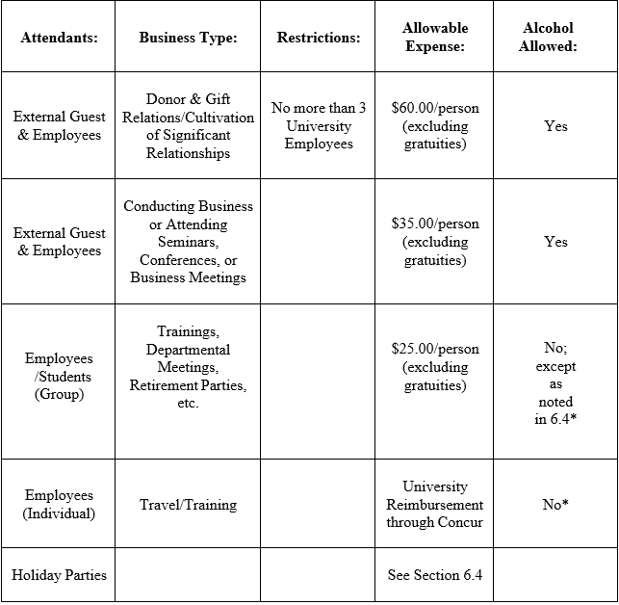
Foundation Meal Matrix
The following are instances where meals and entertainment expenses are allowable:

Slide 23
Alcohol, Tips, & State Per Diem
The purchase of alcoholic beverages is allowed only for employee morale events, and while hosting meals that include external guest(s) while conducting official KSU business.
Any other alcohol related expenditure is not an allowable expense.
Any allowable alcohol related purchase viewed as excessive in costs may be denied by the KSU Foundation at the discretion of the Chief Executive Officer
Up to 20% of meal tips are allowed for payments and reimbursements.
Meal invoices and reimbursements processed with foundation funds DO NOT follow state per diem amounts
All reimbursements require proof of payment (including students (submitted via Blackbaud) and non-employees
Student meals reimbursed via KSU state portals require state documentation (ex. Travel Expense Report Form) and follow state meal per diems.

Slide 24
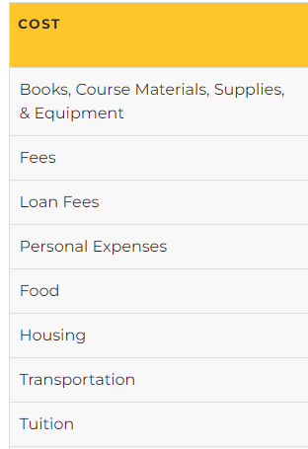
Student Financial Aid Documentation
The Office of Scholarships and Financial Aid must review/approve all financial resources a student receives, unless funding is tied directly to funding received for a job performed (paid student assistant receiving a biweekly paycheck.
All financial assistance granted to a student for the purpose of course credit (conference attendance and registration, transportation to attend a banquet, etc.; Anything related to travel expenses for a student to attend) must be sent to the Financial Aid office to ensure the student is eligible to receive the financial resource.
Competition Teams: If the competition is strictly voluntary (not attached to a class requirement) and if the payment registration is made directly to the event vendor Financial Aid IS NOT required to notate the students’ account.
If the student is receiving payment or reimbursement for expenses relating to items in the Cost Grid (left side) Financial Aid is required to review and notate the students’ account

Slide 25
Student Financial Aid Doc Procedure
Email Sarah Baumhoff in the Office of Scholarships & Financial Aid at sbaumbhof@kennesaw.edu
Information provided to Financial Aid in the body of the email
Student Name
Student ID#
Award Amount
Financial Aid will respond, “This has been added to the student’s financial aid award
Attach this documentation to the request

Slide 26
Best Practices
Bookmark Blackbaud Sign In: https://fenxt.blackbaud.com
Bookmark Foundation Forms: https://foundation.kennesaw.edu/forms.php
Bookmark Foundation Expenditure Control Guidelines: https://foundation.kennesaw.edu/accountspayable/expenditureguidelines.php
Bookmark Foundation Job Aids: https://foundation.kennesaw.edu/accountspayable/job-aids.php
DO NOT USE CASH when seeking reimbursement
DO NOT personally reimburse an individual
DO NOT personally sign a contract, seek foundation contract approval
There should be no personal items on a receipt when seeking foundation reimbursement
Summary of expense IS NOT “required documentation”. Prepare & provide receipt/invoice, list of attendees (small meeting invite), & business documentation (i.e. agenda, itinerary, flyer, meeting invite)

