Slide 1
Welcome!
We will begin promptly at 2pm.

Slide 2
Managing Your Seats
An In-Depth Look at the Manage Positions – Add/Change Position Transaction

Slide 3
What is an Add/Change Position transaction?
  Explanation
  When To Use
  Notes and Reminders
What do all the fields mean?
  Definition of Fields
What resources are available?
  SSC Knowledge Base
  HR Newsletter
  HR Training
  HR Teams
AGENDA

Slide 4
What is an Add/Change Position Transaction?

Slide 5
An Add/Change Position transaction allows any manager to update the details of a specific position number.
These transactions will update both the position and any current incumbents (i.e. employees who are active as of the effective date on the transaction).

Slide 6
Actions that affect a POSITION are
routed through MANAGE POSITIONS
Manage Positions
Use for vacant positions
-OR-
Use when employee is changing while
staying in current position number
Classification (Job Code / Title)
Department
Reports To
Standard Hours / FTE
Pay Frequency
Position Funding

Slide 7

This seat represents position number 12345678.
Position 12345678 is an Administrative Assistant in Human Resources. It is a regular, 40 hours per week position and reports to the Office Manager, position 87654321.
It is funded 100% from Human Resources.
This person represents employee 1122334.
Employee 1122334 is hired into position 12345678. The data from the position is added to the employee for as long as the employee remains in the position.
Employee 1122334 earns compensation based on the classification and their experience level.

Slide 8
Employees who share a position number must all be changed in the same way if making changes via Manage Positions.
If only one or a group of employees within a position is changing, the employee(s) changing will need to be moved to a new position number via Transfer action.

Slide 9
Manage Position transactions can be edited once they are submitted by the HRBP or by HRMS.
However, ensuring that all data is complete and accurate prior to submission, including effective date, will prevent unnecessary delays and possible denial of submissions.

Slide 10
What do all the fields mean?

Slide 11
Please reach out to your HR Team if you have questions about a particular data element.
Submitting a transaction with incorrect information in order to submit it can cause unnecessary delays or possible denial.

Slide 12
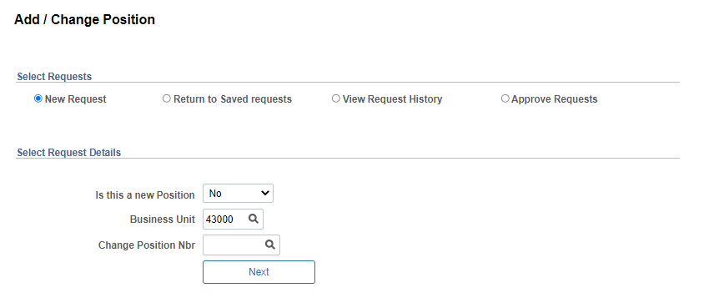
1. Select Requests option should be set to “New Request” to kick off a new Add/Change Position transaction
2. YES will create a new position (allows you to enter an existing position number in order to clone it).
NO will allow you to enter an existing position number in order to update it.
3. Business Unit should be “43000”
4. If YES above, enter position number you wish to clone (or leave blank to create from scratch).
If NO above, enter position number you wish to change.

Slide 13
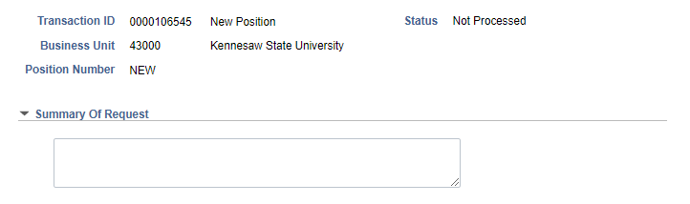
1. Top section contains information pertaining to the request, a unique transaction ID, the type of transaction, the business unit, and the position number (or “NEW” if new position). The status is the current status, which will always read Not Processed until the transaction is submitted.
2. This section should be filled in with a brief summary of the request, including what is changing and why it is changing. You may also include additional details, such as new pay rate, here.

Slide 14
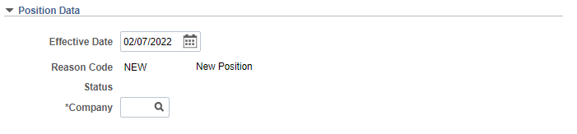
Enter the effective date of action here – the action MUST correspond with a payroll period begin date that matches the position’s frequency.
Choose an appropriate reason code.
DO NOT USE NFY for New Fiscal Year.
Enter company 430 for Kennesaw State University.

Slide 15
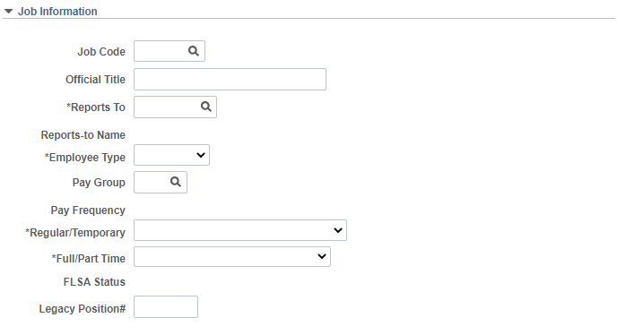
Job Code – classification code for the position. If you are unsure, contact your HR Team.
Official Title – should closely match job code title, but can spell out abbreviations or add program titles.
Reports To – the position to which this position reports. Click the magnifying glass to search for reports to by name.
Employee Type – select hourly or salaried as appropriate for the classification. If you are unsure, contact your HR Team.
Pay Group – select the appropriate pay group. If you are unsure, contact your HR Team.
Pay Frequency – displays the frequency based on the chosen pay group.
Regular/Temporary – select appropriate response.
Full/Part Time – select full-time if 40 hours; select part-time if anything less than 40
FLSA Status – displays the FLSA status based on the chosen job code; should match employee type (hourly = nonexempt; salaried = administrative)
Legacy Position # - do not alter this field

Slide 16
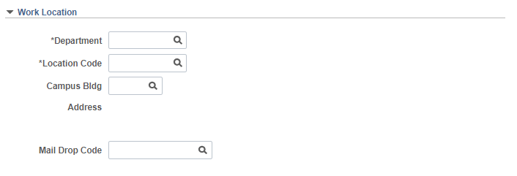
Department – this is the HOME department for the position
Location Code – select 430 for Kennesaw State University
Campus Bldg – leave this blank (not tracked in OneUSG)
Address – leave this blank (not tracked in OneUSG)
Mail Drop Code – leave this blank (not tracked in OneUSG)

Slide 17
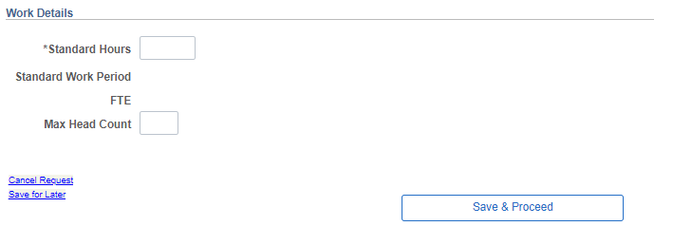
Standard Hours – the number of hours per week the employee is expected to work
Standard Work Period – should be W for 12-month positions or W10 for 10-month positions, but this is not editable; if incorrect, please make a note in the comments
FTE – standard hours divided by 40
Max Head Count – maximum number of occupants for position. If you are unsure, contact your HR Team.
5. Click Save & Proceed to move on to next page

Slide 18
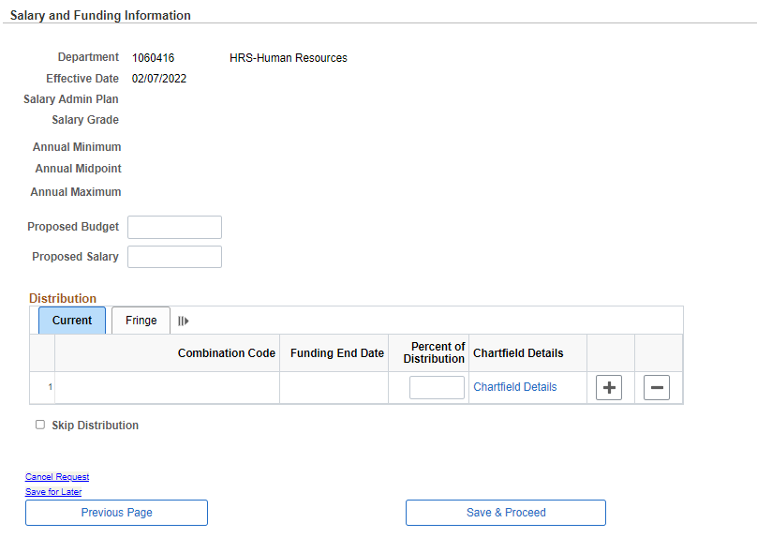
Complete the required funding information for new positions. If you are unsure, contact your business manager and/or budget.
Current positions will display information but will not be editable. If a funding change is also required, the action will also require a separate Change Funding transaction to be submitted. If you are unsure how to do that, contact budget.
2. Click Save & Proceed to move on to next page

Slide 19
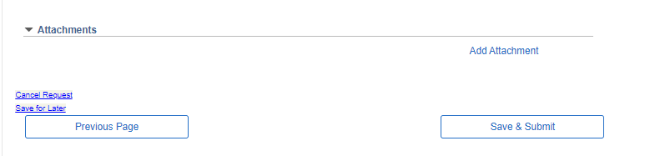
Scroll to the bottom of the page.
Attach any attachments that correlate to the transaction.
Click Save & Submit to submit transaction for processing.

Slide 20
What resources are available?

Slide 21

Shared Services Center
Knowledge Base
https://usg.service-now.com/usgsp
Resource developed by the University System of Georgia Shared Services Center to assist employees of the university system in navigating OneUSG products using knowledge articles and job aids.

Slide 22
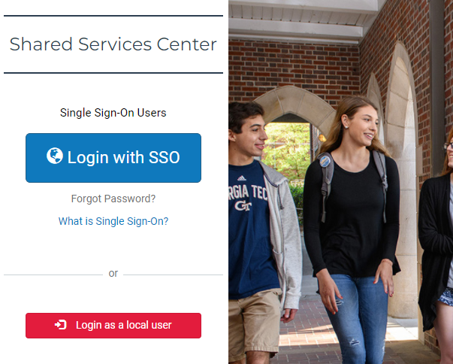
Click the blue log in button and then use your KSU NetID and password to log in, using DUO to authenticate.

Slide 23
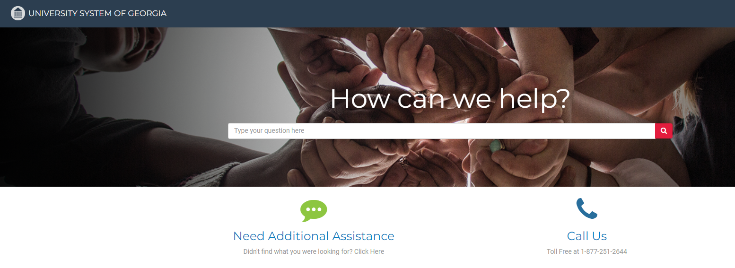
Search the landing page for topics related to
OneUSG transactions and/or products.

Slide 24
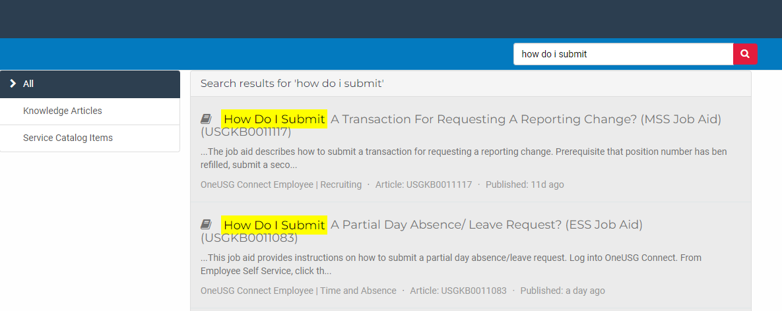
Search the search page for specific text within the searched articles.

Slide 25


https://hr.kennesaw.edu/
communication/newsletter.php
Resource developed by the KSU Human Resources team to inform employees of HR happenings and important topics.
MSS Tips and Tricks articles cover MSS materials and known tips and tricks for transaction success.
HR Newsletter Articles
MSS Tips and Tricks

Slide 26

HR team members provide a monthly webinar and lunch and learn that covers one MSS topic each month.
*See the next slide for a list of topics by month.
https://ksu.percipio.com/channels/df2be379-6673-4008-bd93-2db8587e2217?tab=ATTEND&localeCode=en-US
*Must log in with KSU NetID to view courses
*Dates and times of training sessions are decided at the beginning of the calendar year and all sessions are loaded into the HR Training website.
HR Training
Monthly MSS Sessions

Slide 27
January:
Where do I click? (Manage Positions and My Team Tiles)
February:
Managing Your Seats (Add/Change Position Transaction)
March:
They’re Not Mine! (Reporting and Time&Absence)
April:
Extra! Extra! (Supplemental Pay Transaction)
May:
Moving To a New Seat (Transfers, Promotions, Demotions)
June:
Sorry To See You Go! (Terminations)
July:
Show Me the Money! (Salary Changes)
August:
Let’s Change It All! (Multiple Simultaneous Changes)
September:
Where’s It At? (Viewing and Approving Transactions)
October:
Where’s It Go? (In-Depth Transaction Workflow)
November:
Managing Your Bleachers (Multi-Incumbent Positions)
December:
Can you cover me? (Delegations)
HR Training
Monthly MSS Sessions
(continued)

Slide 28
Have an MSS or HR related issue?
Don’t know who to call?
Check out this website for more info!
https://hr.kennesaw.edu/hrteams.php
Who’s Who in HR?

Slide 29
Questions?

Slide 30
Have a Great Day!

