Slide 1
Welcome!
We will begin promptly at 2pm.

Slide 2
Show Me the Money!
An In-Depth Look at the Salary Change Transaction

Slide 3
What is a Salary Change?
  Explanation
  Types of Salary Changes
How Do I Submit a Termination?
  Transaction Walk Through
What resources are available?
  SSC Knowledge Base
  HR Newsletter
  HR Training
  HR Teams
AGENDA

Slide 4
What is a Salary Change?

Slide 5
A salary change is an ongoing change to an employee’s compensation rate.
Temporary changes to an employee’s compensation rate are supplemental payments and should be submitted via the process for Supplemental Payments.

Slide 6
Compression Adjustment
  A new employee has been hired at a salary close to or higher than a current employee makes, so the current employee is receiving a pay increase
Equity Adjustment
  An employee’s education and experience is substantially similar to another employee in the same role, but the compensation rates of the two employees are vastly different
In Range Adjustment
  A pay rate adjustment within the pay band that is happening for any reason other than those listed (compression, equity, job reclassification, market, or merit)
Salary Changes

Slide 7
Job Reclassification
  An employee has been assigned to a new job description and pay is increasing due to a higher pay grade
Market Adjustment
  An employee earns significantly less than those performing a substantially similar role (can be related to internal or external market)
Merit
  A pay rate increase related to extra funds that have been approved by the state to award employees for performance – typically between .5 and 5% of the employee’s current salary
Salary Changes
(continued)

Slide 8
How Do I Submit a Salary Change?

Slide 9
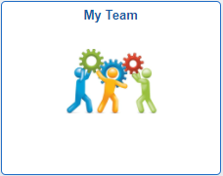
Actions that affect an EMPLOYEE are
routed through supervisor’s MY TEAM
My Team
Use when employee is moving to a new position number
Use when employee information is changing
Transfer
Promote
Demote
Change Time/Absence Approver
Reports To
Retire
Terminate
Salary Change
Supplemental Pay

Slide 10
My Team transactions can NOT
be edited by anyone once
they are submitted.
Ensuring that all data is complete and accurate prior to submission, especially effective date, will prevent HR from having to deny the transaction and you from having to start all over.

Slide 11
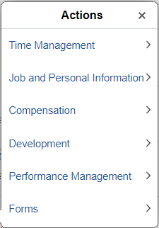
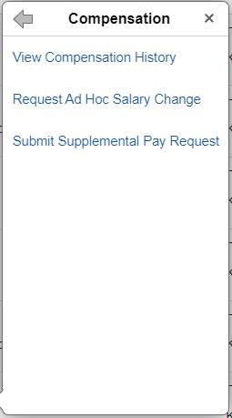
In My Team, you will see a list of employees who report to you. Find the person you wish to change and click the blue arrow next to their name.
Choose Compensation from the actions menu and then choose Request Ad Hoc Salary Change.

Slide 12
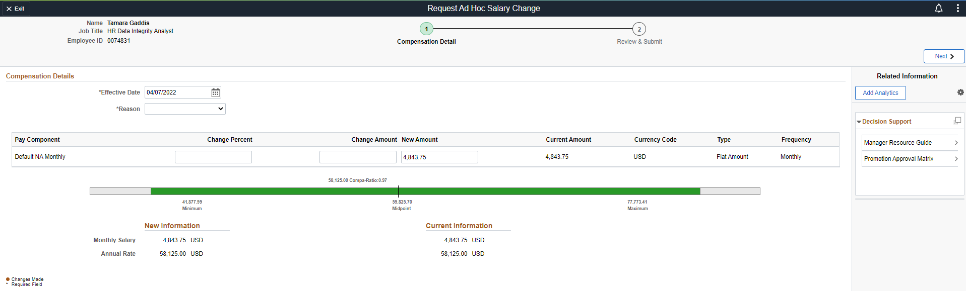
1. Type of transaction
3. Employee information – redacted here for privacy
2. Steps to complete transaction – current step is indicated with a green circle.
8. Navigate to next step
4. Effective date – must be changed to date that coincides with the beginning of a payroll period
5. Reason – select the most appropriate reason from the list of available options
6. Enter the salary change information.
  If the employee is currently paid hourly, the hourly rate of the new position needs to be entered.
  If the employee is currently paid monthly, the monthly rate of the new position needs to be entered.
7. Verify under “New Information” that the yellow dots appear (which indicates that a change has been made) and that the rate displayed matches the correct new rate.

Slide 13
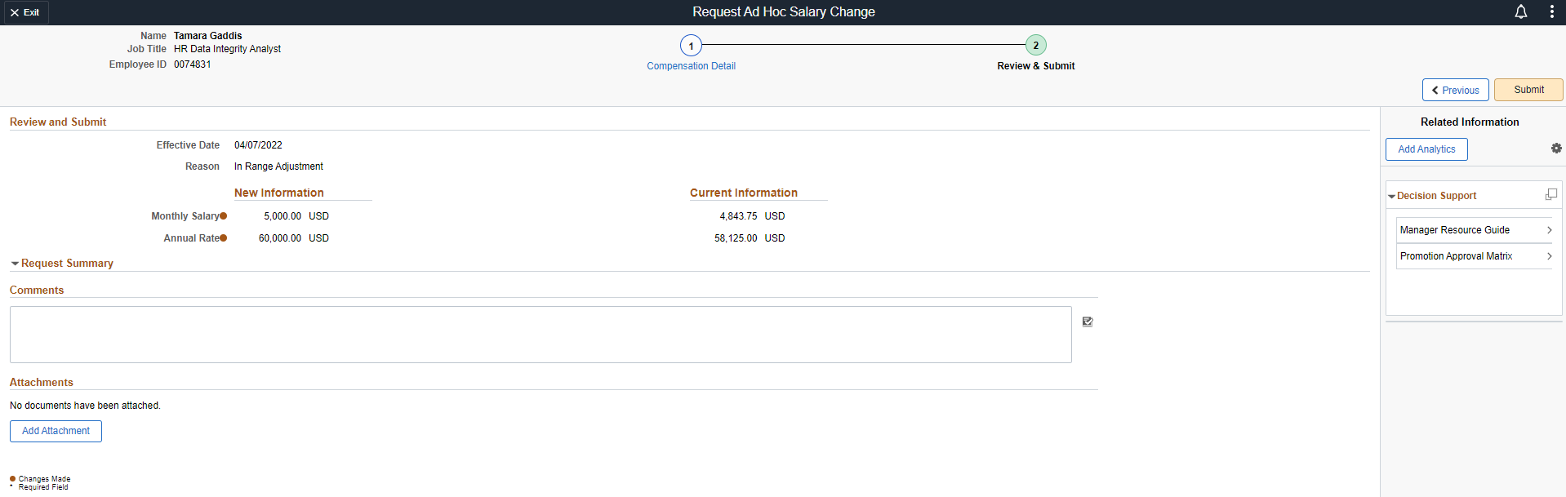
10. Click Submit
9. Review the transaction one more time for accuracy and add any appropriate comments and attachments.

Slide 14
What resources are available?

Slide 15

Shared Services Center
Knowledge Base
https://usg.service-now.com/usgsp
Resource developed by the University System of Georgia Shared Services Center to assist employees of the university system in navigating OneUSG products using knowledge articles and job aids.

Slide 16
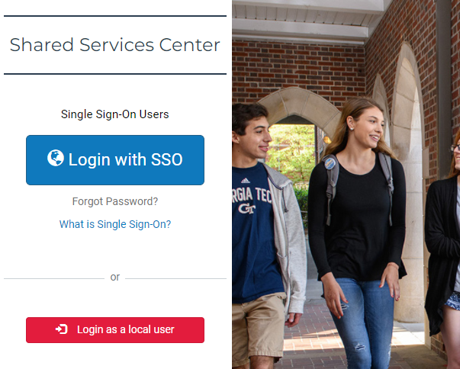
Click the blue log in button and then use your KSU NetID and password to log in, using DUO to authenticate.

Slide 17
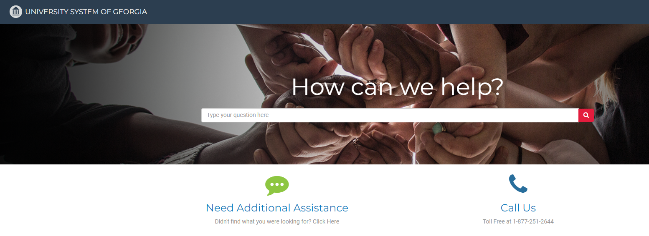
Search the landing page for topics related to
OneUSG transactions and/or products.

Slide 18
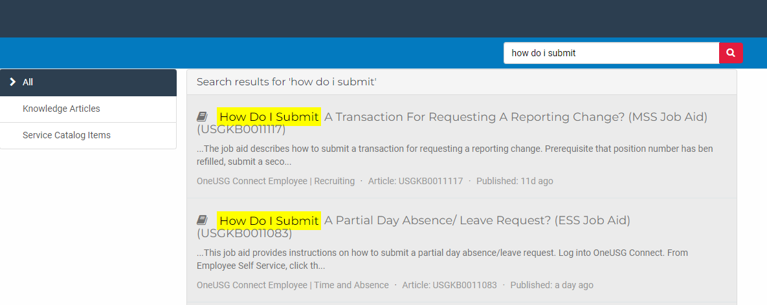
Search the search page for specific text within the searched articles.

Slide 19


https://hr.kennesaw.edu/
communication/newsletter.php
Resource developed by the KSU Human Resources team to inform employees of HR happenings and important topics.
MSS Tips and Tricks articles cover MSS materials and known tips and tricks for transaction success.
HR Newsletter Articles
MSS Tips and Tricks

Slide 20

HR team members provide a monthly webinar and lunch and learn that covers one MSS topic each month.
*See the next slide for a list of topics by month.
https://ksu.percipio.com/channels/df2be379-6673-4008-bd93-2db8587e2217?tab=ATTEND&localeCode=en-US
*Must log in with KSU NetID to view courses
*Dates and times of training sessions are decided at the beginning of the calendar year and all sessions are loaded into the HR Training website.
HR Training
Monthly MSS Sessions

Slide 21
January:
Where do I click? (Manage Positions and My Team Tiles)
February:
Managing Your Seats (Add/Change Position Transaction)
March:
They’re Not Mine! (Reporting and Time&Absence)
April:
Extra! Extra! (Supplemental Pay Transaction)
May:
Moving To a New Seat (Transfers, Promotions, Demotions)
June:
Sorry To See You Go! (Terminations)
July:
Show Me the Money! (Salary Changes)
August:
Let’s Change It All! (Multiple Simultaneous Changes)
September:
Where’s It At? (Viewing and Approving Transactions)
October:
Where’s It Go? (In-Depth Transaction Workflow)
November:
Managing Your Bleachers (Multi-Incumbent Positions)
December:
Can you cover me? (Delegations)
HR Training
Monthly MSS Sessions
(continued)

Slide 22
Have an MSS or HR related issue?
Don’t know who to call?
Check out this website for more info!
https://hr.kennesaw.edu/hrteams.php
Who’s Who in HR?

Slide 23
Questions?

Slide 24
Have a Great Day!

