Slide 1
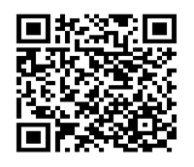
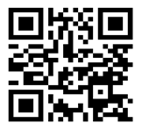
2022 FALL LIBRARY HOURS
All System Libraries
INFORMATION
24-hour chat reference available Except Federal Holidays
ARCHIVES & BENTLEY RARE BOOK MUSEUM HOURS
Kennesaw Campus Archives: Monday-Friday 9:00am-5:00pm By appointment only Bentley Rare Book Museum: Monday-Friday 10am-4:00pm Marietta Campus Archives: By appointment only
Research Help
FAQ
Contact:
Sturgis Library (470) 578 – 6202
Johnson Library (470) 578 – 7276
Archives & Bentley Rare Book Museum (470) 578-6289

