Slide 1
Voting and Power Conversation Series: An Introduction to Propaganda
Dr. April A. Johnson, Associate Professor
School of Government and International Affairs

Slide 2
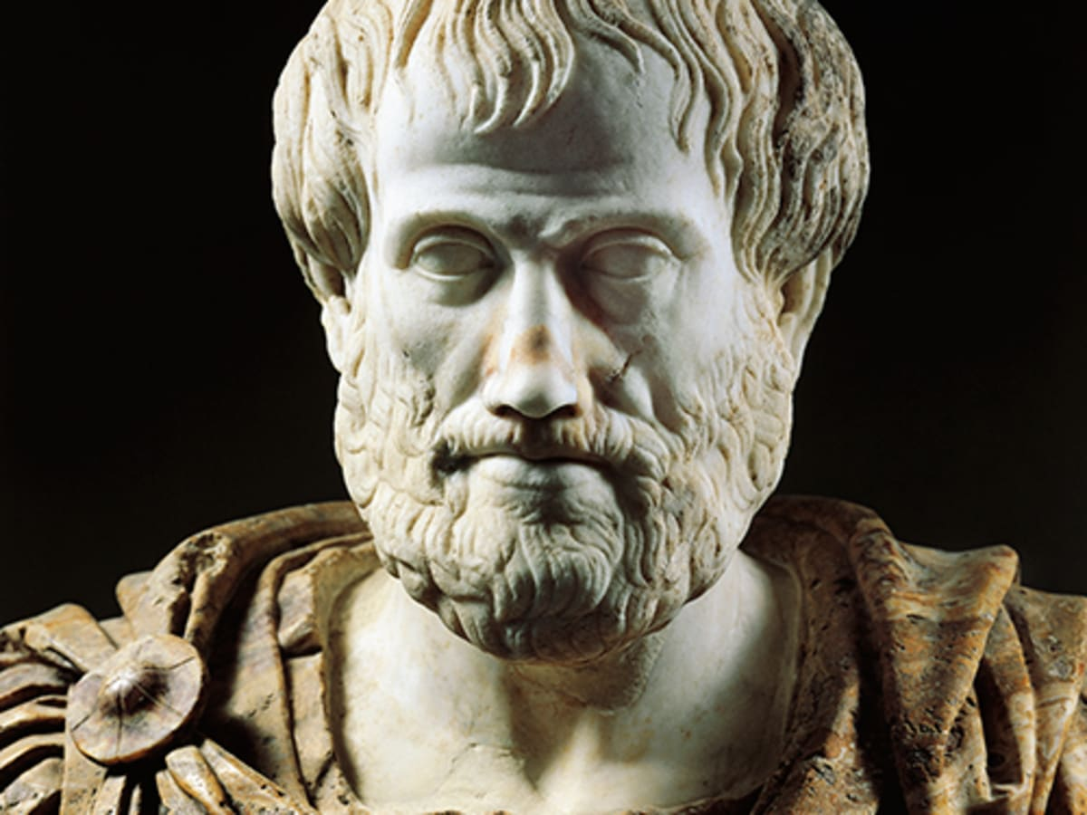
Political Attitudes and Behaviors
What determines political phenomena? How can we study it, predict it, and learn from it?
Question is as old as time
Aristotle- man is a political animal
Politics is not only bound to governance but applies to any social or communal dynamics
Machiavelli, Locke, Rousseau, Hobbes
The state of nature, interworkings of politics
Psychology has always been relevant to politics
How do legislators effectively communicate with constituents?
What factors shape political ideology?
What causes individuals to seek elected office?
What encourages and discourages citizens to vote?

Slide 3
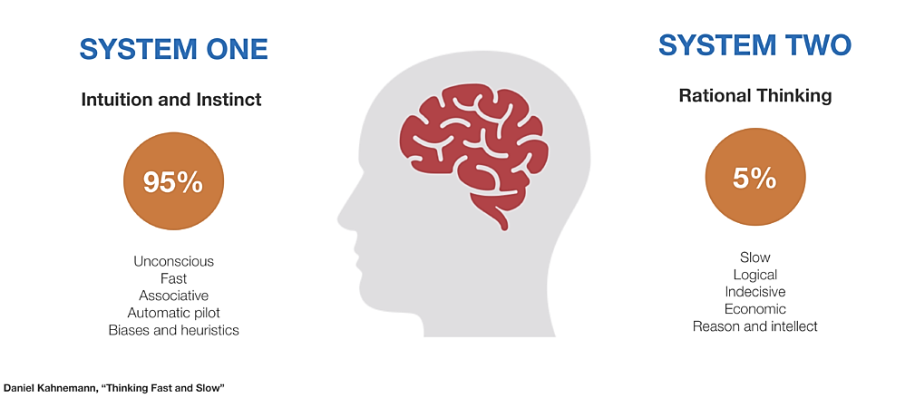
The Duality of Man
How have scholars made sense of human reasoning,
decision-making, and behavior?
Dual process theory:
System 1 is automatic, unconscious, affective, intuitive, relies on mental “shortcuts”
Aka: Heuristic, automatic, implicit processing
System 2 is controlled, slow, effortful, conscious, rule-based
Aka: Systematic, conscious, explicit processing

Slide 4
The Elephant, The Rider
System 1: The elephant
Guides our daily habits, helps us make snap decisions, and reacts instantaneously to dangerous life-and-death situations
System 2: The rider
Deals with complex mental activities, such as managing relationships, logical reasoning, probabilistic thinking, and learning new information
Elephant is more powerful, predominant
“huge and unwieldy, slow to turn and change, and stampedes at threats”
Rider can guide, control the elephant with deliberate and calculated effort

Slide 5
Points of Contention
Long history of perceiving emotions in direct contrast to rational thinking
Is emotion-guided thinking irrational?
Growing body of neuroscience research that suggests our decisions are made outside of conscious awareness
The iceberg in Freudian psychoanalytic theory
Ex: Basal ganglia/insula make up the ‘unconscious brain’; start to work on problems absent conscious thought
Application: Make decisions by flipping a coin
Are emotions/gut reactions superior to effortful deliberation?
Do we operate better on auto pilot?

Slide 6
Cognitive Consistency Theory
Festinger (1957)
Spurred by Marian Keech and the flying saucer
Cognitive dissonance- people experience a state of psychological discomfort when they act in ways contrary to their own beliefs and/or hold beliefs that are incompatible with one another
Consonance- to bring one’s beliefs back into balance
How do people do this?
Rationalizing, ignoring, dismissing importance, altering perception, reframing, counterarguing, all those Freudian techniques
Desire to maintain cognitive consistency can lead people to process information in a biased manner
Directional goals prevail over accuracy goals

Slide 7
Motivated Reasoning
The end goal motivates our cognitive processing
In politics, thinking is driven by accuracy goals vs. partisan goals
Partisan goals spark online processing
Immediate, efficient, relies on overall summary evaluations
Accuracy goals spark memory-based processing
Thoughtful, cognitively draining, relies on file cabinet-like search
Motivated reasoning is a broad term
Best understood as a description of a process and not an explanation in and of itself
Need to identify the motive

Slide 8
The Evidence
Taber and Lodge (2006): Motivated Skepticism in the Evaluation of Political Beliefs
Key component of motivated reasoning is affect, which is elicited automatically (i.e., outside of conscious control)
Affect then serves as a catalyst for biased processing
‘Hot cognition’- idea that all political stimuli are affectively charged
Motivated reasoning involves both System 1 and System 2 processing
“Information congruent with expectations is easily assimilated since it requires no effort to accept what one already knows is true. But incongruent information interrupts normal processing and instead engages a process where some effort must be expended to make sense of the world. Thus, affect and cognition interact for the motivated reasoner engaging in the evaluation of another person.”

Slide 9
Mechanisms
Confirmation bias: People seek out information that confirms/coincides with their prior beliefs
Biased information search
Disconfirmation bias: People avoid information incongruent/contradictory to their prior beliefs
Putting on blinders, discrediting
Prior attitude effect: People who feel most strongly about an issue are those most likely to engage in biased processing
Identity-protection

Slide 10
Research
Interactive, free choice information board
Two issues: affirmative action and gun control
Pre-survey measures of attitude position and strength
*Instructed to view information in an even-handed way so that they could explain the issue to other students (i.e., invoking accuracy goals)
Finding 1: People tended to rate arguments congruent with prior beliefs as stronger, arguments incongruent with prior beliefs as weaker
Especially true among political sophisticates, those with strong opinions
Finding 2: People with high political knowledge and strong attitudes towards the subject spent more time reading incongruent arguments
Why?
Finding 3: People (especially those high in political knowledge) were more likely to denigrate counter-attitudinal arguments

Slide 11
Applications
Motivated reasoning is all around us!
Recall: Affordable Care Act vs. Obamacare
More: https://www.jamesweinberg.co.uk/reading-lists/motivated-reasoning

Slide 12
Our Own Realities
“We may think we’re being scientists, but we’re actually being lawyers”
–Jonathan Haidt
Our preexisting beliefs skew our thoughts and influence our conclusions
Objective facts can be called into question, explains why groups become polarized, even when faced with the same unequivocal evidence
Ex: climate change, vaccines, the birthplace of the president, etc.
How irrational is all of this?
Consider the alternative- disregarding an entire belief system, living in a constant state of dissonance, being ostracized from the group
At what point does motivated reasoning become a conspiracy theory?
Again, motivated reasoning is the process, not the motive or content

Slide 13
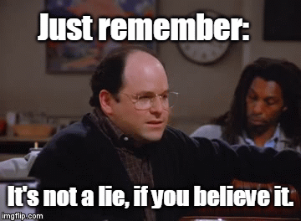
Effects Within Public Opinion
So what? People have always engaged in confirmation bias, disconfirmation bias, selective exposure
What has changed is the way in which we consume information
Political elites, media better positioned to manipulate these basics of human nature
Narrowcasting- targeting messages to certain audiences
Social media, fragmentation of news

Slide 14
Corrections
Nyhan and Reifler’s (2012) research on fact-checking and the backfire effect
When explicitly told WMDs were not found in Iraq and that no link exists between Saddam Hussein and 9/11, people were more likely to hold these beliefs
Especially pronounced amongst Republicans
The spread of misinformation is difficult to control
Accuracy goals vs. directional goals
2016 Trump voters acknowledge ‘factual infidelity’, social identity simply more important in vote choice

Slide 15
Change My Mind
Confronting directional goals
If you want someone to accept new evidence, make sure to present it to them in a context that doesn’t trigger a defensive, emotional reaction
Possible given ‘hot cognition’?
Echo chambers
To overcome directional processing, attitude change must come from within one’s circle (i.e., in-group members)
Allport’s contact hypothesis
Ex: Liz Cheney on same-sex marriage
Effective corrections also reframe an issue rather than simply dismissing it as wrong, intervene early to avoid the spread of a false narrative

Slide 16
Propaganda
Harold Lasswell, political communication scholar and father of modern political psychology
Originally interested in Nazism, propaganda, deliberate manipulation of mass public opinion
Propaganda works via the manipulation and control of "symbols“ or subjective representations or perceptions of things
Mass media is key in disseminating these messages
Herman and Chomsky’s Manufacturing Consent (1988)

Slide 17
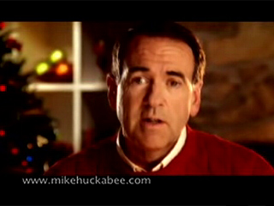
Priming
Media priming is a process where the media attend to some issues and not others, thereby altering the standards by which people evaluate candidates, policies, issues, etc.
Often happens without conscious thought (System 1)
Subliminal or implicit priming occurs when stimuli are presented for less than 500 milliseconds
Ex: George W. Bush’s RATS ad (2000)

Slide 18
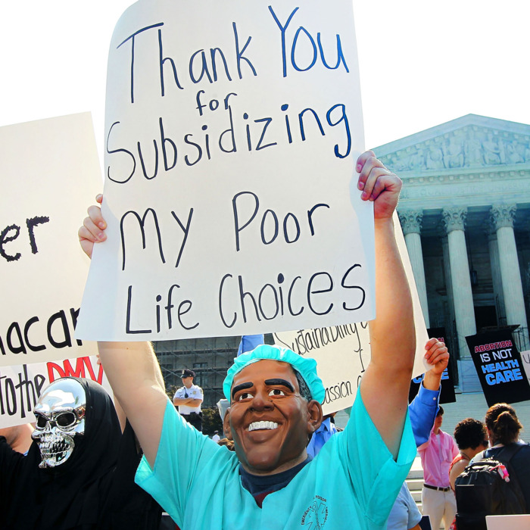
Priming Influences Attitudes and Behavior
Draws upon associations, stereotypes in the mind
Contextual or social priming
Business materials increased competitiveness; money primes increased diligence
Semantic priming
Ex: Respond more rapidly to the word ‘banana’ after being primed with the word ‘yellow’
Racial priming
Ex: Bush’s 1988 Willie Horton ad
Dog whistle politics relates to a wide variety of coded messages
‘bad hombres’, ‘welfare queen’, ‘Barrack Hussein Obama’
Primes work because and/or in spite of the fact that symbols and words means different things to different groups of people

Slide 19
Framing
Political phenomena do not speak for themselves. We often rely on politicians and media pundits to interpret them for us.
Frames provide a way of thinking about a particular construct
Agenda setting tells you what to think about, framing tells you how to think about it
Ex: Is abortion an issue of right to life or right to choice?

Slide 20
Research on Words
Effective persuasion through priming and framing relies upon communication via crafted lexicons
Who develops these?
Political elites, media elites, strategists
Ex: Nazi Propaganda Ministry
In the U.S. Gingrich’s 1994 Contract with America and efforts by political consultant, Frank Luntz, have been instrumental
Luntz created the terms ‘climate change’ (vs. global warming), ‘death tax’ (vs. estate tax)

Slide 21
Jews: A people of contagion
I’m waiting for you
Especially you
Children for the leader
Give me four more years

Slide 22
Voting and Power
Propaganda are powerful tools used to shape political attitudes and behaviors
Priming, framing, symbols, language
Our basic human tendencies are exposed and potentially manipulated through political communication techniques
The elephant and the rider
Cognitive consistency, motivated reasoning, misperceptions
To shed light on human psychology is to shed light on political actors, historical experiences, and the future of voter enfranchisement

Slide 23
Thanks!
Dr. April A. Johnson
ajohn551@kennesaw.edu

