Slide 1
What Causes Democracy to
Fail or Thrive?
Dr. Jeff DeWitt, Professor
School of Government and International Affairs

Slide 2
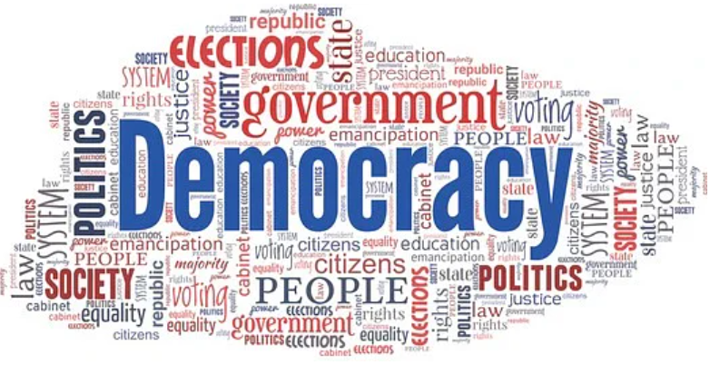
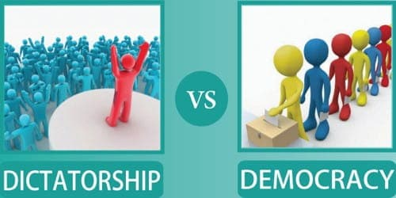
What is Democracy?
Ancient (Greek) political system implemented in many forms and in many places over time
Modern representative democracies - Social contracts
Catchword of contemporary political discourse.
  Resonates in people’s minds and in their rhetoric
  Used/appropriated far and wide
  …is it a debased currency in political marketplace?

Slide 3
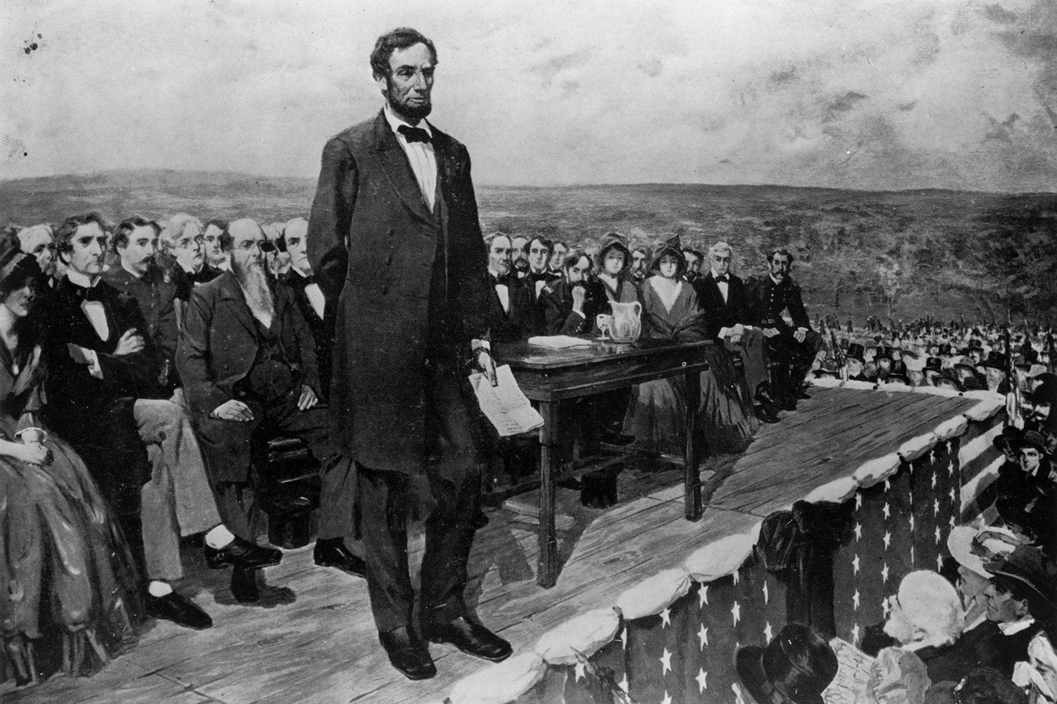
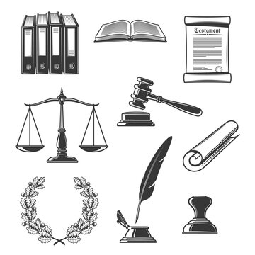
Democracy – Principles
Demos (the people) + kratia (power or authority)
Government function based on consent of the governed
  “We the People” are supremely sovereign.
  “Government of the people, by the people, for the people”
Legitimacy of the process – definable norms
Competition in pursuit of power with some degree of political uncertainty
Rule of law – equal application, equal protection
Fundamental liberties/rights of political minority are protected (liberal democracy)

Slide 4
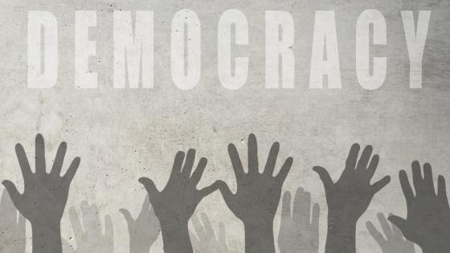
Representative Democracy - Procedural Conditions (Dahl 1982)
Control over government decisions about policy is vested in elected officials.
Elected officials are chosen in frequent and fairly conducted elections
Adults (practically all) have a right to vote in the election of govt officials.
Adults (practically all) have a right to run for elective govt offices.
Citizens have a right to express themselves without the danger of punishment on political matters, which are broadly defined.
Citizens have a right to seek out alternative/independent sources of information. Moreover, such sources exist widely and are protected by law.
Citizens also have a right to form independent associations or organizations, including political parties and interest groups.

Slide 5
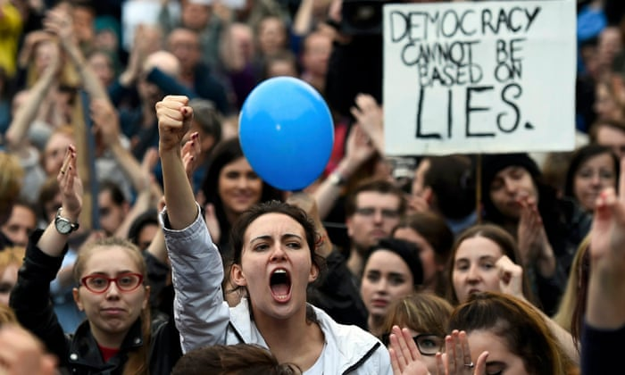
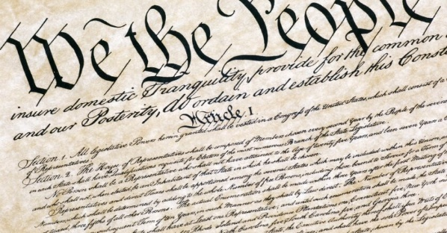
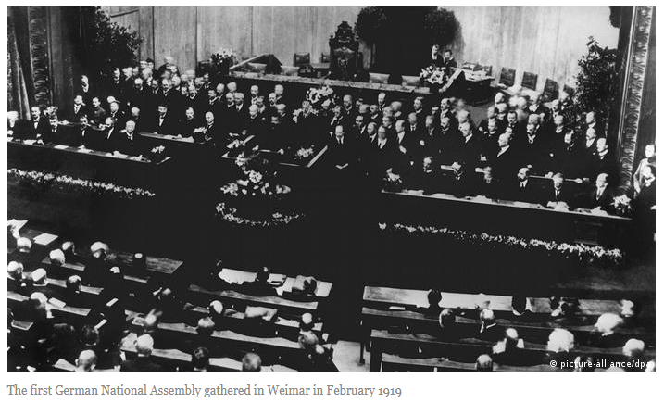
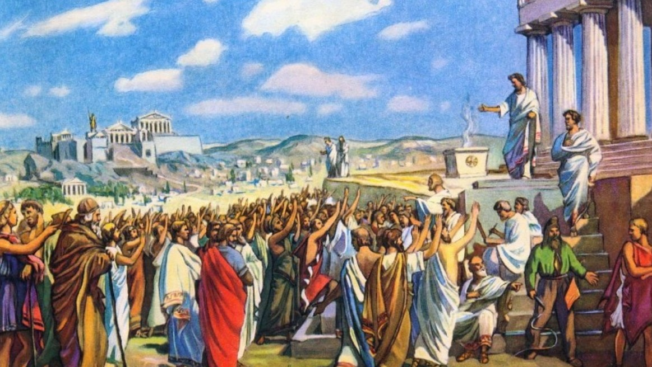
Democracy – Variations and Fluctuations
Different types of democracy reflected in ways in which the power of the people is exercised.
Democracy fluctuates in form and degree - from place to place and time to time

Slide 6


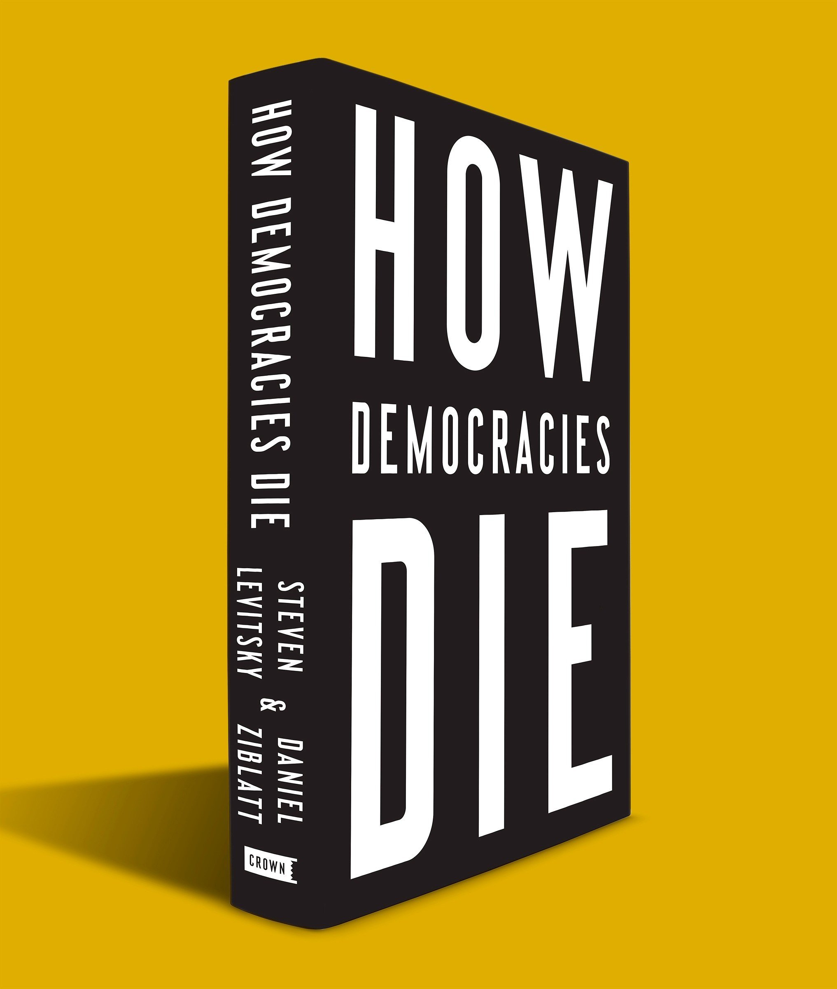
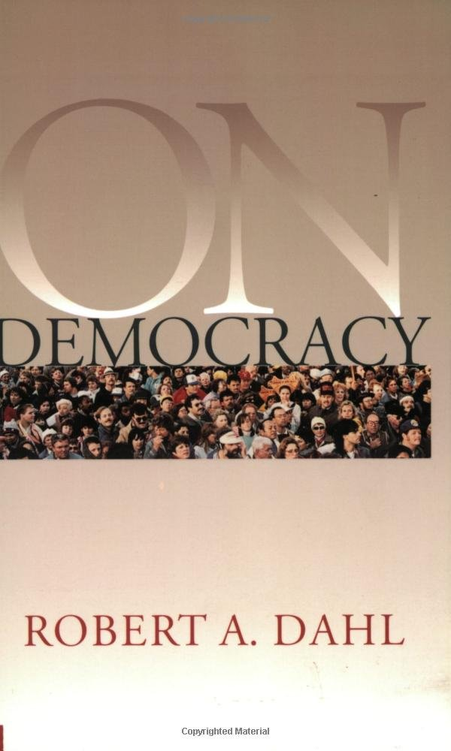
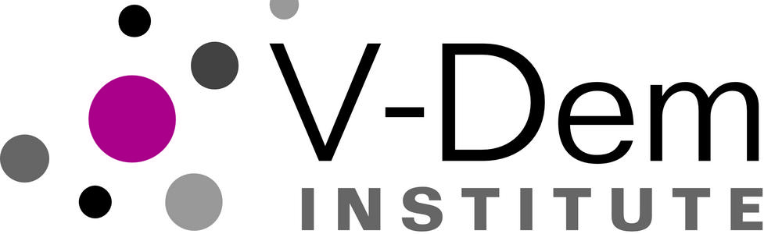
The State of Democracy – Resources

Slide 7
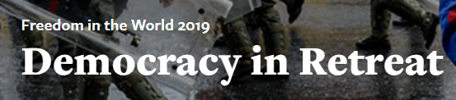
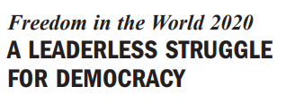
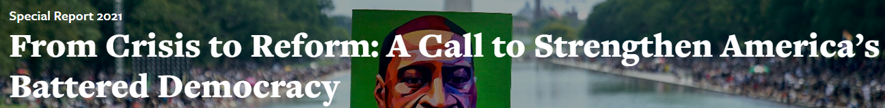
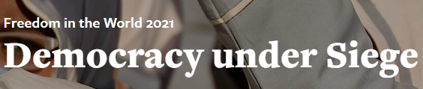
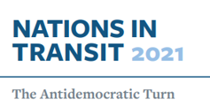
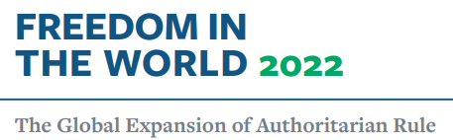
Democracy in Peril: Freedom House Reports

Slide 8
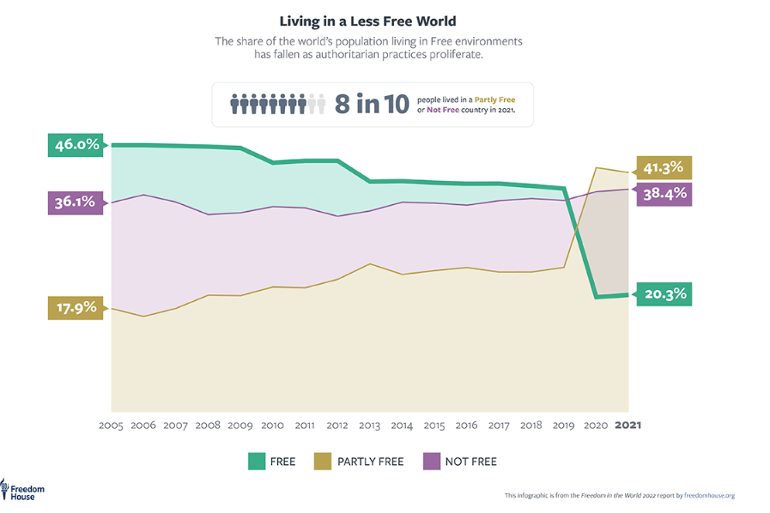
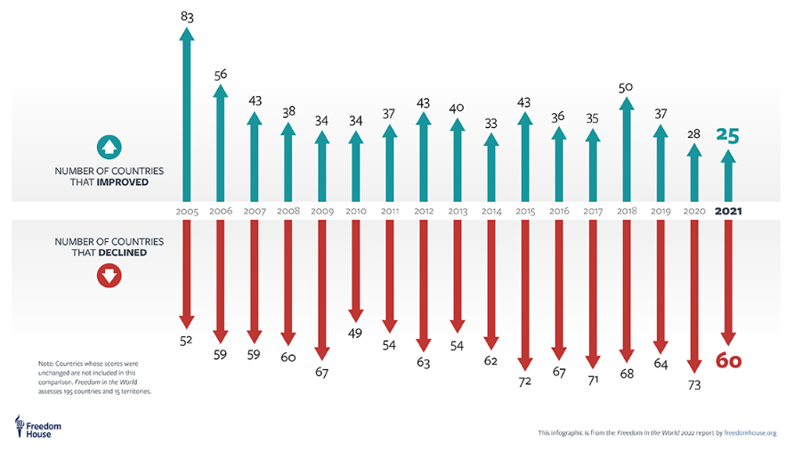
Democracy in Peril: Freedom House Reports

Slide 9
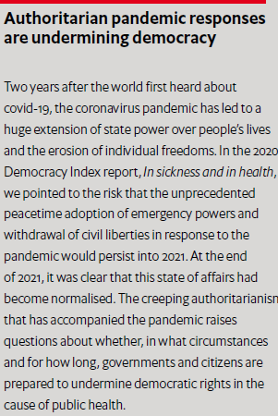
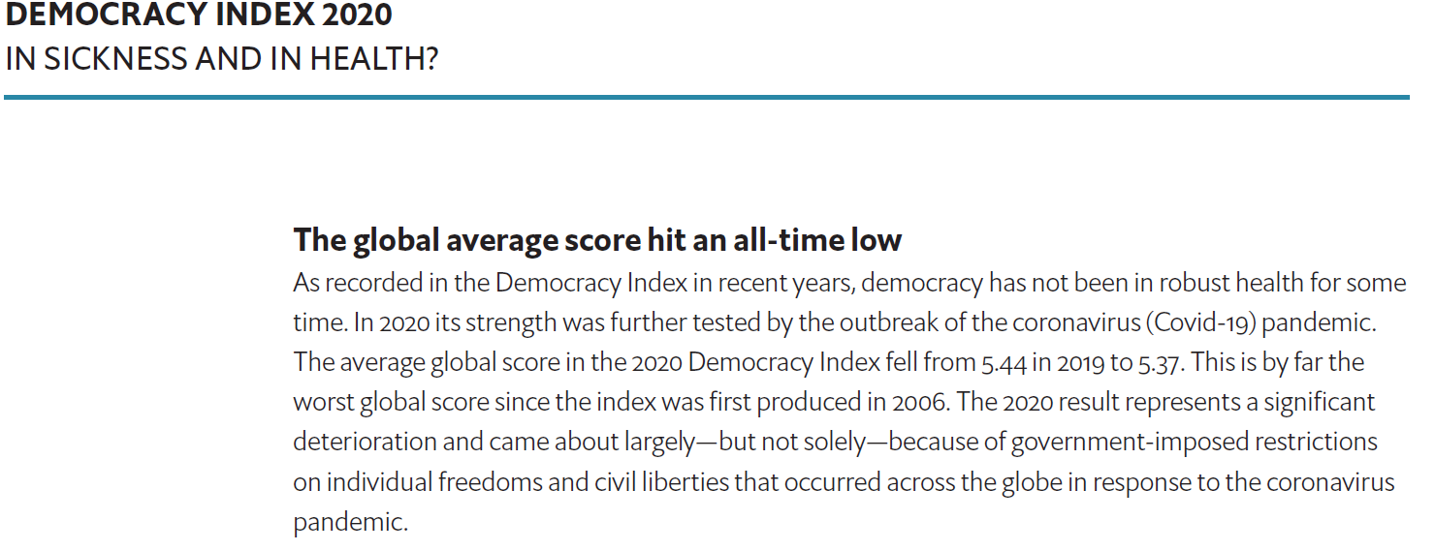
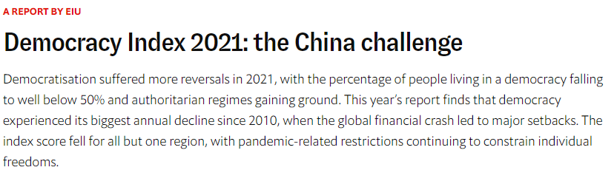
Democracy in Peril: Economist IU Reports

Slide 10
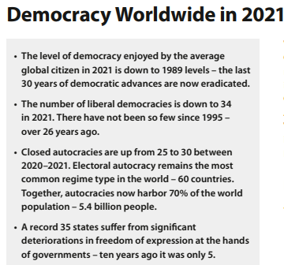
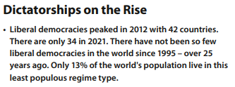
Democracy in Peril: V-Dem Institute Reports

Slide 11
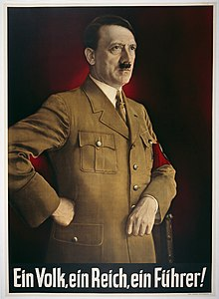
Causes of Democratic Erosion/Backsliding
Coups d’états of “Cold War” era are rare nowadays
Democratic breakdowns originate from within the electoral system
Popular (populist) leader and dominant political party win majority
“Legitimately” elected leader/political party entrenches position, consolidates power, subverts democratic processes and systems
  Built on “cult of personality” – “One people, One empire, and One leader"
  Persuasion and propaganda
    Anxiety and Enthusiasm
  Impact is seen throughout all of society
    Captures political/legal/educational/cultural institutions, and information infostructure
  Ultimate Goals: authoritarian control, annihilate opposition, prolong rule

Slide 12
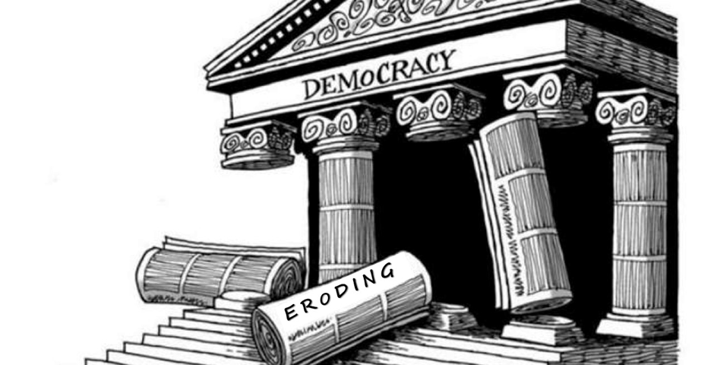
Four Indicators of “Democratic Backsliding”
Rejection of (or weak commitment to) the democratic rules of the game
Denial of the legitimacy of political opponents
Toleration or encouragement of politically motivated violence
Readiness to curtail civil liberties of opponents, including the media
Source: Levitsky and Ziblatt, How Democracies Die and What History Reveals About Our Future, 2018.

Slide 13
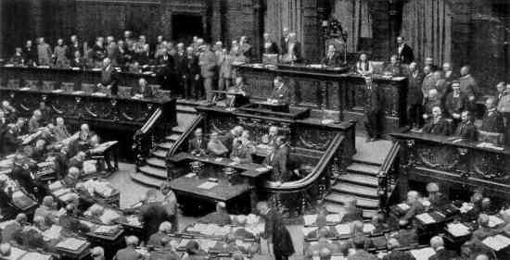
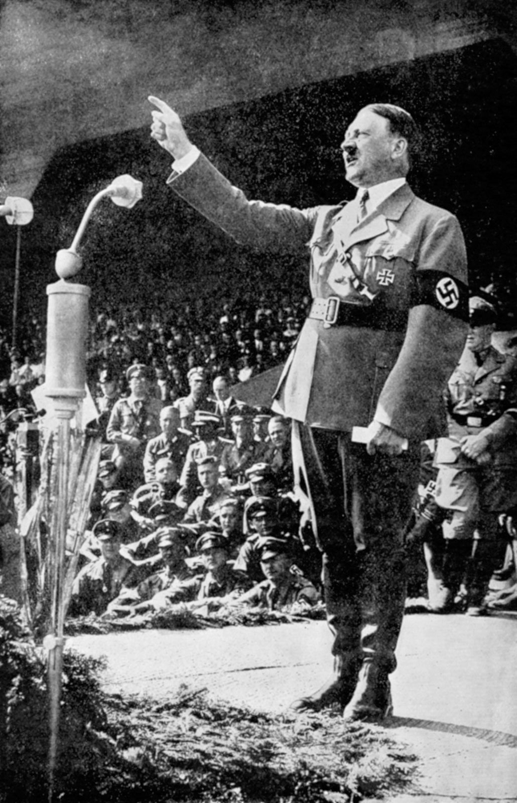
Case Study: Germany
Post WWI, German surrender, Kaiser abdication
1918-19: Weimar Republic/Constitutional Democracy formed,
Rights and Freedoms enshrined, National Assembly, Elections (proportional representation, democratic parties dominate)
1923: Hitler-led coup attempt failed
NSDAP (National Socialist German Workers Party) banned
Hitler jailed/writes Mein Kampf
1930: Economic crises - Germany couldn’t pay debts, unemployment rises
Political crises - cabinets failing, perpetual elections
1933: Von Hindenburg appoints Hitler as chancellor

Slide 14
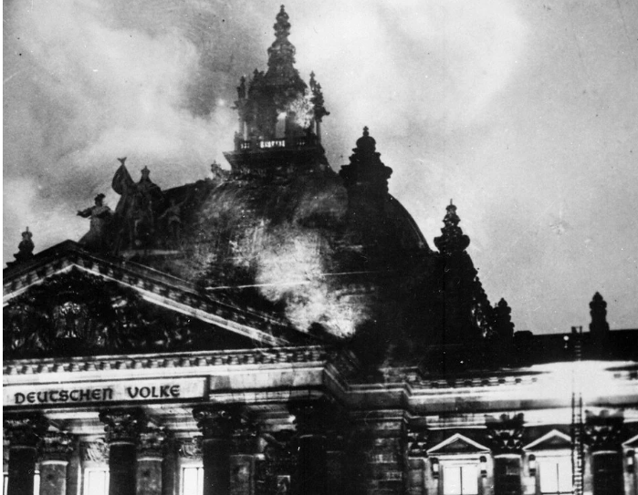
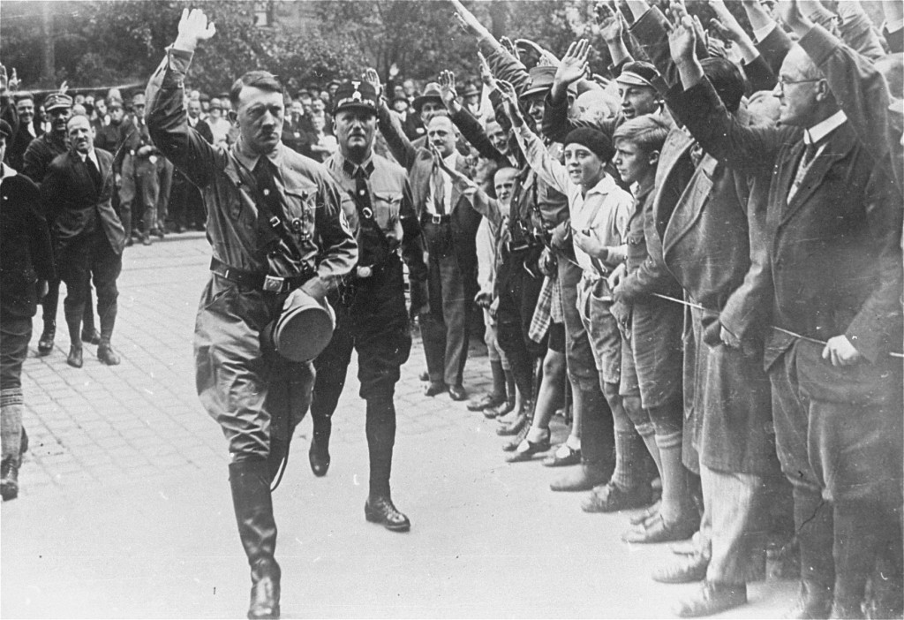
Case Study: Germany
February 27, 1933: Reichstag Fire
“There will be no mercy now. Anyone who stands in our way will be cut down. The German people will tolerate no leniency.”
Reichstag Fire Decree curtails civil rights, freedoms of expression. Opposition outlawed and arrested
Enabling Act adopted allowed Cabinet/Hitler to enact new laws w/out interference.
Concentration camps opened
NSDAP calls for Volksgemeinschaft (“national community”)
Germany becomes single-party state, cultural cleansings…
– Jews, Roma, Ethnic Minorities, Homosexuals, Critics and opponents

Slide 15
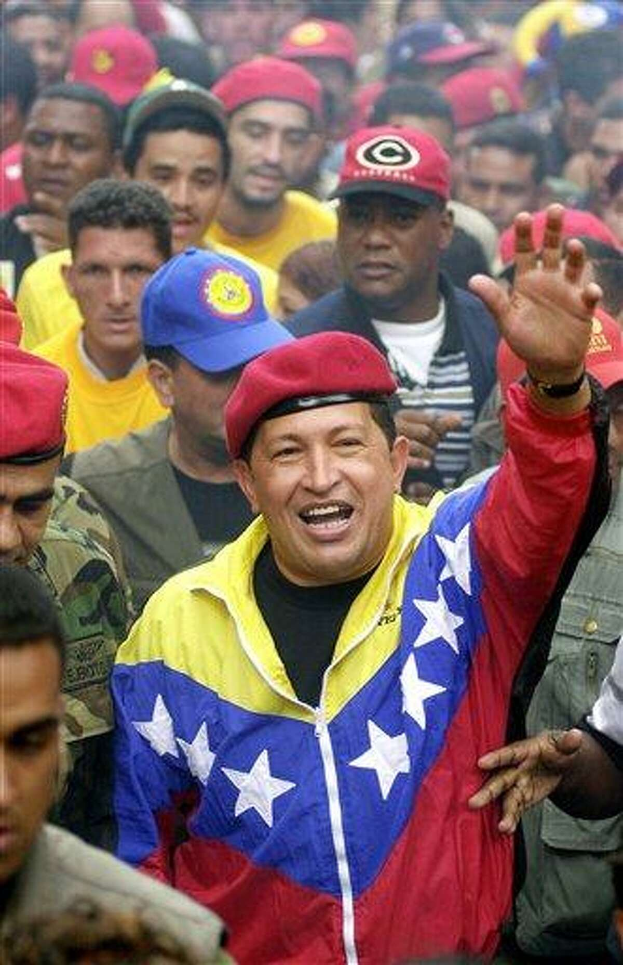
Case Study: Venezuela
Once considered model democratic country with civilian control and a strong economy. Corruption under Pres. Pérez began in mid-1980s.
Hugo Chavez – leader of Fifth Republic Movement / United Socialists
Political outsider, railed against corrupt governing elite
Promised more “authentic” democracy
  Enact socialist policies; Use oil wealth to help disadvantaged
Tapped into anger/anxieties of ordinary Venezuelans who felt ignored, mistreated
1998: Elected president
  “Democracy is infected, and Chavez is the only antibiotic we have.”
2003: Used power to stall recall referendum

Slide 16
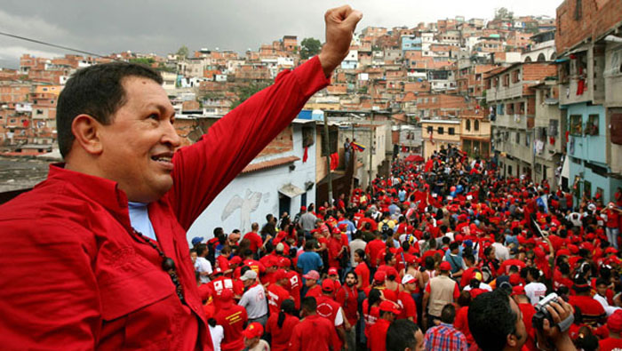
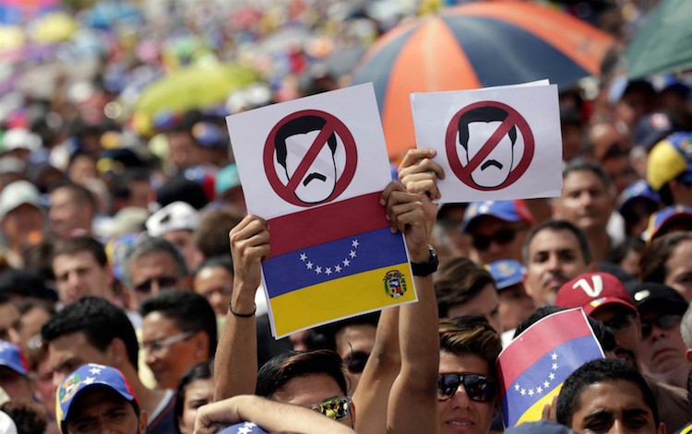
Case Study: Venezuela
2004: Blacklisted those who signed recall petition, packed Sup Ct with allies
2006: Chavez re-elected in landslide, “Chavista” regime more repressive
  Closes television station, arrests/exiles opposition politicians, judges, and media figures, eliminates presidential term limits
2013: Chavez Dies. Maduro wins in questionable election
2014: Opposition imprisoned
2017: Assembly usurps power of Congress
Rated "authoritarian regime" by EIU in 2020, lowest score among countries in the Americas.

Slide 17
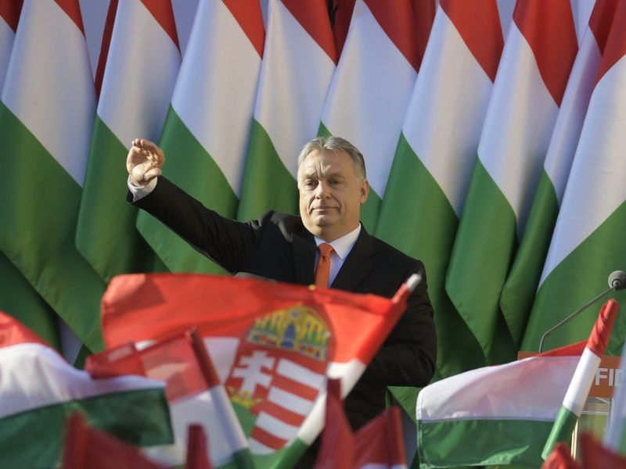
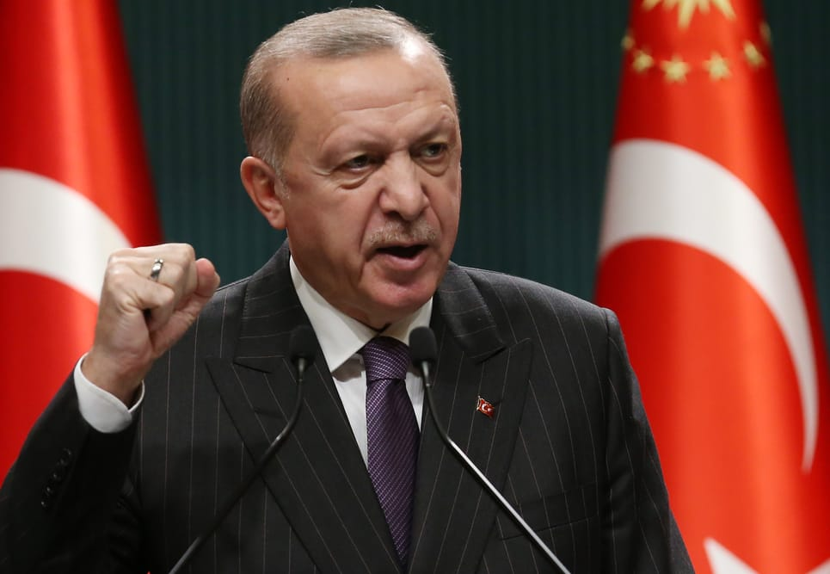
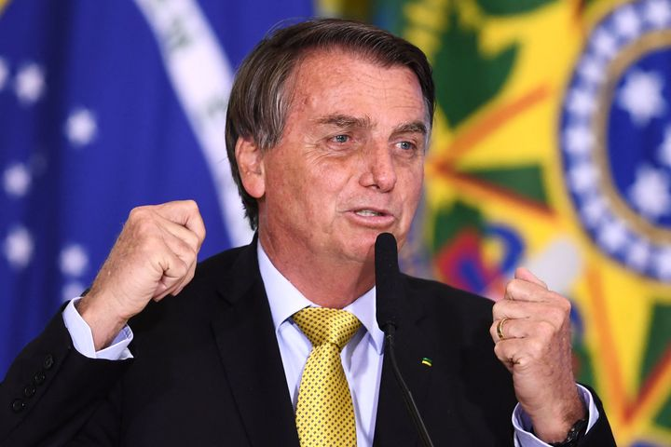
Other Cases, Similar Paths
Hungary (Orbán)
Turkey (Erdoğan)
Brazil (Bolsonaro)?

Slide 18
USA on the Precipice
“It is a depressing reflection of the dangerous political situation in which the nation finds itself that President Biden felt compelled to deliver a prime-time address decrying political violence and election denialism and calling on Americans ‘to unite behind the single purpose of defending our democracy.’”
Washington Post, September 2, 2022

Slide 19
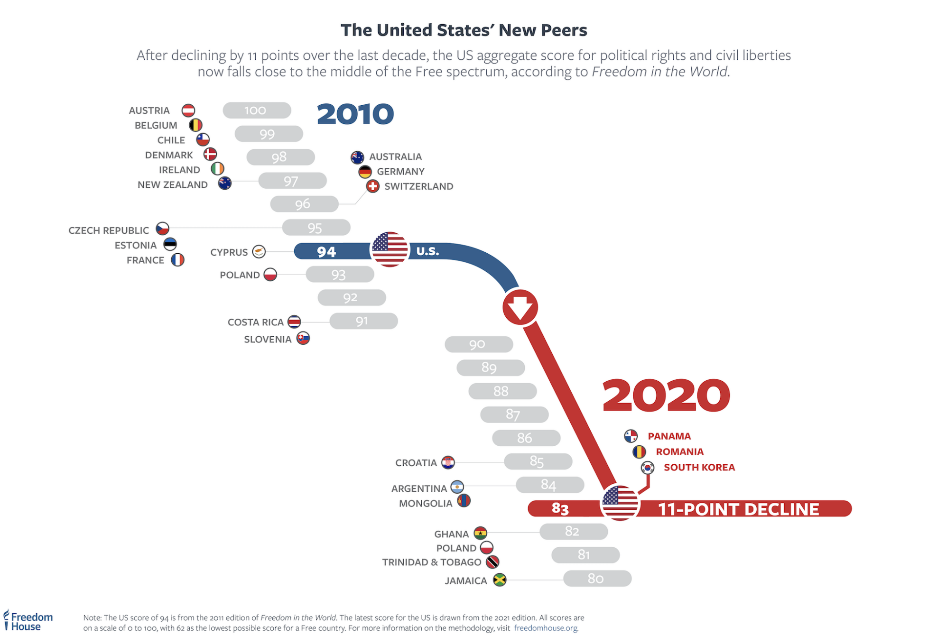
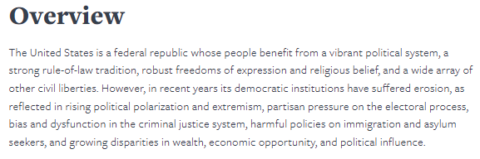
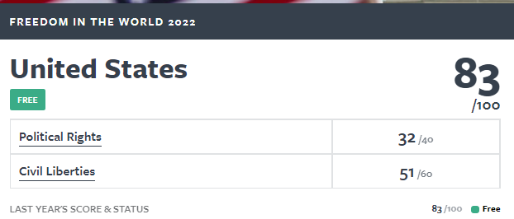
USA: Polarization, Extremism, Dysfunction (FH)

Slide 20
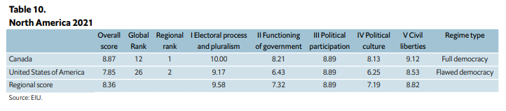
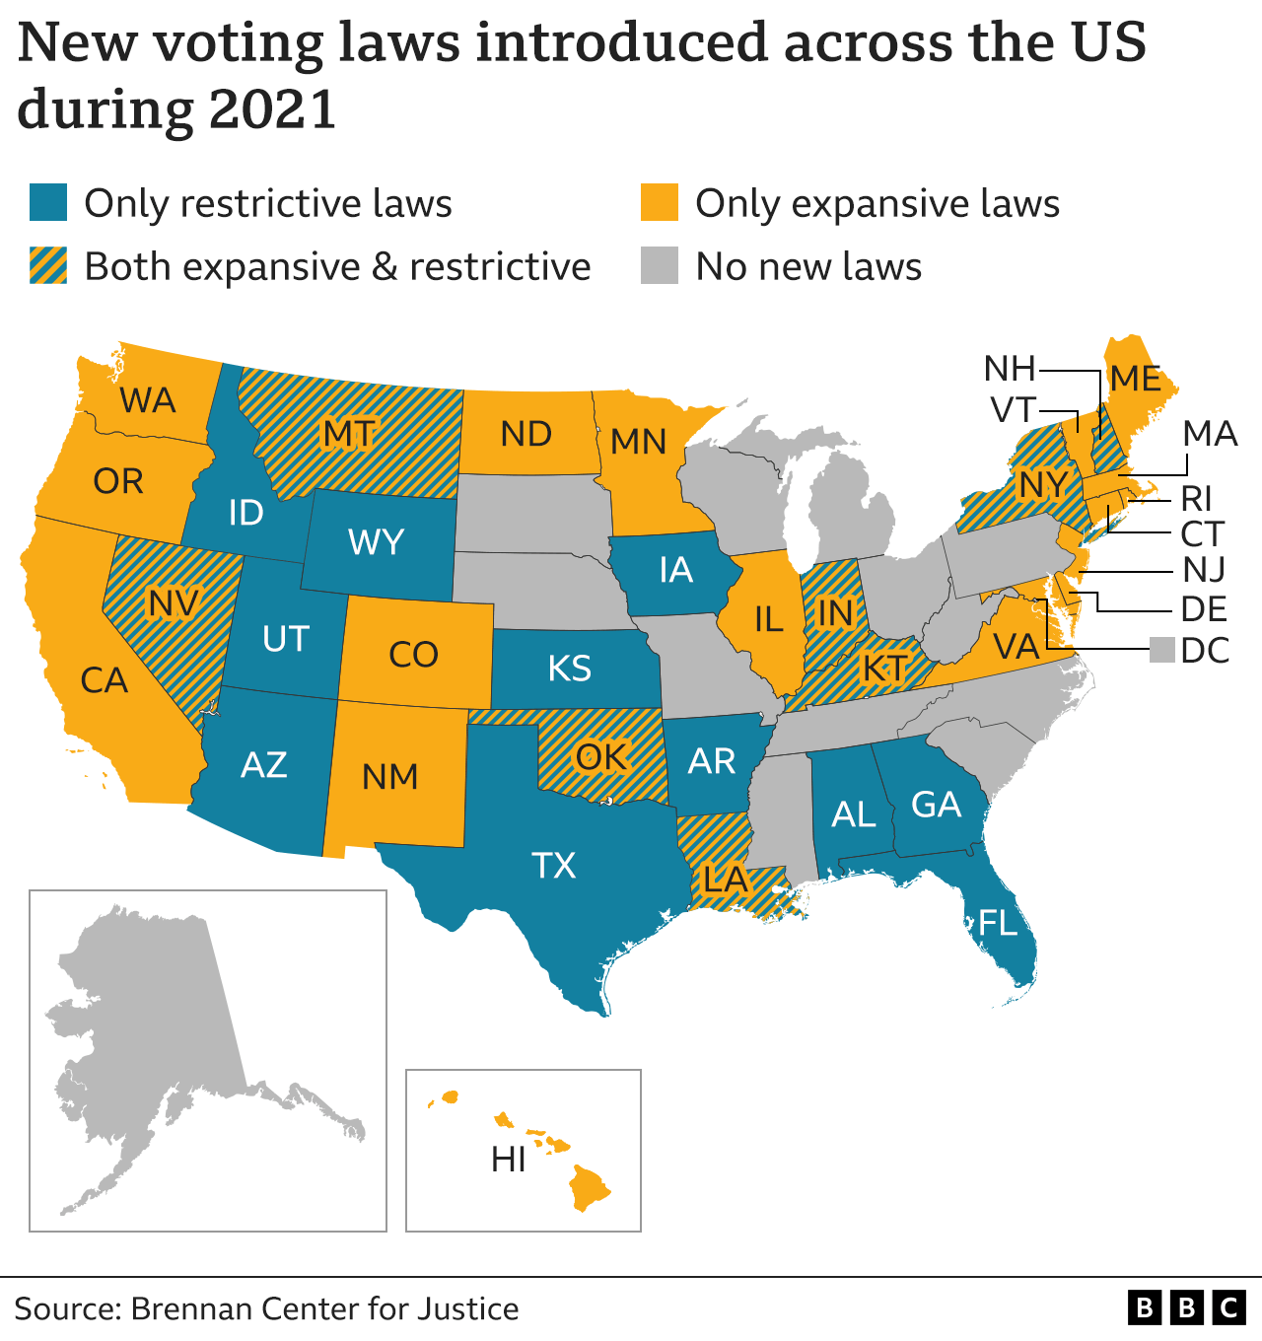

USA: Polarization, Extremism, Dysfunction (EIU)

Slide 21
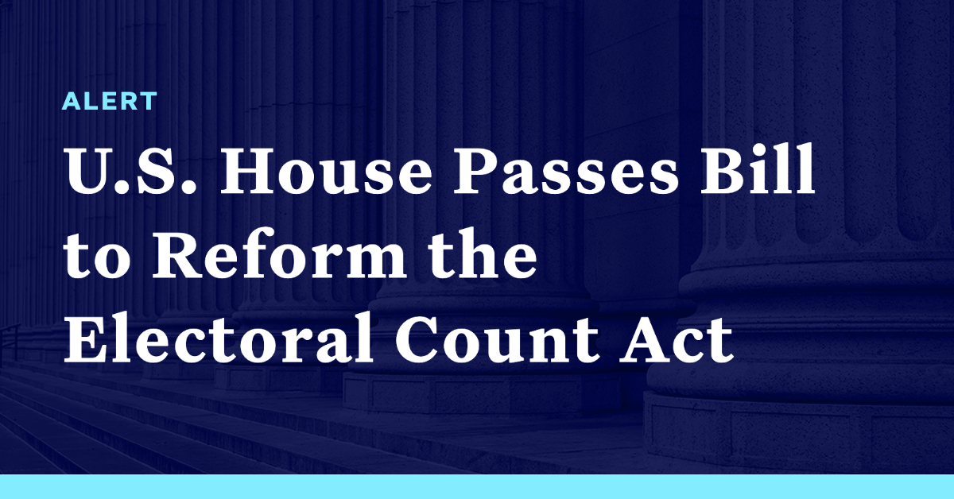
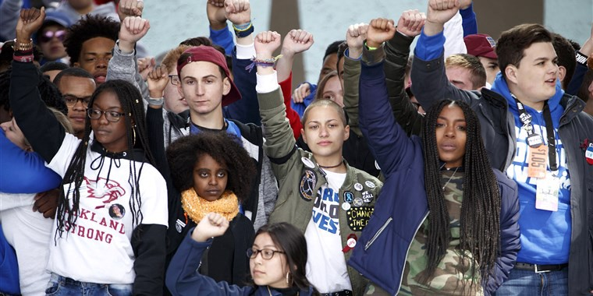
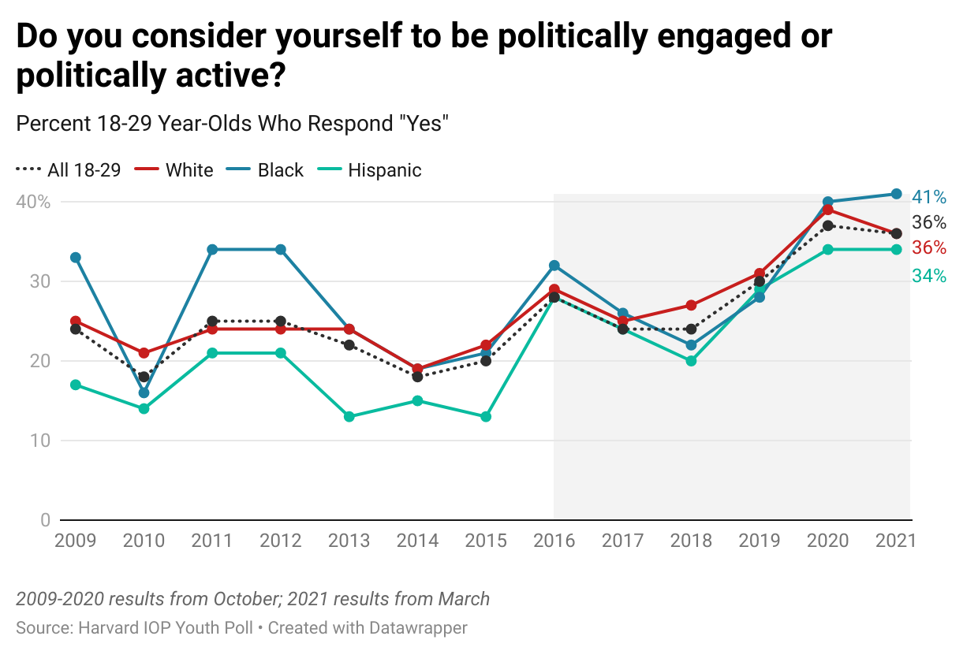
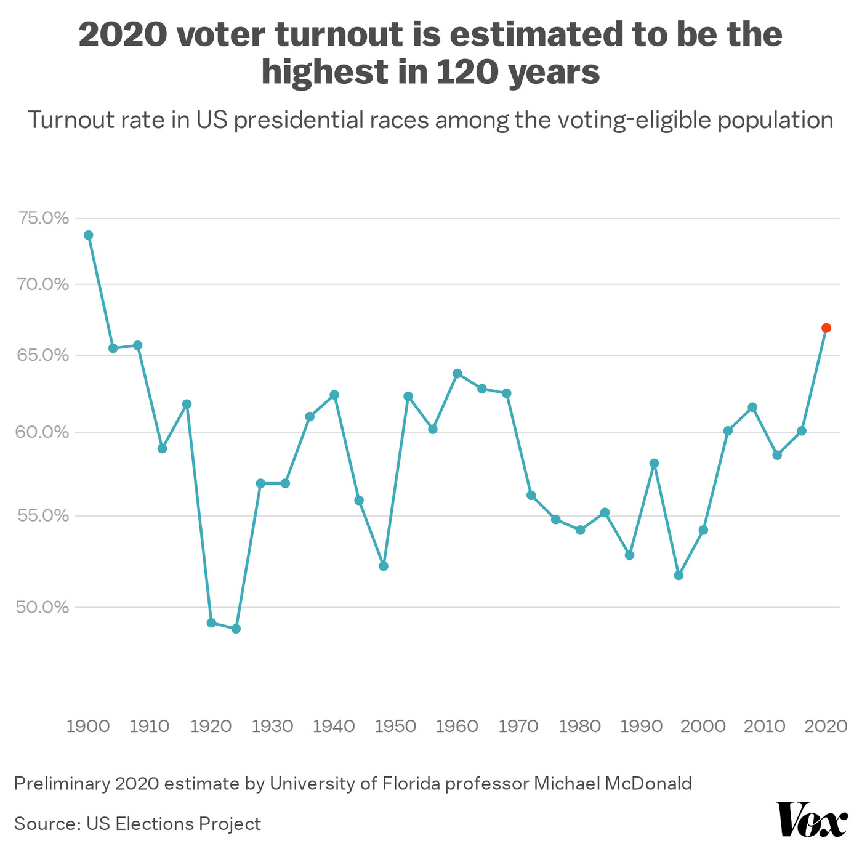
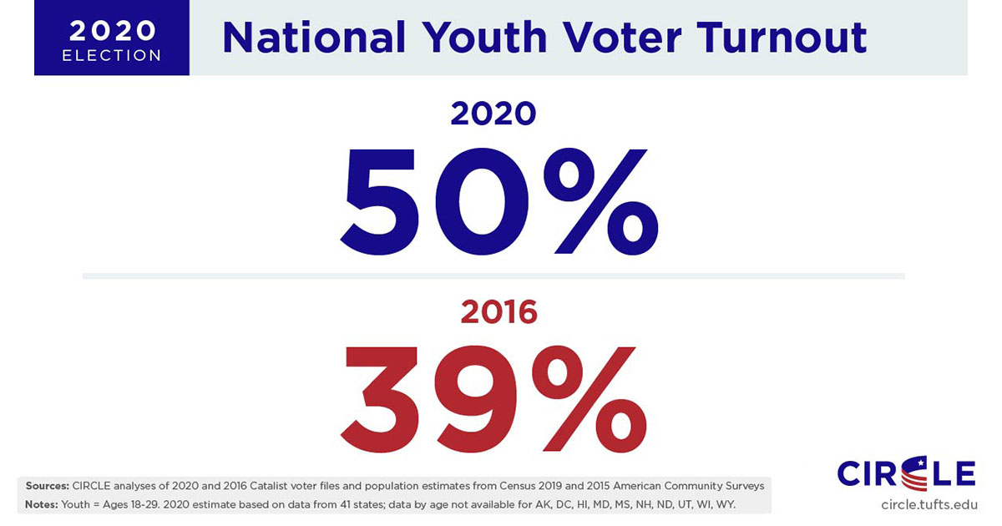
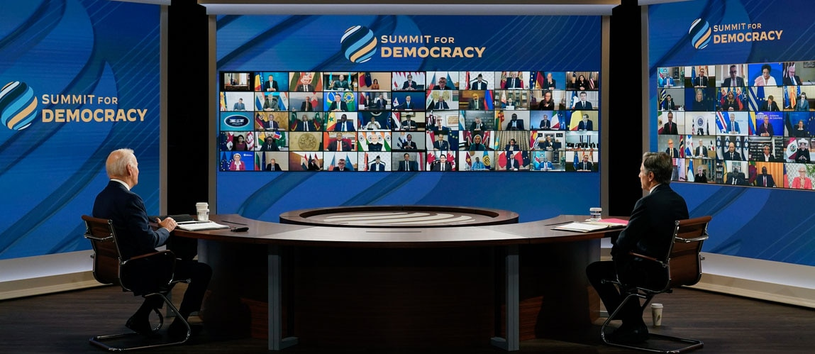

Yet…Glimmers of Hope

Slide 22
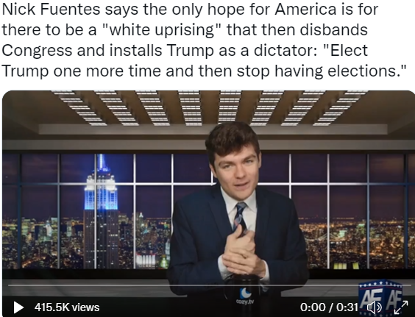
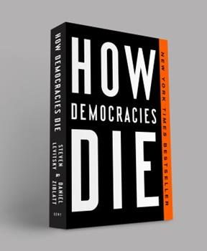


Could it happen here?
Rejection of (or weak commitment to) the democratic rules of the game
Denial of the legitimacy of political opponents
Toleration or encouragement of politically motivated violence
Readiness to curtail civil liberties of opponents, including the media

Slide 23

Summary of the State of Things and What’s at Stake
“In countries with long-established democracies, internal forces have exploited the shortcomings in their systems, distorting national politics to promote hatred, violence, and unbridled power. Those countries that have struggled in the space between democracy and authoritarianism, meanwhile, are increasingly tilting toward the latter. The global order is nearing a tipping point, and if democracy’s defenders do not work together to help guarantee freedom for all people, the authoritarian model will prevail.”

Slide 24






Challenge #1:
Engage! Promote, Restore, Nurture Dem Norms
What “norms” in particular?

Slide 25





Challenge #2:
“Be Humble and Bold”
Learn from other countries and from the past

Slide 26




Challenge #3:
Commit to Free, Fair, and Independent Elections

Slide 27




Challenge #4:
Support Free and Independent Media

Slide 28
Thank you all!
Dr. Jeff DeWitt
jdewitt@kennesaw.edu

