Slide 1
Lessons Learned from One Year of Team-Based Learning
Fred Carroll
Senior Lecturer of History, Kennesaw State University

Slide 2
Topics
Course Redesign
Flipped Classroom
Active Learning
Metacognition

Slide 3
Reflection Writing
How satisfied are you with the level of learning in your survey courses? Why?
What would you most like to change about your course? Why?

Slide 4
Your level of satisfaction with learning:
X
X
X
What you would like to change:
X
x
x

Slide 5
KSU Student Demographics
40% first generation
40% Pell Grant eligible
20% learning disability
Minority-majority institution
Source: CETL Starting Blocks Student Success program
Notes:
Demographic information shared by Ivy Way, a member of KSU CETL Starting Blocks Student Success program.

Slide 6
The Problem with Mostly Lecture
30%
Information lost by end of class.
50%
Information lost in one month.
80%
Information lost in one semester.
100%
Phones are more fun.
Source (about information): UGA Active Learning
Notes:
Source: Leah Carmichael, UGA Director of Active Learning.

Slide 7
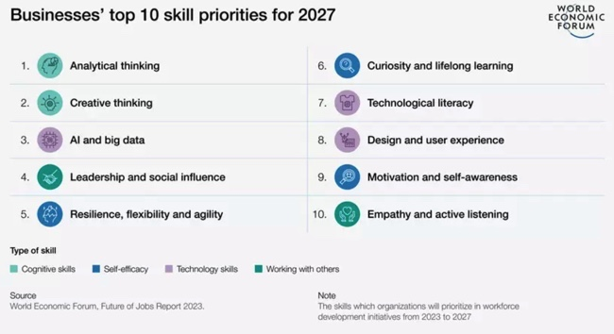

Slide 8
The Process
Source: Tris Utschig, KSU CETL

Slide 9
Formative Assessments
Perusall
iRAT
gRAT
In-class team activities

Slide 10
Examples: In-Class Team Activities
Open-ended multiple choice
Dot-ocracy: Class notes
Reflection writing with lecture
Concept map
Scrambled primary sources
Pre-quizzing

Slide 11
Criticism of Instructor
Alignment Concerns
Structure ready but not daily activities.
Summative assessments: “old school.”
Expecting too much with early quizzes??? Maybe.

Slide 12
Criticism of Instructor
Engagement Concerns
Still adjusting readings.
No projects except Reacting game.
Experimental Stage
Still finding my voice.

Slide 13
Frustrations with Students
Dismissive of value of active learning.
Grade-focused task completion.
Still not as prepared for class sessions as preferred.
Few take notes.

Slide 14
What’s Working?
In-class engagement increased significantly.
Everyone more aware of student study limitations.
Students receiving better advice on studying.
Instructor offering more structured and frequent formative assessments.

Slide 15
What I’m Changing
More Intentional Learning Community
Promote value of active learning and team learning.
Develop student-drafted participation guidelines.
Continually review active learning activities.
Discuss ethical and effective AI usage.

Slide 16
What I’m Changing
Assessments
Shift to hybrid standards-based alternative grading.
Add more Reacting games and/or team projects.
Shift exams to more frequent and revisable quizzes.
Increase in-class quizzing and pre-questions.

