Slide 1
Promoting Student Success by Increasing Engagement
with University Services
Increasing Student Engagement with University Services to Promote Overall Student Success​
RCHSS Student Success Summitt 2025
Will Carter Dr. Keir Singleton-Ortiz Rachel Greil Dr. Mary Lou Odom
Dr. Mary Lou Odom

Slide 2
Workshop Objectives
AGENDA
Building Community with Student Services: Will Carter
Exploring Student Success with The KSU Writing Center: Dr. Mary Lou Odom & Rachel Greil
Using Student Services to Develop Student Scholars: Dr. Keir Singleton- Ortiz

Slide 3
Why Empathetic Teaching?
“Students’ perceptions of teacher empathy are related to both students’ perceptions of their learning (Bozkurt and Ozden,2010) and to their performance on objective tests and papers.” (Chang, Berger, and Chang,1981) (Meyers et al., 2019)
“Studies by Noblit, Roger and McCadden (1995) and Noddings (1995) indicate that many students must believe that their teachers care about them and understand them in order for them to be motivated to learn.” (Bostic, 2014; similarly Keating, Van Boven, & Ito, 2016).
These strategies demonstrate to students that you care.

Slide 4
The Loneliness Epidemic in College
“In a Gallup poll specifically of college students, which was released in August, 39 percent said they had experienced loneliness the previous day. While it wasn’t the top concern for students—that appeared to be stress, which 66 percent of students reported experiencing the previous day—loneliness ranked above sadness (36 percent) and anger (25 percent). (Alonso 2023).
Belonging uncertainty may result in disengagement and poor academic outcomes. In contrast, a sense of belonging is associated with academic achievement, persistence in the course, major, and college (Walton & Cohen, 20011, Yeager & Walton, 2011) (M.I.T. Learning Lab 2023).

Slide 5
Student Services
Especially if you have first-year students, let them know about campus services.
Many students are unaware of services that could help them.

Slide 6
The KSU Writing Center
The SMART Center
Counseling & Psychological Services
Career Planning & Development
The Office of Financial Aid
The Office of Disability Services
Faculty can request in-class presentations from student services such as . . .

Slide 7
course component: Student Scavenger Hunt
To help students become familiar with the locations and services provided by university services, I created a scavenger hunt assignment for Dr. Lori Lowder (AVP of Student Success) to highlight the following campus services/ locations:
Advising & Retention Services
Office of Disability Services
KSU Writing Center
Counseling & Psychological Services
Global Village
Career Planning & Development
Library
CARE Services
Center for Young Adult Addiction & Recovery
Student Recreation & Activities Center
Fifth-Third Bank Stadium
Stillwell Theater & Bailey Performance Center-Department of Student Activities
Department of Student Activities
Odyssey Peer Mentoring
Health Promotion & Wellness

Slide 8
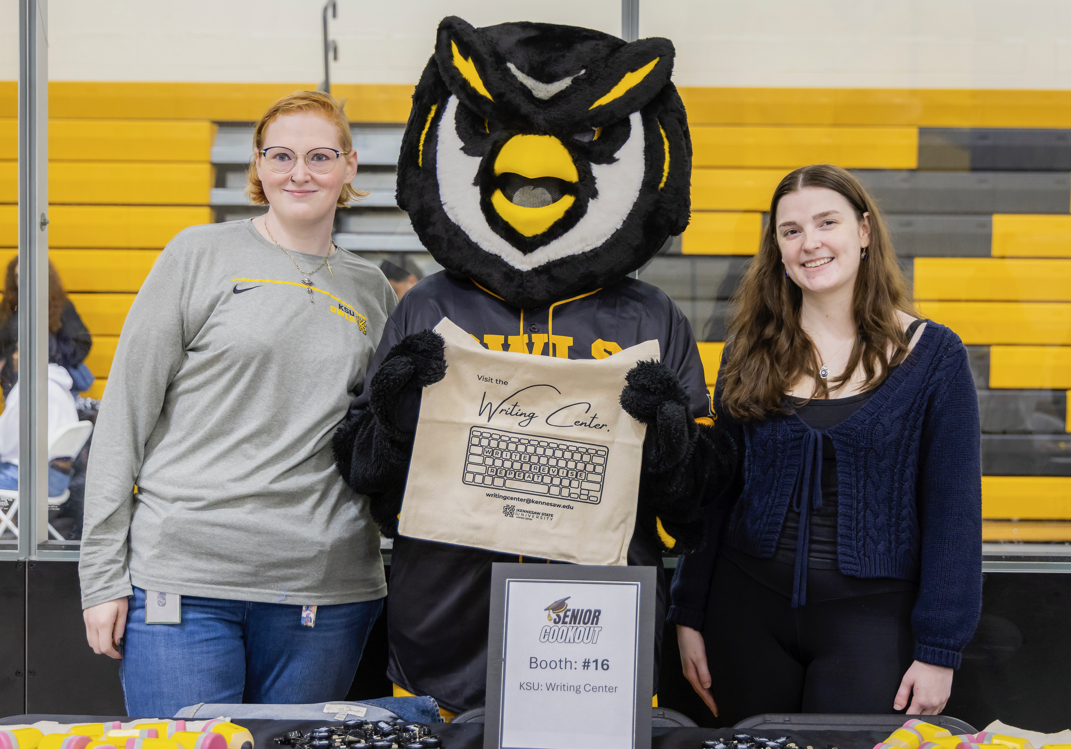
Campus Events
Many of our students come to KSU and do not know anyone.
Helping them connect with other students and university clubs, events, etc. creates connections proven to improve RPG and DFWI rates.

Slide 9
course component: Campus Events
My English 1101 students are required to attend at least 3 campus events during the semester.
They must then submit a photo of themselves at the event and do a little reflection on why they chose the event or club and what they got out of it.
Any university event they attend or different club they are a part of, outside of the three they submit for the assignments counts as extra-credit.
Students get double extra-credit if they attend events with their workshop group from class.

Slide 10
Student Engagement IMPACT
“James was AMAZING! He helped me find my way in this unchartered territory. I clearly had NO idea what I was doing, but he was kind and really helped me figure things out."
“Going to the Center genuinely improved my mood. I felt more confident in the progress of my paper and [am] definitely coming again!

Slide 11
Fall 2024 DFWI Data
WRITING CENTER ENGAGEMENT
DFWI Impact

Slide 12
Fall 2024 DFWI Data
WRITING CENTER ENGAGEMENT
GPA Impact

Slide 13
TAKEAWAYS
Your students will connect more with the university and its services and be more academically successful and emotionally well as a result.
Your students will feel that you care about them and will feel more connected to the class as a result.
Your students will better build the friendships and connections that will enable them to be successful during their time at KSU.

Slide 14
Campus Services for Research Writing
“To encourage the development of empathetic experiences among students, teachers must merge creative instructional strategies with objectives specifically designed to promote empathy among learners” (Casale et al. 4).
Week One: Diagnostic Essay Prompt: Before we get going in the course, I'd like to have an idea of how you feel about writing and research in general. How do you feel about this course? Please share your thoughts in one to two paragraphs. There is no right or wrong answer. You get full credit for completing the assignment if there is some substance to your response. So, please be honest and specific. What do you enjoy or struggle with on writing or research projects?

Slide 15
Campus Services for Research Writing (cont’d)
This is an informal writing assignment, so mechanics do not affect the grade. However, this assignment will serve as a casual diagnostic of students’ writing, so they should show their best-effort at constructing well-crafted sentences.
Week Four: Representative from KSU Writing Center Speaks to Class
Schedule a class visit from a Writing Assistant
Kennesaw campus: English Building, Room 219
Marietta campus: Johnson Library, Room 101
Online location

Slide 16
Opportunities for Research Writing
“…scholars have continuously noted that the use of controversial issues and contemporary points of contention in the classroom has some benefits which, when implemented effectively, will help teachers achieve the aims of … education” (Tannebaum 100).
Week Four: Research Paper
Cohort Class Prompt: At the end of the course, each student will complete a research paper that relates to a social issue that impacts the mental and/or physical state of diverse people, communities, genders, cultural groups, etc. You will explore ways to eradicate the trauma caused by these issues. You can analyze and synthesize your topic in any manner you choose.
General Class Prompt: This research paper is an opportunity for you to research and learn about a topic that interests you. Writing a research paper is not simply looking up facts and stringing them together. As you do your research, you may find different points of view or contrary results. Good research usually leads to new understanding of a topic. As you compile information, you may see a new way to apply the information. Your new understanding is what is referred to as “synthesizing something new.” You might propose a new practice or a new explanation of a well-known phenomenon. This is considered academic use of information, and you should strive to achieve it.

Slide 17
Opportunities for Research Writing (cont’d)
Week Five: Representative from Office of Undergraduate Research Speaks to Class
Dr. Amy Buddie, Director of Undergraduate Research and Professor of Psychology
abuddie@kennesaw.edu
5500 Academic Learning Center
Reserve space for student research in Office of Undergraduate Research
Reserve class visit from the Office of Undergraduate Research
Week Fourteen: Representative from Office of National and International Scholarships and Fellowships (ONISF) Speaks to Class
Dr. Michelle Miles, Director of Office of National and International Scholarships and Fellowships
onisf@kennesaw.edu
5525 Academic Learning Center
Office of National and International Scholarships and Fellowships website

Slide 18
Benefits
Limitations
Semester | Attendance | Grade A | Grade B
Spring 2024 | 76% | 60% | 40%
Spring 2025 | 100% | 86% | 14%
 | 24% increase in attendance |  |  | 26% increase in grades
Smaller classes- average of 15 students in a class
Honors students
Only Wellstar Nursing cohort

Slide 19
ACTION ITEMS
Listen to the specific needs of your students.
Identify which student services will support the needs of your students and the objective of the course curriculum.
Create assignments designed to encourage engagement with the campus, its services, and build community.
Implement the first class visit within the first month of class.
Have at least one student service engagement within the last two weeks of class.

Slide 20
References
Casale, Carolyn, et al. “Developing Empathetic Learners.” Journal of Thought, vol. 52, no. 3–4, 2018, pp. 3–18. JSTOR, https://www.jstor.org/stable/90026734. Accessed 2 May 2025.
M.I.T. Learning Lab. (2023, February). Students’ sense of belonging matters: Evidence from three studies. Teaching + Learning Lab Students Sense of Belonging Matters Evidence from Three Studies Comments. https://tll.mit.edu/sense-of-belonging-matters/
Tannebaum, P. R. (2013). Dialogue, discussion, and democracy in the Social Studies classroom. Social Studies Research and Practice, 8(3), 99-109.

Slide 21
Student Inform
EAB Blasts
Social Media
Classroom Visits
Faculty Support
Incentives
Targeted Outreach (e.g., following Early Alerts, midterm grades)
OwlLife
Website Calendar
How Student Support Services Encourage Student Engagement

Slide 22
QUESTIONS?

