Slide 1
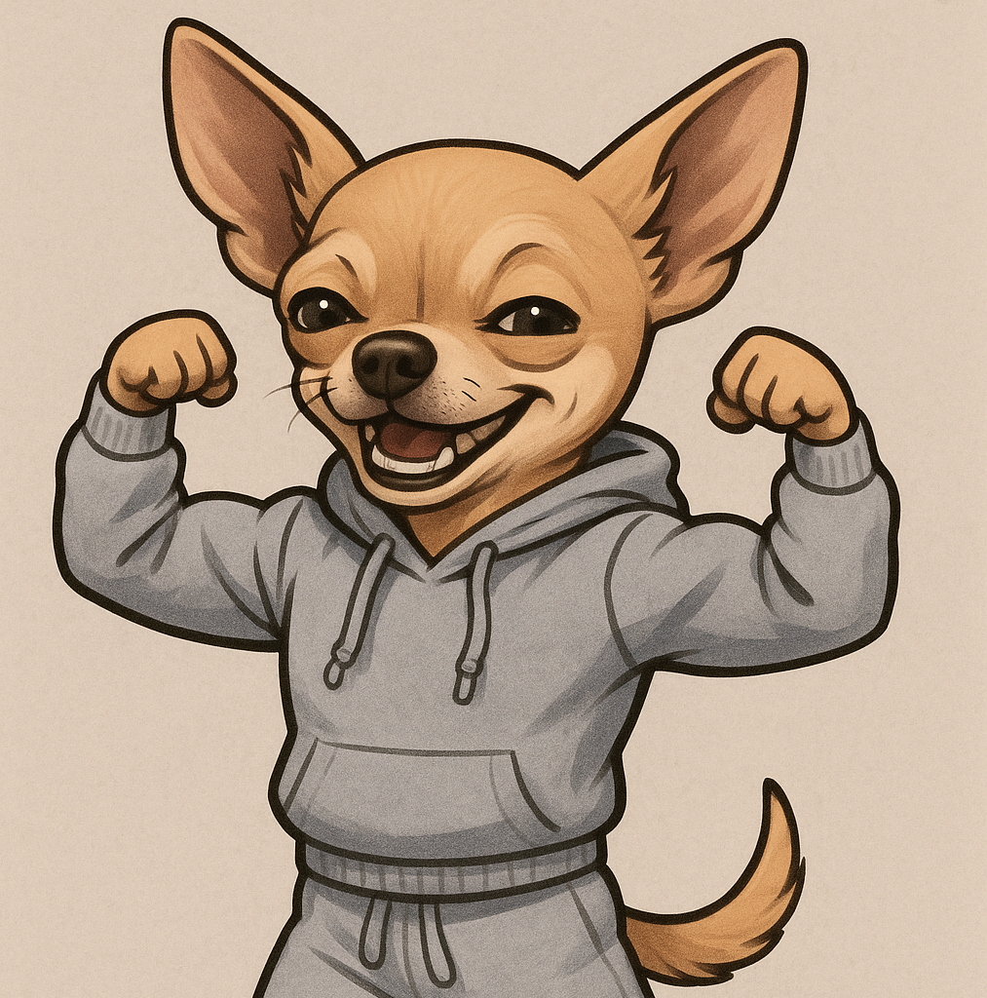
Teaching ethical ai use through creative writing assignments
Prompt: “Create an image of a chihuahua in a sweatpants and a sweatshirt. He should be flexing his muscles and grinning. Make him very jaunty.”

Slide 2
From poetry to song – Exploring AI adaptation
Overview
In this assignment, you will use AI tools such as Suno or Udio to adapt a short poem you’ve written into a song. Through this process, you’ll experience firsthand how AI interprets poetic elements—like tone, rhythm, and imagery—when translating them into musical form. After listening to your AI-generated song, you’ll critically analyze the adaptation, reflecting on what aspects of your poem were enhanced, altered, or lost in the transformation to song. Finally you will consider the role of authorship using AI tools and ethical considerations regarding copyright and intellectual property.
Objectives
To explore the adaptation of poetry into music and examine how medium changes impact meaning.
To understand how AI interprets poetic elements, such as rhythm, tone, and voice, and how it influences the listener’s perception.
To critically analyze the role of AI in creative expression and adaptation, discussing the shifts in meaning and artistic effect.
To analyze the ethical considerations for authorship using AI tools and their relationship to copyright and intellectual property.

Slide 3
From poetry to song – Exploring AI adaptation
Compose a very short poem or haiku that has a clear emotion, tone, imagery, and rhythm. The subject is up to you (Default Topic: Write an ode to your discipline).
Example: Creative writing rocks / stones clicking in a felt bag / that bag is my mind
Adapt the poem into song using https://suno.com/home. Prompt Suno (for example) with the following: “create a [genre] song using the following poem: [your poem]”

Slide 4
AI Process and Ethics Questions
Listen and analyze the adaptation. Write a short 250-word reflection and analysis on the process of adapting your poem to song through AI:
  What was lost or gained through this process?
  How did the tone shift?
  Did the AI omit certain elements of your poem in music? Did it influence the rhythm and style?
  What lines felt different (or the same) when heard in music?
  What potential and limitations do you see for using AI in the creative process?

Slide 5
AI Process and Ethics Questions
4. Do you own the song that was produced from your poem? Is the work copyrightable? Why or why not? Write a 250-word response.

Slide 6
Use case example – is this a creative process?
Prompt:
professional photo, bespectacled cat in a robe reading the Sunday newspaper and smoking a pipe, foggy, wet, stormy, 70mm, cinematic, highly detailed wood, cinematic lighting, intricate, sharp focus, medium shot, (centered image composition), (professionally color graded), ((bright soft diffused light)), volumetric fog, hdr 4k, 8k, realistic

Slide 7
Copyrightability of AI Works
Human copyright is essential under current copyright law
Most countries (South Korea, Japan, EU nations, China, etc.) agree that human authorship is fundamental for copyright
AI-generated content alone is not copyrightable
Using AI tools alone do not make you the author of a work
Prompting alone does not equal authorship—it’s still considered “unprotectable instruction”—copyright protects expression, not ideas
AI, not the user, is making the choices so prompting alone doesn’t qualify for copyright

Slide 8
Copyrightability of AI Works
AI are tools not creative acts alone
You can claim copyright in parts of a work where you:
  Provide original text, drawing, or audio that remains visible in the output
  Modify, edit, or arrange AI-material in a creative way (examples to be explored in this class)
  Ultimately even those works are considered derivative works with rights only to the human-created components
  (https://www.copyright.gov/ai/Copyright-and-Artificial-Intelligence-Part-2-Copyrightability-Report.pdf)

Slide 9
Example of copyright submission
Input
Output
Prompt: “a young cyborg woman (((roses))) flowers coming out of her head, photorealism, cinematic lighting, hyper realism, 8k, hyper detailed.”

Slide 10
Example of copyright submission
“The drawing itself is a copyrightable work, and its expressive elements are clearly perceptible in the output, including the outline of the mask, the position of the nose, mouth, and cheekbones relative to the shape of the mask, the arrangement of the stems and rosebuds, and the shape and placement of the four leaves.
The applicant disclaimed “any non-human expression” appearing in the final work, such as the realistic, three-dimensional representation of the nose, lips, and rosebuds, as well as the lighting and shadows in the background. After reviewing the information provided in the application, the Office registered the work with an annotation stating: “Registration limited to unaltered human pictorial authorship that is clearly perceptible in the deposit and separable from the non-human expression that is excluded from the claim.”124 (US Copyright Office)

Slide 11
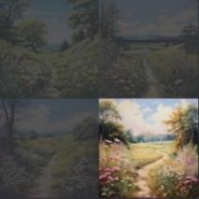
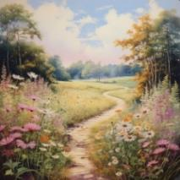
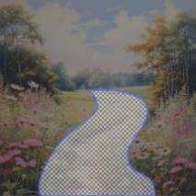
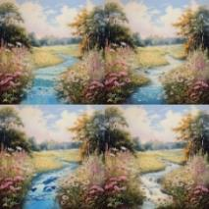
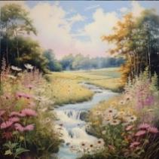
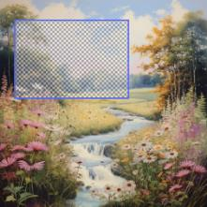
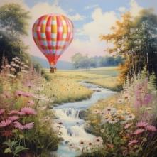
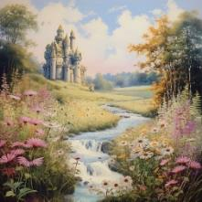
AI Tools with more creative control
Select and upscale image
Use freehand editing tool to select region
Generate
Candidate Images
with Prompt:
meadow stream
lithograph
Select and
Upscale Image
Generate images with prompt: meadow trail lithograph

Slide 12
“Unlike prompts alone, these tools can enable the user to control the selection of individual creative elements. Whether such modifications rise to the minimum standard of originality … will depend on a case by case determination. In those cases where they do, the output should be copyrightable.
Similarly, the inclusion of elements of AI-generated content in a larger human-authored work does not affect the copyrightability of the larger human-authored work as a whole.” (US Copyright Office)

Slide 13
Ethical questions regardingAI works and content ownership
Did I truly make something new?
  If yes, when did that really happen in the creative process? Can you pinpoint it?
Am I using tools ethically that were created from other people’s data and work? (*)

Slide 14
Sources exploring issues of intellectual property, copyright, and AI tools
Bondari, Negar. “Ai, Copyright, and the Law: The Ongoing Battle over Intellectual Property Rights.” IP Technology Law Society, 4 Feb. 2025
  Link
Knibbs, Kate. “Every AI Copyright Lawsuit in the US, Visualized.” Wired, Conde Nast, 19 Dec. 2024,
  Link
Mauran, Cecily. “Ai Music Startup Suno Admits to Using Copyrighted Music, but Says It’s ‘Fair Use.’” Mashable, Mashable, 2 Aug. 2024.
  Link

Slide 15
resources
Bondari, Negar. “Ai, Copyright, and the Law: The Ongoing Battle over Intellectual Property Rights.” IP Technology Law Society, 4 Feb. 2025 https://sites.usc.edu/iptls/2025/02/04/ai-copyright-and-the-law-the-ongoing-battle-over-intellectual-property-rights/#:~:text=In%20the%20past%20year%2C%20courts,should%20adapt%20to%20new%20technologies.
Knibbs, Kate. “Every AI Copyright Lawsuit in the US, Visualized.” Wired, Conde Nast, 19 Dec. 2024, https://www.wired.com/story/ai-copyright-case-tracker/.
Mauran, Cecily. “Ai Music Startup Suno Admits to Using Copyrighted Music, but Says It’s ‘Fair Use.’” Mashable, Mashable, 2 Aug. 2024, https://mashable.com/article/ai-music-startup-suno-admits-using-copyrighted-music-says-its-fair-use#:~:text=AI%20music%20startup%20Suno%20has,by%20the%20fair%20use%20doctrine.
Office, U.S. Copyright. “Copyright and Artificial Intelligence (Part 2).” Copyright and Artificial Intelligence | U.S. Copyright Office, www.copyright.gov/ai/. Accessed 11 May 2025.
https://chromeextension://efaidnbmnnnibpcajpcglclefindmkaj/https://www.copyright.gov/ai/Copyright-and-Artificial-Intelligence-Part-2-Copyrightability-Report.pdf

