Slide 1
Early Alerts
Reach out. Make connections. Be the human in the loop.

Slide 2
The Post-Covid Student Blues

Slide 3
My Teaching
Context
Dr. Keaton Lamle, Senior Lecturer of English
65% General Education
35% Upper Division/Graduate Courses

Slide 4
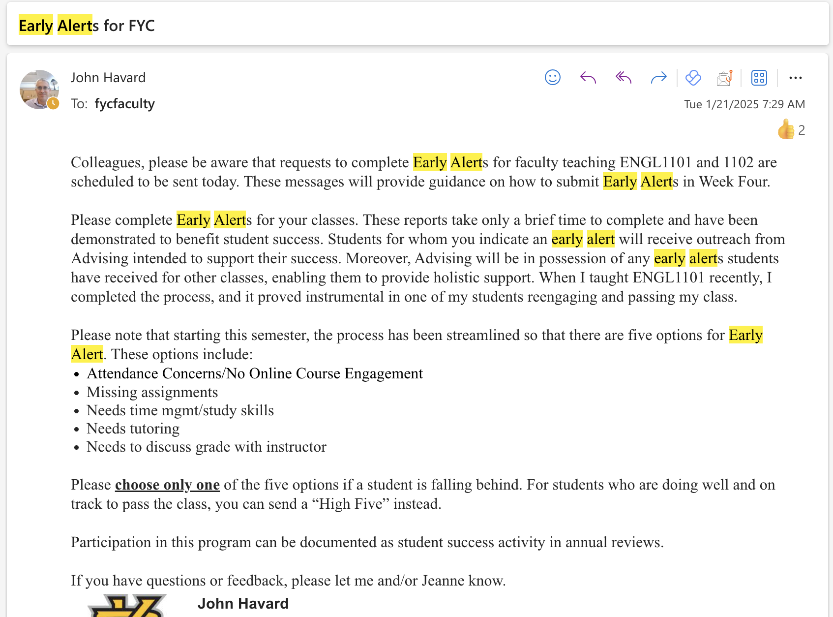
Start with the Easy Stuff: Early Alerts

Slide 5
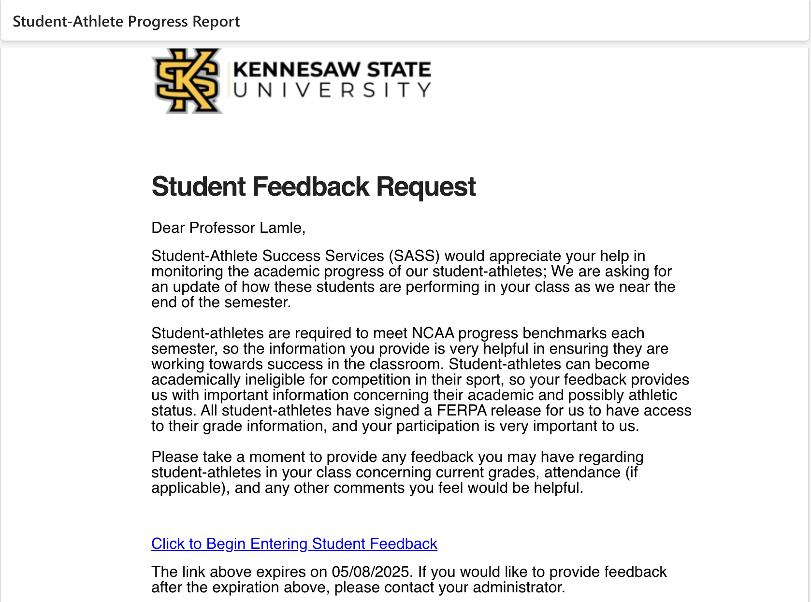
Start with the Easy Stuff: Student-Athlete Feedback

Slide 6
Start with the Easy Stuff: Mid-Term Grades
Some studies indicate that mid-term grades are particularly important for students in the D-C range (Gray & Bunte, 2022).

Slide 7
My Personalized Feedback System

Slide 8
My Personalized Feedback System
The institutional interventions help me build a mental map of how each of my 5 classes is shaking out early in the term.
The first two (student-athlete progress and early alert) typically arrive after we’ve completed several weeks of low-stakes work, and one high-stakes assignment. This is a significant sample of student work.

Slide 9
Performing the Scan
What I’m Looking For:
Excessive absences in F2F; Missed modules in online courses.
More than one zero in the gradebook.
Averages below 75%.

Slide 10
Sending the Message
Contrast with institutional efforts: Personable, humane, non-threatening.
More consulting physician; less traffic cop.

Slide 11
Sending the Message

Slide 12
Sample Responses
“Thank you so much for checking in. Not many professors would do that, and it means a lot. I would like to apologize for neglecting your class recently.”
“Thank you very much for your understanding. I’d also like to thank you for telling me what exactly I could do to better my grade, I’ll turn in these assignments as soon as possible. I greatly appreciate your help and patience!”
“Hey! First of all wow - thank you so much for reaching out. I wasn't too happy to find out that I have a failing grade in this class. I've been kind of a wreck recently, and for me school has always been a balancing act I've had a hard time keeping in check.”

Slide 13
Keys to Success
Affirmation
Affirm anything student *has* done well.
Specificity
Emphasize specific metrics where engagement is lacking–for example: attendance, daily writing assignments.
Optimism
Maintain an optimistic tone, pointing out what can be done to fix the problem.
Personal Invitation
Ask about confusion and offer to meet.

Slide 14
What Questions Do You Have?
How Do You Approach This?

