Slide 1
Promoting Self-Directed Learning in AI-Assisted Writing
Kathy Negrelli RCHSS Student Success Summit, 2025

Slide 2
Presentation Outline I. Background of experiment II. Semester compositions III. Final Project IV. Student feedback V. Benefits, Limitations, Potential
help students be better prepared for INTERNSHIP

Slide 3
I. Background of experiment: Why explore AI in a JAPN writing course?
instant feedback
learner autonomy
tailored corrections and suggestions
an innovative language learning experience

Slide 4
II. Semester compositions
one component of JAPN 3303 Grammar and Composition
“Leverage AI to improve your writing skills”,
”Culminates in Final Project”.
Day 1: students’ lack of knowledge of/inexperience with AI
Begin with explanation of what ChatGPT, CoPilot, DeepL are and how to use them
Q: Have you used AI previously? 6 strongly agreed/agreed VS 8 strongly disagreed/disagreed

Slide 5
Composition guidelines
Choose a TOPIC: a description of my room; a very bad day; my annoying little brother/sister; [a topic of your choice]
Type up each step; copy/paste on a Word file
Part 1, Step 1 (Initial Draft)
Without using AI, write 1-2 paragraphs in your own words that include … [eg. specific grammar points/sentence patterns]
Prompt AI: “Translate to English”; Copy/paste translation below Initial Draft
Highlight mismatched parts in yellow, then revise to intended meaning

Slide 6
Part 1, Step 2 (Revised Draft)
Prompt AI: “Translate to English”
If it now matches intended meaning, copy/paste Revised Draft
Part 1, Step 3 (Corrected and Refined Draft)
Prompt AI: “Correct my Japanese. Do not add anything extra unnecessarily. Then, refine it to be more natural-sounding, but keeping it at upper-elementary level of Japanese.” Also, “in English explain what changes were made. Categorize changes into a) grammar corrections, b) natural flow adjustments, c) word choice, d) clarity and consistency.”
Copy/paste a) AI’s Corrected Version and its explanation of changes, and b) Refined Version and its explanation of changes

Slide 7
Part 1, Step 4: Review Corrected, Refined Draft
Study your errors and corrections made; take note of all suggestions that make your composition more “native sounding”. Incorporate those suggestions in your future compositions.
Submit Word file.
Part 2 (Corrected and Refined Draft)
Hand-write the Final/Refined version onto manuscript paper. Same procedure for Compositions #1~4
Too big an ask? How to follow-up?

Slide 8
III. Final Project
Part 1: Survey
Part 2
Compile a) AI’s Explanation of Changes to REVISED drafts, followed by b) AI’s Explanation of Changes to REFINED drafts. [Compositions 1~4];
categorize as: I. Grammar corrections II. Word Choice III. Clarity and consistency IV. Natural speech and flow

Slide 9
Part 3: Synthesis and Reflection
Study / summarize AI’s suggestions: (a) most critical, frequently recurring suggested changes
(b) Include 3~4 examples of those changes
(c) Write a thoughtful, achievable Action plan

Slide 10
IV. Student feedback (survey)
perceived benefits
usage
future

Slide 11
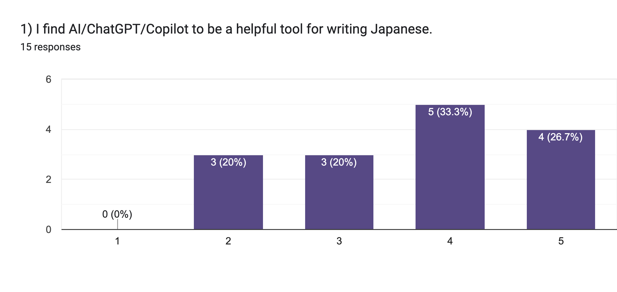
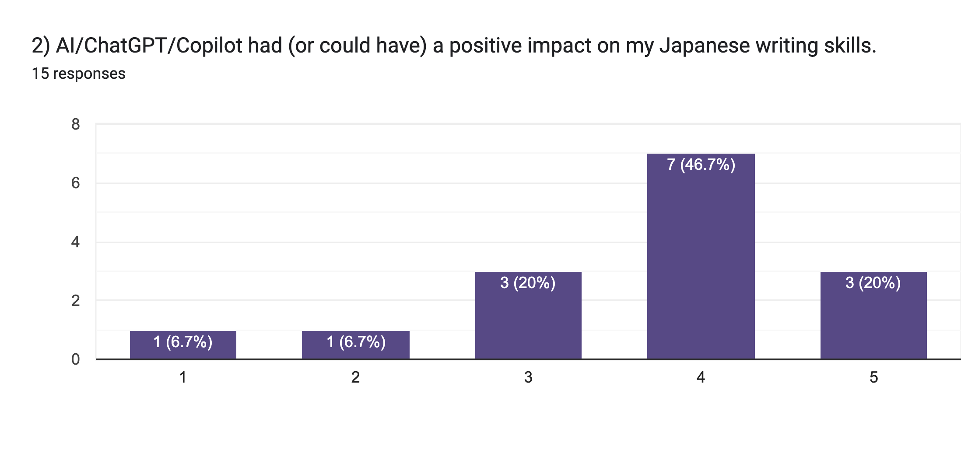

Slide 12
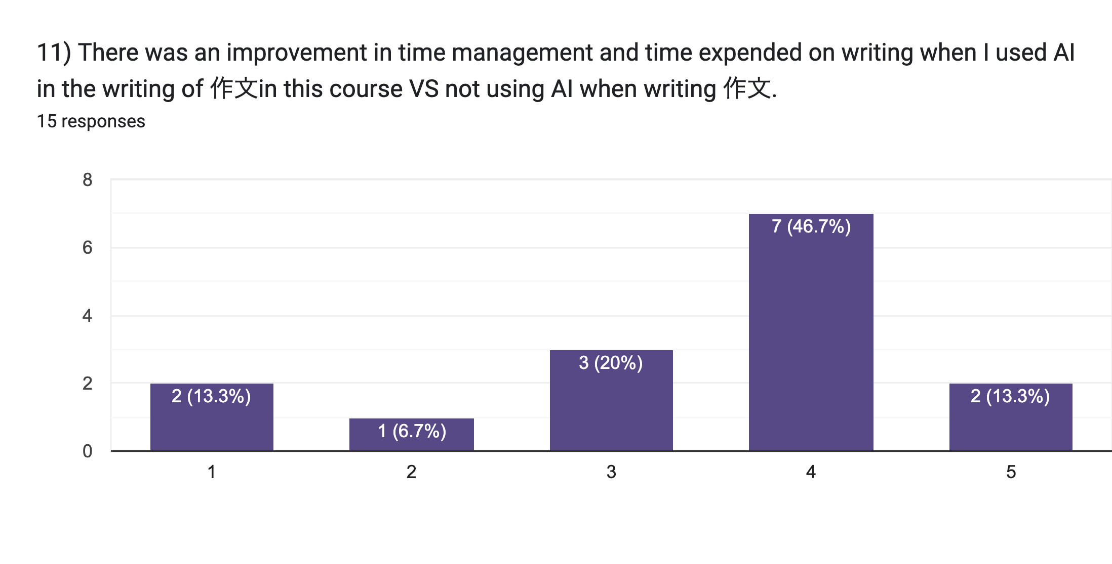

Slide 13
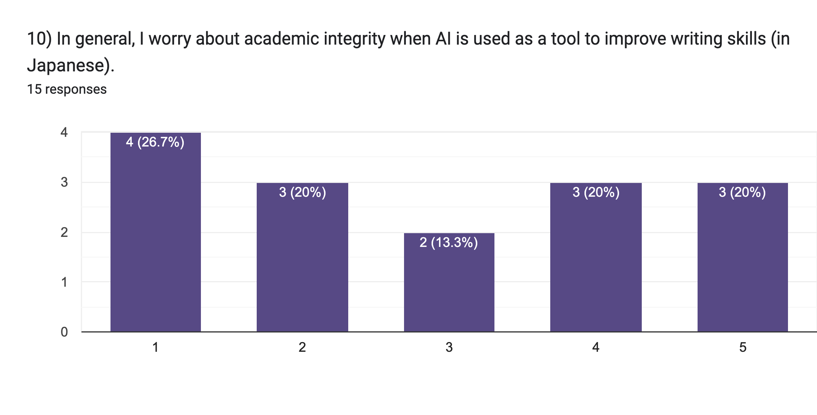
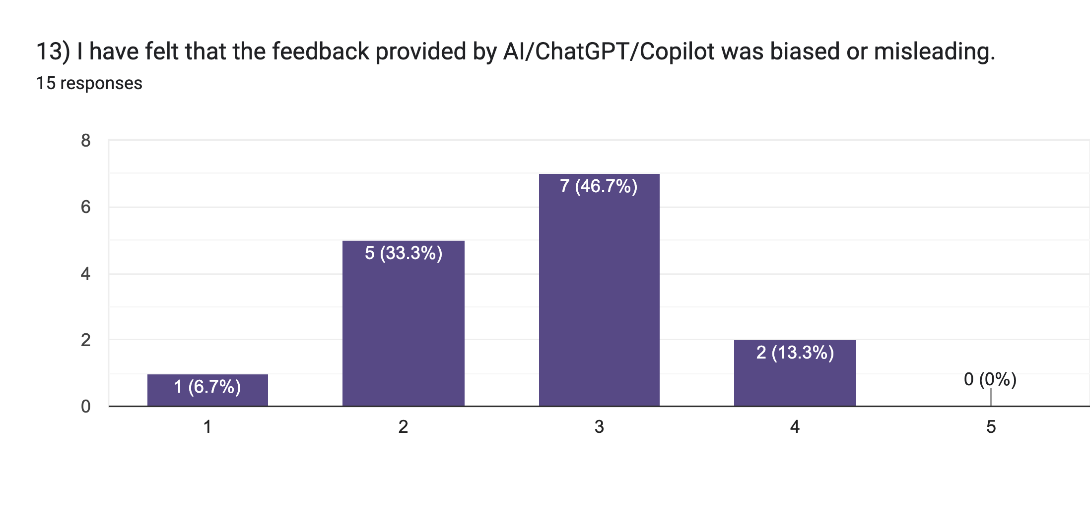

Slide 14
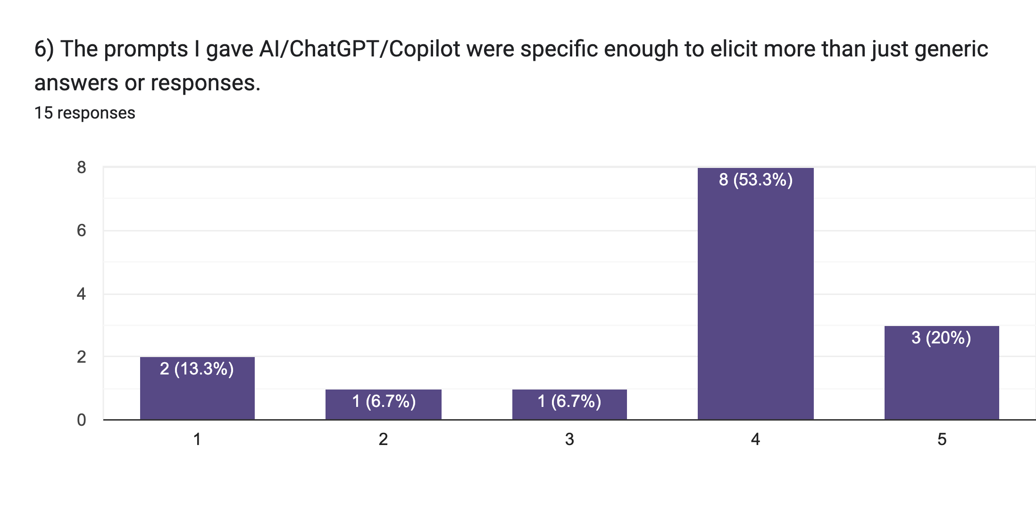
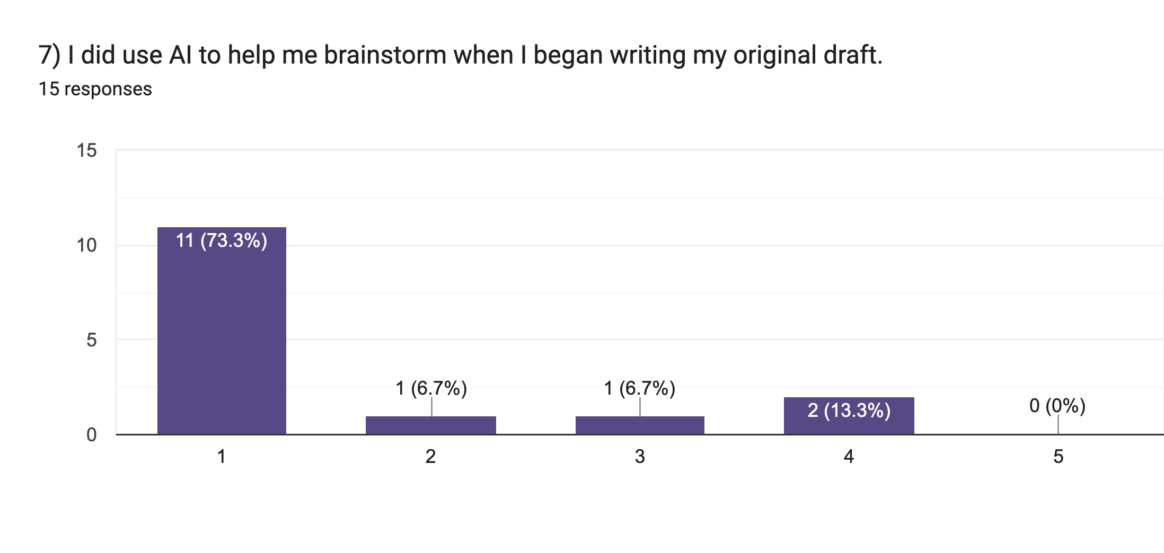

Slide 15
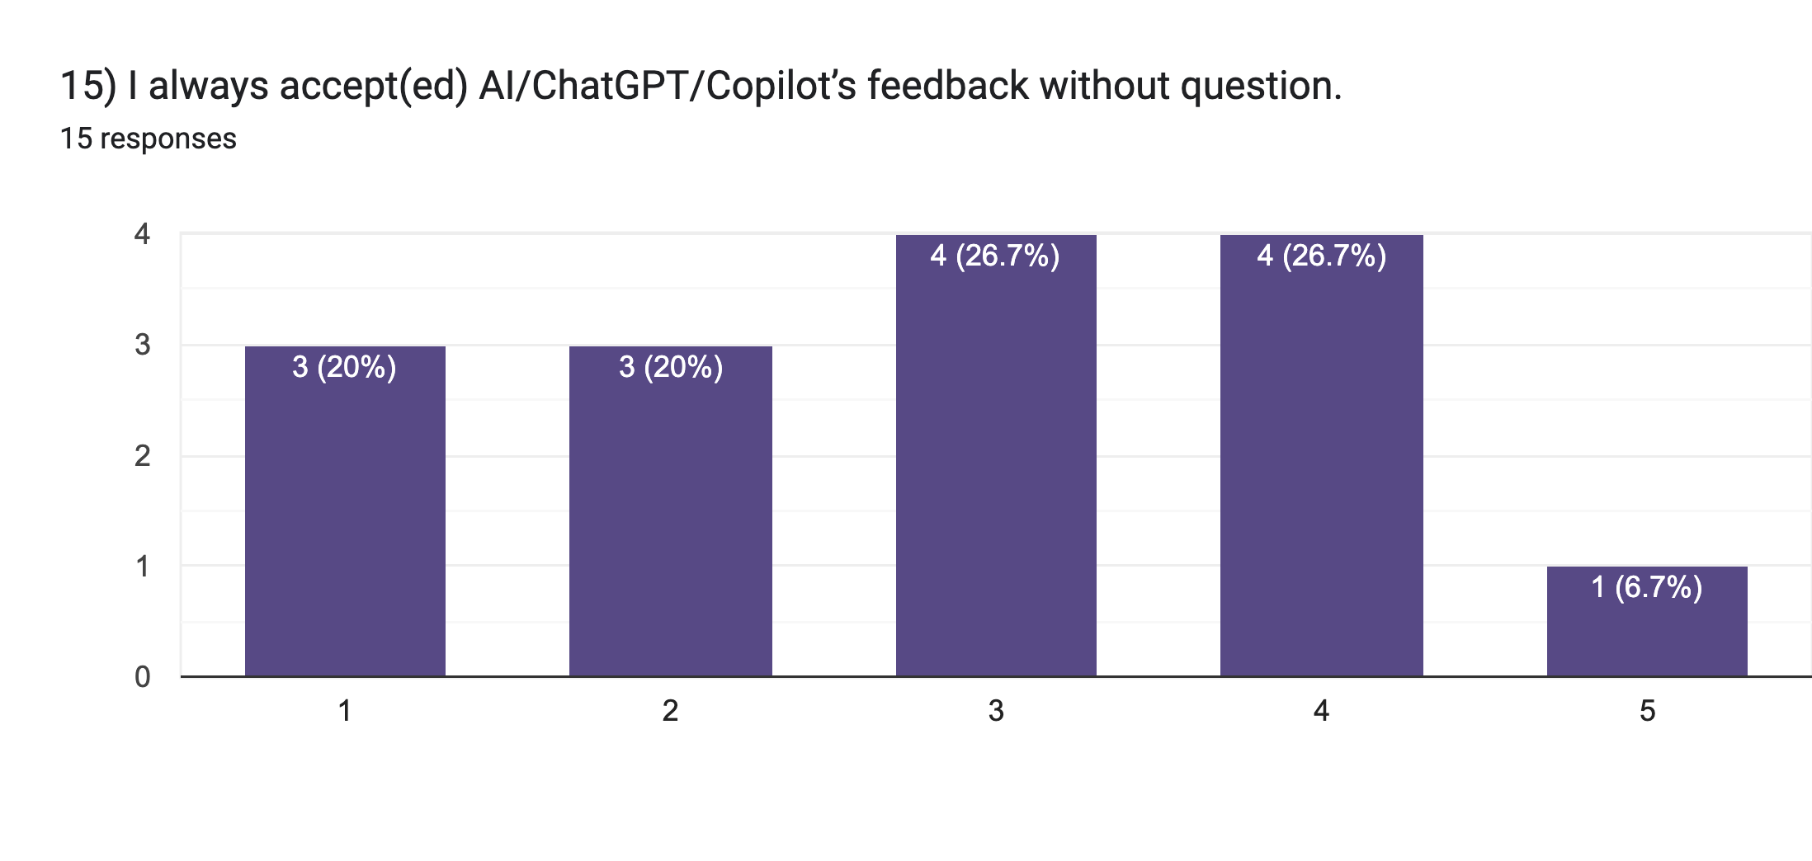

Slide 16
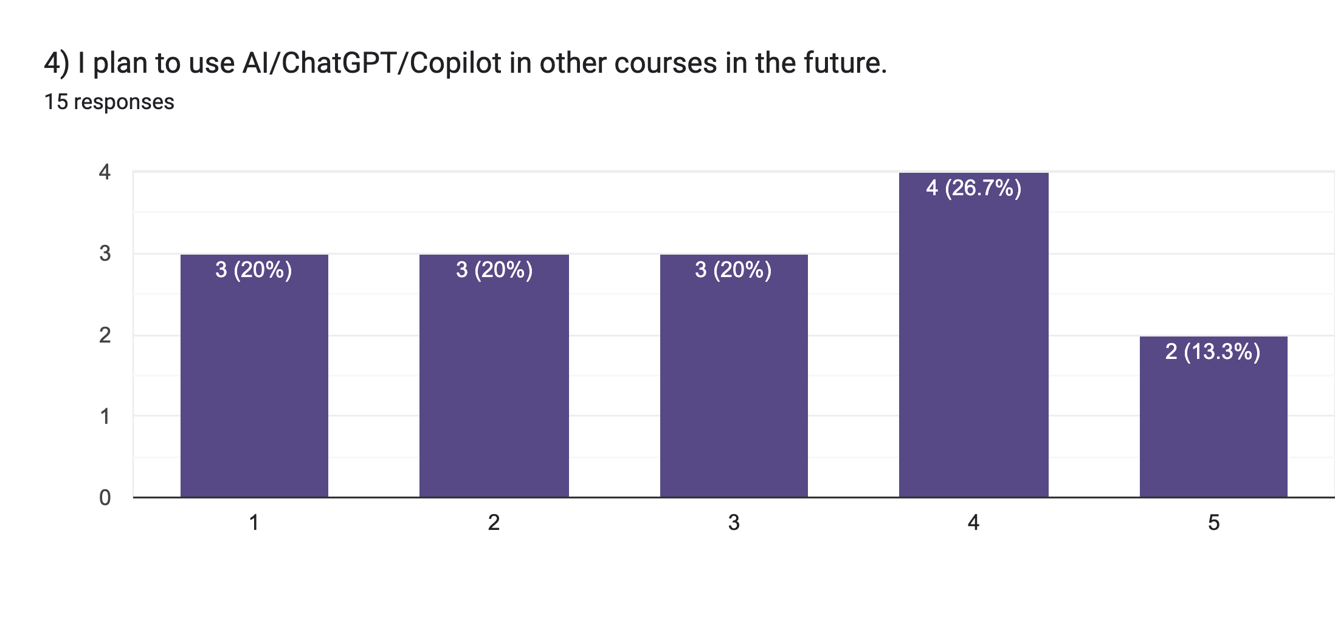
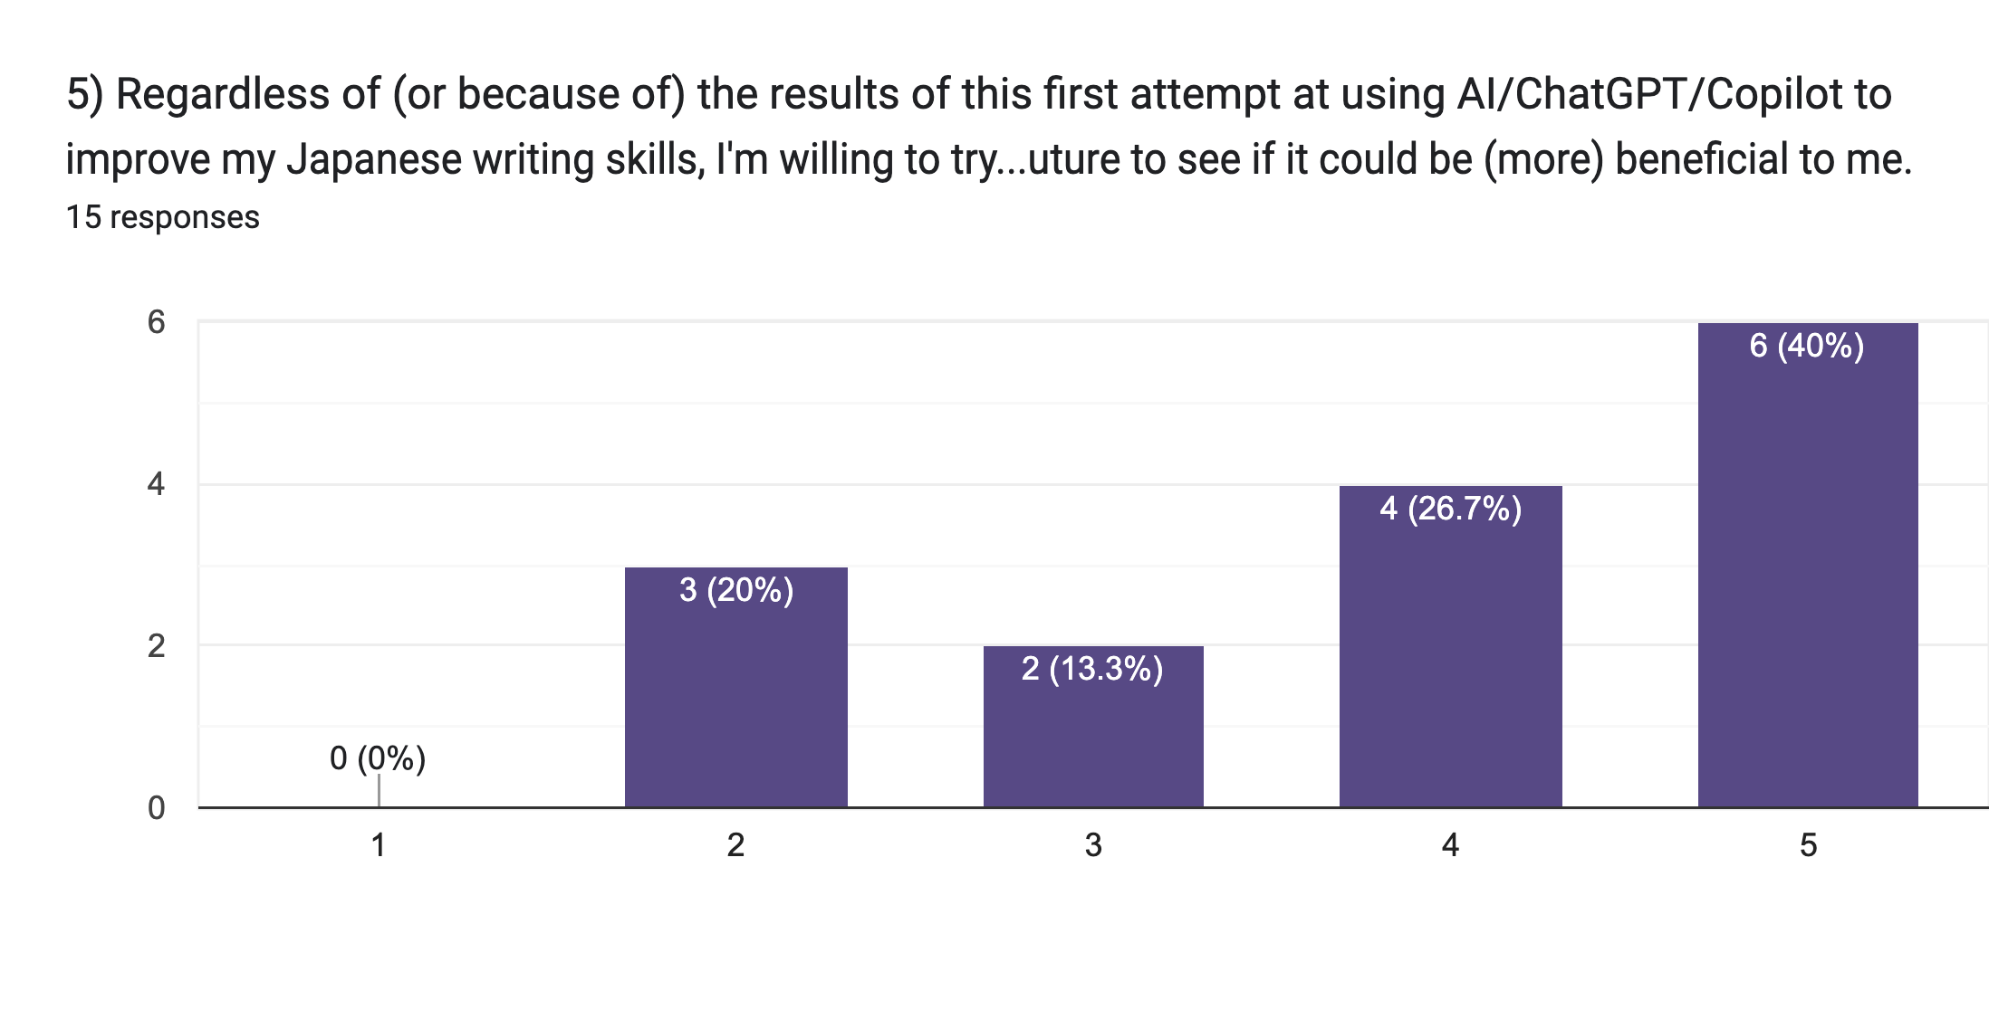

Slide 17
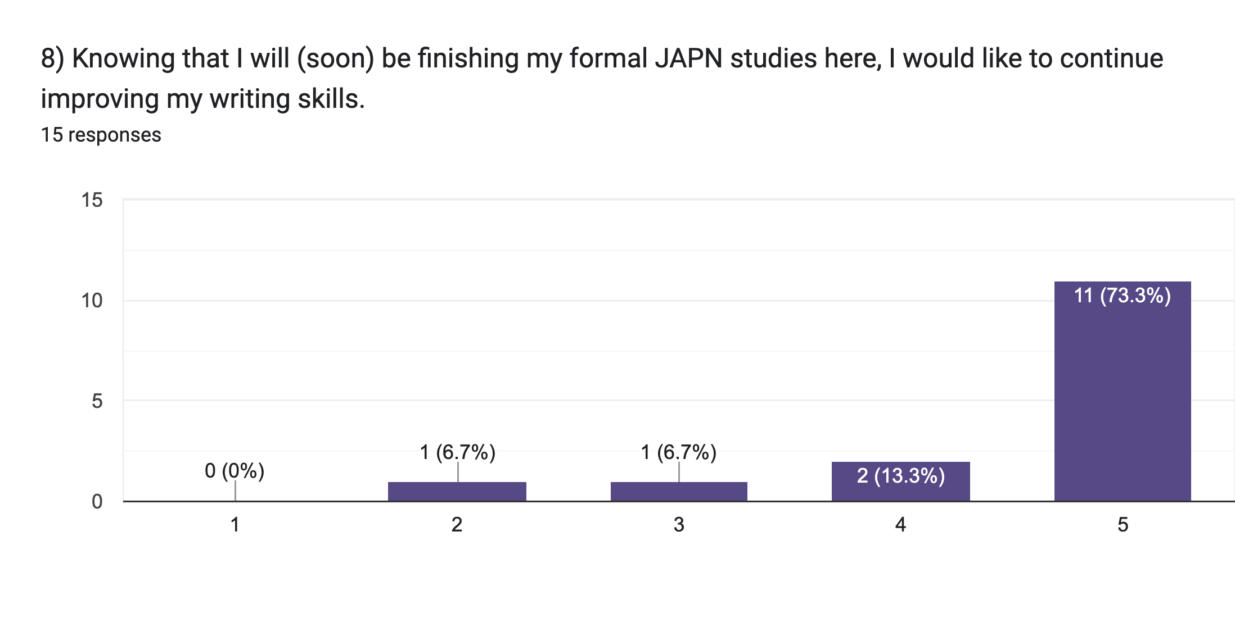
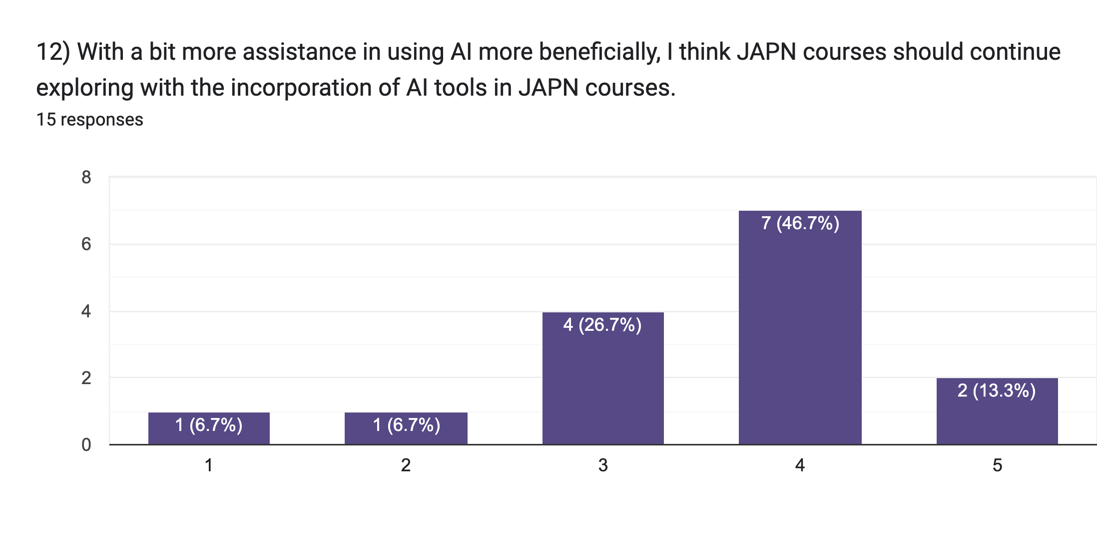

Slide 18
V. Benefits, Limitations, Potential Goes back to the “Why explore AI in a Japanese Grammar and Composition course:
instant feedback
learner autonomy
tailored corrections and suggestions
an innovative language learning experience
Allows instructor to more efficiently focus on strengths and weaknesses in compositions, especially with large classes

Slide 19
“I really enjoyed walking the AI on a leash by giving it prompts to get exactly what I was looking for. It helped me stay motivated to write more and get more feedback on my mistakes.”
“I am generally skeptical of over-application of AI, but in using it for this course, I saw useful capabilities that can be applied to language learning.”
“I was most satisfied with the AI's ability to: provide suggestions for translating English phrases and words which didn't translate directly, explain the differences in nuance between similar words, and correct grammar syntax and spelling in my draft.”
“I found the AI very helpful during the initial draft when it was making "mechanical" corrections to the paper.”
“Copying the passage was a straightforward, but enjoyable final step which resulted in a satisfying physical piece of paper in my own handwriting.”

Slide 20
V. Benefits, Limitations, Potential
AI does not appeal to everyone “I did not enjoy engaging with AI. It made me feel as if I wasn't doing the work properly. It made me feel lazy.” “Using AI has greatly decreased my motivation and engagement. It takes away the critical thinking of trying to comprehend…” “I find generative AI tools frustrating to use …” .
Need for clear, continued guidance on how to make the most of AI “If you use it like a personal tutor, ask it follow up questions, treat its advice with curiosity and try to deeply understand the content, then it will be more helpful.” .
Distrust of AI responses “I don't really trust AI to properly use Japanese that well, or at least fully understand what I am trying to convey”
“It was sometimes difficult to assess whether AI’s suggestions were actual improvements”
“I do not trust AI with language acquisition. AI is not creative, nor can it create something from nothing”
Grammar and Composition course

Slide 21
“It might be beneficial for students to compile…sentences the AI corrected most frequently, and go over them in class, in order to cement the idea of using them in a face-to-face environment.”
“I wish there was some more in-depth human correction in there somehow?” TRUST issue: “I just simply don't trust AI that much and don't want to learn bad Japanese habits.” “I do not trust AI with language acquisition. AI is not creative, nor can it create something from nothing.” “I personally don't think AI is at the level of language comprehension to be precisely helpful yet” “I think that some people hate AI, and although this assignment helps you learn to utilize it in a helpful way, it was a struggle trying to figure out if what it said was true.”

Slide 22
V. Benefits, Limitations, Potential
Q: Is AI worth exploring in your discipline?
What is one [assignment, project, assessment] you currently do in one of your courses that you could envision integrating AI in?
Do the challenges/limitations of AI outweigh the benefits?
Are there ethical issues (e.g., students claiming AI work as their own)? How to deal with that?
Already use AI in your courses? Please share your experiences and best practice strategies!

Slide 23
T H A N K Y O U Kathy Negrelli RCHSS Student Success Summit, 2025

