Slide 1
Maximizing Critical Thinking In the Classroom
Engaging Minds as We Help Students Navigate the Knowledge Explosion
Powerpoint by j. steve miller, author of why brilliant people believe nonsense, for the 2025 STUDENT SUCCESS SUMMIT
See https://criticalcreativethinking.wordpress.com/ for more resources.

Slide 2
Tip: Write Down only Your Takeaways! (Otherwise, just follow along and think.)
THIS POWERPOINT PRESENTATION, AND OTHER RESOURCES, ARE YOURS to use! Go to the Summit web page for this PowerPoint, and here for other resources:
www.criticalcreativethinking.wordpress.com
THE ENTIRE TEXTBOOK IS YOURS to review or use! Find it free in .pdf by Googling “J. Steve Miller Kennesaw State University Digital Commons.”

Slide 3
Introduction Why Prioritize Critical/Creative Thinking?

Slide 4
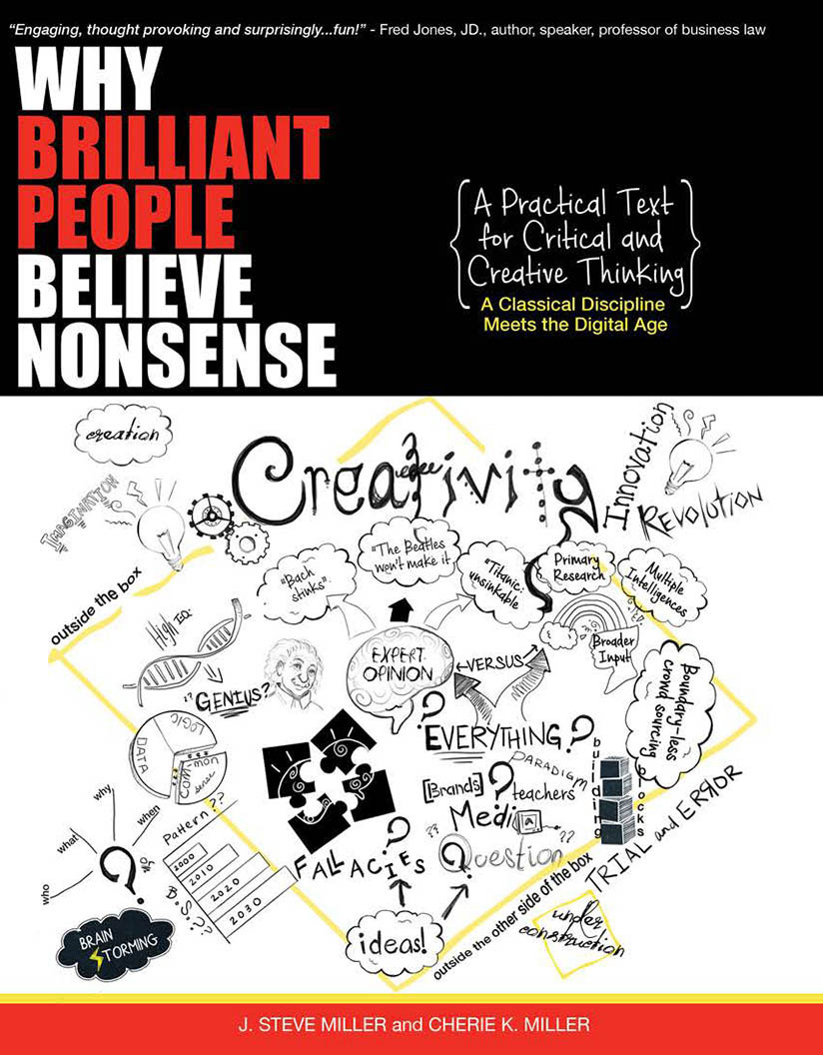

Slide 5
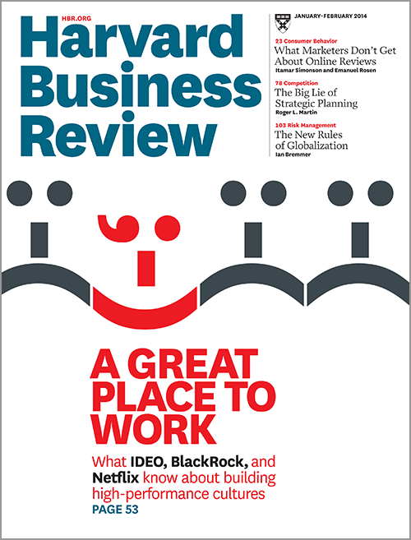
The Crying Need of Today’s Businesses: Critical & Creative Thinkers
According to writers for the Harvard Business Review:
"If you want to succeed in 21st Century business you need to become a critical thinker.”(1)
"A company’s most important asset isn’t raw materials, transportation systems, or political influence. It’s creative capital—simply put, an arsenal of creative thinkers whose ideas can be turned into valuable products and services. Creative employees pioneer new technologies, birth new industries, and power economic growth. Professionals whose primary responsibilities include innovating, designing, and problem solving—the creative class—make up a third of the U.S. workforce and take home nearly half of all wages and salaries. If you want your company to succeed, these are the people you entrust it to.“(2)
1) John Baldoni, "How Leaders Should Think Critically," Harvard Business Review, Jan. 20, 2010.
2) Richard Florida and Jim Goodnight, "Managing for Creativity," Harvard Business Review, July 2005.

Slide 6
Who Do Top Businesses Want to Hire?
A survey of over 1,000 people who hire for various industries, conducted by the Accrediting Council for Independent Colleges and Universities, asked respondents to rank the importance of various competencies for the future. They ranked "novel and adaptive thinking" first, for both "current importance" and "future importance.”
Survey by the Accrediting Council for Independent Colleges and Universities (ACICS), "Panel Discussion: Workforce Skills Reality Check," http://www.acics.org/events/content.aspx?id=4718

Slide 7
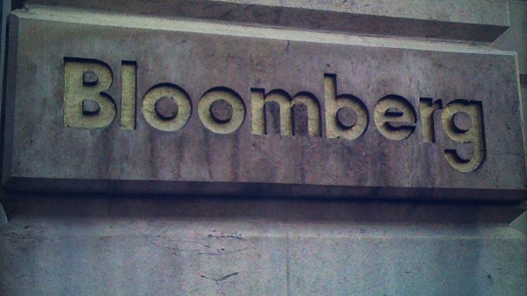
Is There a “Sweet Spot” That Recruiters Look for, But Can’t Find?
Bloomberg recently released the 2015 Job Skills Report, which surveyed 1,320 recruiters for 614 companies.² They found a "sweet spot" of skills that 1) companies were most looking for and 2) were hardest to find.
Here are the four "rare skills that companies want most":
Strategic Thinking
Creative Problem Solving
Leadership Skills
Communication Skills
(Francesca Levy and Jonathan Rodkin, "The Bloomberg Recruiter Report: Job Skills Companies Want But Can’t Get," in the online Business section of Bloomberg, July, 2015)

Slide 9
Beyond Textbook Knowledge: What Kind of Engineers Does Lockheed-Martin Seek Out?
“…a candidate who demonstrates capabilities in critical thinking, creative problem-solving and communication has a far greater chance of being employed today than his or her counterpart without those skills.”
— Norman Augustine, former chairman and CEO of Lockheed-Martin, which employs over 80,000 engineers¹

Slide 10
The Challenge of Navigating The Knowledge Explosion
The Problem: The knowledge explosion is accompanied by a wisdom deficit.
My Perspective: High school didn’t prepare my students to think critically. Apparently, they hardly even addressed it.
Sadly, education has become “transferring a set of notes from the teacher to the students, without going through the minds of either.” If students understand and remember the lectures and the texts, they’ll typically make great grades.
Even at the college level, students aren’t given a memorable way to evaluate the claims of their texts and lectures.
Allow me to propose an approach: something you can use in helping students both one on one and in seminars. Think critically and give me candid input!
TEACHING TIP: What did I accomplish in this introduction?

Slide 11
My Intent: Maximize Critical Thinking as I Teach
I asked the question:
“What if, rather than think of critical thinking as some add on to my class, I instead examine each part of my course (class discussions, home work, testing, papers) and try to maximize critical thinking?”

Slide 13
1. Continually Motivate with “What’s in It For Me?”
The Problem: They’re expecting “the same old thing” and don’t take it seriously.
The Solution: Take time to demonstrate the relevance of the material. Use business/people stories. (Many illustrations in the text.)
(How I did it in this presentation.)

Slide 14
2. Set Them Free to Think about Their Reading
The Problem: Are they really thinking if they’re reading to guess “What’s gonna be on the test?” so they can memorize it? (Multi-Tasking?)
My Solution:
Do “Daily Wisdom” reflections. “It’s about you!”
Direct them 2 weeks before the test to the material they need to know.
Example: Know and understand “Bloom’s Revised Taxonomy” on p. 286.
Warn them that there will be test questions that should be obvious if they actually read it in their text or came to class.

Slide 15
3. Cover New Stuff in Class
The Problem: If class time merely reinforces their reading, why not just choose between going to class or doing the homework?
The Solution: Assume they’ve done the reading and use class time for discussion, reflection, and covering new material.

Slide 16
4. Get Them to Open Up and Brainstorm!
The Problem: They enter college with one big concern—”DON’T LOOK STUPID!” Thus, they resist speaking up.
The Solutions:
1 - Be candid about my own intellectual weaknesses.
2 – Spend time each day getting comfortable with each other. (Mid-Class networking?)
3 – Consider the mantra: “It’s only weird if it doesn’t work.”
4 – Make good use of brainstorms. (Anything goes!)

Slide 17
“It’s Only Weird if It Doesn’t Work”
https://www.youtube.com/watch?v=VaRryzjKPxk

Slide 18
Let’s Try a Brainstorm!
What are some interesting ways you learn best? (Drawing from 250 years of experience)
1. Personal reflection/writing:
Remember: “It’s only weird if it doesn’t work!” Places? Music or not? Group or alone? Memorizing names and dates? Memorizing Lists? Studying for tests? Taking notes? Getting organized? Staying motivated?
2. Share with your neighbor (HP’s “Next Bench” Technique)
3. Brainstorm as a Group! (“Brain Trust” at Pixar; see also Google and G.E.)
What I’m learning from this: We’re very different in how we learn! Utilizing visual memory, colors, unique strengths.

Slide 19
5. Create a Class Culture of Open Sharing
Present myself as a fellow learner.
Don’t give that “I know it all” vibe. Get comfortable with “I don’t know.” (Quote Isaac Newton)
Respect off-the-wall comments. (“Thanks for sharing…what do some of the rest of you think?”)
Don’t allow disrespect or teasing.

Slide 20
6. Shock Them Out of Complacency
The Problem: They’re used to blindly accepting authoritative lectures and readings.
The Solution: Examine “Daily B.S.” – (Stories of Brilliant Blunders in Why Brilliant People Believe Nonsense: Steve Jobs, Albert Einstein, Experts in Their Fields, etc.)
Example: A Top Educator Speaks of How to Learn— “Just engage in the material rather than use memory tricks.” (Look for the “e’s”. Start at 5.00 minutes.) “Did you notice that this directly contradicts what I taught yesterday?” (Nobody yet.)

Slide 22
7. Give Them a Method For Thinking Through Things

Slide 23
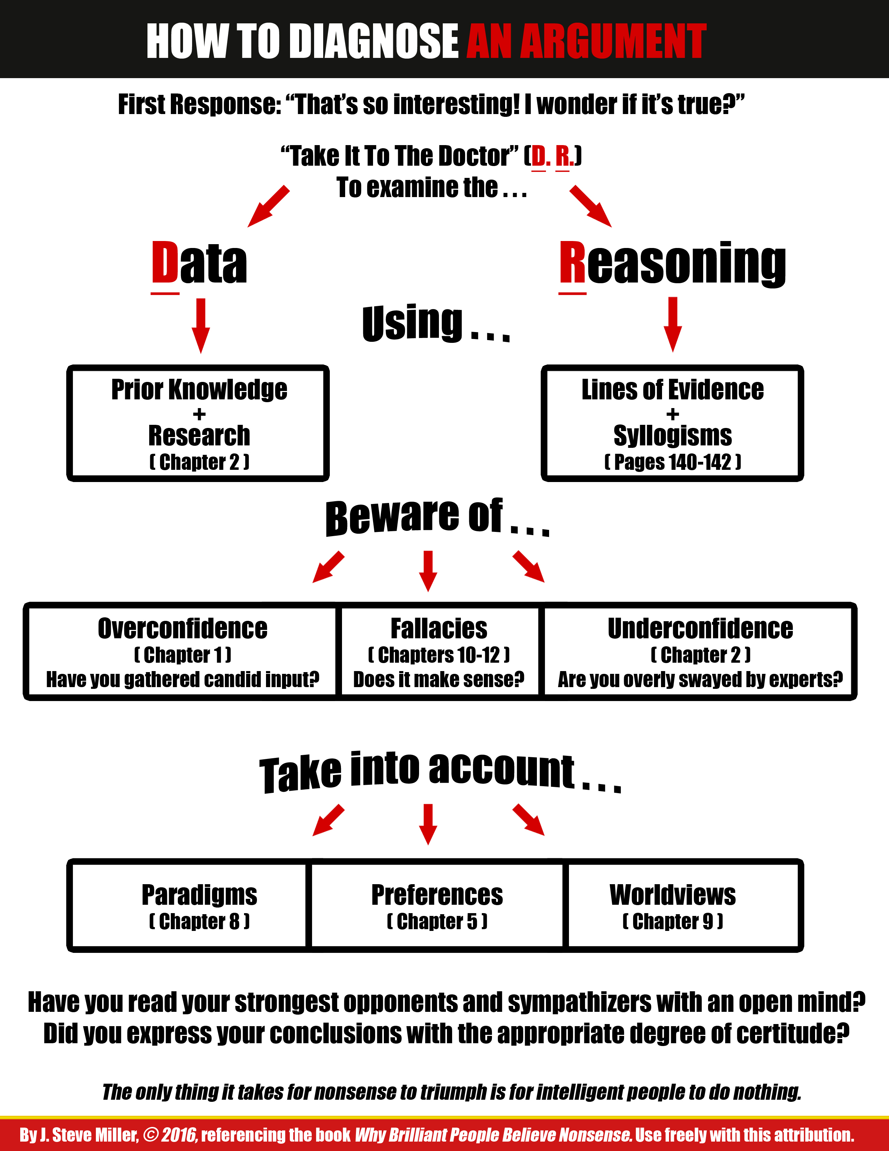

Slide 24
Why the “First Response?” Critical/Creative/Innovative Challenge #1: A Prophet Gets Bitten
An article recommended to me by some educated friends, which also was trending on Facebook:
http://www.rawstory.com/2016/03/christian-prophet-loses-his-buttocks-to-a-hungry-lion-while-trying-to-prove-god-would-save-him/
What nobody seemed to be asking, in reader comments, plus in my Introduction to Religion class….
This reveals a momentous problem in the age of the internet and the knowledge explosion: we can choose our news, or Facebook can choose it for us, based on matching “what’s trending” with our preferences.
So even massive reading can be narrow reading, which merely reinforces our prejudices.
Also, news sources can look really professional, but in reality be tracking what’s trending, with little to no editing/discernment by humans.

Slide 25
Critical/Creative/Innovative Challenge #2: How Can We Teach More Effectively? (See chpt. 17 of Why Brilliant People Believe Nonsense)
Chart Displayed Concerning “Student Attention During Lectures” From a Respected Research University Site (Carnegie Mellon)
What’s your first impression of the meaning of this chart?

Slide 26
The Chart As I First Interpreted It

Slide 27
Top University Interprets the Chart
“Grabbing and holding students’ attention”
“Research on student attention in lectures has demonstrated that attention levels naturally vary during lectures in predictable ways. In fact, attention is high during the first minutes, then it falls down and stays flat for the rest of the lecture. Toward the end of the lecture, attention picks up again, with some fluctuation, according to the following graph (Bligh 2000)”
DO YOU SEE THE IMPORTANCE OF THIS CLAIM, AND HOW IT IMPACTS OUR LECTURES, ETC.
OUR CRITICAL RESPONSE: “THAT’S SO INTERESTING! I WONDER IF IT’S TRUE?”
WHAT WOULD YOU LIKE TO QUESTION ABOUT THIS CHART?

Slide 28
Are There Alternate Ways to Interpret It?

Slide 29
What About This? (Assume they may have “omitted the origins”)

Slide 30
So we have some data (the chart) and some reasoning based on that data (“Typical lectures largely suck.”)
1 - Reflection: List questions you’d like to ask to further investigate this claim. (Engaging your creativity as well as critical thinking.)
2 – Compare your questions with your neighbor’s. (HP’s “Next Bench” method.)
3 – Share with the group. (Pixar’s “Brain Trust”)

Slide 32
Tracing Down the Source: The Chart as Bligh Drew It
What differences do you see?

Slide 33
The Chart That Started It All! (Same Study as Originally Published by Lloyd in 1968)

Slide 34
Bottom Line: Are Lectures Worthless?
Lectures aren't futile, as the original chart seemed to indicate. Instead,
"…a good lecture, one that is well crafted and expertly delivered, can surpass instructional media not only in cultivating so-called higher levels of learning, such as critical thinking, analysis and problem-solving skills, but also in the transmission of factual information" (Figlio, Ruish & Lin, 2010).¹⁴
But students do indeed get distracted, and more so as the lecture goes on. So in addition to learning to lecture well, in many contexts teachers would do well to avoid speaking nonstop for more than 15 to 20 minutes at a time. Instead, they would be wise to break up lectures with active learning such as student discussions to maximize student learning.

Slide 35
So What Are Your Takeaways Concerning Critical/Creative Thinking?

Slide 36
Critical/Creative/Innovative Challenge #3: What Causes Colds? (See chpt. 2 of Why Brilliant People Believe Nonsense)
Your quandary: “Dragon Con is around the corner, a key networking event for my vocational interest. Should I go hiking/camping this weekend, the first cold night of Fall? Or, should I stay home and not risk a cold that might keep me from Dragon Con?”
My question: Can cold weather cause colds?
Your Approach:
1 – Find and search the most authoritative medical sites for reliable data on “What Causes Colds?”
2 – Team up; compare other authoritative sites, and discuss issues.
3 – Draw a tentative conclusion.
4 – Free think the challenges of consolidating vast information, “The Woozle Effect,” and how this exercise could impact your future learning.

Slide 37
Debriefing: Tips on Thinking from Challenge #3
Question “authoritative pronouncements,” even by experts. Think: “Now I know what one expert believes,” rather than, “Now I know the truth.”
In fast-growing fields, it’s difficult to keep accurate, up-to-date consolidations of research.

Slide 38
3. As you read, think critically about the material. Does it make sense?
4. You may need to consult several types of consolidation sources.
General Encyclopedias
Specialist Encyclopedias
Wikis
Literature (“Lit”) Reviews (in peer-reviewed journals)
5. Beyond consolidation sources, you may need to trace down the primary sources.

Slide 39
Critical/Creative/Innovative Challenge #4: In Which Specialty Are The Most STEM Jobs? (See chpt. 16 of Why Brilliant People Believe Nonsense)
Your challenge: You’re trying to decide on a major; you are generally interested and talented in STEM-type skills, so you want where the most jobs are. You search “STEM jobs .gov” to find the relevant statistics and find this page: http://www.ed.gov/stem
DO YOU SEE THE RELEVANCE OF THIS ISSUE?
What questions would you like to ask about this data?
Do a group search to try to get to the bottom of the data.
Draw some tentative conclusions concerning searching for such data.

Slide 41
Sample Questions Concerning Biotech
How was this data derived?
Historically, how accurate have predictions about growth in tech fields been?
Does growth of this industry necessarily mean prosperity? (Buffett on the airline industry.)
It’s 2025: how much has it grown so far? (In 2012 there were about 19,400 biomedical engineers. In 2023 there were 19,700 jobs for this degree, an increase of only 300 positions.
How big is the biotech industry?
How many people are currently preparing for this field? (Too many? Just enough? Not enough?)
What do people graduating with degrees in biotech say about the field?

Slide 42
Preliminary Thoughts/Research
1. “Percentage increase” differs from “increase in numbers.” (Note: if the data is accurate, the reasoning from the data—that there will be lots of jobs—may not be accurate.)
2. Biotech is a small field. On a United States Department of Labor site I discovered that "because it [biotech] is a small occupation, the fast growth will result in only about 5,200 new jobs over the 10-year period."⁴
Thus, if this rapid growth occurs, America as a nation needs to graduate 520 biomedical majors per year, during the ten year time period, to meet the demand for 5,200 new jobs.
3. America has over 550 graduate school programs related to biotech. Thus, if each of them graduates only one student per year, this could supply the demand. (But there are also four-year and two year degrees in related fields.
4. A 2012 National Science Foundation report, before giving their predictions of the growth in STEM jobs, admits that “Projections of employment growth are plagued by uncertain assumptions and are notoriously difficult to make.”
5. Many are complaining that “the jobs aren’t there.”
6. I’m not finding evidence of growth so far in this decade.

Slide 43
Do more recent stats support the claim that STEM occupations are mushrooming?

Slide 44
Some New Studies Questioning A Surging Demand for STEM Workers
http://www.bls.gov/opub/mlr/2015/article/stem-crisis-or-stem-surplus-yes-and-yes.htm - a recent literature review, including new data from interviews in various industries. Concludes that there are shortages in certain specific segments, but an overabundance in many areas (such as an overabundance of PhDs in biological sciences.)
https://www.google.com/url?sa=t&rct=j&q=&esrc=s&source=web&cd=1&ved=0ahUKEwiv3oGRtJjNAhVgGlIKHfE0CSwQFggeMAA&url=http%3A%2F%2Fwww.rit.edu%2Fnews%2Fpdfs%2FCHE_Hira.pdf&usg=AFQjCNHOVAjAhIAfebLruhQx44nPRexFsQ&sig2=Fhiaq-gPQzcs0-gaLsju2g&cad=rja – Stem Crisis, Reality or Myth? Chronicle of Higher Education.

Slide 45
Debriefing: Tips on Thinking from Challenge #4
As in “The Matrix,” the questions should drive us. Learn to ask creative questions.
Ask, “How could I evaluate this claim?” Use your creativity to formulate a strategy.
Beware of “motivated reasoning.” What people/organizations may benefit from the stated position?
Don’t “lose the forest by obsessing on the trees.” Example: Will we lose our students who are brilliant at hands-on mechanics or management or the arts by myopically focusing on math and science?
Is there an off-setting “opportunity cost” to obsessing on certain fields? Why not fund physicians (not considered STEM).
Government statements aren’t typically primary sources. They are somebody’s consolidation of primary sources.

Slide 46
Conclusions from Part 1: Critical Thinking
Our students aren’t prepared to research and reason concerning truth claims. Yet, these skills are critical for their success.
Students love being empowered to think for themselves!
They also love to evaluate real claims, made by respected sources, concerning subjects relevant to their lives.
Librarians and resource personnel work at the cutting edge of helping us navigate the knowledge explosion.
By continually honing our skills and learning how to more effectively pass on these skills, we can powerfully and effectively impact the next generation.
My book is available free, if you wish to use it in part or as a whole for yourself or with students, as a .pdf. Search “Kennesaw State Digital Commons J. Steve Miller”. If you want a hard copy cheaper than Amazon, I’ve got some here.
If you have ideas to help move us along in this process, please let me know! Also, alert me to other speaking opportunities that might fit with my passions. I’m at jstevemiller@gmail.com.

Slide 47
Part 2 Exploring Creativity and Innovation

Slide 48
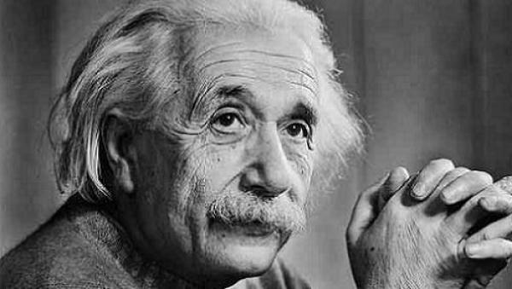
Critical/Creative/Innovative Challenge #4: How Do You Define “Smart”? (See chpt. 20 of Why Brilliant People Believe Nonsense)
Your Challenge: You’re starting a company with a few of your friends. You determine that your main concern is neither experience nor their particular major. You just want “smart” people who can learn whatever they need to succeed. So 1) how do you define “smart”? And 2) what are the characteristics of “smart” that you’re looking for? (Go to second set of slides.)

Slide 49
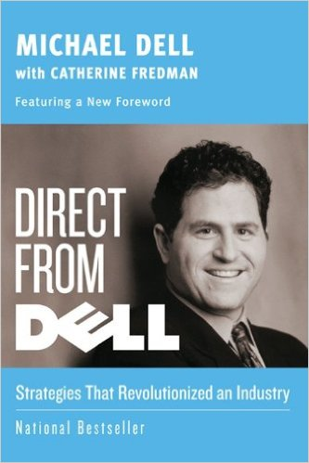
Who Does Michael Dell Want to Hire?
"At Dell we look for people who possess the questioning nature of a student and are always ready to learn something new. Because so much of what has contributed to our success goes against the grain of conventional wisdom, we look for those who have an open, questioning mind: we look for people who have a healthy balance of experience and intellect; people who aren't afraid to make a mistake in the process of innovation; and people who expect change to be the norm and are liberated by the idea of looking at problems or situations from a different angle and coming up with unprecedented solutions.“ (Michael Dell, Direct From Dell, p. 110)

Slide 52
INNOVATION How Two Idea-Driven Companies Make It Happen
Google’s Small Groups
Google is "obsessive about having very small groups working on projects. Five or six people are generally sufficient to handle a major project."³⁷
(Richard L. Brandt, The Google Guys (New York: The Penguin Group, 2011), pp. 59,60.)
Pixar’s “Brain Trust”
Began with “Toy Story”
Takes films from “suck” to “non-suck”
Resulted in a string of blockbusters
Brings together creative people from all levels to give their candid, but friendly input
(See Ed Catmull, Creativity, Inc., especially chapter 5, “Honesty and Candor”)

Slide 53
So Let’s Think Beyond the Book and Lecture!
“Education has largely become transferring a set of notes from the teacher to the student, without going through the minds of either.” (Educator Howard Hendricks)

Slide 54
Critical/Creative/Innovative Challenge #1: IBM Asks, “Help Us Optimize Our Learning!”
The Challenge: You’ve just graduated and gotten hired by IBM. Your boss says, “You were an honor student. Obviously you learn better than most students. So I want you to put together a presentation on how IBMers can understand and retain more information when they go to seminars and continue their education.” Your Strategy: Pull together a “Brain Trust” and brainstorm “What works for you?” to come up with new stuff that they haven’t already read.
Tips:
We’re using “metacognition” (“thinking about thinking”) to get beneath the surface
Don’t be restricted by “What they want you to say,” or “What conforms to the current theories.”
“It’s only weird if it doesn’t work.” So in one sense, you’re looking for stuff that they don’t already know, so “the weirder the better.”
Get motivated! This is practical stuff you can use!

Slide 55
IBM Motto = “Think”
Apple Motto = “Think Different”
Our Strategy
Think personally of “what works for you” in learning. Write down ideas.
Share it with your neighbor and get more ideas. (HP’s “next bench” technique)
Collect ideas on the board with the entire class (Pixar’s “Brain Trust.”)
Categories can include (but are not limited to):
Tricks for memorizing.
Tricks for note-taking.
Tricks for organizing.
Tricks for focusing attention in class or while reading.
Tricks for overcoming weaknesses.
Tricks to enhance your environment.
Tricks with visualizing material.

Slide 56
Debriefing: Tips on Thinking from Creative Challenge #1
Metacognition = Thinking about our Thinking
“Crowdsourcing” often trumps “Me-Sourcing” in the race for ideas.
200 years of experience can trump 10 years of experience + expertise.
Brainstorming requires balancing candor with kindness.
Effective brainstorming celebrates the weird in search of the workable. “It’s only weird if it doesn’t work.” Don’t stifle the flow of ideas with comments like, “But that’s not practical!”
The intuitive = “duh.” The counterintuitive fascinates and captivates.
“What works” can trump “Following the prevailing theory,” so feel free to ignore the reigning theories.
Find ways to consolidate the best ideas.
It takes work to develop a “culture of candor.” (Jack Welch, at GE, kicked the managers out of brainstorming sessions. Catmull wouldn’t allow Steve Jobs into the “Brain Trust.” Jobs’ personality was too strong.)

