Slide 1
QUICK FLEXES: Amplifying Resources and Best Strategies for Student Success Lauren Taglialatela Department of Psychological Science

Slide 2
PRESSURES AND OPPORTUNITIES
Students, even Juniors and Seniors, are largely unaware of available resources
Only a minority of those who are aware of resources seek out those services
Students have often been told “what” to learn but not “how” to learn
Source: Navigating Challenges: The Psychology of Student Success, Capstone Project

Slide 3
Selected Resources and Best Practices
CARE Services
Counseling and Psychological Services
Career Planning and Development
RCHSS Advising Center
Psychology Laboratory
Active Recall
Metacognition
Concept Mapping

Slide 4
PROCESS
Hybrid/F2F
Show at the beginning and ending of class
Provide some context
Provide as Announcement or other format in D2L

Slide 5
PROCESS
Online
Provide as Announcement or other format in D2L
Embed in content

Slide 6
PROCESS
Department
Provided to all faculty via weekly departmental newsletter
“PSYC Weekly”

Slide 7
EXAMPLES
Curate for your department and for your students
Update links
For the win: Create QR codes

Slide 8
What is Active Recall?
Active recall is a study method that involves retrieving information from memory, often without using prompts or notes, instead of passively reviewing information. It is more effective than just rereading your notes because it requires you to do mental work with the material, which is one factor that strengthens memory connections.
Active Recall Strategies for You to Use!
Summarization Without Notes:
After reading or studying, close your book and notes:
then try to write or verbally explain the main concepts from memory (without your notes, book, etc.)
create a concept map identifying/explaining major concepts and connecting related concepts to one another
What's a concept map? The Learning Center is here to help!
Teaching Others:
Explain a concept like operant conditioning to a classmate, friend, or family member. Teaching is a form of active recall that reinforces your understanding by forcing you to retrieve and organize information.

Slide 9
Radow College Undergraduate Advising Center
Schedule an In-person or Virtual Appointment
420 Bartow Ave NW (470) 578-7728
Willingham Hall, Suite 202 rchssadvising@kennesaw.edu
Trained Advisors Can Help You With:
Removing holds
Future course planning
Review of program requirements
Strategies for student success
Readmitting from academic dismissal
Dropping or withdrawing from courses
Internship information for your major
Referrals to campus services and offices
Navigating curriculum and university policies
Course Program of Study
Double Owl Pathways
Review of transfer credits
Academic standing and academic standing appeals
SAP Appeals
Staying on track for graduation
RCHSS Undergraduate Advising Center

Slide 10
PSYC Lab
Free resource for any students taking a Psychology class.
Location: 4026, 4th floor of the Social Sciences Bldg.
Trained Laboratory Assistants
Computers
Internet access
SPSS
MS Office
Respondus LockDown Browser and Monitor
APA Manuals
SPSS Guides
Flowcharts for statistical decision making
D2L shell with additional resources
Website for more information and links to tutorials about APA Style and SPSS

Slide 11
Knowing What You Know
Sometimes we overestimate what we know. When we do this, often we’re just using ineffective strategies to evaluate our knowledge.
Give these a try for a better evaluation of what you know!
Self-Testing:
Regularly quiz yourself on the material without looking at your notes.
Teach Someone Else:
Try to explain the material to a friend, study partner, or even to yourself out loud.
Apply the Material:
Test your knowledge by applying concepts to new problems or scenarios. For
example, in psychology, you might take a theory and apply it to a real-world
situation.
Review Mistakes:
Look at any mistakes made on quizzes, homework, or practice exams and make
sure you understand why you missed those items.
Engage in Active Recall:
Instead of passively reviewing notes, close your book and try to recall key
concepts and details from memory.

Slide 12
COUNSELING and PSYCHOLOGICAL SERVICES (CPS)
Located on both campuses the CPS mission is to help students develop the skills necessary to better manage their emotions, navigate relationships, and address other mental wellness concerns.
_________________________________________________________________
Wide variety of mental health counseling services for enrolled KSU students
All services are confidential
Enrolled students are not charged any fees for mental health services at CPS
__________________________________________________________________________________
During the Initial Consultation the student and counselor will discuss next steps that may include:
an Extended Assessment
workshops (e.g., Managing Anxiety & Depression, ROI)
individual counseling
group screening
an Initial Assessment by Psychiatry
referral to case management
referral to other campus and off-campus resources (e.g., UWill, Upsych, ThrivingCampus)
CPS assists with these and other circumstances:
Depression, Anxiety, Relationship Issues, Self-Esteem, Sexual Orientation, Stress Management, Eating Issues, Feelings of Loneliness, Cultural Adaptation, Personal Growth, Concerns about sexual assault or trauma, Developing skills for academic, scholastic, and interpersonal success
Website: Information about hours, location, phone number, and walk-in option

Slide 13
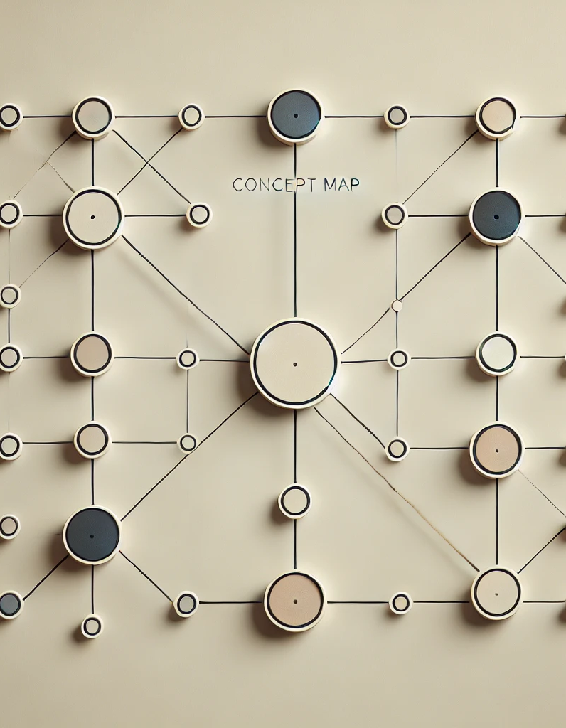
Concept Mapping
Concept mapping, also known as mind mapping, is a visual study strategy that helps you organize and represent knowledge. It involves creating a diagram that connects concepts with lines or arrows to illustrate relations between and among ideas. Concept mapping helps visualize complex ideas, making it easier to see connections and recall information. It's especially useful for subjects that require deep understanding, such as psychology or biology.
How to Use It:
1. Start with a Central Idea: Write the main topic in the center of your page.
2. Branch Out: Add related subtopics around the central idea, connecting them with lines.
3. Expand Further: Continue branching out with more detailed concepts, examples, unpacked descriptions.
4. Use Colors and Images: Enhance understanding by using colors, symbols, or images to differentiate ideas.

Slide 14
Career Planning & Development Find Your Path. Find Your Success.
Appointments with Career Advisors
Undeclared major and need guidance
Thinking about changing your major
Unsure about career paths
Setting yourself up to be successful in the job market
Online Assessment Tools
GAfutures Career Assessment Tool
ONet Interest Profiler
Steppingblocks
Micro-Credentials
Complete online trainings to earn badges and certificates to promote career readiness
Career Planning & Development Website

Slide 15
CARE Services
Campus Pantry: CARE Services has a campus pantry that provides essential food supplies to students facing food insecurity.
Temporary Housing: For students experiencing housing insecurity, CARE Services offers temporary on-campus housing for up to 14 days. This program, supported by grants, also helps students find more permanent housing solutions.
Financial Literacy: Through a partnership with the Coles College of Business, CARE Services provides a financial literacy course to help students manage their finances better, particularly in times of emergency.
Case Management: Each student working with CARE Services is paired with a dedicated case manager. Together, they develop a personalized plan that includes access to resources, referrals, and life skills training aimed at fostering self-sufficiency.
Emergency Assistance: The Emergency Assistance Program provides financial aid to students facing unexpected hardships, helping them stay on track academically.
CARE Services Website

