Slide 1
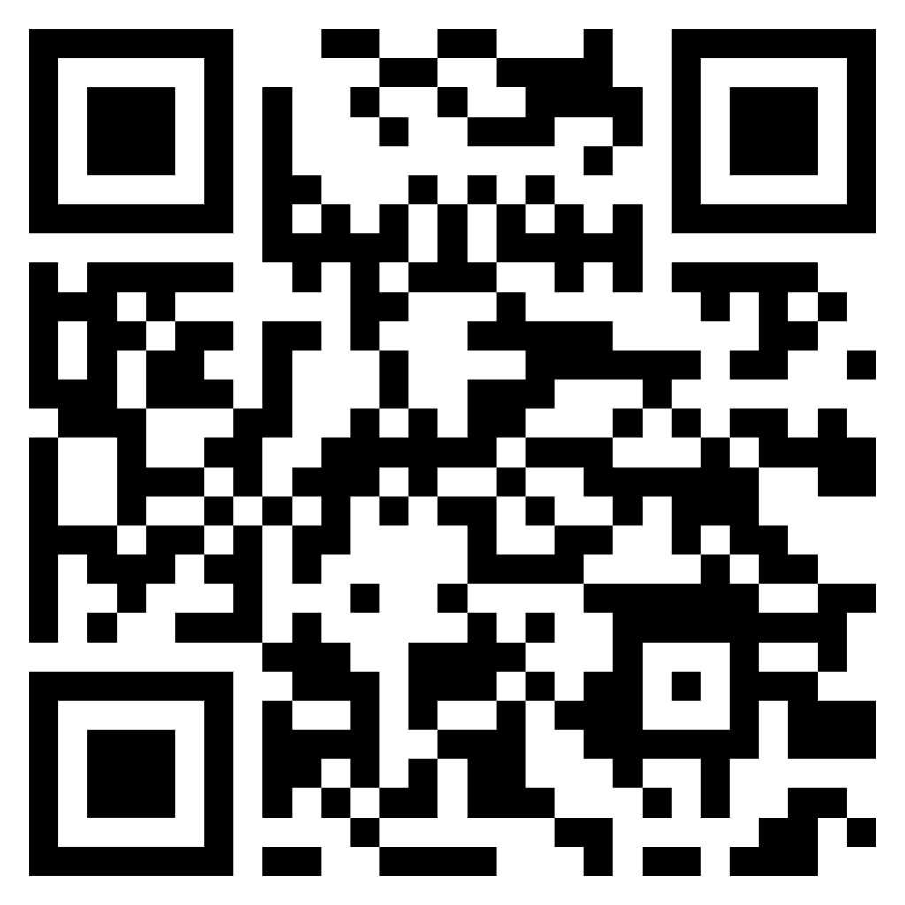
How do you feel about this assignment?
Assessing student confidence & Engagement
Student
Confidence
Teacher Confidence
Write an Anonymous Question
By a Show of Hands!
Reflect, Learn & Grow
Questions
Concerns
Engagement
Validation
Input in Process
More Teaching?
More Time?
Individual Conferences?
Engagement?
On a scale of 1-10, how do you feel about being able to complete this assignment by Sunday?
Between Assignments
Scaffolding
End of Semester
Annual Reviews
Discussion Board
Kahoot/Quizziz
Answer
Dr. Valerie A. Smith
Lecturer of English, Kennesaw State University
https://www.surveymonkey.com/r/TBHJDTS

