Slide 1
Easy Korean with Color-coded Flashcards
2025 KSU Radow College Student Success Summit
Improving language learning through sentence structure awareness and visual aids
Grace E. Ko
Department of World Languages and Cultures

Slide 2
Contents
Famous quote
Most difficult languages for English speakers
Key differences: English vs Korean
Korean alphabet
Korean syllables
Parts of speech
Sentence structure comparison
Two categories of Korean grammar
Fixed structure: English vs Korean
Color-coded flashcards activity

Slide 3
“You can never understand one language until you understand at least two.”
- Geoffrey Willans -
https://www.azquotes.com/quote/526115

Slide 4
Most Difficult Languages for English Speakers
Language | Reason
Mandarin Chinese | It requires memorizing thousands of characters, mastering four distinct tones (which can change the meaning of a word), and navigating a complex grammatical structure.
Arabic | It features a unique script written from right to left, along with a pronunciation system that can be difficult to grasp. The grammar is challenging, with complex rules and verb conjugations.
Japanese | Japanese has three distinct writing systems (hiragana, katakana, and kanji), and its grammar. Various levels of formality and sentence structure make it hard to master.
Korean | It has simple and logical writing system (Hangul). However, Korean grammar can be complex, with various levels of formality, unique verb endings, and a sentence structure different from English.

Slide 5
Key Differences: English vs Korean
Feature | English | Korean
Word Order | Subject – Verb – Object (SVO) | Subject – Object – Verb (SOV) *Considered free order except verb at the end
Use of Particles | Preposition before noun | Particle after noun (It is attached to a noun.)
Articles | a, an, the are used | No articles
Verb Changes | Changes for tense and subject | Changes for tense and politeness
Pronoun Usage | Frequently used | Often omitted if understood
Politeness/Honorifics | Tone and word choice | Grammar structure changes
Writing System | Latin alphabet | Hangul (phonetic Korean alphabet)

Slide 6
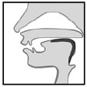
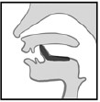
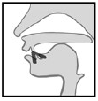
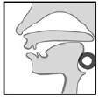
Basic Korean Alphabet
10 Vowels
* V marks vertically shaped vowels. H marks horizontally shaped vowels.
ㅏ |  | ㅑ |  | ㅓ |  | ㅕ |  | ㅗ |  | ㅛ |  | ㅜ |  | ㅠ |  | ㅡ |  | ㅣ
[a] | V | [ya] | V | [eo] | V | [yeo] | V | [o] | H | [yo] | H | [u] | H | [yu] | H | [eu] | H | [i] | V
14 Consonants
ㄱ | ㄴ | ㄷ | ㄹ | ㅁ | ㅂ | ㅅ | ㅇ | ㅈ
[k,g] | [n] | [t,d] | [r,l] | [m] | [p,b] | [s] | [ng] | [j]
ㅊ | ㅋ | ㅌ | ㅍ | ㅎ
[ch] | [k’] | [t’] | [p’] | [h]

Slide 7
40 in All
19 Consonants
21
Vowels

Slide 8
Korean Syllables
C+V: vowel-ending syllable | C+V+C: consonant-ending syllable
나 고 와 | 낙 곤 왈
a
k/g
n
o
n
k/g
C+ Vertical Vowel
C+ Horizontal Vowel
o+a= wa
l/r
C+ Combination Vowel
* Consonant “ㅇ” is silent if it is in the initial consonant position.

Slide 9
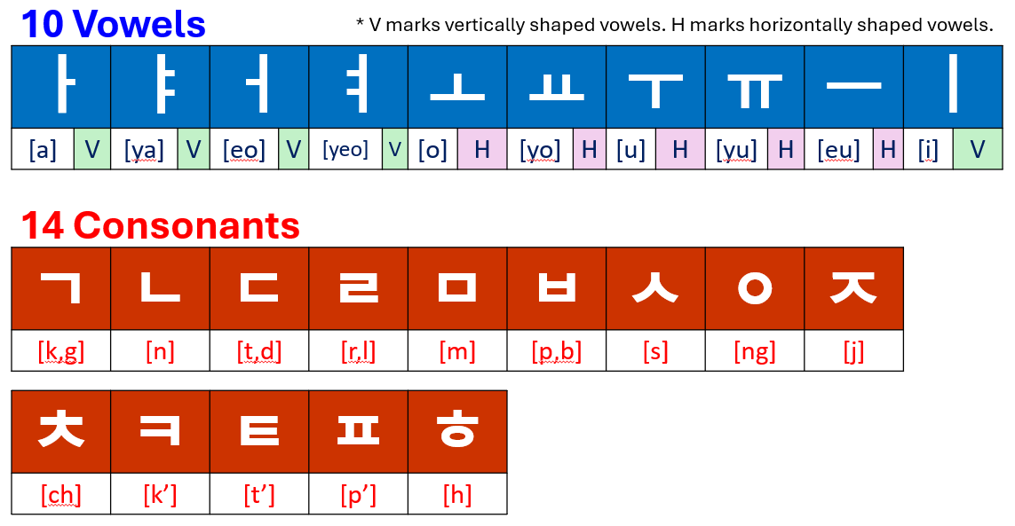
Syllable Structure
drama | 드 | 라 | 마
tree | 나 | 무
baby | 아 | 기
mirror | 거 | 울

Slide 10
9 Parts of Speech
English: 8 parts of speech
Noun
Pronoun
Verb
Adjective
Adverb
Preposition
Conjunction
Interjection
Sentences are made with words. Based on the function, all words are classified into the following subgroups.
Substantives
Noun
Pronoun
Numeral
Independent Words
Interjection
Relatives
Particle
Modifier
Pre-noun
Adverb
Declinable Words
Verb
Adjective (= Descriptive Verb)

Slide 11
Sentence Structure Comparison
English: S-V-O | Korean: V always come at the end
저 김치 먹어요.
I eat kimchi.
= 김치 저 먹어요.
* In Korean, there is no fixed position for the subject or object. The elements of a sentence can be interchanged freely. However, the main verb always comes last.

Slide 12
Two categories of Korean Grammar
1. Noun + Particle
I
[jeo]
T
O
[reul]
to eat
[meo-geo-yo]
[neun]
kimchi
저
는
김치
를
먹어요
2. Verb Conjugation
먹다/먹습니다

Slide 13
Fixed Structure: English vs Korean
Topic
은/는
Location
Time
Destination
Subject
이/가
in, on, at
in, on, at
Object
을/를
to
Location
에(서)
Verb
Verb
Subject
Object
Destination
에
by
with
Time
에
Co-participant
하고
Means
Co-participant
Means
(으)로*

Slide 14
Designed to help beginner students visualize and internalize sentence structure
Color-coded Flashcards
Interjection/Conjunction | Noun/Pronoun | Particle/Marker | Adverb | Verb/Adjective
Basic rules:
Separate words with spaces.
A particle is attached to a noun as a unit.
The verb comes last.
The other elements can move around freely.
Elements that are understandable in the context are frequently omitted.

Slide 15
G1
Equational Expression: N1 is N2
I am a freshman.
To be
Noun 1
은/는
Noun 2
이에요/예요
for
C-ending
for
V-ending
for
C-ending
for
V-ending
Noun |  | Particle (Marker) |  | Verb/Adjective

Slide 16
I
[jeo]
Steve
Yumi
저 |  |  | 스티브 | 유미
마이클 |  |  | 1학년 | 2학년
3학년 |  |  | 4학년 | 예요
이에요 |  |  | 예요 | 이에요
은 | 는 | 도 | 안녕하세요 | 반갑습니다
Michael
freshman
[il-hak-nyeon]
sophomore
[i-hak-nyeon]
junior
[sam-hak-nyeon]
senior
[sa-hak-nyeon]
to be
[ye-yo]
to be
[i-e-yo]
to be
[ye-yo]
to be
[i-e-yo]
T
[eun]
T
[neun]
I
[do]
to be well
[an-nyeong-ha-se-yo]
to be glad
[ban-gap-seum-ni-da]

Slide 17
G2
Subject-Adjective
= Descriptive Verb
School is good.
for
C-ending
for
V-ending
Noun
이/가
Adjective
Adverb
Noun | Particle (Marker) |  | Adverb |  | Verb/Adjective

Slide 18
Korean language
[eo-ttae-yo]
한국어 | 수업 |  |  | 어때요?
숙제 | 아주 |  |  | 재미있어요
도서관 | 넓어요 |  |  | 좋아요
아침 | 괜찮아요 |  |  | 많아요
학교 | 이 | 가 | 도 | 맛있어요
[han-guk-eo]
class
[su-eop]
how is?
homework
[suk-je]
very
[a-ju]
to be fun
[jae-mi-i-sseo-yo]
library
[do-seo-gwan]
to be spacious
[neol-beo-yo]
to be good
[jo-a-yo]
breakfast, morning
[a-chim]
to be okay
[gwaen-cha-na-yo]
to be a lot
[man-a-yo]
school
[hak-gyo]
S
[ee]
[ga]
[do]
to be delicious
[ma-si-sseo-yo]
S
I

Slide 19
G3
Subject-Object-Verb
* Object-Subject-Verb is possible.
Yumi eats breakfast.
for
V-ending
for
C-ending
for
V-ending
for
C-ending
Noun 1
이/가
Noun 2
을/를
Verb
Noun |  | Particle (Marker) |  | Verb/Adjective

Slide 20
today
[o-neul]
what
[mwo]
Yumi
오늘 |  |  | 뭐 |  |  | 유미
마이클 |  |  | 아침 |  |  | 텔레비전
숙제 |  |  | 친구 |  |  | 먹어요
봐요 |  |  | 해요 |  |  | 만나요
은 | 는 | 을 | 를 | 이 | 가 | 을 | 를
Michael
breakfast
[ah-chim]
television
homework
[sook-je]
friend
[chin-goo]
to eat
[muh-guh-yo]
to see, watch
[bwa-yo]
to do
[hae-yo]
to meet
[man-na-yo]
[eun]
[neun]
[eul]
[reul]
[ee]
[ga]
[eul]
[reul]
T
T
O
O
S
S
O
O

Slide 21
G4
Expressing Location: Subject-Location-Verb
* Location-Subject-Verb is possible.
Yumi is in the library.
for
C-ending
for
V-ending
The library is in front of the student center.
Noun
이/가
Noun
에
Verb
Relative Position
Noun
Noun |  | Particle (Marker) |  | Verb/Adjective

Slide 22
student center
[hak-gyo-shik-dang]
library
[do-seo-gwan]
[hak-saeng-hwe-gwan]
school cafeteria
도서관 |  |  | 학생회관 |  |  | 학교 식당
어디 |  |  | 뭐 |  |  | 기숙사
1층 |  |  | 2층 |  |  | 안
있어요 |  |  | 옆 |  |  | 앞
은 | 는 | 도 | 이 | 가 | 에 | 뒤
where
[eo-di]
what
[mwo]
dormitory
[gi-suk-sa]
1st floor
[il-cheung]
2nd floor
[i-cheung]
inside
[an]
to be, exist
[i-sseo-yo]
next to
[yeop]
in front
[ap]
behind, back
T
[eun]
T
[neun]
I
[do]
S
[ee]
S
[ga]
L
[e]
[dwi]

Slide 23
G5
(Subject)-Location-Object-Verb
* Only verb is fixed at the end.
* An element can be omitted even if it is a subject.
Lisa meets a friend at the bookstore.
Noun
에서
Noun
을/를
Verb
for
C-ending
for
V-ending
Noun |  | Particle (Marker) |  | Verb/Adjective

Slide 24
department store
[baek-hwa-jeom]
gift
coffee shop
백화점 |  | 선물 |  |  | 커피숍
커피 |  | 서점 |  |  | 친구
집 |  | TV |  |  | 사요
마셔요 |  | 만나요 |  |  | 봐요
에서 | 에서 | 을 | 를 | 을 | 을 | 를 | 를
[seon-mul]
coffee
bookstore
[seo-jeom]
friend
[chin-gu]
home, house
[jip]
to buy
[sa-yo]
to drink
[ma-syeo-yo]
to meet
[man-na-yo]
to see, watch
[bwa-yo]
L
[e-seo]
L
[e-seo]
O
[eul]
O
[reul]
O
[eul]
O
[eul]
O
[reul]
O
[reul]

Slide 25
감사합니다
to be thankful
[gam-sa-ham-ni-da]
Thank you for your time!
Grace E. Ko | gko@kennesaw.edu

