Slide 1


Class Schedule Builder at
Online Registration Tool

Slide 2
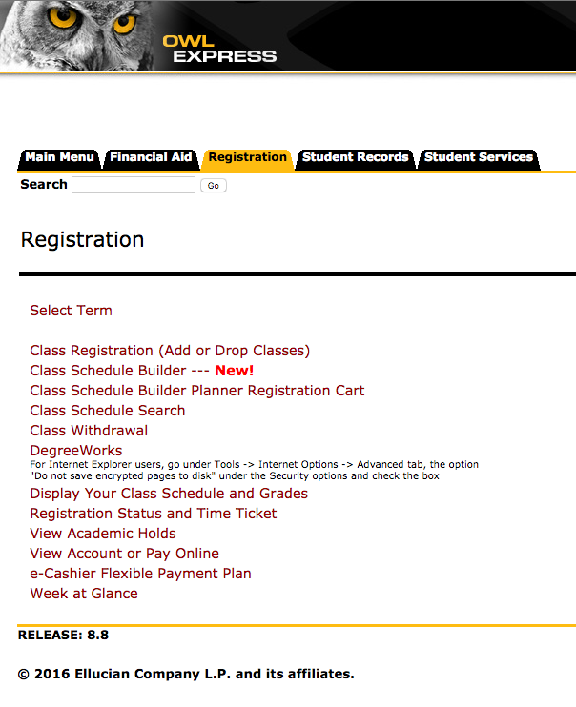
Log into Owl Express
After logging into Owl Express, Click the Registration tab. The Class Schedule Builder portal is located at the top of the menu.

Slide 3
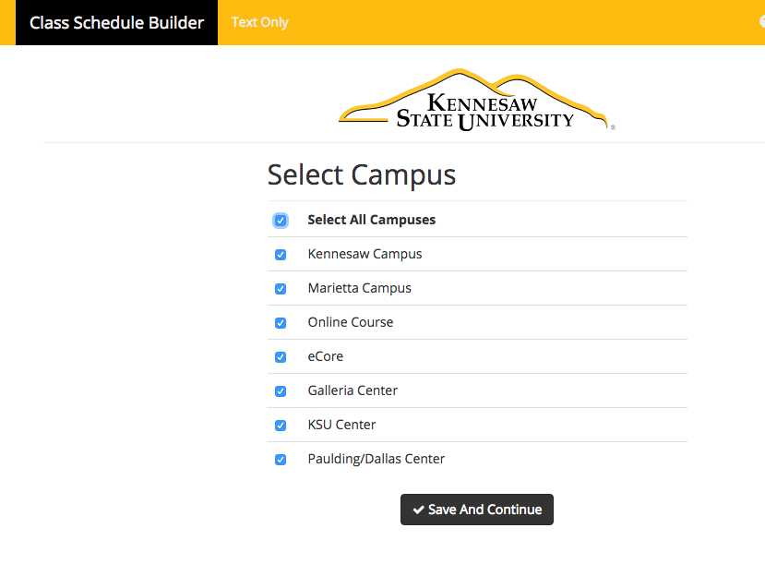
Select Campus
The first search filter allows students to select the campus location they wish to attend.

Slide 4
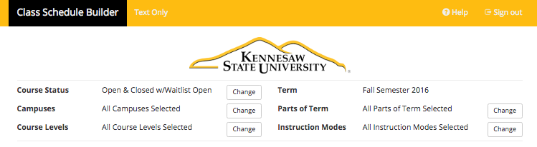
Additional Filters
Additional search filters for Course Status, Campus, Course Level, Term, Parts of Term, and Instruction Modes are available.

Slide 5
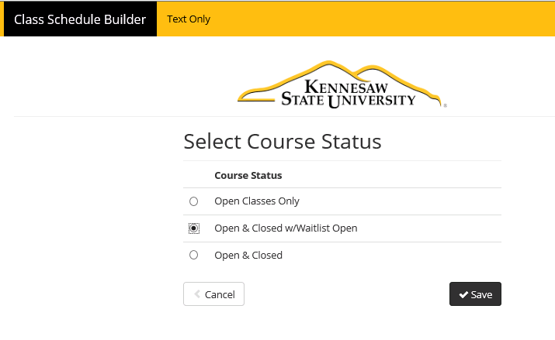
Searching Waitlisted Courses
Searches default to
“Open Classes Only”; however, students may search for classes offering a waitlist by selecting the
Open & Closed w/Waitlist Open option using the Course Status filter.

Slide 6
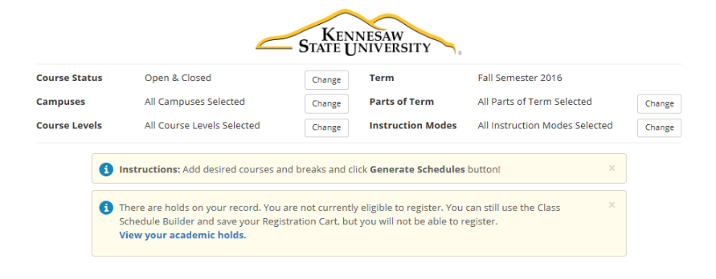
Factors Impacting Registration
Dialogue boxes will appear to inform students of any current holds or other factors that may immediately impact their registration.

Slide 7
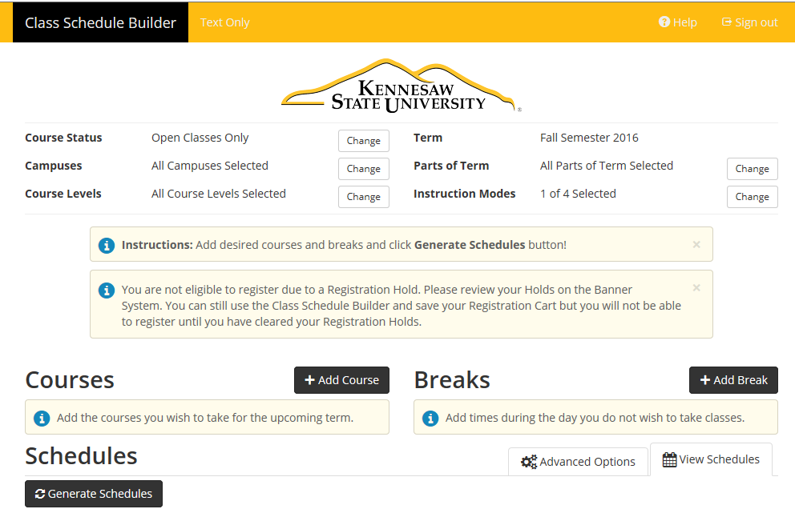
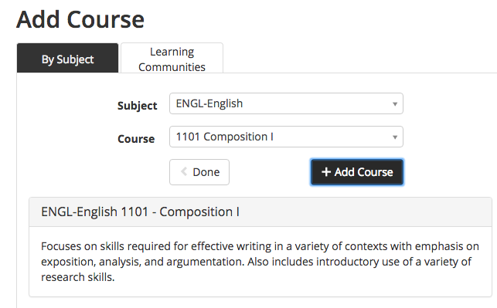
Adding Courses
Begin the schedule building process by clicking Add Course.
Search courses by Subject or Learning Community.

Slide 8
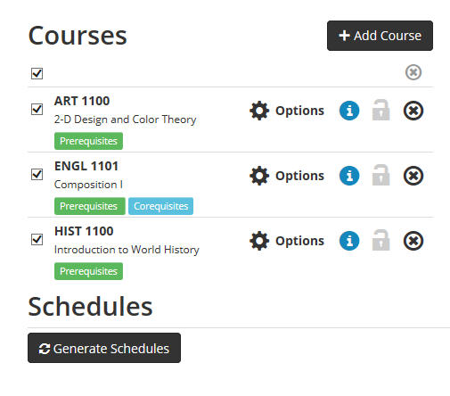
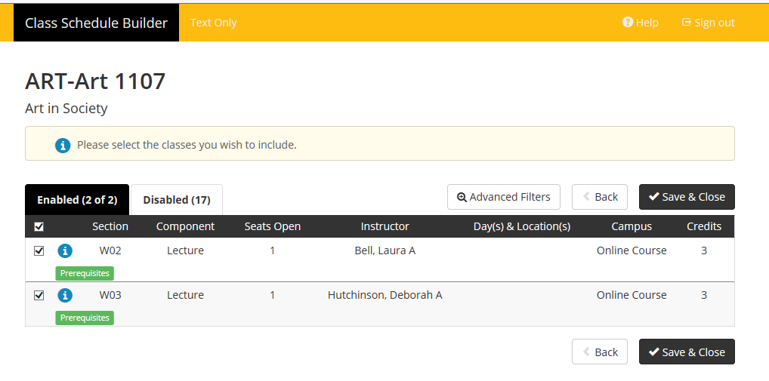
Selecting an Instructor
When searching courses, students are able to select an instructor by clicking Options.
On the next screen, click Advanced Filters to see a drop down list with all course instructors.

Slide 9
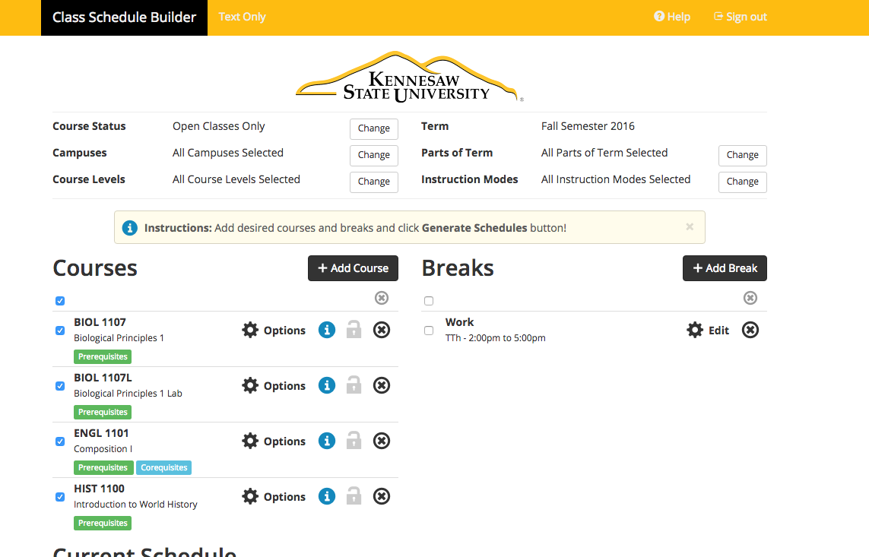
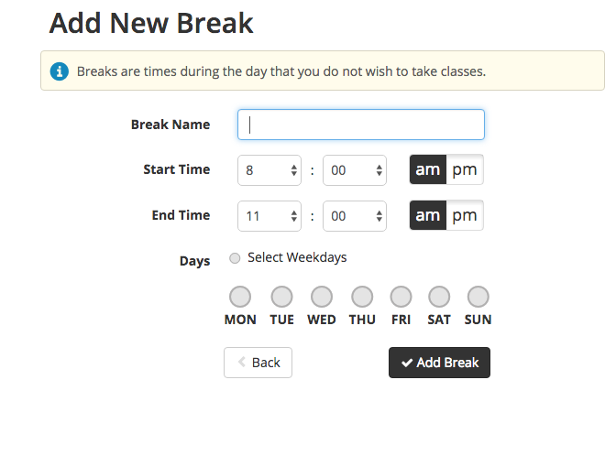
Adding Breaks
Students can add breaks for work, sports, or other personal commitments.

Slide 10
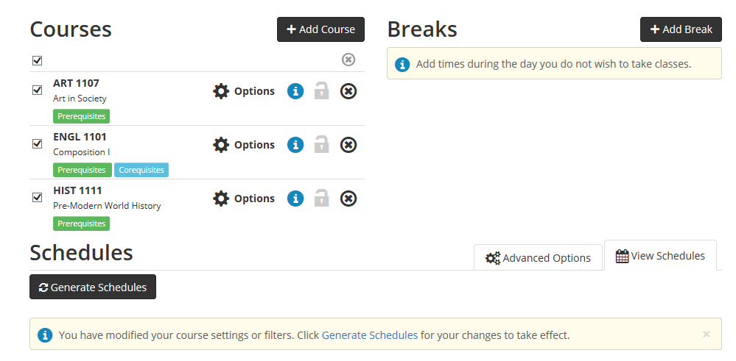
Generating a Schedule
To generate multiple schedule options, student selects box beside each course to be included.
Then click Generate Schedules.

Slide 11
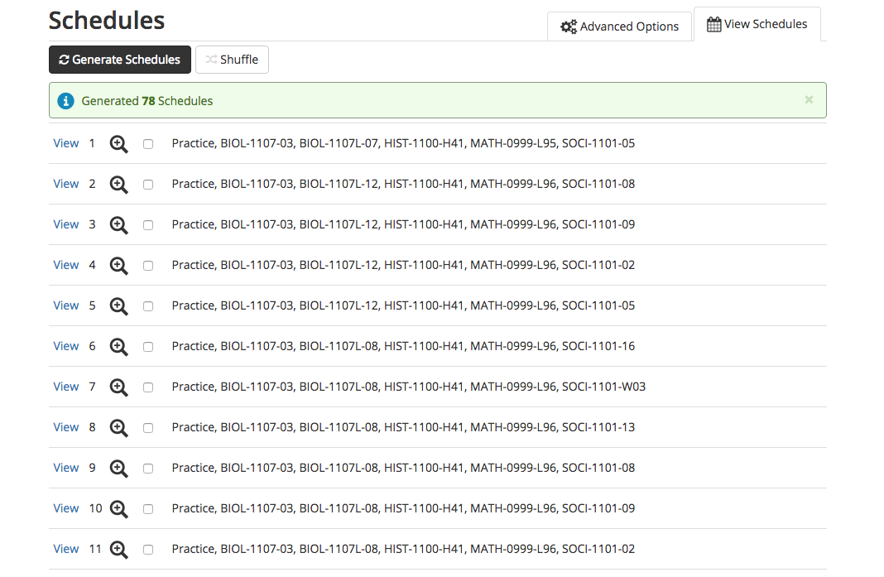
Viewing Schedule Options
The Class Schedule Builder shows all possible schedule options based on student’s filters.
Shuffle feature allows schedules to be viewed in a different order.
Click View to see schedule details.

Slide 12
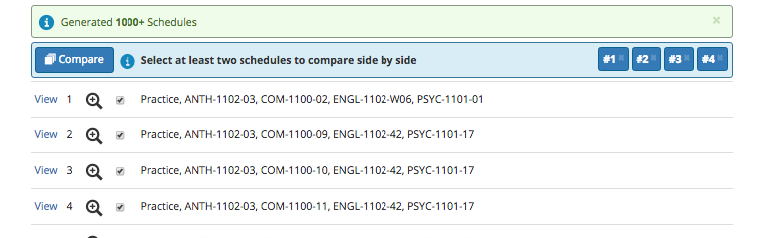
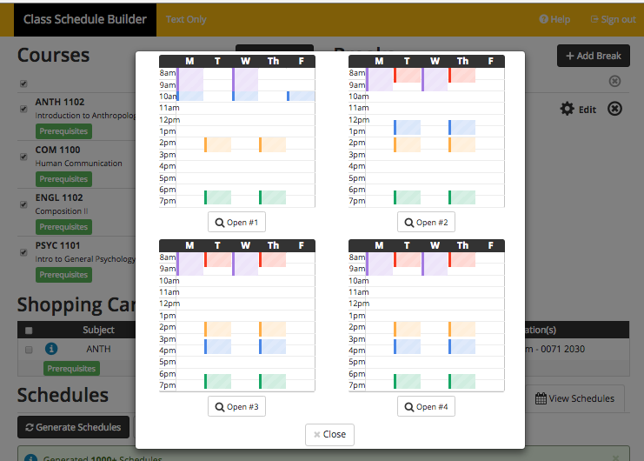
Comparing Schedules
Select box beside each schedule to be included in the comparison. Then click Compare.
Students can compare up to four schedule options at one time.

Slide 13
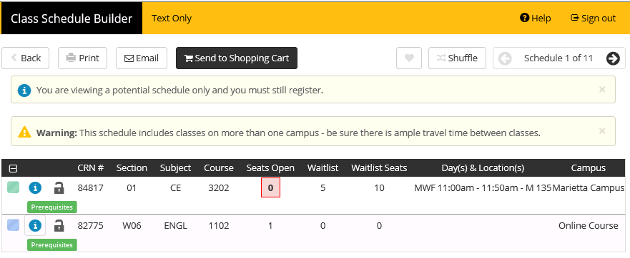
Closed Course Waitlisting
Closed sections offering a waitlist will be displayed when viewing schedule options.

Slide 14
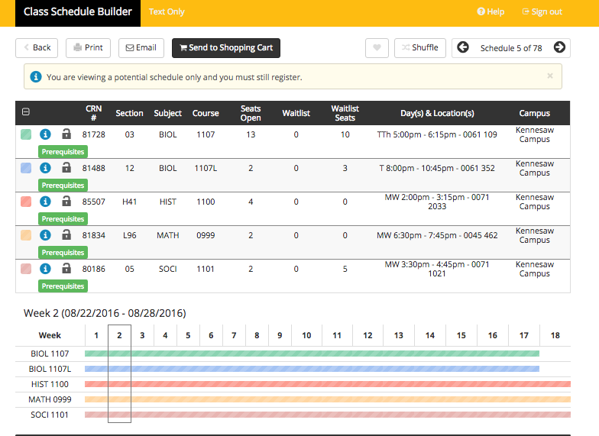
Viewing Schedule Details
Warnings appear here.
When viewing each schedule, Class Schedule Builder will show course details such as Seats Open, Waitlist, Campus Location, and Prerequisite Notices.

Slide 15
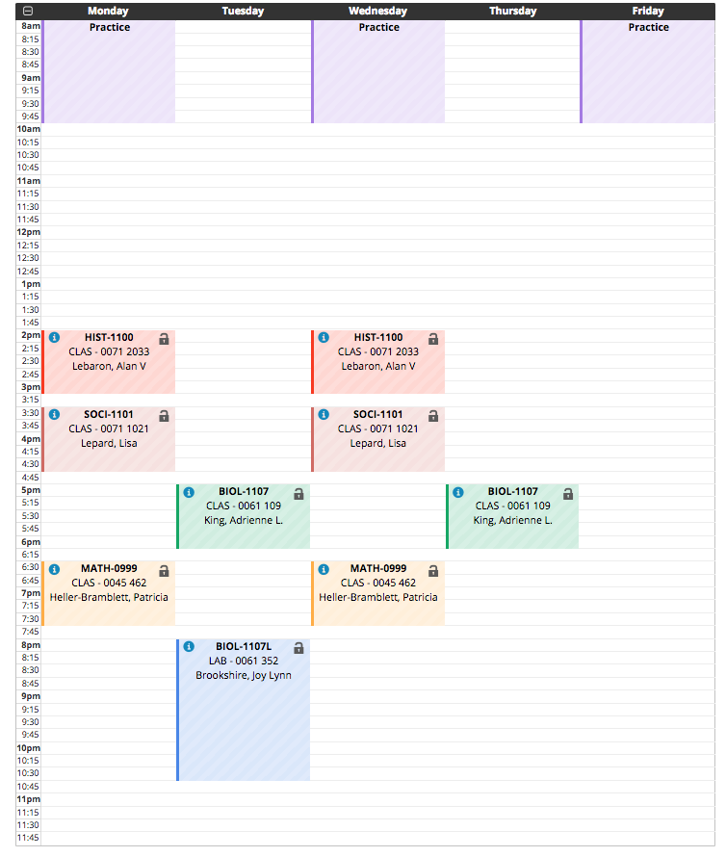
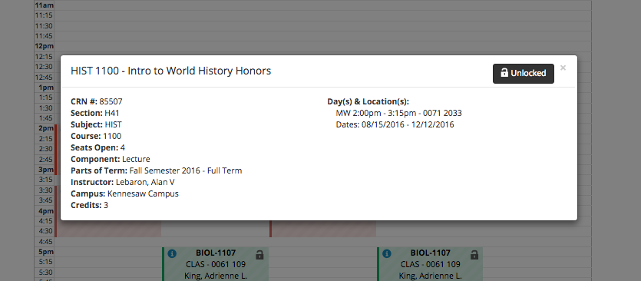
Viewing Schedule Details
Clicking a class on the schedule will highlight further details about that course.
Class Schedule Builder will display a weekly layout of each schedule viewed.

Slide 16
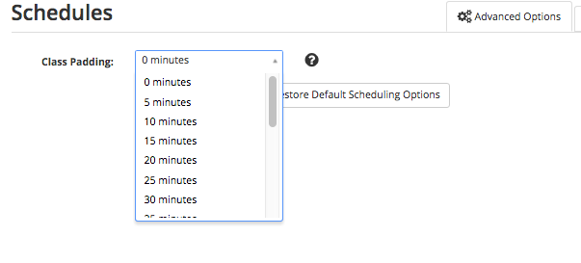
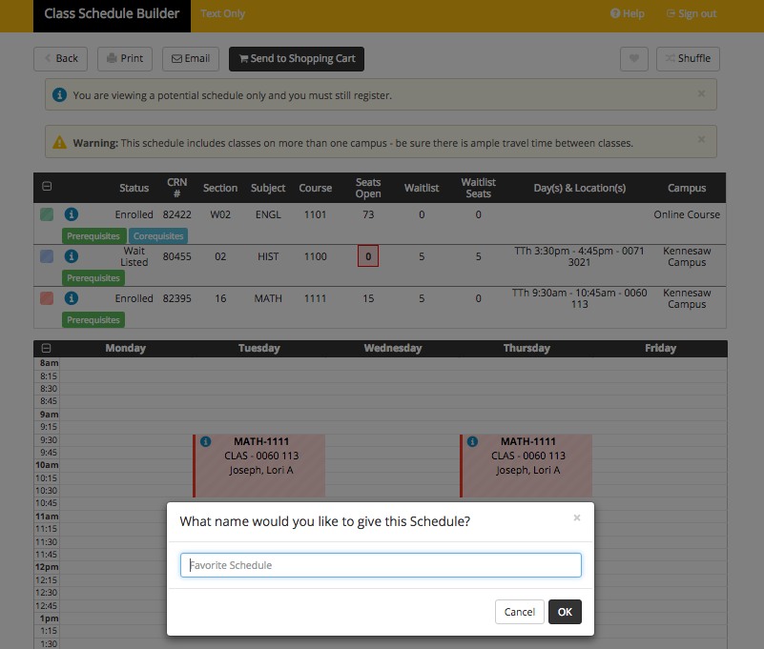
Schedule Features
Clicking Advanced Options allows students to build time in their schedule for travel.
Clicking the heart icon allows students to name and save their favorite schedule options.

Slide 17
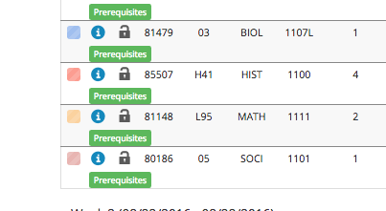
Schedule Features
When viewing possible schedules, the student can lock preferred course sections.
Clicking Generate Schedules will generate new schedule options around the locked courses.

Slide 18
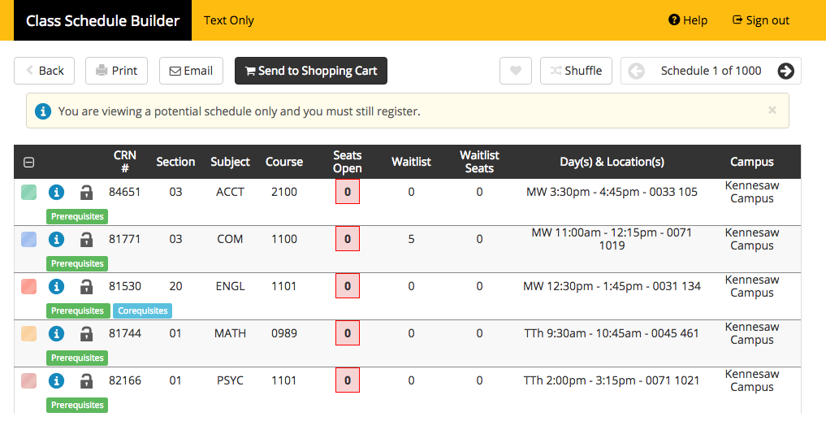
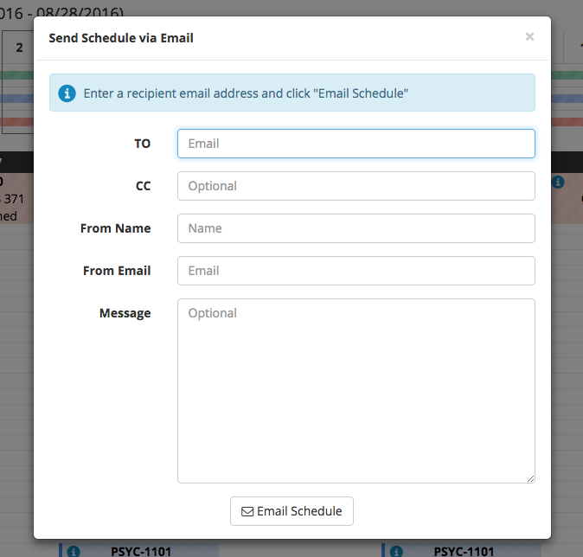
Emailing Schedules
Students have the ability to email potential schedules to advisors or others during the schedule building process.
IMPORTANT: This does NOT finalize a schedule. To be used for planning purposes only.

Slide 19
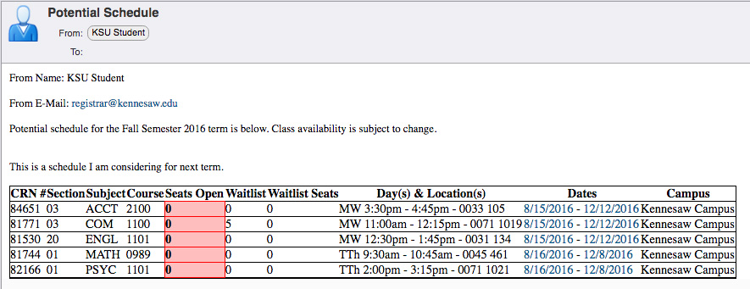
Emailing Schedules
In addition to the email message the sender creates, the recipient will also see the following automated message:
“Potential schedule for the (term) is below. Class availability is subject to change”.

Slide 20
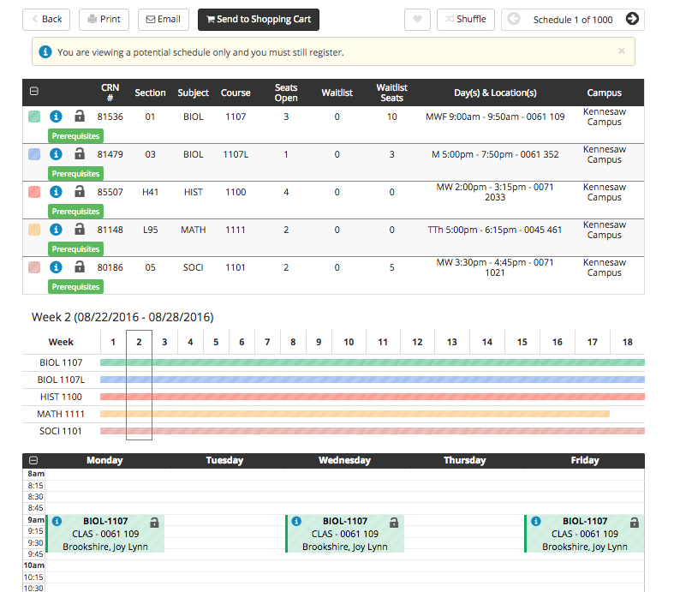
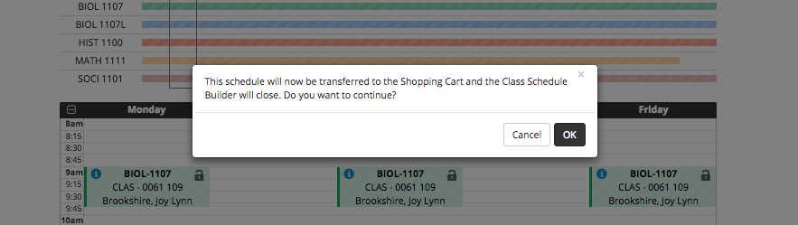
Selecting a Schedule
Once a schedule decision is made, the student must click Send to Shopping Cart and then click OK.
IMPORTANT: This does NOT finalize registration. The student will be redirected to Owl Express where registration will continue.

Slide 21
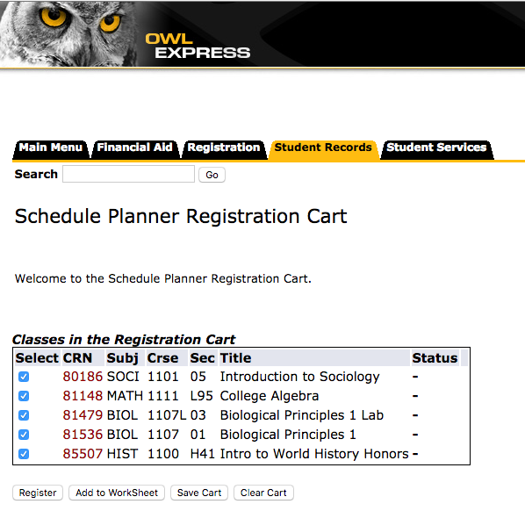
Submitting Registration
To submit courses for registration, students must click Register in Owl Express.
Review for any notifications or possible registration errors.

Slide 22
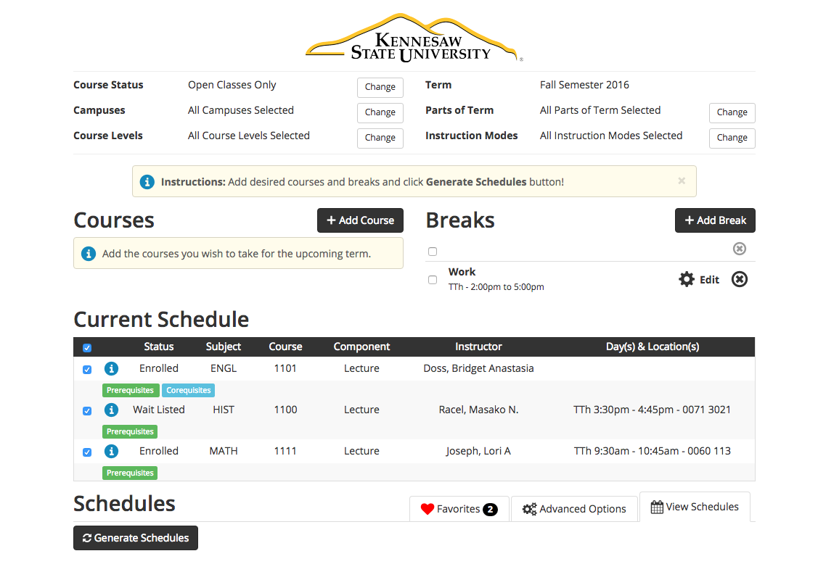
Modifying a Schedule
To modify a schedule or search for course sections, students may return to the Class Schedule Builder
The student’s current schedule will appear in the window.

Slide 23

Questions
Contact:
Office of the Registrar
770-423-6200
registrar@kennesaw.edu

