Slide 1

Well Star College Lunch & Learn
Getting Digitally Enhanced Courses Approved
Kandice Porter and Sarah Cooper

Slide 2

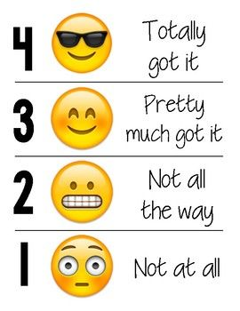
How familiar are you developing digitally enhanced courses?
How comfortable are you with teaching digitally enhanced courses?

Slide 3

Provide overview of Wellstar College Digitally Enhanced Learning Policy
Review how/where to Start Developing Classes
Discuss Common Issues in Submitted Courses
Develop Course Maps and Structures to Promote Learning
Examine Strategies to Increase Accessibility
Introduce steps for Partially Approved Courses Moving Forward

Slide 4

What Policies and Standards Drive Digitally Enhanced Learning in the Wellstar College?

Slide 5
Wellstar College Information and Resources
Faculty Guidebook for Digital Teaching and Learning
Wellstar College Digital Learning Policy
Databases:
Online
Hybrid
Notes:
Highlights:
Use QM Rubric (Passing score = 85 or above)
Review every 5 years
No more than 20% of the course content can be changed w/out triggering a review
New (all) faculty are encouraged to complete DLI training on course design and/or facilitation

Slide 6
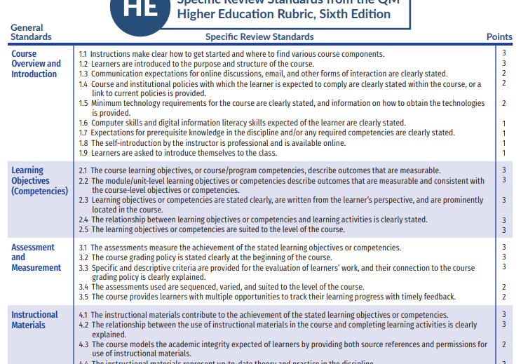
Quality Matters Rubric

Slide 7
Where Do I Start?

Slide 8
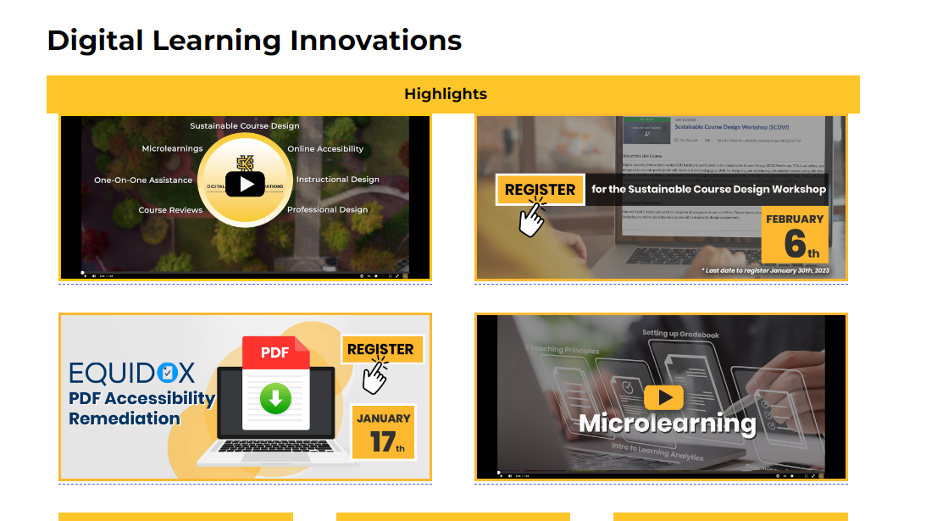
Virtual Field Trip - Digital Learning Innovations

Slide 9
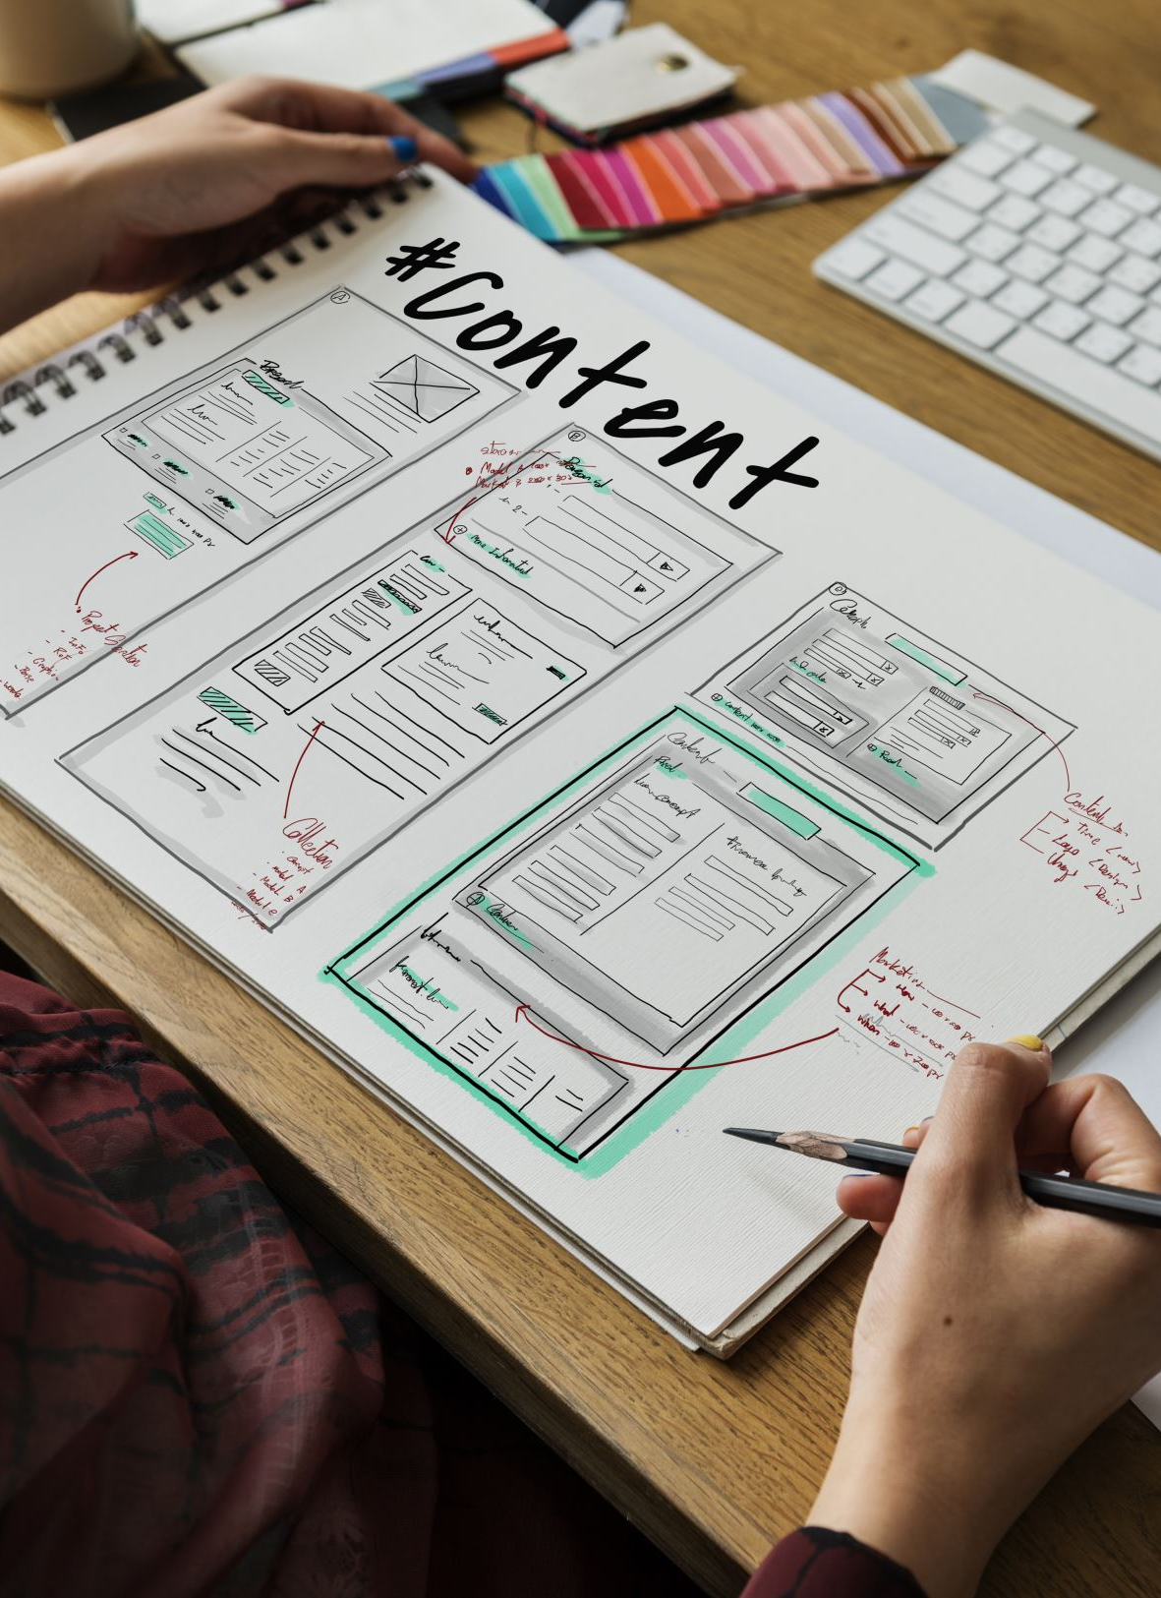
Resources You’ll Want to Bookmark
Microlearning
Course Shell Request (link not working)
DLI Course Review Request

Slide 10
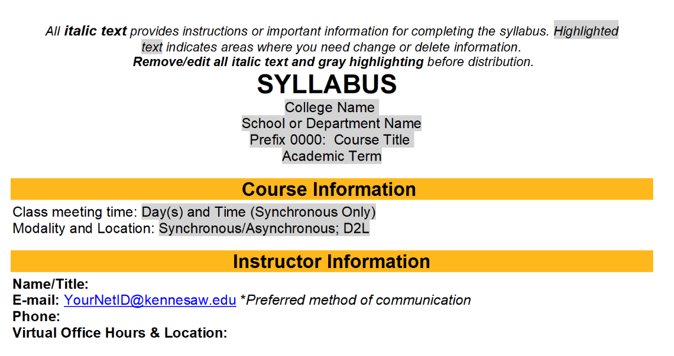
Online Syllabus Template (Updated)

Slide 11
What are Common Issues in Courses Submitted for Review?

Slide 12
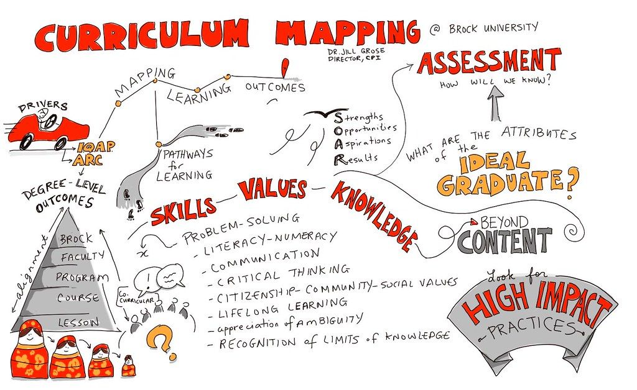
Course Structures
Using Universal Design for Learning to develop course maps
Faculty often organize by content
QM is looking for modules (time/theme)
Course objectives -> Module objectives -> Learning Activities -> Assessments

Slide 13
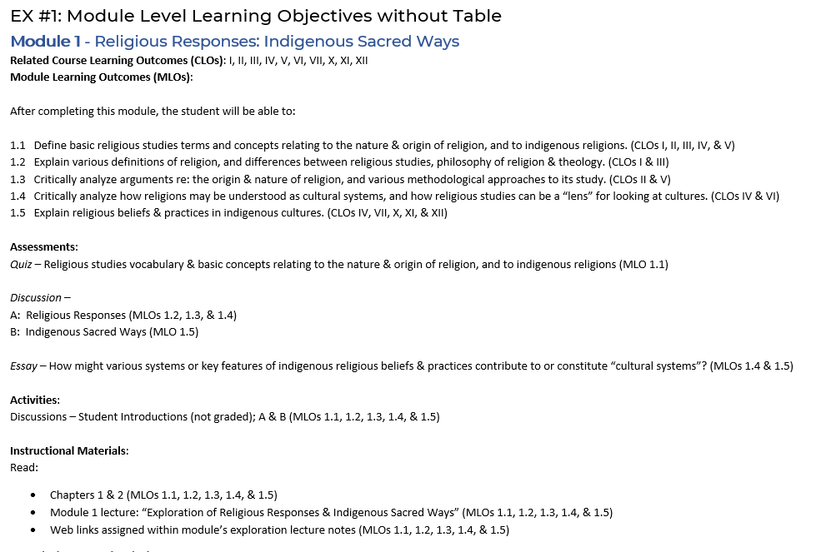
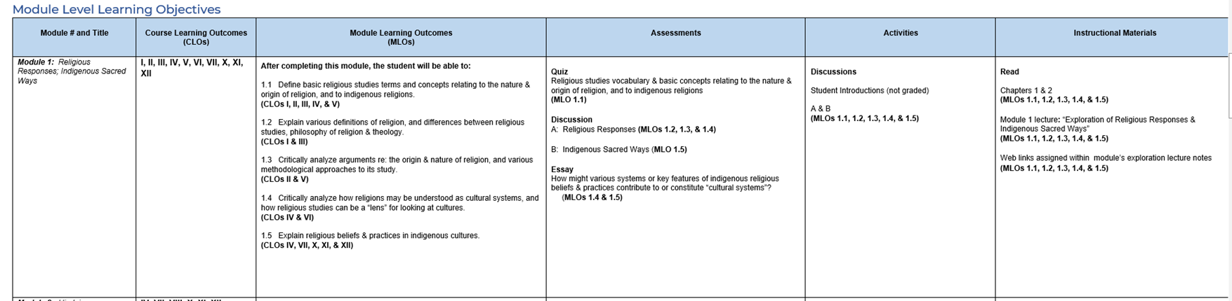
Course Map Example

Slide 14
Strategies To Increase Accessibility

Slide 15

Academic Web Accessibility (website)

Slide 16
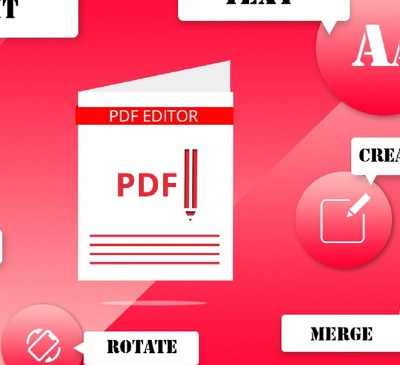
Document Revision
The best way to tackle issues with PDFs is to find alternatives to them!
Original document are more accessible
Check to see if they have a more screen reader friendly version is available
Specify what information you need and copy that into a more accessible format
Equidox PDF Accessibility Remediation
PDF Accessibility Solutions Resource
Creating Accessible Documents

Slide 17
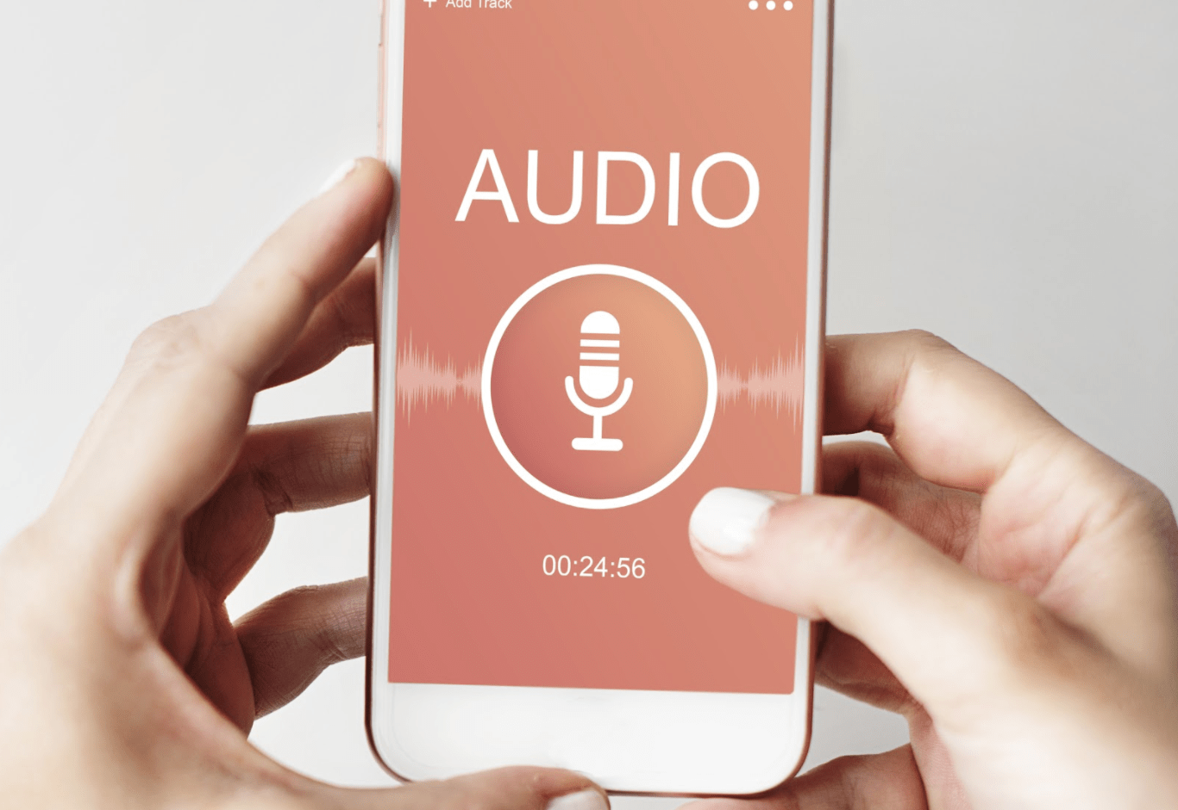
Video and Audio Files
All videos need to be accurately captioned and all audio has an accompanying transcript.
Learn more from the following link:
Media Accessibility

Slide 18
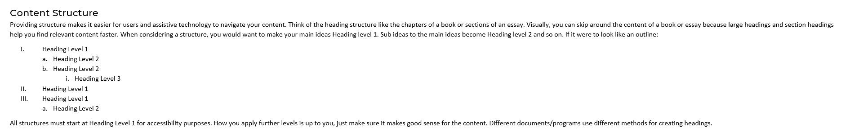
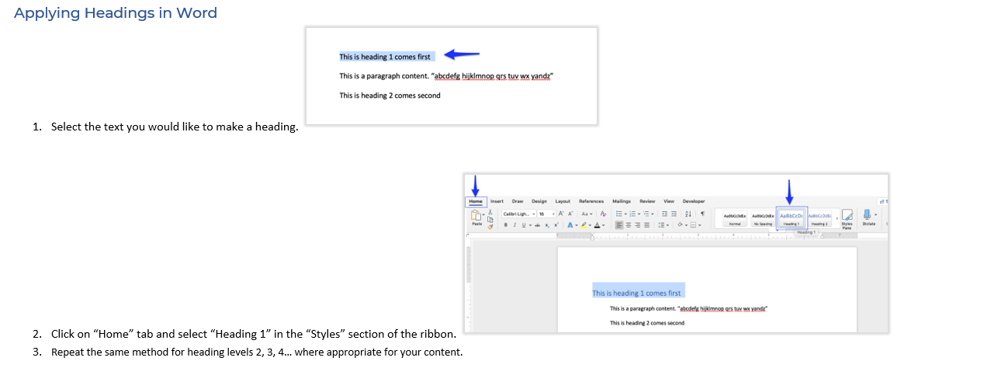
Creating Heading Structures

Slide 19
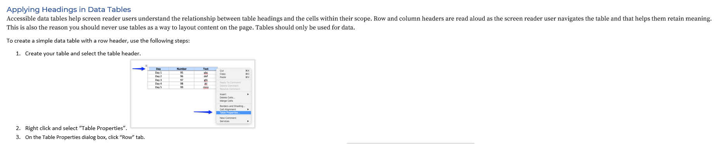
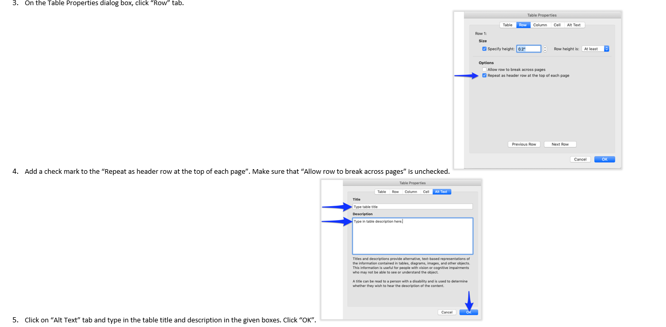
Data Tables

Slide 20
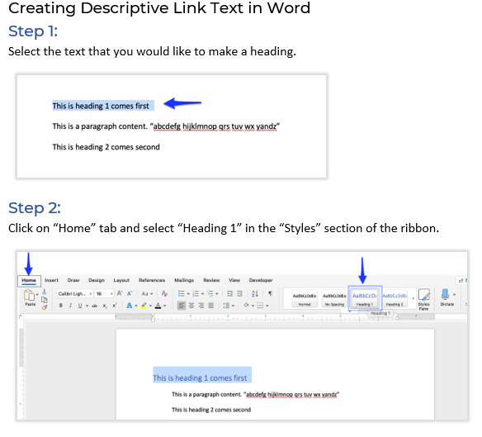
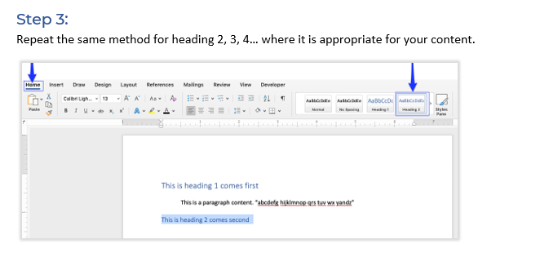
Descriptive Link Text

Slide 21
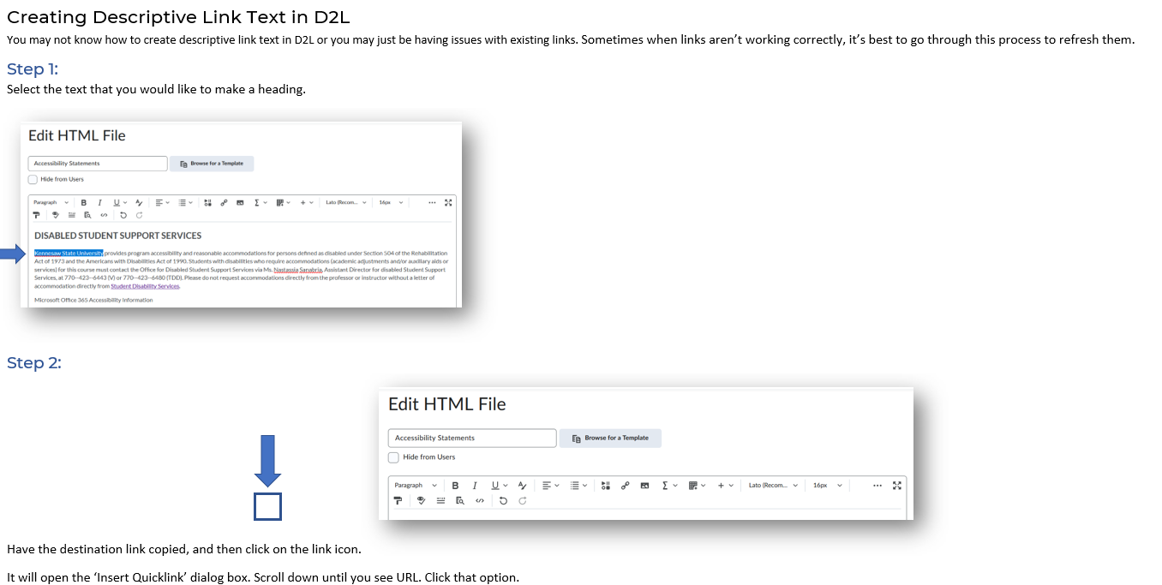
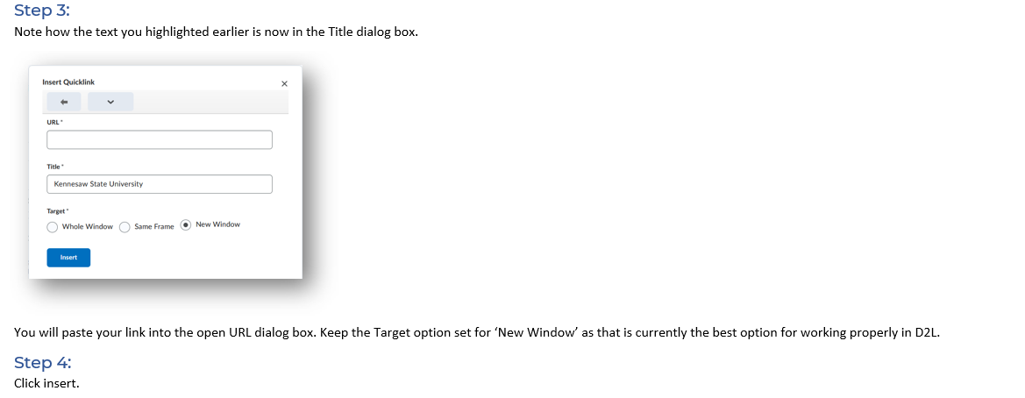
Descriptive Link Text in D2L

Slide 22

Help! I'm teaching an online class I did not develop....

Slide 23
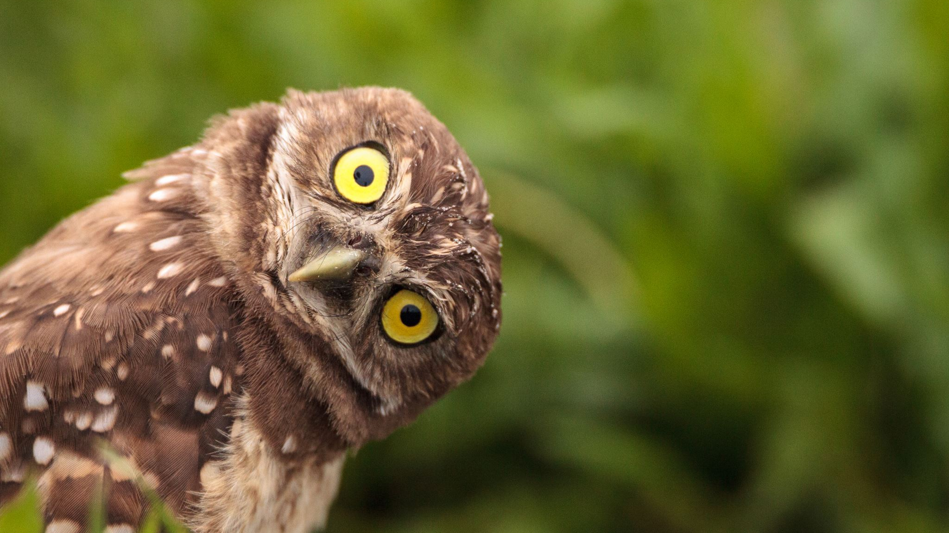
Questions?
One-On-One Service Request - Digital Learning Innovations (kennesaw.edu)

