Slide 1




Finding Research Collaborators
Lunch & Learn Faculty Development Series

Slide 2



Slide 3
Finding Research Collaborators
Lunch & Learn Faculty Development Series

Slide 4
Overview
Importance of collaboration
Tools for finding and facilitating research collaborations
Collaboration Mentorship
Writing Groups (Feb. 17)

Slide 5
You Are Not Alone
(and if you are, you should change that!)

Slide 6

The NIH says you should work together
Funding agencies, such as government, private foundations, are increasingly structuring request for proposals (RFP) to favor the involvement of interdisciplinary research teams
Collaboration can address the demand for expanded capacity that is required of research projects demonstrating suitable scope and complexity
One important justification for collaboration is the enhanced ability to share and exchange resources
Research collaboration may provide opportunities for investigators to learn how approaches from complementary disciplines may be applied to existing problems, and lead to the development of innovative solutions. This may occur when discussions among colleagues stimulate new ideas.
https://ori.hhs.gov/education/products/niu_collabresearch/collabresearch/need/need.html

Slide 7
5 ways that collaboration can further your research and your career
Maximize outputs
  Answer bigger and more complex questions
Maximize impact
  Analysis of 28 million papers from the humanities and the natural, medical, and social sciences published between 1900 and 2011: papers with more authors received more citations, particularly if the authors were from different institutions
Attract funding
  Some funding agencies prioritize collaborative projects, including international collaborations and industry-academia collaborations
Expand your network
  Meet future mentors (or employers?)
Embrace the new
  Learn new skills, perspectives, dissemination
https://www.springernature.com/gp/researchers/the-source/blog/blogposts-life-in-research/benefits-of-research-collaboration/17360752

Slide 8
Give yourself permission to be a student, to not have all the answers, and to seek to improve
https://www.psychologicalscience.org/observer/the-benefits-of-engaging-in-collaborative-research-relationships Sprunger JG 11.30.2017

Slide 9
Overview
Importance of collaboration
Tools for finding and facilitating research collaborations
Collaboration Mentorship
Writing Groups (Feb. 17)

Slide 10

Search for Collaborators on Pivot
https://pivot.proquest.com/dashboard

Slide 11
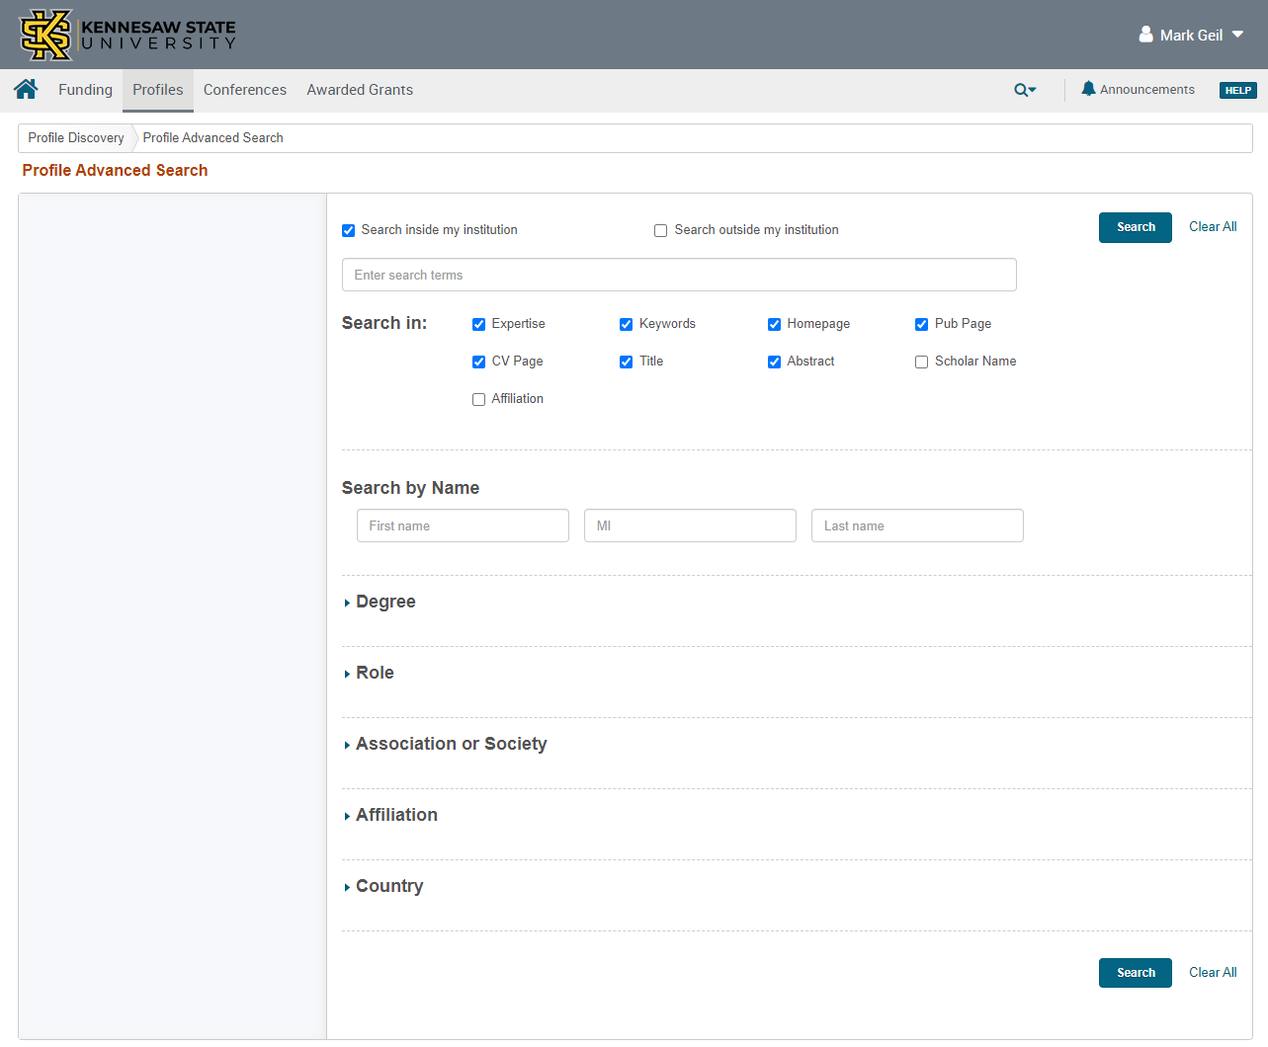
Search PROFILES
Advanced Search
KSU or the world

Slide 13
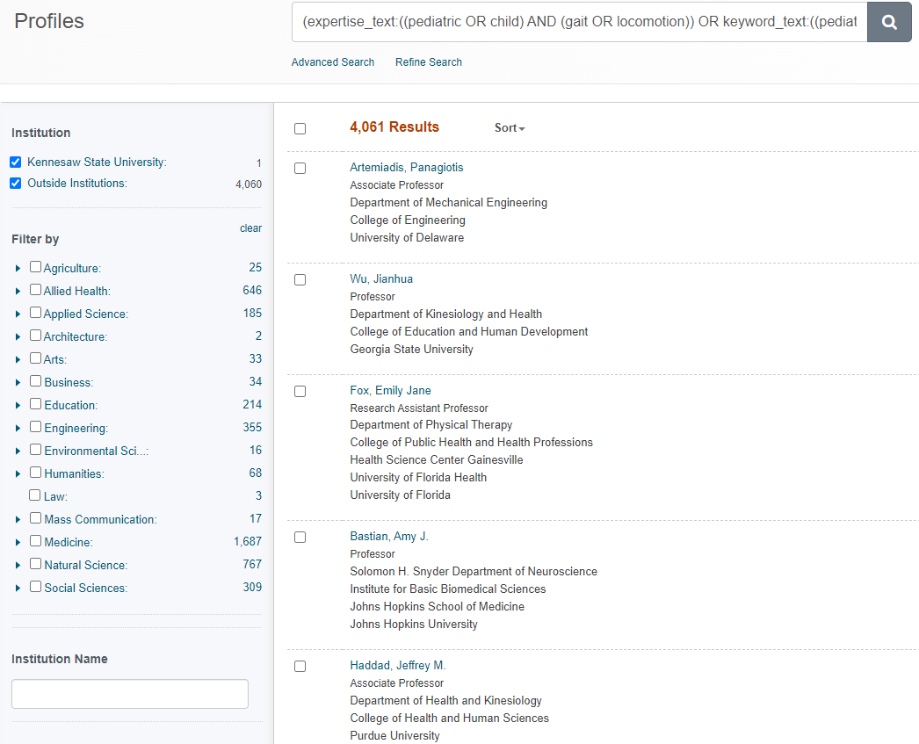
4,061 Results

Slide 14
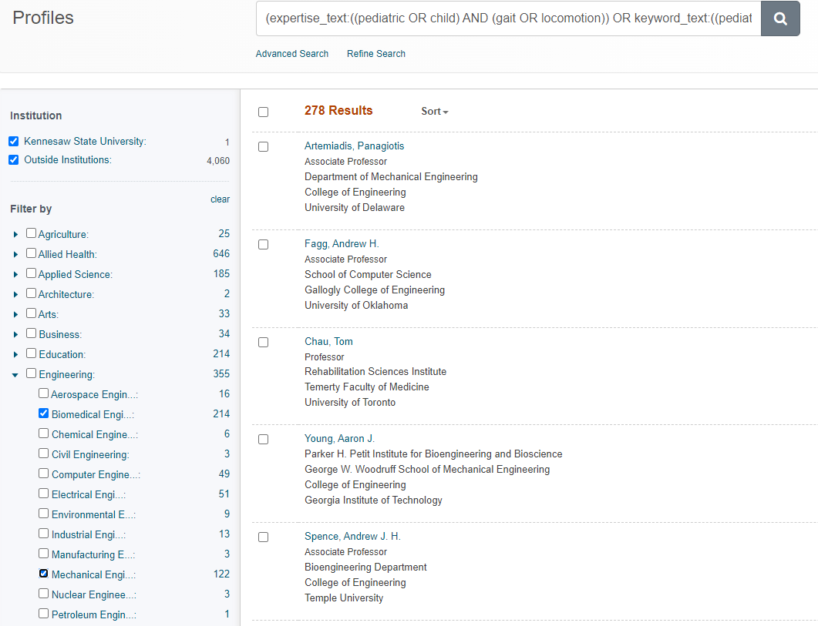
278 Results

Slide 15
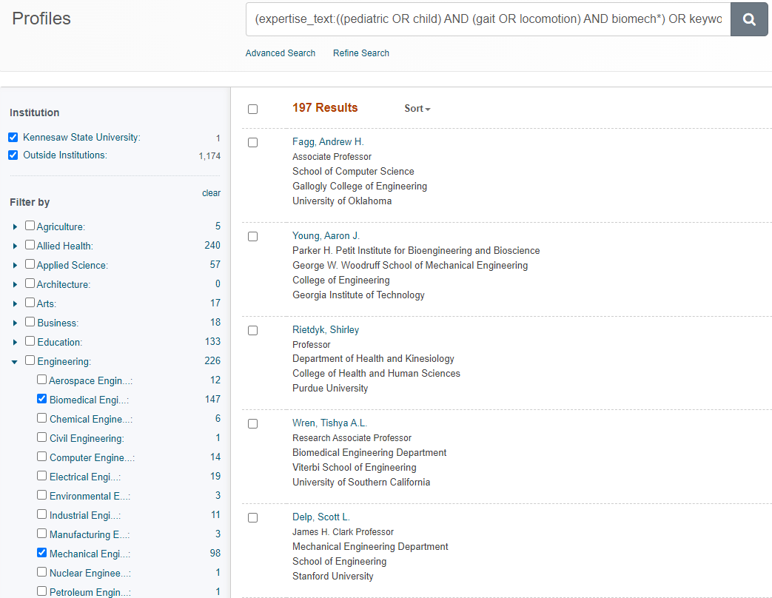
197 Results

Slide 16
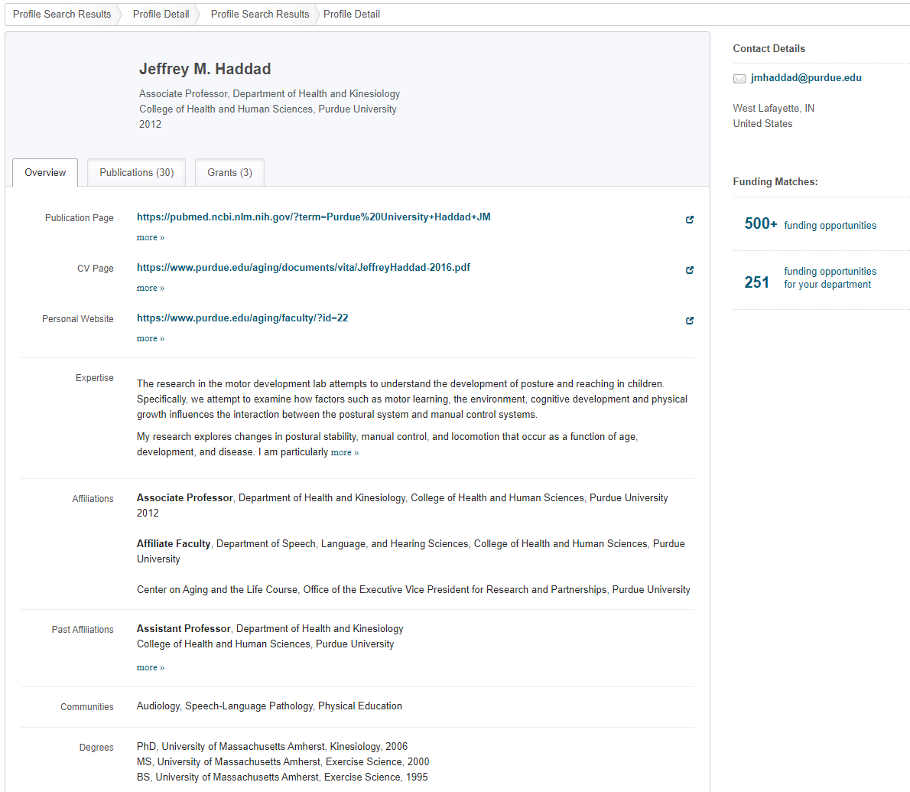
Grants
Email
Pubs
CV

Slide 17
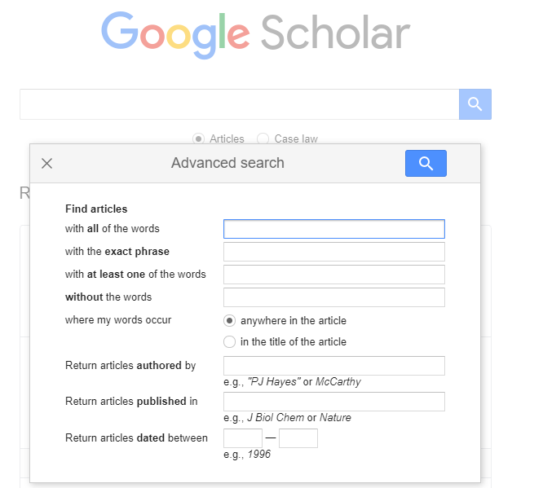
Google Scholar
Profiles at Kennesaw State:
  https://scholar.google.com/citations?view_op=view_org&hl=en&org=4779274515122251060&before_author=XI3Y_iYeAAAJ&astart=0
Article searches

Slide 18


Slide 19
Overview
Importance of collaboration
Tools for finding and facilitating research collaborations
Collaboration Mentorship
Writing Groups (Feb. 17)

Slide 20
Alternative Model for Mentorship

Slide 21
One size does not fit all
Multiple mentors
  Mentor within department/university – how things work, what’s where, P&T, etc.
  Cultural Mentor – what it’s like for someone who is like me
  Research/Discipline Mentor – research ideas, funding advice, networking
Collaborators might become mentors or mentees

Slide 22
Internal Funding
OVPR Seed Grants
Summer Research Fellows
VIP
External Mentor Program
Post-Doc Awards
First-Year Scholars
Publication fees
GRA support
https://research.kennesaw.edu/researchdev/find-funding/internal-funding.php

Slide 23
Overview
Importance of collaboration
Tools for finding and facilitating research collaborations
Collaboration Mentorship
Writing Groups (Feb. 17)

Slide 24

We are here to help!
Please ask
Notes:
You can use this slide as your opening or closing slide. Should you choose to use it as a closing, make sure you review the main points of your presentation. One creative way to do that is by adding animations to the various graphics on a slide. This slide has 4 different graphics, and, when you view the slideshow, you will see that you can click to reveal the next graphic. Similarly, as you review the main topics in your presentation, you may want each point to show up when you are addressing that topic.
Add animation to images and graphics:
Select your image or graphic.
Click on the Animations tab.
Choose from the options. The animation for this slide is “Split”. The drop-down menu in the Animation section gives even more animations you can use.
If you have multiple graphics or images, you will see a number appear next to it that notes the order of the animations.
Note: You will want to choose the animations carefully. You do not want to make your audience dizzy from your presentation.

